Slide 2
Guide to using online tools to support the delivery of SQA products and services
SQA Regional Manager
SQA Co-ordinator Conference
Notes:
Raising Awareness of SQA Qualifications that can support young people’s development.
Celebrate all skills that young people have.
Wider view of what’s available to help you navigate around the various different types of information and resources that are available to you.

Slide 3
Aim of the session
Recapping on approval process
Using the SQA website and other web platforms
Update on SQA qualifications/new awards

Slide 4
SQA Approval Process
Navigator
https://www2.sqaextra.net/
Deadline
NQ /Skills for Work – 29 Sept 2017
Approval Forms
Recommend that you contact RM
Pitfalls
approval.applications@sqa.org.uk
Notes:
Where to find applications/completing application forms/submitting to approval applications (reasons for returning application forms before it gets to approval)
Which qualifications (that do not meet the approval deadline)? (NQ and Skills for Work but not WWA (but end March where possible)
E.g. Psychology/sociology – specific requirements!
Do you know how to check your approval file (link overview of navigator)?
Right now you should know what your delivering next year and should be checking what you need approval for.
The last date and final deadline is the 29th of September but forms should be coming in now.
If your new to the role, the RM contacts are in the back of the book

Slide 5
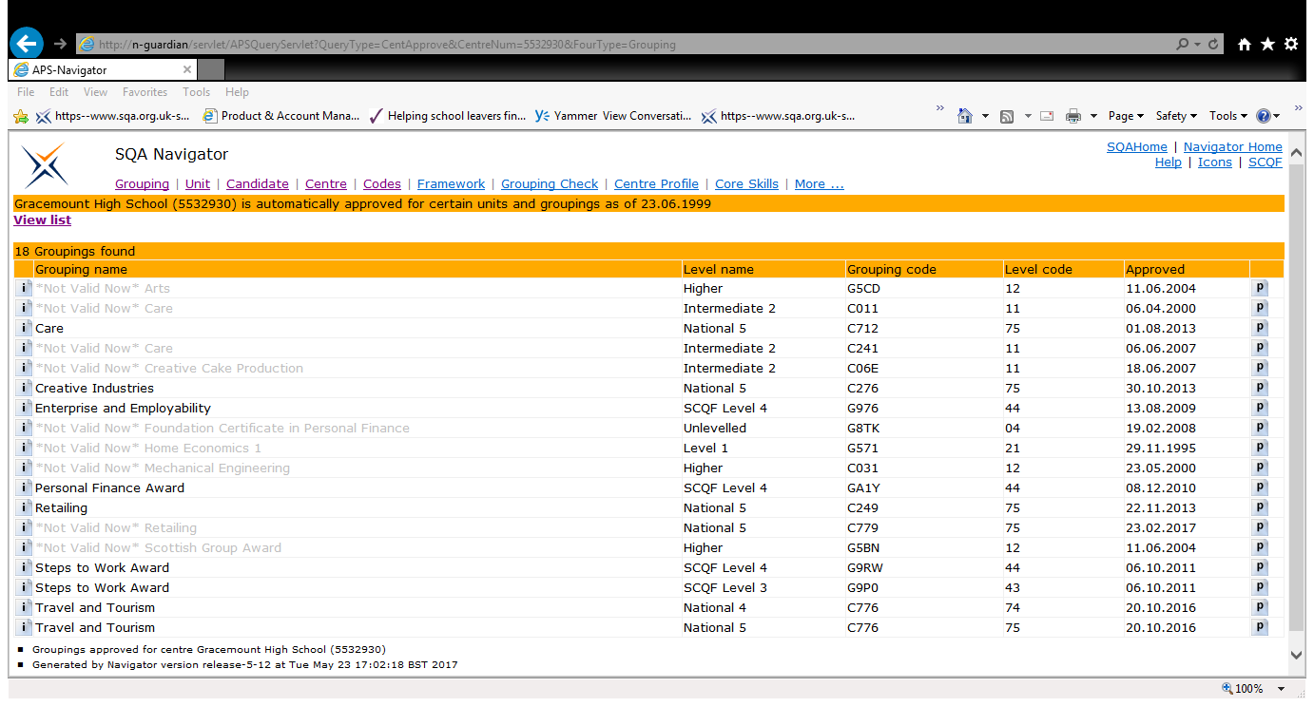

Slide 6
Navigating Qualifications
SQA Home SQA Website page
My Sector My Sector
Notes:
Overview of where to find quals – hyperlinks to HOMEPAGE/ My Sector, NQ unit search, Awards/Catalogue

Slide 7
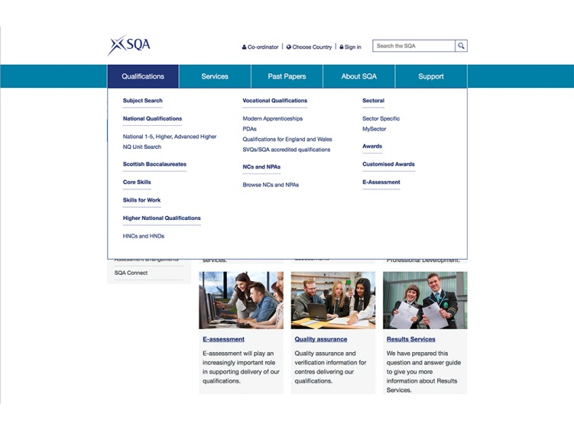

Slide 8
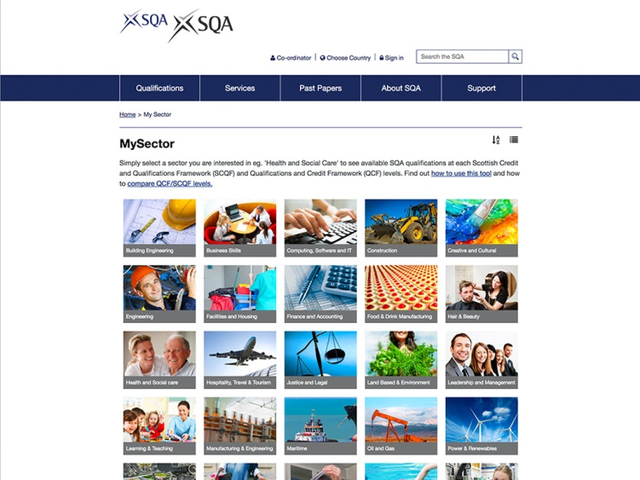

Slide 9
Navigating Qualifications
Subject search Subject search
Awards Awards
Catalogue of NQs NQ Catalogue

Slide 10
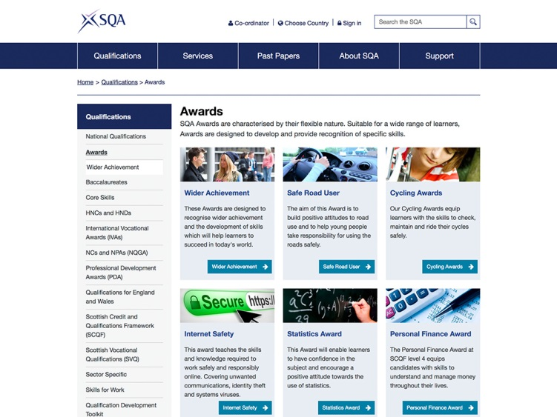

Slide 11
Awards Update
Personal Finance
(SCQF level 4 & 5)
Personal Finance Award
Essential Skills Units
(SCQF level 3, 4 & 5)
Essential Skills
Work Placement Units
(SCQF Level 3, 4, 5 & 6)
Work Placement Units
Notes:
Overview of new WWAs and specific Personal Finance, Essential Skills and Work Placement units.

Slide 12
SQA Resources
Solar Solar - Open Access
U-share U-share Education
SQA Blogs SQA Blogs
SQA Journeys SQA Journeys
Notes:
Ushare/Solar/blogs/sqa journeys

Slide 13
Additional Resources
My World of Work
SDS – WOW
Enterprising Schools
Enterprising Schools
Apprenticeships. Scot
Apprenticeships.Scot
Notes:
My world of work/ENTERPRISING SCHOOLS/apprenticeships

Slide 14
Case studies
Kyle Academy Ayrshire - NPA Cyber Security
The Code Academy at Dundee and Angus College
CodeClan in Edinburgh
Overview of the case studies

Slide 15
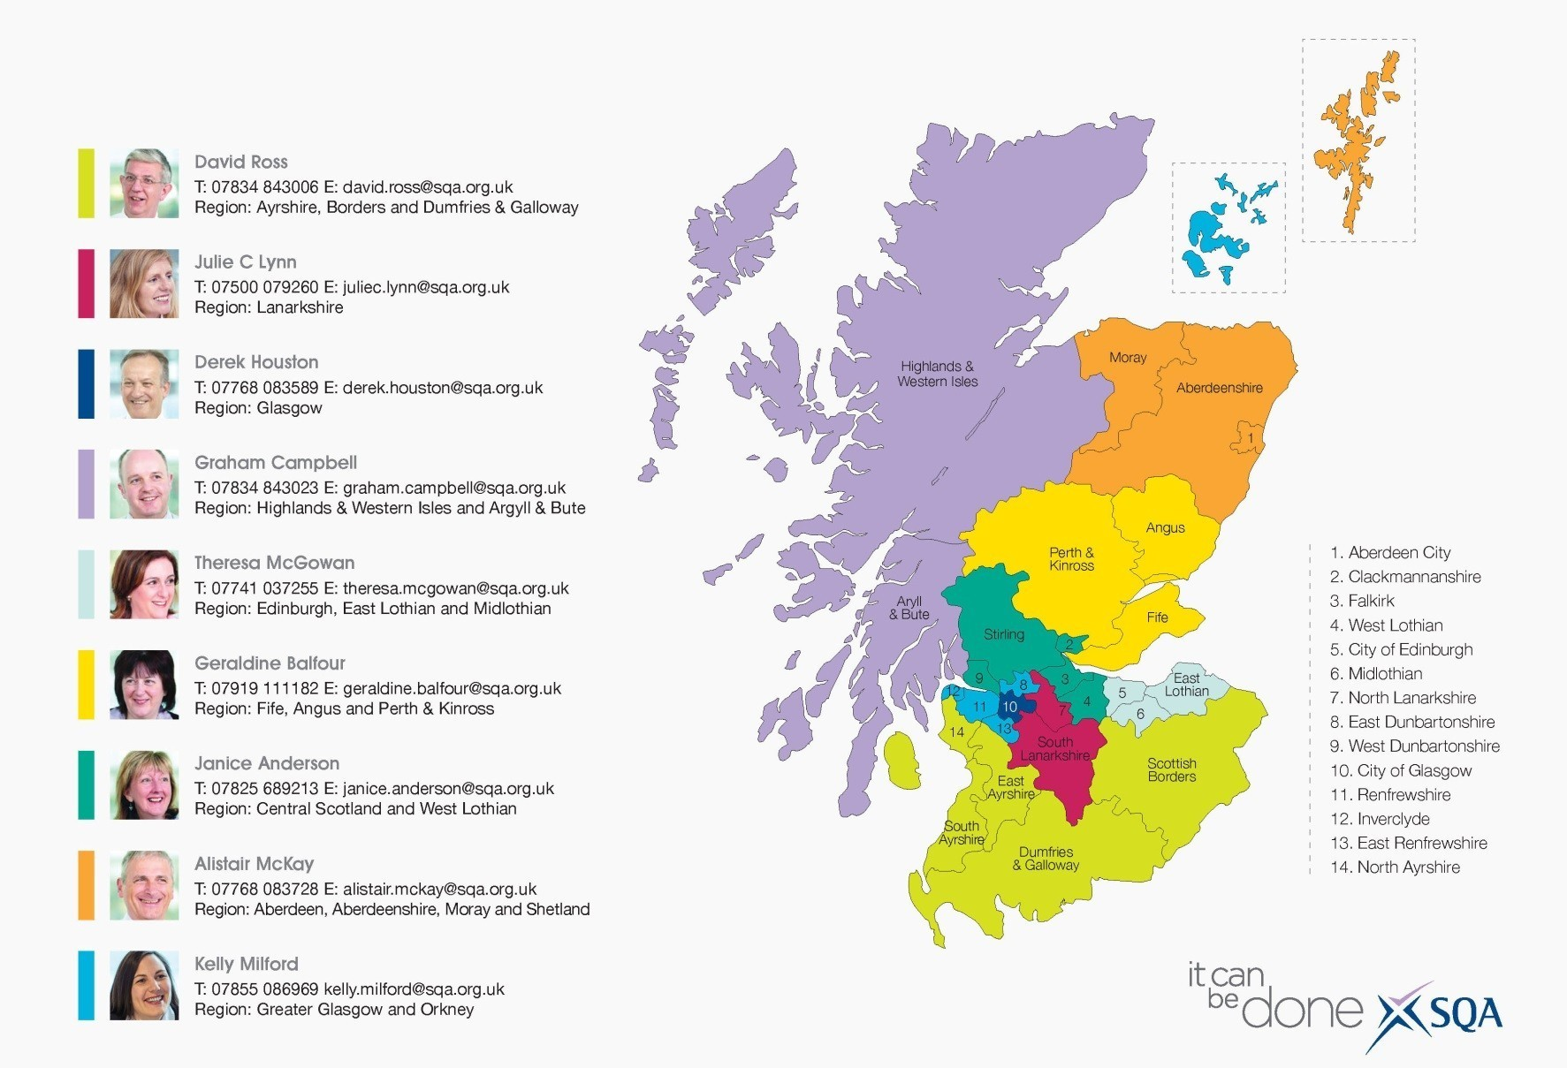
Your Regional Manager

Slide 16
Questions
Thanks for listening
Questions

Slide 17
Web Links
SQA www.sqa.org.uk
My Sector www.sqa.org.uk/mysector
Solar www.sqasolar.org.uk
Awards www.sqa.org.uk/awards
U-share www.sqa.org.uk/ushare
SQA Journeys www.sqa.org.uk/journeys
Subject Search www.sqa.org.uk/subjectsearch
Personal Finance www.sqa.org.uk/personalfinanceaward
Essential Skills www.sqa.org.uk/essentialskills
Work Placement www.sqa.org.uk/workplacement
SQA Blogs http://blogs.sqa.org.uk/

