Slide 1
DELIVERING VQ’s IN A VIRTUAL ENVIRONMENT

Slide 2
Agenda
BPP Background
Model
Adaptations
Measuring Success

Slide 3
Who are BPP?
Established over 40 years ago - Accountancy
Educating Over 80,000 Learners a Year
Law, Accountancy, Leadership & Mgt, Data & Technology, Financial Services, Psychology & Nursing & Healthcare
Working with 7000 Businesses
Apprenticeships, Degrees, Professional development & Professional Qualifications
90% of FTSE 100 companies

Slide 4
BPP Scotland
Then…
Established 8 years ago
2 part-time staff
20 learners – 1 Employer
SDS contract around £25K – B&A and PFS
Now…
6 staff
150 learners
Last years SDS contract was in excess of £375K
Over 30 Employers
B&A, PFS, Management, AAT, IT and Data Analytics
100 Additional Starts

Slide 5
Model
Remote
Planning
SVQ Units
Authentication
Contact
Safeguarding/Learning Support

Slide 6
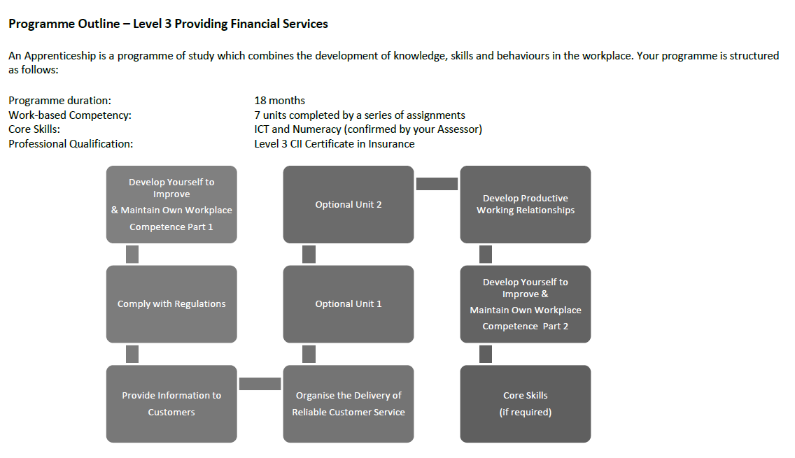
ALP

Slide 7
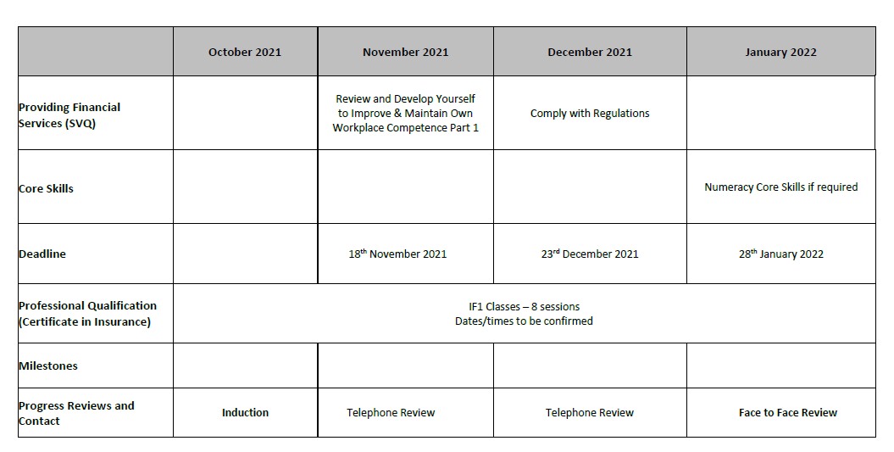
ALP

Slide 8
Model
SVQ Units
Authentication
Contact
Safeguarding/Learning Support

Slide 9
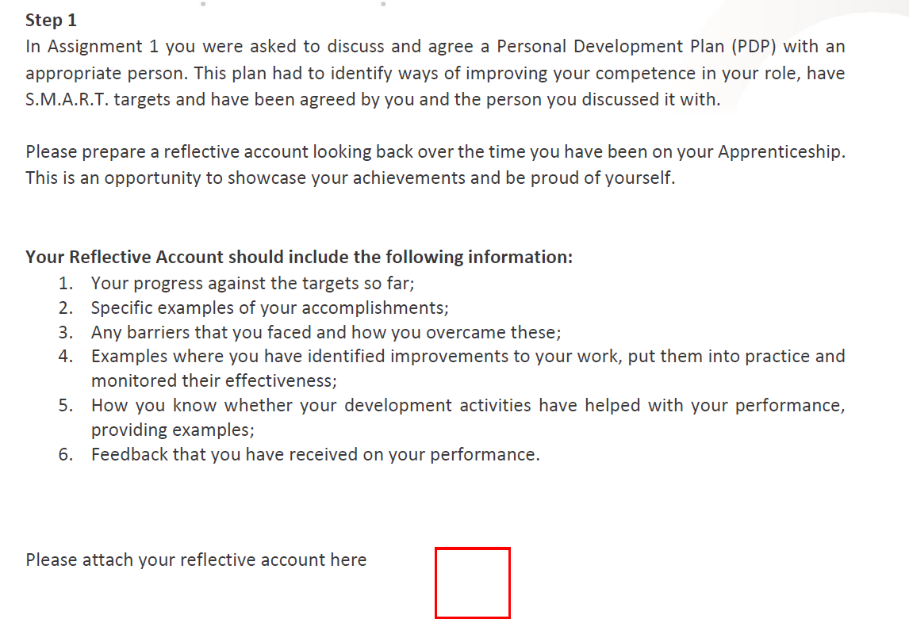
Task Book

Slide 10
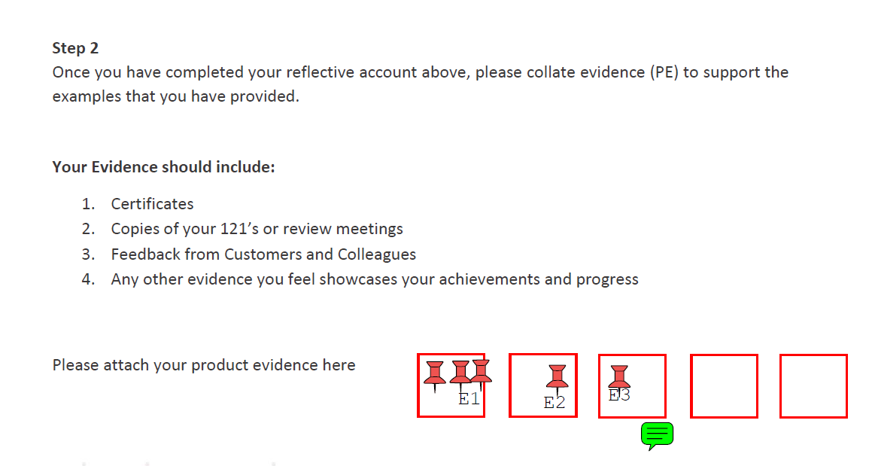
Task Book

Slide 11
Model
SVQ Units
Authentication
Contact
Safeguarding/Learning Support

Slide 12
Feedback
Very impressive learner statement. You have gone into great detail on what professional development means for you and your company. I like that throughout this statement you have demonstrated your understanding by providing examples and referencing specific processes, systems and developments.
could you expand on your learner statement and give some examples of the limits of your authorities

Slide 13
Model
SVQ Units
Authentication
Contact
Safeguarding/Learning Support

Slide 14
Adaptations
Induction
Contact
SVQ Units
Authentication
Global Tracker

Slide 15
Learner Progress Policy
Expected progress means that participants are achieving in a timely manner i.e. as per their ALP.
Limited progress – 6-15% away from expected progress
Expected progress means that learners are achieving in a timely manner i.e. as per their ALP.
Limited progress – 6-15% away from expected progress
Insufficient progress – 15+% away from expected progress
Insufficient progress – 15+% away from expected progress

Slide 16
Measuring Success
SQA/EV Visits
SDS Contract
Inactivity
Reduced from 39% Contract to just 4%
All exam based
Finance spreadsheet
No longer External TERRIFIER
2 Recommendations at EV Visit
Qualification approval gained
SIA Monitoring Feedback
Success Rates
Growth Requests

