Slide 1
SQA Logo

Slide 2
HNC & HND Business GT04 15 / GT05 16
Tony Hamilton
Qualifications Manager

Slide 3
Programme
Welcome and Introduction Tony Hamilton (SQA)
Senior EV Update Iain Walker (SQA)
MPO assessment Outcome-by-Outcome Iain Walker (SQA)
Delivery of new Business Law: Intro Liz McFarlane (Argyle College UHI)
Delivery of new HNC Nicola Darroch (City of Glasgow)
Q&A All

Slide 4
Activity 2022/3
Production of new ASP for MPO (Outcome by Outcome)
Change to guidance in Graded Unit 1 ASP001 paper 2 Q3b (Ratios) - Reference to Ratios referred to in guidance removed
Business Law: - Contract Law removed from O1 as covered in O2 - ASP amended to refer specifically to the Scottish Charities Regulator

Slide 5
Uptake Trends
HNC 2016/17 to 2020/21 (+15) 970 to 985
HNC 2020/21 to 2021/22 (-156) 985 to 829
HND 2016/17 to 2020/21 (-342) 1077 to 735
HND 2020/21 to 2021/22 (-274) 735 to 461
HNC 2016/17 to 2021/22 (-141)
HND 2016/17 to 2021/22 (-616)
Covid related? Students entering employment market directly? Universities lowering entry requirements? What can we do – what influence do we have?

Slide 6
Uptake Trends – HNC & HND Business 2017-23

Slide 7
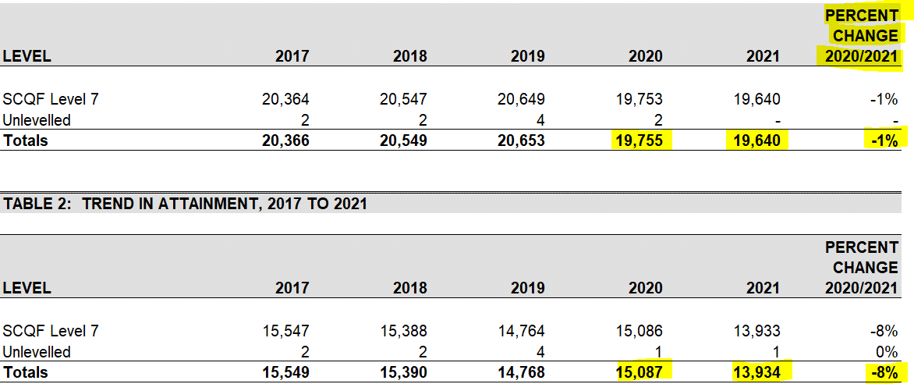
Uptake Trends – All HNC
HNC 2021
Notes:
10th

Slide 8
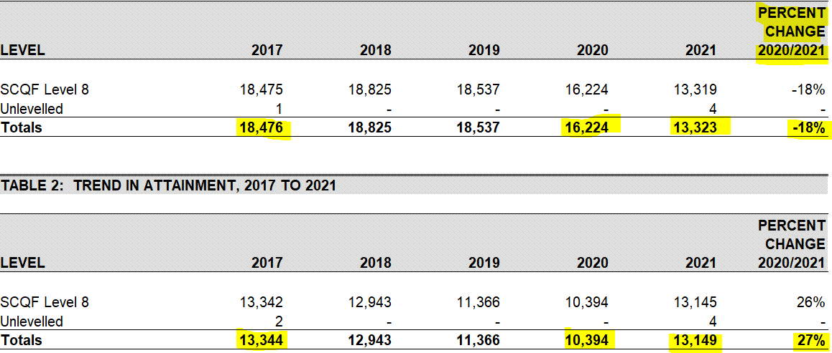
Uptake Trends – All HND
Notes:
10th

Slide 9
Uptake 2021 – HNC Top 10 Entries
Notes:
16th

Slide 10
Uptake 2021 – Top 10 HND Entries
Notes:
16th

Slide 11
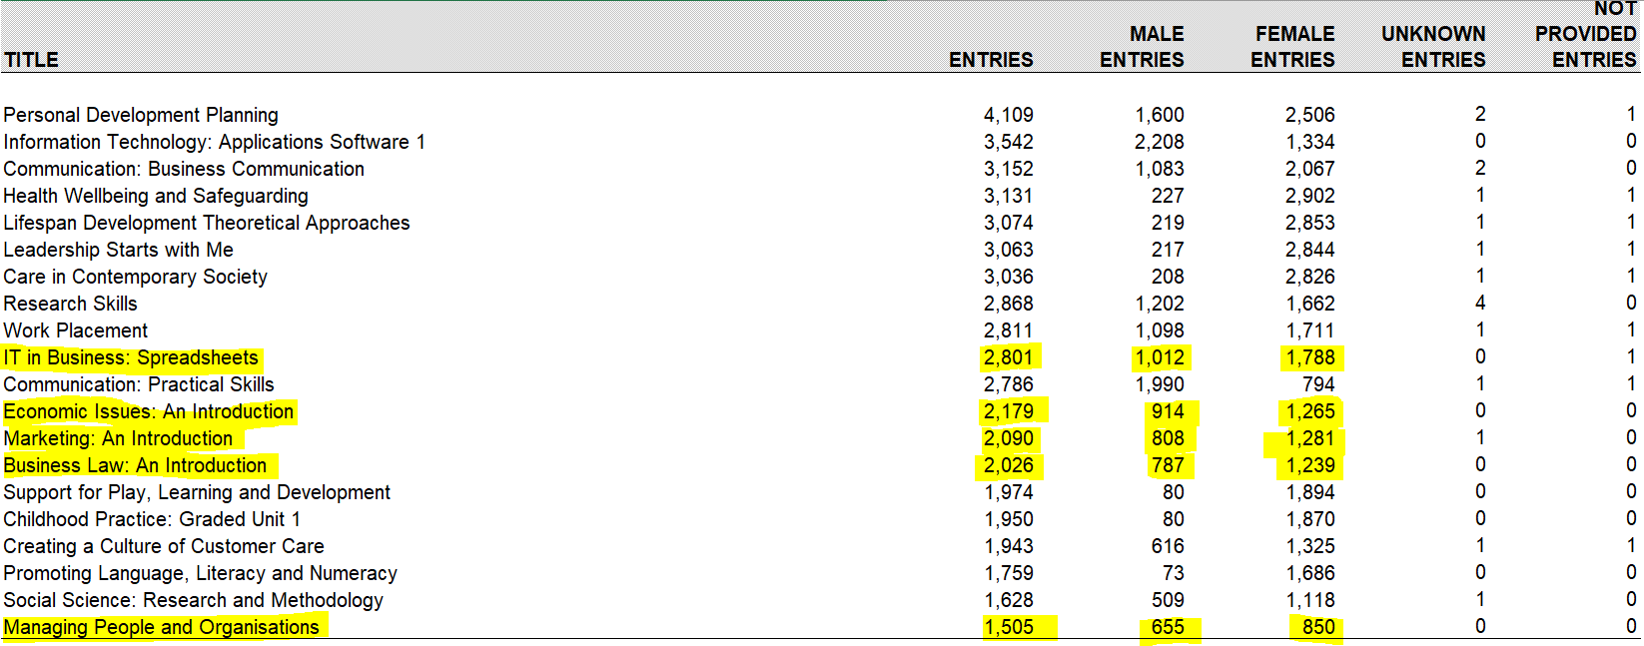
Uptake Trends – Top 20 HN Units SCQF 7

Slide 12
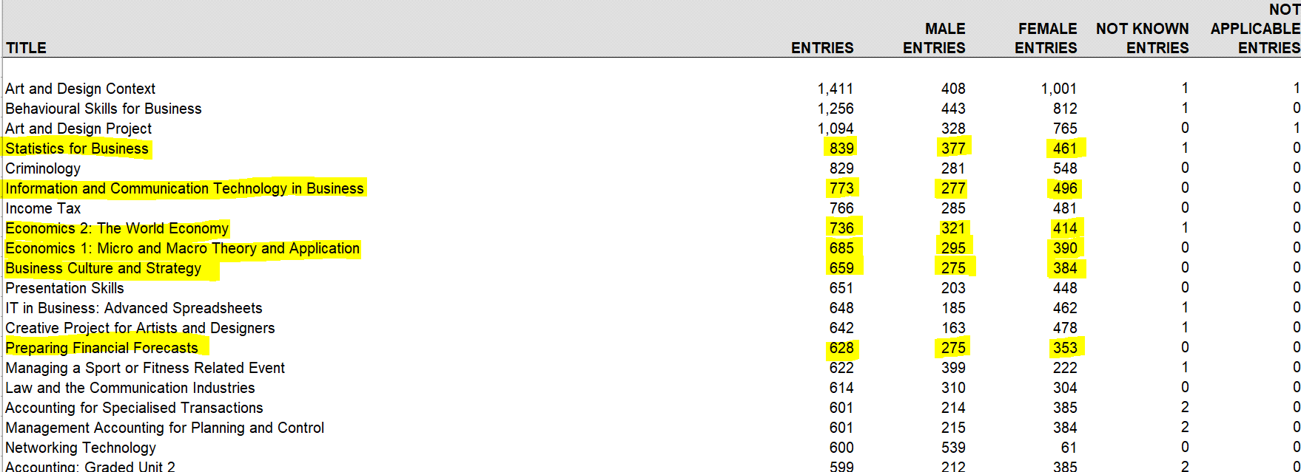
Uptake Trends – Top 20 HN Units SCQF 8

Slide 13
Further activity in 2023
Establish new Qualification Support Team (QST) – September/October
Establish Advanced Qualifications in Business internationally
Monitor performance of qualification and external forces
Potential maintenance activity – ASPs / Understanding Standards
2024 – Potential Physical Network Event – Centre hosted?

Slide 14
SQA Contact number

