Slide 1
Next Gen HNC in Accounting
The Good, the bad and the beautiful
What we have found out whilst delivering it

Slide 2
HNC in Accounting
The Good, the bad and the beautiful
What we have found out whilst delivering it

Slide 3
The Bad!
Driving Forces
It is more industry relevant
Better skill set
Less assessment
Combats AI
Restraining Forces
It is more industry relevant?
Better skill set, but at a loss of other skills!
Less assessment, but so much to do now!

Slide 4
A challenge to find the balance!
Bring in new
A fresh approach to areas that we didn’t enjoy before
Embrace new activities
Bringing in guest speakers
Looking at more real life scenarios
Focus on projects
Keep the best of the old
Materials that work well
Approaches that work well
Activities that work well

Slide 5
Financial Accounting Principles
The Good

Slide 6
What has changed!
Not a lot!
Still the same topics
Still the same tutors
BUT
More of the work on computers
The fewer assessments / resits / remediation has freed up time
Still to come:-
Trialling a block system to allow for more focus
Linking the assessments better into a single focus
Helping students to better prepare for the closed book style assessments

Slide 7
Management Accounting Principles
The Good

Slide 8
What has changed!
Not a lot!
Still the same topics
Still the same tutors
BUT
As much as possible on computers
Better spreadsheet skills
The fewer assessments / resits / remediation has freed up time
Open book assessments allowing students to manage time (with focus and guidance)
Still to come:-
Trialling a block system to allow for more focus
Linking the assessments better into a single focus
Helping students to better prepare for the closed book style assessments and the time management

Slide 9
Professional Considerations in Accounting
The beautiful

Slide 10
Outcomes
Identify, develop and review their own meta-skills
Discuss and apply ethical principles and practices in accounting
Explain the importance of and apply risk management practices in business
Explain and apply sound corporate governance and corporate social principles in business
Explain the importance of sustainability in business
Covered over 4 hours a week
Broken into 2 hours break then a 2-hour activity

Slide 11
meta-skills
Worked through definitions
Applied them to their experiences in group work.
Building confidence with the language
Looking for gaps in skill set
Looking for strengths
Introducing the idea or peer to peer learning with meta skills in group work

Slide 12
Ethics
Meta skills
Sustainability
Every weekly task is looped back to the meta skills
Group work and peer review and learning is encouraged within group
Methods of communication
Ensure that the models and examples we use contain sustainability
Ie Tuckman
Utilitarianism and who we consider.
This is part of the case study where they need to recognise the ethical requirements as given

Slide 13
Risk
Meta skills
Sustainability
Every weekly task is looped back to the meta skills
Individual tasks with group research to build confidence
Link to other classes with referencing
Focus on who the stakeholders are for risk
Risk appetite is considered for different groups
Look at the risk reward and downside.
This is part of the case study where they need to recognise the risk issue requirements as given

Slide 14
Corporate Governance
Meta skills
Sustainability
More focus on types of written element
Assessing who your audience is and how to effectively communicate
Business needs v others needs
Mendelow for positioning
Gray, Owen and Adams for the levels and views
Environmental reporting as part of the financial statements
This is part of the case study where they need to recognise the corporate governance requirements as given

Slide 15
Sustainability
Meta skills
Sustainability
Address the meta-skill selected from initial tasks and show how they now feel
Help them to identify next meta skill
Reinforce lifelong learning and self-improvement
Presentation to reflect and demonstrate their meta skill learning
The presentation will ask them to look at all the learning and to bring from that their understanding of how sustainability sits within the business
They will be asked to define it and demonstrate best practice in at least two areas above.

Slide 16
Accounting in the Business Environment
Designed to give confidence to students
Designed to show them the areas they will work with
Designed to give them an overview of the management skills

Slide 17
Back to area specialists!
Economics
Law
Standard teach and notes
But
Addition of speakers
Real life scenarios
Self-marking assessment
On-line interactive course
Work to be done weekly at their time
Access to tutor for Q&A and help
Tasks and quizzes are self marked
Self-marking assessment
Trying to relate to the students time and give as many opportunities as possible but keep engagement at a high level
Want to pick the best of both next year!

Slide 18
Management
Project based
'Real report'
Charity shop
Linking to Law, Economics and PCA
Gives a chance to bring in Meta-skills and Sustainability in the cross over
Taught 4 hours a week
2 hours taught
2 hours of tasks / role play
Interview panels etc
Guest speakers
Referencing Library support

Slide 19
New ways to ask students to present information
Mouse mat
Recorded presentations
Press release
Essays
Group work
Report
Blended with more traditional ways to present information

Slide 20
In conclusion
It is our experience that this can work and that we can blend the old and the new together – but we also know that change needs to be embraced to keep this fresh

Slide 21
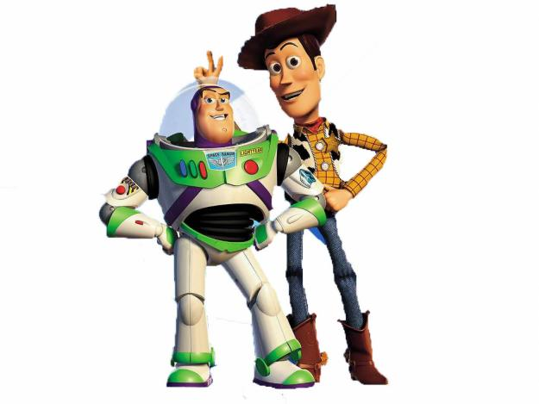
Any Questions?

