Slide 1
HNC/HND: The Next Generation

Slide 2
Engagement Activity: February – August 2018
Students: Recent HN graduates and current HN year two students SQA: General cross-directorate open sessions
Specific colleges: Engagement with senior managers, Curriculum Managers and lecturers
General colleges: Colleges Quality Managers Forum; College Expo18; HNNG Steering Group; College Curriculum Advisory Forum
Other groups: Skills Development Scotland; Scottish Drama Training Network
300+ people have engaged in Service Design workshops so far

Slide 3
Specific Messages and Comments
Flexibility:
Centres identified the HNC/D structure as ‘inflexible’, ‘slow to change’, ‘complex’ and ‘not suitable for specific industry needs’.
Large number of qualifications, with significantly long option lists; long mandatory sections (in some cases); long chain for development and updating
Centres frequently highlighted courses and units which are extremely specific (specific actions, equipment, software etc) making it very hard to tailor assessment to meet student and customer needs

Slide 4
Specific Messages and Comments
Assessment:
Candidates highlighted the relentless nature of continuous assessment
Some did highlight continual, bite-sized assessment as providing encouragement and evidence of progress
Over-assessment (competence based model) was highlighted as a core issue
Centres and candidates highlighted combined word counts across units being significantly higher than comparable Advanced Higher or Degree
Centres and candidates highlighted perceived lack of choice of assessment mode and lack of strong online assessment methods
Current Pass/Fail units plus Graded Units is not recognised as differentiating performance effectively enough for employers

Slide 5
Specific Messages and Comments V
Accessible:
Inflexibility of assessment and high assessment load means most centres find HNC/D unsuitable for part-time, returning learners or learners with particular learning needs
Candidates, in particular, highlighted increasing demand for online access to information and assessment
Centres increasingly discussed recognising prior learning in a more effective, streamlined manner –
Recognition of other learning at same level, e.g. Advanced Higher or similar HN qualifications
Recognition of industry-specific qualifications, e.g. vendor quals

Slide 6
21st Century Skills
Strong support for requirement to develop lifelong learning ethos with ‘Common Core’ 21st Century Skills which cut across industries and which make multiple-career progression in a complex environment more effective
Strong support for 21st Century Skills (in context to award) as the HNC/D ‘Common Core’

Slide 7
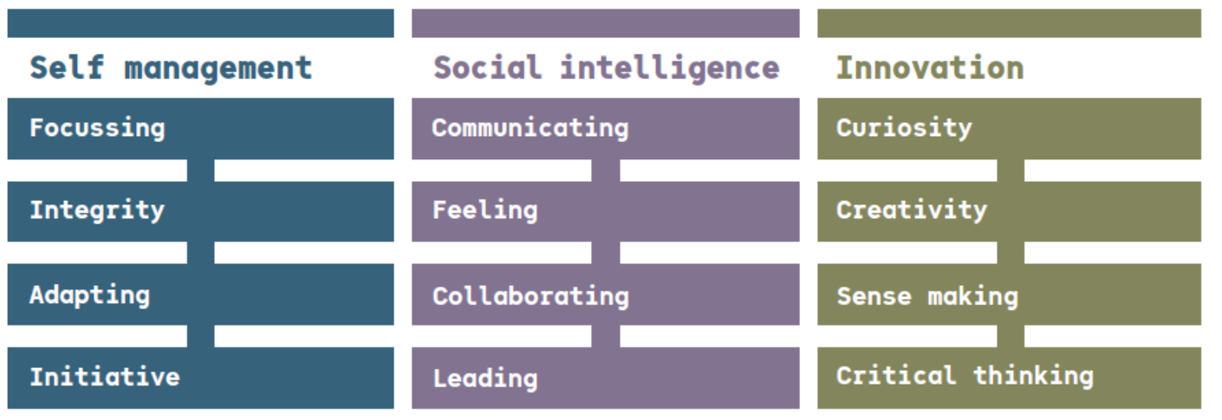
Skills Development Scotland: Skills 4.0

Slide 8
Broad Potential Outcome Suggestions
120 SCQF Credits HNC and HND (i.e. 15 credit HNC and HND)
General 80% / 20% split, with 80% of each level to be based at the qualification’s core level i.e. HNC – 80% SCQF7; HND 80% SCQF8
Qualifications to build from ‘three concentric circles’ model as follows:
Common Core: 21st Century Skills
Context: Projects(s) for developing understanding of sector
Key Skills: Industry/job-specific training and development
Move away from unitised 1 & 2 Credit units as course ‘building blocks’
Towards larger components of activity,
Less specific outcome-by-outcome assessment more on intended skill outcome,
Centre-led design of specific content, projects etc. – led by initial ‘Statement of Intent’, including assessment plan, and evidence of need etc.

Slide 9
‘Common Core’: A central design feature of all HNC/D, which can be contextualised to suit centres, sectors or specific courses, and is designed to deliver ‘21st Century Skills’ to all learners.
‘Enterprise and Context’: A supporting project which enables candidates to develop sector-specific contextual understanding, Personal Development Planning and relevant business skills
Industry-Specific Training: Key skills development for job/sector

Slide 10
Grading and Awarding
Feedback from candidates, universities and employers that the current system is not providing clear enough differentiation of quality of candidates
This has led to the following suggestions:
Removal of Graded Unit as aggregator of diverse skills and provider of grade
From component grading, one overall grade for HNC and one for HND
Clearly has broader implication for role and requirement around External Verification, validation etc.

Slide 11
Prototyping and Pilot Plan
Phase One: 18 months, commencing circa April ‘19
Creative Industries; Engineering; Care (Early Years focus)
Phase Two: 12 months, commencing circa October ‘19
Computing; Business; Science

Slide 12
Martin.Boyle@sqa.org.uk

