Slide 1
Modern Languages for Life and Work Award Leadership: An Introduction

Slide 2
Leadership: An Introduction
Helen Hope PT Modern Languages
Aisling Clark PT Developing Young Workforce

Slide 3
Aims: To learn about Oban High School’s journey in delivering Leadership Award To look in detail at the Leadership unit in the MLLW award and its assessment To give an overview and some detail of the lessons we deliver with practical examples
Leadership: An Introduction

Slide 4
By the end of today, you should have an understanding of: The content to be delivered Possible practical approaches to delivery The 3 outcomes The final assessment evidence
Leadership: An Introduction

Slide 5
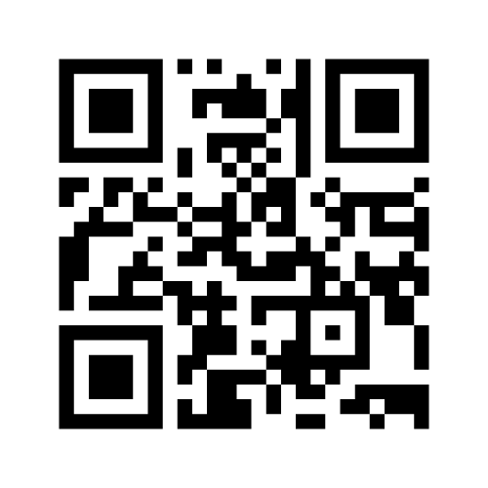
https://www.menti.com/ya7t1fjhhu

Slide 6
Leadership
There are two units which make up the whole Leadership Award –
Leadership An Introduction
Leadership in Practice

Slide 7
Oban High School Presenting whole Leadership Award to S6 pupils for several years.

Slide 8
Leadership: An Introduction
For MLLW at both levels 5 and 6, learners work on ONLY the first of these Leadership units :

Slide 9
Leadership: An Introduction Overview
The purpose of the unit is to provide learners with the opportunity to develop their research skills, reflect on their own qualities, skills and experience in relation to leadership and to develop the leadership skills and values necessary to work cooperatively with others

Slide 10
There are 3 outcomes to be passed at
both levels 5 and 6

Slide 11
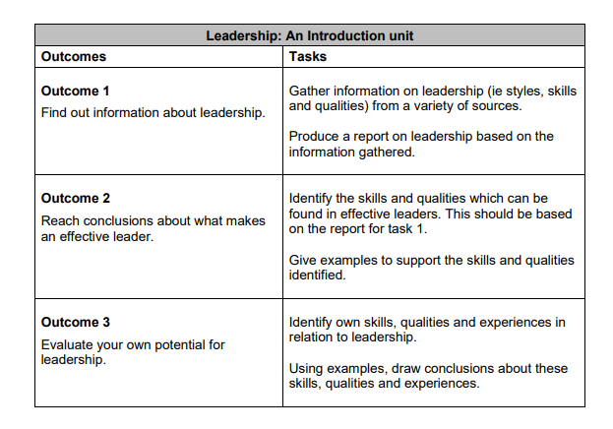
Level 5

Slide 12
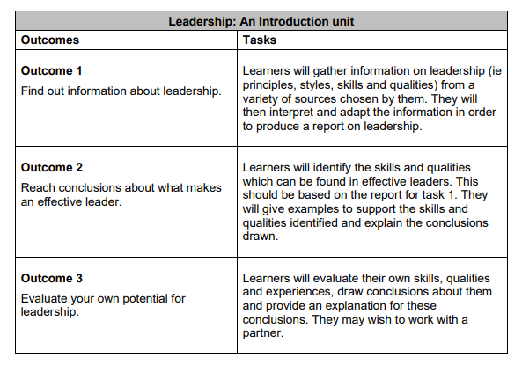
Level 6

Slide 13
Differentiation Outcome 1 – find out information and produce report
Level 5
use at least three different sources of information
Produce a report on leadership based on the information gathered
Level 6
use at least four different sources of information.
Interpret and adapt the information gathered in order to produce a report

Slide 14
Differentiation Outcome 2 – reach conclusions about what makes an effective leader
Level 5
Make conclusions about the skills/ qualities found in effective leaders.
Examples can support these conclusions
Level 6
Make conclusions about the skills/ qualities found in effective leaders
Provide an explanation to support these conclusions
Compare the effectiveness of different leaders

Slide 15
Differentiation Outcome 3 – learners evaluate their own potential for leadership
Level 5
Identify own skills, qualities and experiences in relation to leadership
Use examples to draw conclusions about these
Level 6
As per Level 5 and including:
An explanation to support these conclusions

Slide 16
Differentiation - level of support
Principle | SCQF level 5 | SCQF level 6
Support: learners will work with | minimum support — tutors will answer specific questions to enable learners to progress. | Non-directive supervision — the learners will take responsibility for their own learning but the tutor may explain and interpret if requested.
Level of participation: learners will | negotiate — put forward suggestions and ideas and agree a way forward | take responsibility for a range of tasks and, where appropriate, for the work of others.
Level of understanding: learners will show | knowledge of a range of simple ideas and facts | factual and theoretical knowledge of a range of ideas and practices
Level of maturity displayed: candidate will | use some abstract constructs, eg draw conclusions | draw conclusions and suggest solutions.

Slide 17
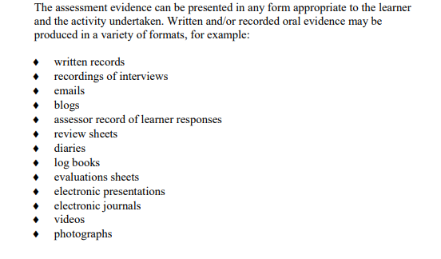
Assessment – arrangement documents

Slide 18
Oban High School
Introductory lesson to Unit 1

Slide 19
Unit 1 – lesson 1
Leadership: An Introduction

Slide 21
SQA Leadership Award SCQF 5-6
The Leadership Award is made up of two units: Unit 1 Leadership an Introduction, Unit 2 Leadership in Practice.
The first unit is research based and the second unit is activity based.
The two units can be worked in conjunction
At level 6 it accrues 7 UCAS points.

Slide 22
Unit 1
In this unit, learners carry out research to find out about leadership styles and the skills and qualities found in effective leaders. Learners are required to produce a short report on their findings and evaluate their own potential for leadership. You will write a report on leadership including the following:
Principles, styles, skills and qualities of leadership.
Reach conclusions about what makes an effective leader.
Reach conclusions about the skills and qualities which can be found in effective leaders.
Evaluate your own leadership potential

Slide 23
Benefits to you! This award will help you to:
Understand the impact you can have on others and on the success of an activity
Build your self esteem and confidence in speaking with peers as well as staff across the school and in the wider community
Raise your self awareness about how you can contribute to school and society

Slide 24
Benefits to you! This award will help you to:
Develop organisational and time management skills
Develop self management and independent learning skills in preparation for Further/Higher Education and employment

Slide 25
The Report
You will research information about leadership. This will be done using information from the media, the Internet, personal experience, interviews or questionnaires
You will reach conclusions about what makes an effective leader and present it in the form of a report or presentation.
You will need to identify at least two effective leaders and compare the different ways in which they provide effective leadership. You should link these leaders into one of the identified styles e.g. Hitler is autocratic
You will evaluate your own potential for Leadership. What are your skills and qualities? What principles do you have that you think are important?
Please ensure you have at least 4 sources of information. These can include The Internet, Textbooks, Newspapers and Magazines, Television and People.

Slide 26
Time 100
Time 100 is an annual list of the 100 most influential people in the world assembled by the news magazine Time.
First published in 1999 the list is now a highly publicised annual event.
Appearing on the list is often seen as an honour. Time makes it clear that entrants are recognized for changing the world, regardless of the consequences of their actions.

Slide 27
Task: Leader or influencer?
https://time.com/collection/100-most-influential-people-2020/
Discuss
What is the difference between influence and leadership? Is there a difference?

Slide 28
Task: Leader or influencer? Some thoughts
Leaders Need Influence, But Not All Influencers Are Leaders
Marketers influence. Authors influence. Leadership demands more than that.
It empowers people to do the work themselves to create a positive future in line with values

Slide 29
Task: Leader or influencer? Some thoughts
Influence Can Happen Without Leadership Yet Will Be Fleeting
Being a leader has more to do with who you are than influence. Influence can happen without leadership yet will be fleeting.

Slide 30
Task: Leader or influencer? Some thoughts
Influencers lead ideas. Leaders lead people.
Influencers come up with ideas no one every thought of before.
Leaders figure out how to formalize those ideas and mobilize teams to turn those ideas into reality.

Slide 31
Task:
Everyday Leadership TED talk 6 minutes
How to start a movement
Discuss what leadership is with your partner or in a group.
Share your findings with the class
Define the idea of leadership in a sentence or two:- what is it about, what does it involve, what is the theory behind leadership? Think about what you have learned from the 2 films you have watched. Is everyone a leader?

Slide 32
Task Rewrite this definition in your own words.
“Leadership may be defined as having the ability to influence people through personal qualities, actions or behaviours to achieve a common goal.
People want to be guided by someone they respect. To gain respect they must be ethical and responsible and demonstrate a sense of respect in their team or followers.
A successful leader makes people want to follow them by having a clear sense of direction. A sense of direction is achieved by having a strong vision of the future.”

Slide 33
Think!
Leadership is not about being in a formal position. It’s about action. You can grant someone the title of chief executive, but that does not make him or her a leader. Leadership is earned.
You get to be a leader in the eyes of others because of what you do. Leadership is about having the courage and spirit to move from whatever circumstances you are in to a place of making a difference in the world.
The next time you say to yourself, “Why don’t they do something about that?” look in the mirror. Ask the person you see, “Why don’t you do something about that?”
Be a Leader

Slide 34
Sequence of work
Introduction to Leadership
Focus on Sir Alex Ferguson
Leadership Styles
Principles and Practice
Skills and Qualities
Completing the Report

Slide 35
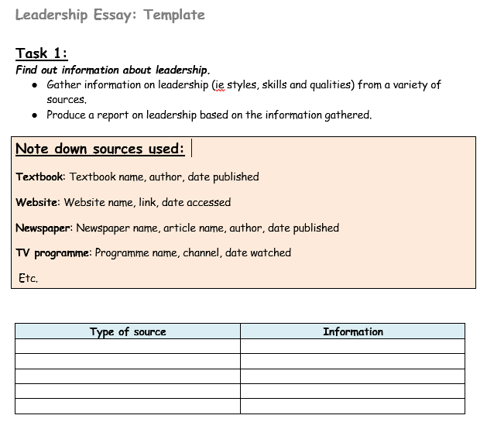
Writing the Report Researching information about Leadership – styles and leaders

Slide 36
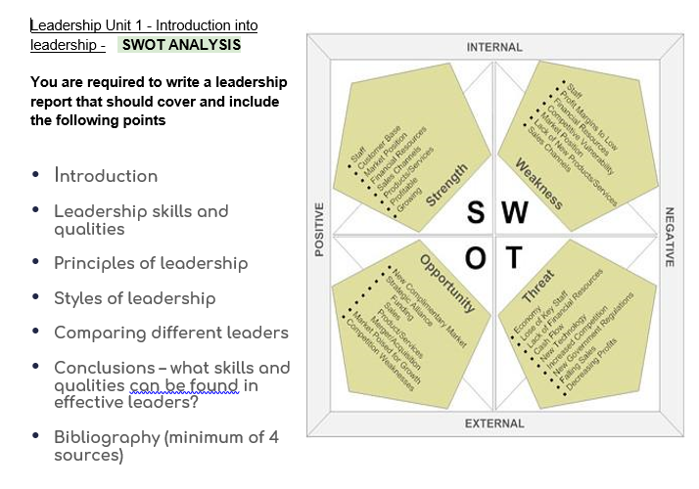
Writing the Report Evaluating own potential for leadership

Slide 37
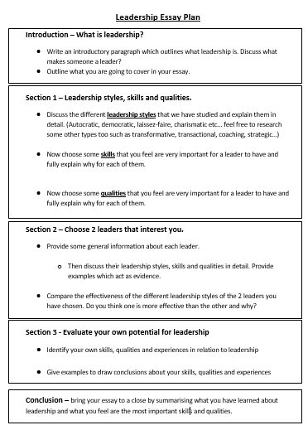
Writing the Report

Slide 38
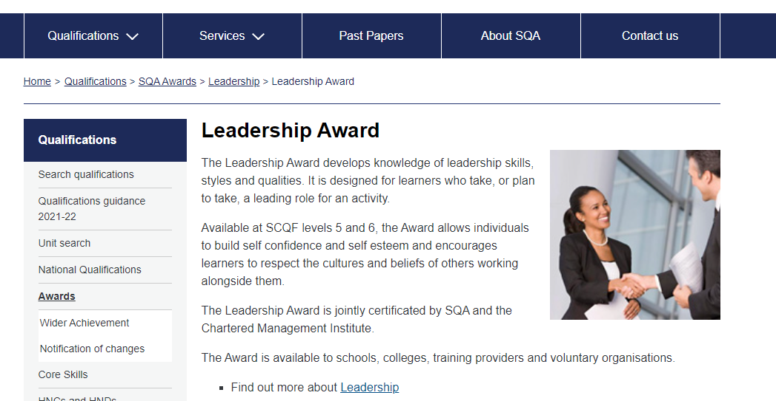
Where to find documentation
https://www.sqa.org.uk/sqa/47258.html

Slide 39
Recap
How many Units are there in the overall Leadership Award?
2
How many Units are studied as part of the Modern Languages for Life and Work Award?
1
What is the name of the Unit?
Leadership an Introduction
What 3 Outcomes need to be met?
Find out Information about Leadership
Reach conclusions about what makes an effective leader
Evaluate own potential for leadership
How do pupils evidence this?
Various formats

Slide 40
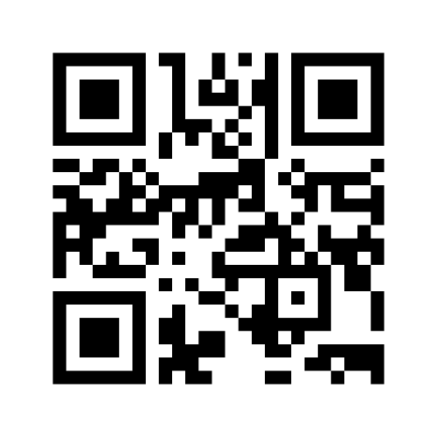
https://www.menti.com/tv4ij1n3bt

Slide 41
Any questions?

