Slide 1
HN Accounting Network Event
4th March 2020

Slide 2
Programme
Welcome and SQA Update
Senior External Verifier Update
Networking opportunity (tea/coffee)
IFRS16 Leases Update
Lunch (12:15)
Graded Unit 2 – Delivery examples
Scoping and Consultation Update
Plenary
Close (circa 15:00)

Slide 3
New Qualifications Officer
Eileen Reid eileen.reid@sqa.org.uk
Qualifications Officer
HN/SVQ Accounting and Financial Services

Slide 4
SQA Update – IFRS16 Leases
Amendments to unit specifications
Accounting for Specialised Transactions
Financial and Reporting Analysis
Amendments to ASPs
Accounting for Specialised Transactions
Auditing
Business Taxation
Financial and Reporting Analysis
Graded Unit 3

Slide 5
SQA Update – IFRS16 Leases
Guidance on impact on each unit affected (Aug ‘19) on SQA website (HN Accounting page)
Timing
2019/20 status quo will be accepted providing financial statements and lease commencement used are prior to 1st January 2019.
Centres can update materials to meet new standard prior verification of assessments is recommended
2020/21 New standard must be used. Relevant SQA units and ASPs have been updated

Slide 6
SQA Update – Next-Gen
Covers all aspects of SQA’s products and services
First meeting regarding standards and assessments Feb ‘20
Aim – iterative changes and piloting rather than block fully formed untested Design Principles
Desire to see mainstreaming of Enhancements Pilot approaches
Aim to have some outputs available August ‘20 (eg Economic Issues: Intro)
Meta-skills
Opportunity to incorporate in HN Accounting at next review

Slide 7
SQA Update – Entry & Cert Stats

Slide 8
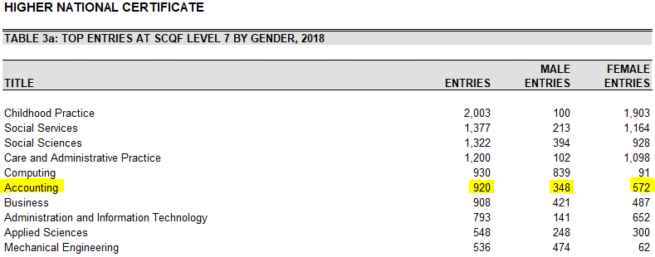
SQA Update – Entry & Cert Stats

Slide 9
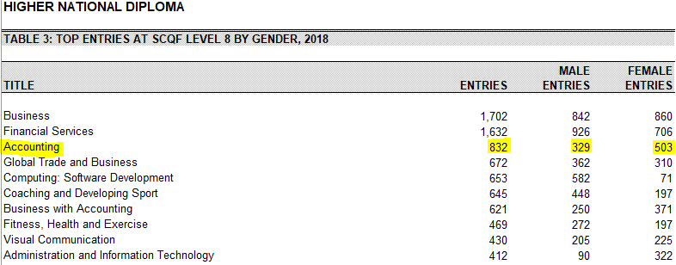
SQA Update – Entry & Cert Stats

Slide 10
Questions?

