Slide 2
Word Counts
“How long should my answer be?”

Slide 3
Word Counts
There seem to be two answers that spring to mind

Slide 4
Word Counts
Background and remit
Word Count Group Exercise
Discussion
Some preliminary thoughts
The end result

Slide 5
Word Counts – Background and remit
Produce a summary report that appraises the use of word counts within some of the mandatory HND Business Units:
MPO
Business Culture and Strategy
Economic Issues
Economics 1: Micro and Macro Theory and Application
Economics 2: The World Economy
Business: Graded Unit 2

Slide 6
Word Counts – Background and remit
The report should take into account approaches to word counts used by other institutions
Today offers an ideal opportunity to obtain views from those involved directly in the delivery and assessment of the HN Units identified
Word Count - Group Exercise

Slide 7
Word Counts – Some preliminary findings
Factors influencing the word count
SCQF level
Number of SCQF Points
Number of HN credits
The number and nature of the Outcomes
Number of assessments
Types of assessments
Conditions of assessments
Complexity of the tasks
The assessment load across the award
Assessment length and design in comparable Units/Modules

Slide 8
Word Counts – Some preliminary findings
Suggested word counts
University of the Highlands and Islands – 20 SCQF point modules
University of Sheffield

Slide 9
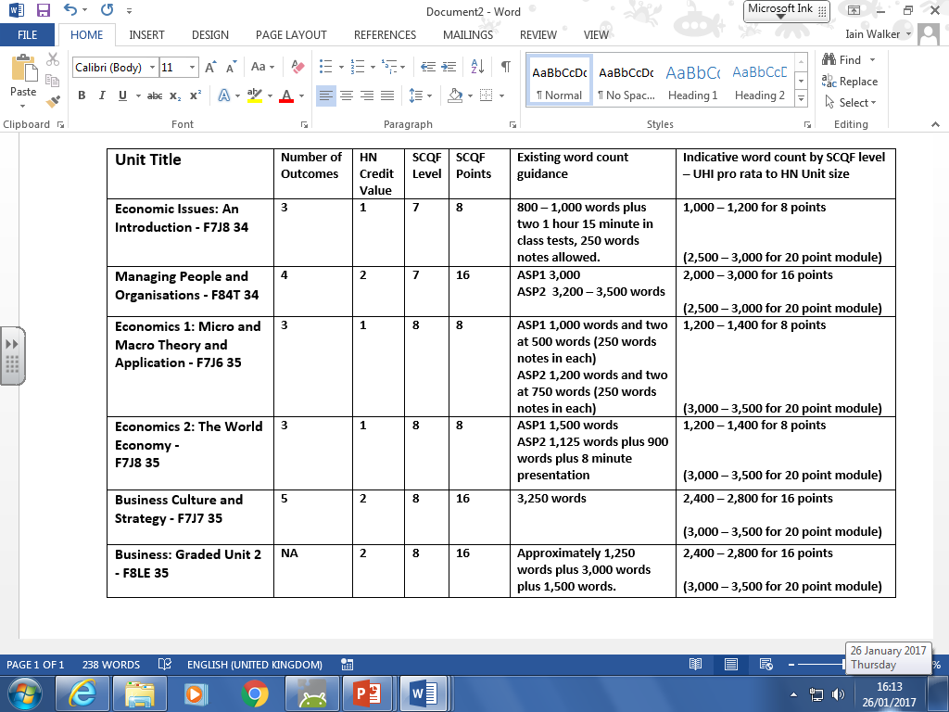
Word Counts – Some preliminary findings
Suggested word counts

Slide 10
Word Counts – Some preliminary findings
% tolerances
UHI +/- 10%
University of Sheffield +5% to +15%, over 15%
University of London 0% to +10%, 11% - 20%, 21% - 30%, +30+, No deductions for less than the word count

Slide 11
Word Counts – Some preliminary findings
Some words of wisdom
“..if you decide that the most appropriate assessment task is an essay, then you will want to look at the custom and practice for essays in your subject area both within MMU and elsewhere. Assignments of the same name should normally be comparable in demand/expectation. ……Once the unit assessment tasks have been decided, then the programme team should compare all assessment tasks across each stage to ensure that there is a balance of different types of task and that the ways in which student workload are estimated are similar. “
Manchester Metropolitan University

Slide 12
Word Counts – The end result
Recommended word count guidelines in Units
General guidelines for centres on the use of word counts within HN Business assessments

