Slide 1
HN Business Enterprise

Slide 2
Course Options
HN Business Enterprise
HN Business HR
HN Business Languages
Rationale
Align courses to Industry and HE articulation opportunities

Slide 3
City Learning 4.0
Key aims of City Learning 4.0:
Guide students in defining and achieving their own Learning
Develop new models of partnership between students and lecturers. Prepare students for citizenship and industry
Cultivate students and lecturers to be lifelong learners
Embrace technology as an enabler in the delivery of Learning and Teaching
Reactive/Adaptive to internal and external drivers

Slide 4
Entrepreneurship Units
LO1
Lo1-Lo4
Lo2
Developing Entrepreneurship Skills:
Developing Entrepreneurship Skills:
Preparing and Presenting a Formal Business Plan:
Personal & Business Details
Characteristics of an entrepreneur and reasons for and against becoming one.
Self assessment, audits and identifying areas for development
Creating an entrepreneurial action plan and implementation
Identifying employability strengths and experiences
Reflection of personal development
Business Idea & Market Analysis
Resource Requirements
Regulation & Legislation
Financial Analysis
Appendices
Presentation:
Business Idea & Market Analysis
Resource Requirements
Regulation & Legislation
Financial Analysis
Entrepreneur Action Plan

Slide 5
Enterprise Delivery
Student
Develops students analysis and evaluation skills while utilising a diverse range of technologies
Develops interpersonal, networking and team working skills
Provides project management experience
Supports development for GU2 in year 2
Opportunity practical based activities internally and externally
City Learning 4.0 agenda

Slide 6
Enterprise Delivery
Enterprise Activities
College Enterprise Team Activity: Teams create an Enterprise Collage / Tiktok Video on the different industry learning which take place
Product Innovation Tasks: Students are tasked to create their own unique product in teams and pitch them to the class for a specific target market
Business Model Canvass Workshop: Delivered in partnership with Strathclyde University Enterprise Hub
Building an effective team, Personality Poker: Personal Skills assessments activity
Skills Self Assessment Activities: Personal Skills assessments activity
Product Evaluation Activity: Evaluation Activity
Competitor Analysis Trip: Winter markets research trip focusing on advertising, pricing and unique products
F&C Competition Entries: Students developed entry submissions on how to manage financial concerns
Charity Fundraising Events: Students worked in competition to raise awareness and funds for the Australian Wild Fires

Slide 7
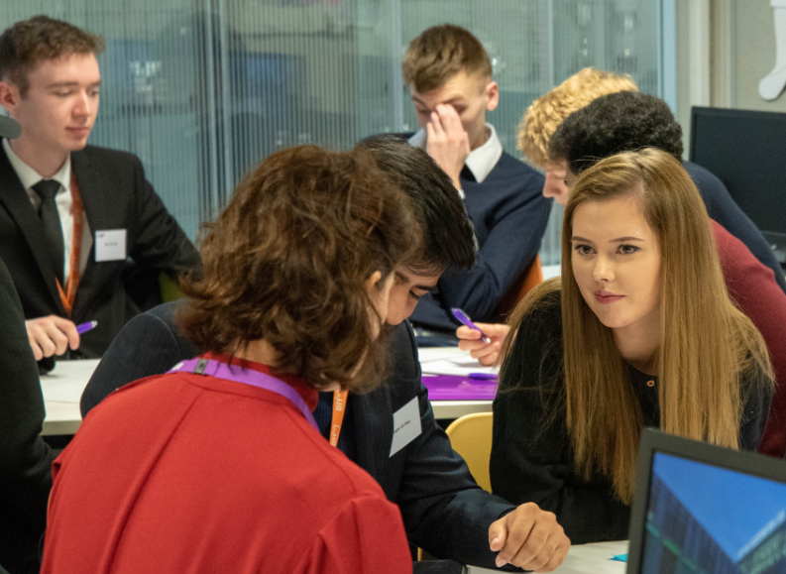
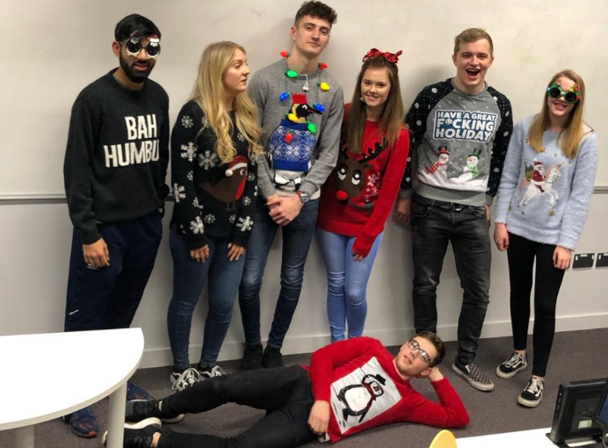
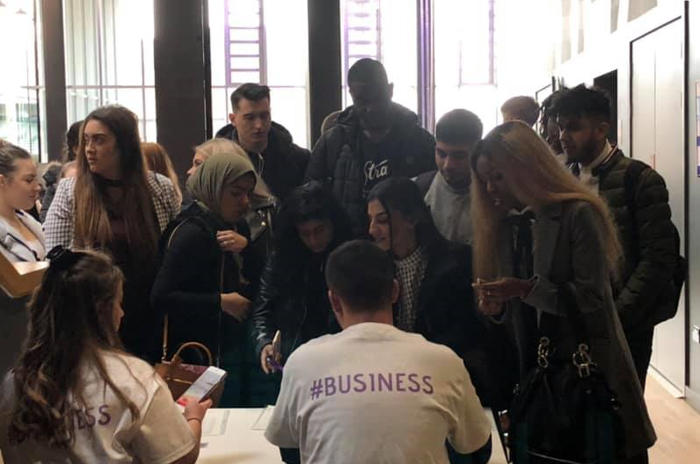
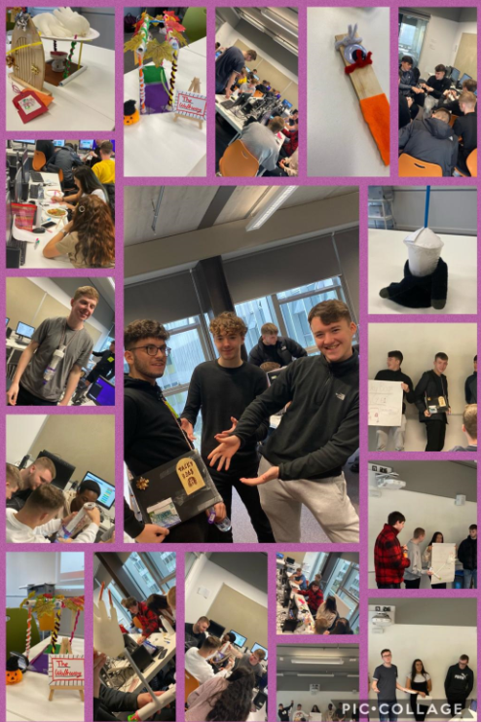
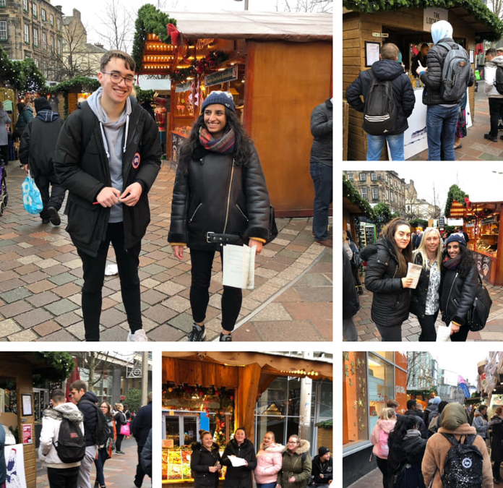
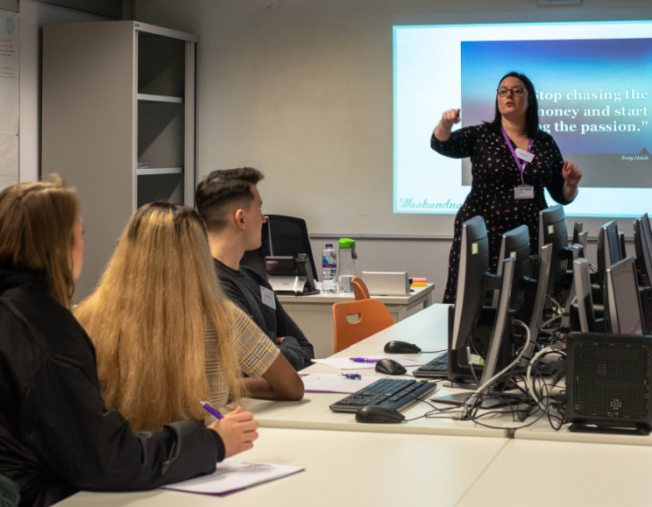
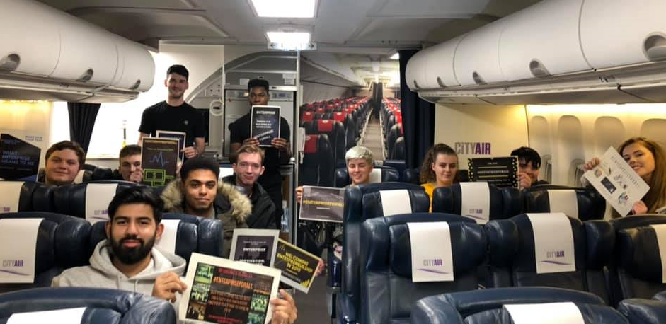
Enterprise Activities

Slide 8
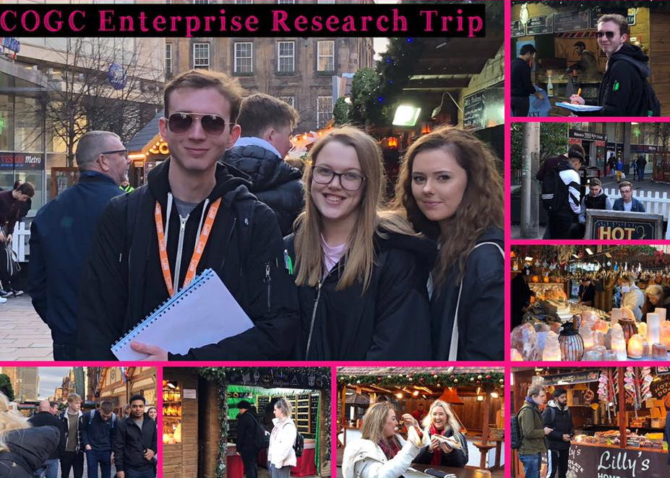
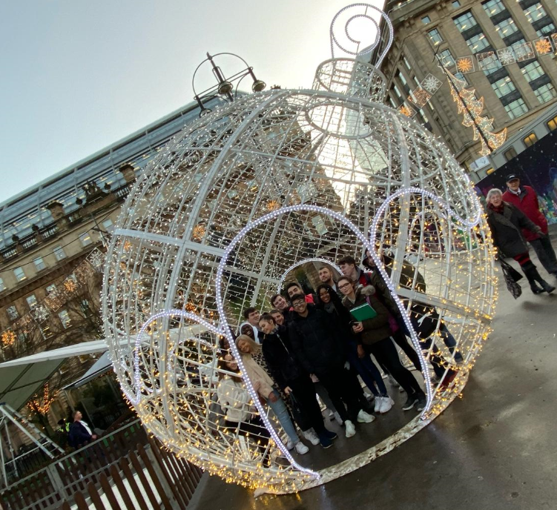
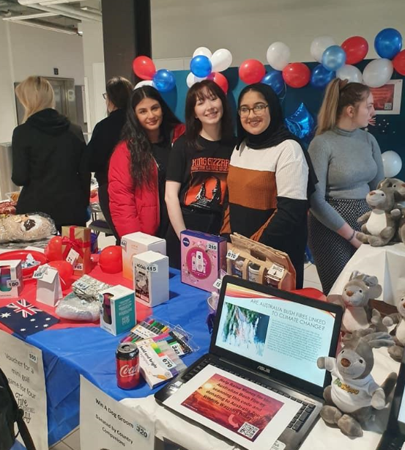
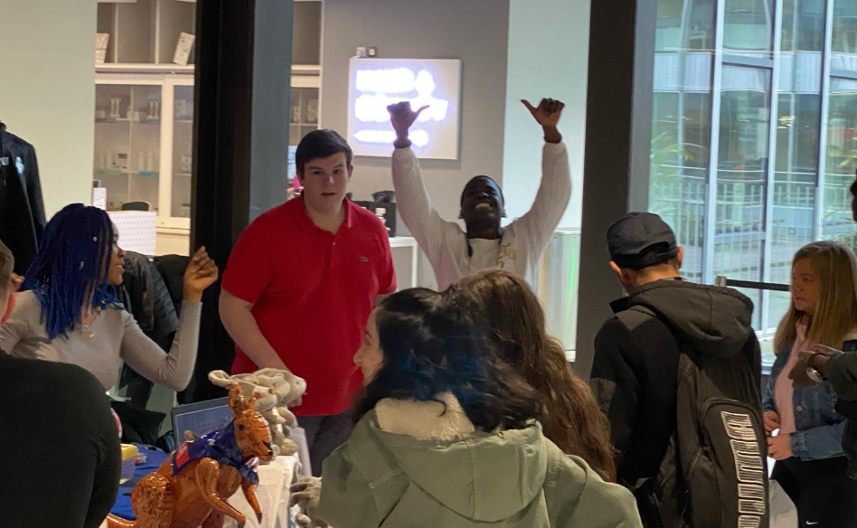
Enterprise Activities
Sasha Watson: HNC1B
Going to the Christmas market with the class was a great opportunity to get to look at some of the strategies the sellers were using to entice customers and how to make the most sales. We were able to use this information in other subjects such as marketing and economics.
The fundraiser event was very useful to me as it gave me great insight into running a business. Having to set it up mostly by ourselves was fantastic as it helped us learn how to entice customers and to make sales. We were also able to learn a lot from the mistakes we made, which aided us when writing our business plans.
Iona Gibson: HND 1A
I think the personality poker at the beginning of the year was not only a good way to start conversations with other people in the class, but also I thought it was a unique idea that brought up personal reflection effectively. I had low expectations for this task (sorry) but it was actually a very memorable task and made me understand myself better.
I personally really enjoyed both the product design tasks that we did with Heather and yourself. It was engaging, creative and was a great opportunity for leadership/team working.
Stephen Donohoe: HNC 1A
I feel the practical activities done in class were very beneficial in gaining skills and experience that could be applied to the theory in class as well put into practice in the future. I’ve appreciated how quickly any work handed in has been marked and I’ve been given honest feedback in terms of the quality of my work being to the standard I can achieve rather than the average expeditions. Overall, enjoyed the course and feel the skills we are developing will be useful in and out of college.

Slide 9
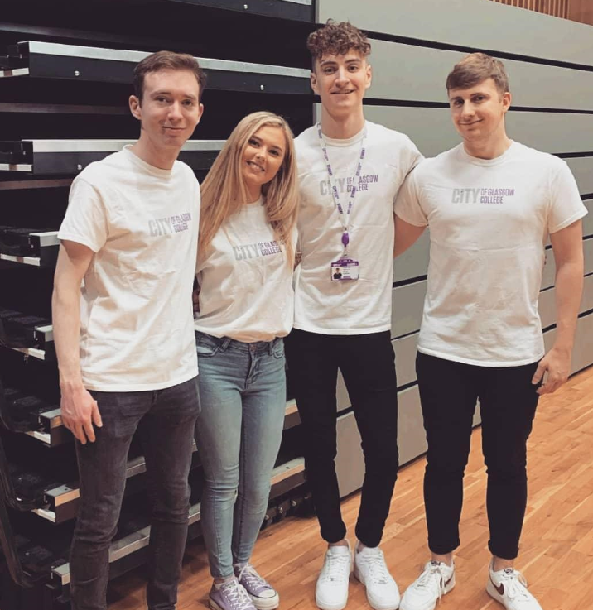
Student Feedback
Mark Burnett: HND Year 2
The enterprise units helped me vastly to learn how I can develop skills that employers are looking for, allowing for personal growth which will help me secure work in the future.
The hands on activities we had supported me in developing an entrepreneurial mindset and allowed me to connect my business acumen with critical thinking and problem solving skills which will be invaluable to me throughout my career.
The unit also prepared me in developing my analysis skills that we are also utilising this year as part of our Graded Unit 2 project.
Erin Traynor: HND Year 2
I gained many extremely important transferrable skills, more than I could’ve anticipated. At the Conference, we heard from former students about their journeys. This was astonishingly motivational as I felt I could relate and connect with people only a few years further on in their journey from myself.
We were not just learning, we were growing, understanding, experiencing, expanding our knowledge and increasing our network with every opportunity we were given.
We showcased this when we presented our final business plan at the end of the year. This was the most in-depth pieces of academic work I have completed. Using the skills and experience I gained, I created my own 8,000 word portfolio. This was the most rewarding piece of work I have completed and I have found the skills gained during this experience to greatly prepare and help me with my Graded Unit 2 as I am much more confident and proficient in carrying out research and completing large academic pieces.
I feel overall, this course has given me more than just knowledge of entrepreneurs, it has taught me what it takes to become one, it has given me the skills and the opportunities to work hard and succeed in life.

Slide 10
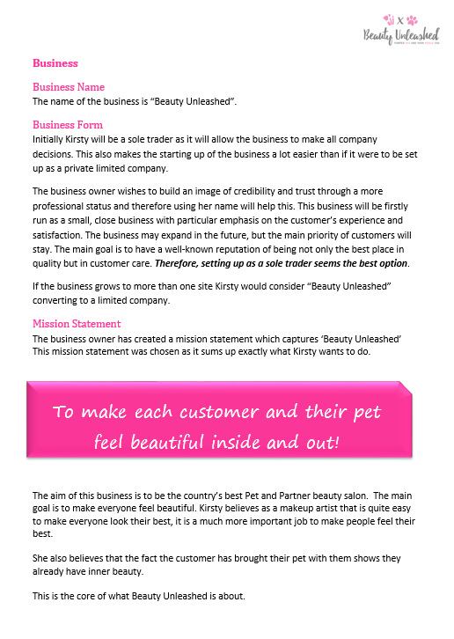
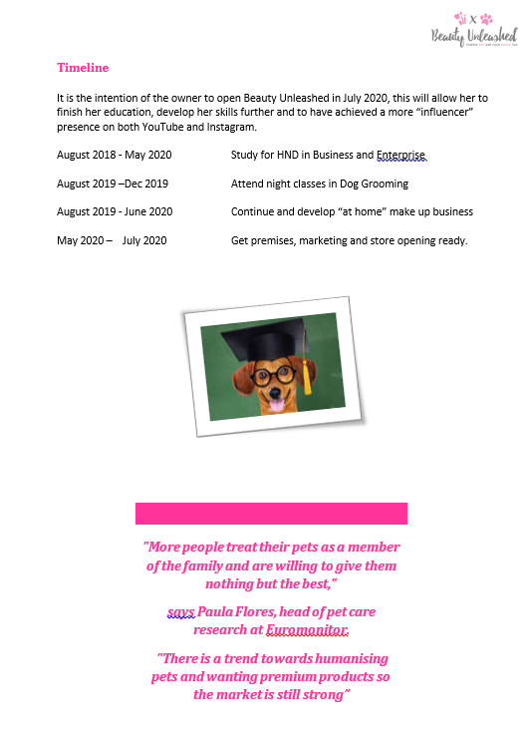
Enterprise Delivery: Business Plan

Slide 11
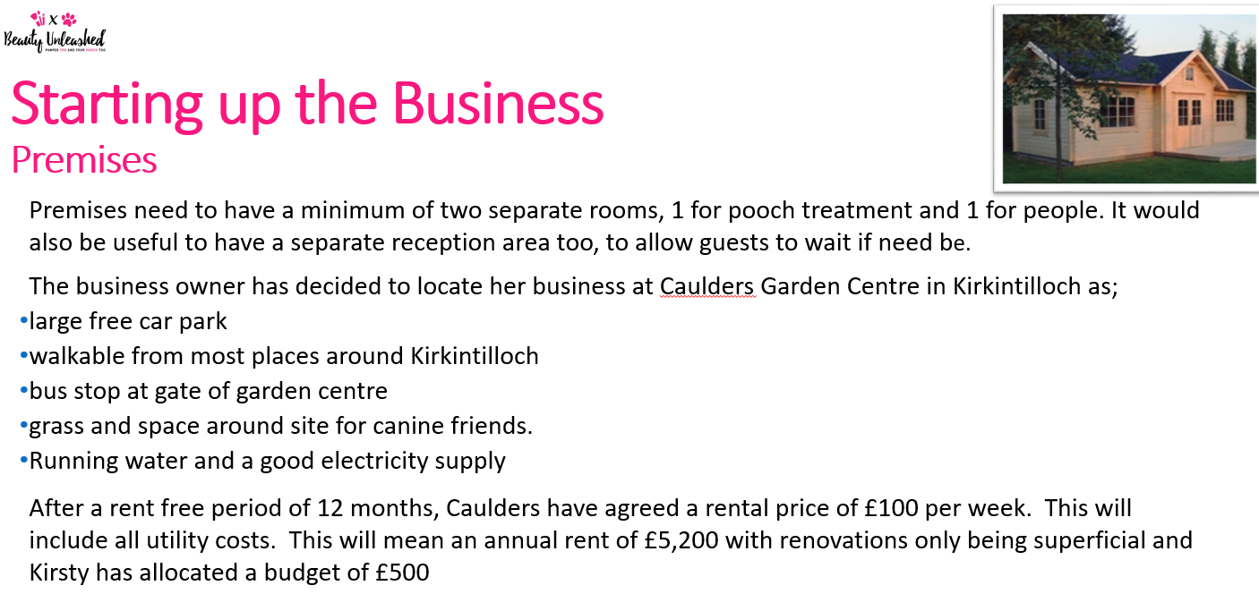
Enterprise Delivery: Business Presentation

Slide 12
Product Evaluation Activity
In your groups you have been given a product and you have to identify how the end product satisfies the needs and wants of a consumer.
Evaluate the full product and its use by creating a presentation on the pros and cons of the product.
What are your likes and dislikes of the full product? Is it fit for purpose and use?
You have been given 15 minutes for this activity.

Slide 13
Questions?

