Slide 1
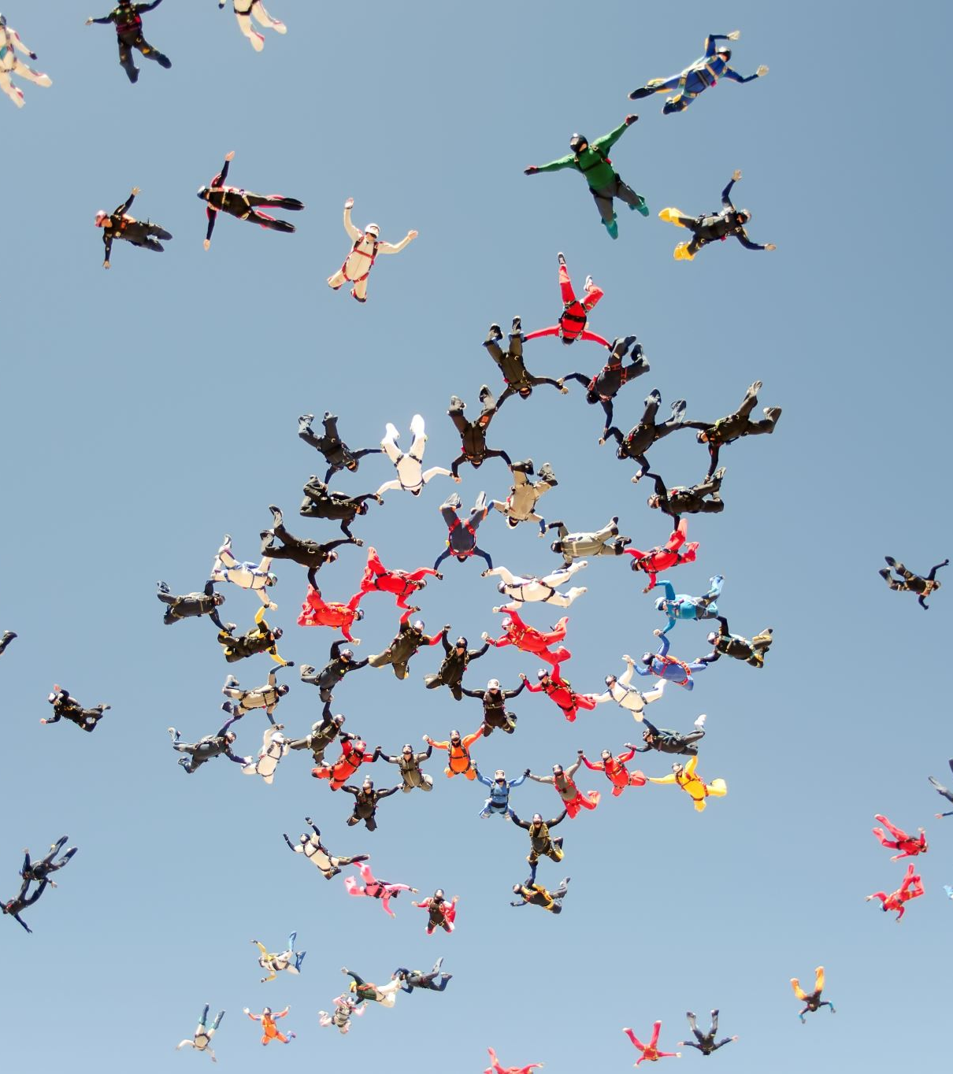
Bringing the Fun into Remote Delivery
Ss
Inverness college UHI

Slide 2
Some of the Challenges…
Students not engaging with each other
Students not turning on cameras
Students not using voice function
The Great Wall of Webex (the radio broadcaster effect!)

Slide 3
What I Did…
Open, honest and frank discussion
Reasons:
Too shy
No-one else is
I’m still in my jammies
Haven’t brushed my hair/done my make-up

Slide 4
Fix it with Fun!
PJ day!!!!

Slide 5
Fix it with Fun!
Christmas party!!
Pictionary
Scavenger Hunt

Slide 6
Fix it with Fun!
Nonsense Chat
Ask anything random!
Where’s good for a Chinese?
Do a quick poll – pineapple on pizza?

Slide 7
Fix it with Fun!
One line story…
It was a dark and snowy Christmas eve when Mac heard a strange noise
... he peered out of the window and was horrified to see Jeremy, dressed up as the grinch, throwing presents at the window! .. he opened the door and ...
…stood on a piece of Lego that John had left lying around...
…who is now tucked up in bed waiting for Santa dreaming about .....
…being a bad a** like Liam Neeson in Taken while Joanie panics to buy...

Slide 8
Fix it with Fun!
Meme wars

Slide 10
Fix it with Fun!
Online Escape Room!!!!

