Slide 1
Information Session – Skills for Work Retailing/NPAs in Events/NPAs in Customer Service
- 9 June 2022 4.30 – 6.00pm

Slide 2
Purpose
To provide information on the qualifications for schools interested in exploring some new vocational options
To give some guidance on approval requirements for the qualifications
Hints and tips from subject specialists
Q&A

Slide 3
Introductions: SQA Officers
Christine Keenan – Qualifications Manager*
Craig McDonald – Qualifications Officer*
Gail English – Qualifications Manager**
Kirsty Mitchell – Qualifications Officer**
Theresa McGowan – Regional Manager
Cheryl Anderson – Operations Officer
* for SfW Retailing/ NPAs in Events (and NPA Supply Chain Operations)
** for NPAs in Customer Service

Slide 4
Introductions: Subject Specialists
Morag Doig – Qualifications Verifier - Retailing
Caroline Patterson – Qualifications Verifier - Events
Andrew Calder – Senior Qualifications Verifier - Customer Service

Slide 5
Follow-Up/Contacts
Information/Resource sheets/Progression Charts for each qualification + NPA Supply Chain Operations
christine.keenan@sqa.org.uk
craig.mcdonald@sqa.org.uk
gail.english@sqa.org.uk
kirsty.mitchell@sqa.org.uk

Slide 6
Approval Overview
Theresa McGowan
SQA Regional Manager
Edinburgh, East Lothian and Midlothian theresa.mcgowan@sqa.org.uk

Slide 7
Range of Wider Achievement Qualifications- designed in partnership with industry experts to ensure learners gain the skills and experience needed in the workplace
SQA Qualifications
Awards
Skills for Work
National Progression Awards (NPAs)
Notes:
There are a number of qualification types that you can deliver alongside the National Courses and support values, purposes & principles of CfE.
They sit under the banner heading of Wider Achievement Awards, designed to give recognition for wider achievement and to recognise life and work skills.
and in for many there is an opportunity to capture evidence from the wide range of extra curricula activities that many learners take part in.
They are:
Awards … 14 now available – Personal Development to Cycling – to suit all levels of abilities SCQF level 1 – SCQF level 6
Skills for Work … more commonly known – still available and growing in number – 22 available – new this year Travel and Tourism and Food Production
National Progression Awards … Less commonly known – vocational qualifications – specific skills and knowledge in a vocational area – Some popular in schools are:
Sport, Computing
Dance, Music, Rural Skills,

Slide 8
SfW Retailing, NPA Events and NPA Customer Services
SKILLS FOR WORK courses focus on generic employability skills needed for success in the workplace. They offer opportunities for learners to learn these skills through a variety of practical experiences that are linked to vocational areas
NPAs are aimed at assessing a defined set of skills and knowledge in specialist vocational areas — linking to National Occupational Standards.
  process for ensuring that candidates’ development needs and prior achievements will be matched against the requirement of the award.
  contact with assessors – meeting regularly to review progress and revise assessment plans

Slide 9
Key benefits
No external assessment
A wide variety of learning and teaching approaches
Opportunities for personalisation and choice
Unit by unit or integration delivery
Holistic assessment
Assessment evidence – drawn from a variety of sources and presented in variety of formats
SCQF credit rated – same level of difficulty as National Qualifications at the same level
Not time bound – normally 24 SCQF credit points (240 hours of notional learning)

Slide 10
Approval Status
SfW Retailing – available at SCQF Level 5
  Course and units are auto approved
NPA Customer Service – available at SCQF Levels 4, 5 & 6
  Units are all auto approved, for approval contact the Local Regional Manager through the SQA Co-Ordinator
NPA Events- available at SCQF Level 4 & 6
    NPA and following units are not auto approved:
    Assist with an Event (F5FJ 10) Level 4
      Level 6
    Events Costing: An Introduction (FN3A 11)
    Corporate Events: An Introduction (HJ2X 46)
    Marketing in Travel and Tourism: An Introduction (DM4R 12)

Slide 11
Support in Delivery
Partnerships
  DYW groups
  School College Partnerships
  Marketplace
    https://www.myworldofwork.co.uk/marketplace
      connecting School, College and Business
  Partnership Agreements – with responsibilities
Other Delivering Centres
  Regional Managers can refer you to other Schools that are delivering
Ushare
https://ushare.education/Ushare/Home

Slide 12
C779 75 Skills for Work: Retailing National 5 (SCQF level 5)
Morag Doig – Qualifications Verifier

Slide 13
National 5 level qualification
Group Award (C779 75) comprising of 4 mandatory units
- Retailing: Working in Retail HH8M 75
- Retailing Maintaining, Storing and Replenishing Stock HH8J 75
- Retailing: Satisfying Customer Needs HH8L 75
- Retailing: Planning and Implementing a Retail Event HH8K 75
Focus on employability skills and vocationally related learning

Slide 14
Progression Routes
National Certificate in Retailing
Employment within the Retail Sector
  Customer Service / Sales
  Stockroom / Warehousing
  Dot.com / Click and Collect
SVQ Retailing SCQF Level 5
Modern Apprenticeship Retailing

Slide 15

Why Choose to Study Retail?
1/3 of consumer spending in UK in retail
Employs over 3 million people in UK
Offers range of work based qualifications
Offers extensive in-house training
Wide range of career opportunities
- Ecommerce
- Digital
- Creative
- Management / Professional

Slide 16
Learner Experience
Develop greater levels of work readiness
Attain knowledge and understanding of sector requirements
Develop core skills and enhance own personal development
Gain practical experience of team work and customer service
Identify and utilise personal strengths when working with others

Slide 17
Hints and tips
Units can be accredited individually
Adopt a holistic approach to assessment
Link with other centres to share knowledge / resources
Seek wider involvement – DYW, local chamber of commerce, retailer CSR opportunities
Use SQA ASP’s and resources as your guide

Slide 18
Good Practice
Utilise staff and student experience
Engage students in current affairs
  global supply chain issues
  fast fashion and the green economy
  rise of selling platforms
Invite different types of retailers and community organisations to talk to students
Be creative with your enterprise activity

Slide 19
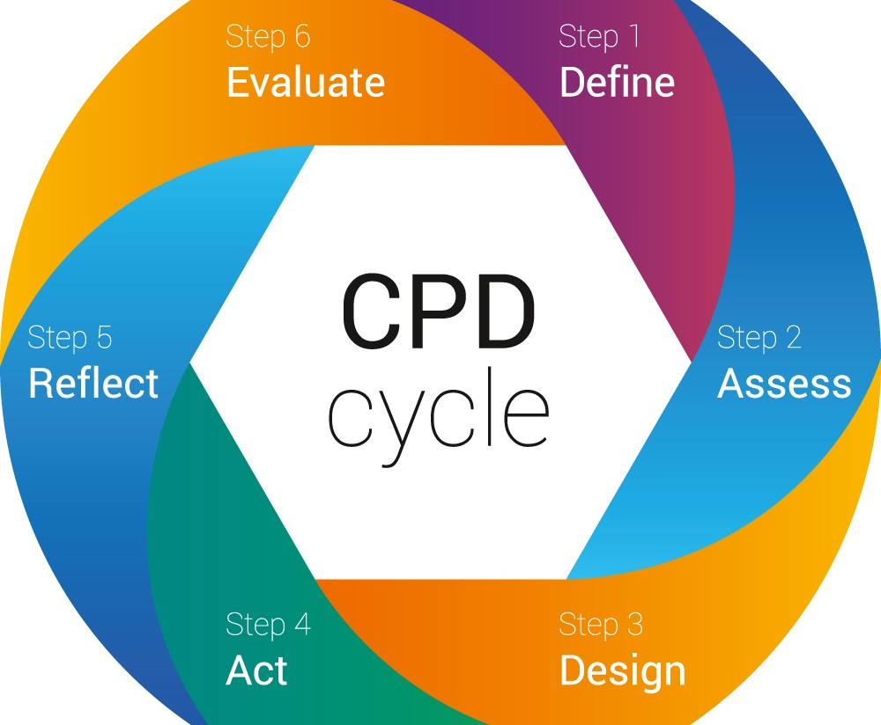
CPD Opportunities
Decision logs can inform CPD
Engage with local chamber of commerce and business gateway events
Standardisation process can identify both individual and centre development
Engage with current news and events
Remember you are also a consumer!

Slide 20
Resource Links
Retail Strategy for Scotland
https://www.gov.scot/publications/getting-right-change-retail-strategy-scotland/documents/
Retail Week and Retail Gazette for sector news and updates
https://www.retail-week.com/
https://www.retailgazette.co.uk/
Visit retailers own websites
Visit retailers social media channels
Offical Statistics https://www.ons.gov.uk/businessindustryandtrade/retailindustry

Slide 21
NPA in Events
Caroline Patterson
External Verifier – Events Management

Slide 22
Event Qualifications
NPA Level 4 – 4 credits
NC Events Co-ordination 5 - 12 credits
NPA Level 6 – 4 credits
HNC/D
Degree Events Management

Slide 23
Why choose a National Progression Award?
Most are only 4 credits in value so can be easily delivered as a column option
All units are ‘stand alone’ so pupils will achieve qualifications if not the whole award
Both the Level 4 and Level 6 NPAs in Events are easily accessible and have good progression opportunities
Good fit with the skills and knowledge
  Already in Bus Ed departments

Slide 24
NPA in Events
SCQF Level 4
No Formal Entry Qualifications
Practical introduction to formal Events Industry
Enhances and develops transferable skills
Content
  Assist with an Event or Hospitality: Intro to Events
  Skills for Customer Care
  IT Solutions for Administrators
  Digital Culture: Social Software

Slide 25
NPA in Events SCQF Level 6
More suited to S6 pupils – should have some previous qualifications at SCQF Level 5
Helps to develop theoretical and practical skills
Progression to HNC/D in Events Management
Content
  Event Organisation (SCQF level 6)
  Corporate Events (SCQF level 6)
  Events Costing (SCQF level 5)
Options
Marketing Mix/Basic Principles/Branding
or Travel and Tourism – all (SCQF level 6)

Slide 26
Benefits for pupils
Definite enhancement of skills which already exist for pupils who have undertaken Business or Admin qualifications
Can be integrated with other parts of the school curriculum ie Creative Arts, Sports/PE or Music
Develops employability and soft skills ie team working, reflection and evaluation of own strengths and weaknesses

Slide 27
Going for Approval – Hints and Tips
Submit timetabling of the course
Submit any materials used to inform pupils of the course
Submit some examples of formative materials for each unit that you will use
Be aware for the Level 6 award that Events Organisation and Corporate Events cannot be integrated unless the Centre is really running a
corporate event.

Slide 28
Delivery and Assessment
There are no hard and fast rules of how the units should be sequenced or delivered, though it might be easier to deliver the Event Organisation unit first as it would set in context the theory of Events.
A Portfolio (Event Manual) can be submitted for the Event Organisation unit with individuals submitting signed pieces of work
All Assessment is open book except for the multiple choice for Outcomes 1 and 2 in Corporate Events. This assessment is also available on Solar

Slide 29
Be aware of the Level the ‘Event’ is delivered at for SCQF 6 – why?
Assist with an Event – Level 4 | Basic, good for candidates to gain some team working – has an SQA ASP | Bake Sale Tombola Raffle Craft table Or being volunteers at a bigger event
Event Organisation – Level 5 | Embeds Working With Others at Level 4 hence some of the differences between this and Level 6 unit. Has an SQA ASP | As above more focussed could involve organising a guest speaker for the class or organising a lunch or coffee morning

Slide 30
Event Organisation – Level 6 All pupils need to be fully involved in the delivery of the event and have clearly defined role(s) ie Admin Marketing Legal Finance | Embeds Problem Solving at Level 5 – there is a ‘prior verified’ document on secure site but has a strong hospitality theme and does not cover all the knowledge and skills – so use with care | Could be Course specific conference Treasure Hunt – T& T Film/ book Review group Afternoon Tea for staff/charity Quiz afternoon Involves using team name/themes etc Selling tickets Donations

Slide 31
What minimum evidence should be available at Level 6
Group portfolio with PLAN and TIMELINE for the event and alterations that might need to be made over the course of the delivery of the unit to the plan
Evidence of each member’s roles and responsibilities
Minutes of team meetings
Risk Assessment
Venue Floor Plan
Budget/simple income statement/requests for resources
Copies of any booking forms
Running Order on the Day
Photos/videos/posters/social media marketing and promotion
Any customer feedback

Slide 32
Resource Recommendations and information for CPD
www.eventsbase.co.uk
Event Management Guide | VisitScotland.org
Our Recorded Webinars & Online Training | VisitScotland.org
Search Resources (ushare.education)
Solar - Events SCQF 6 (sqasolar.org.uk)
YouTube – videos on organising events
Variety of good textbooks available – depends
on level of delivery

Slide 33
NPA in Customer Service (SCQF level 4,5 &6)
Andrew Calder – Senior Qualifications Verifier

Slide 34
National Progression Awards (NPAs) in Customer Service qualification at SCQF Level 4,5 & 6
Group Award Code: GP84 44, GP85 45, GP86 46
Each SCQF Levels comprise of 3 units
Communication Skills for Customer Service
Social Media for Customer Service
Customer Service : Product and Service Requirements
- Practical communication skills
- Focus on employability skills
- Knowledge of how to engage with customers using social Media

Slide 35
Specific aims — SCQF level 4
Develop practical customer service skills and knowledge
Develop basic communication skills and skills in working with others
Develop basic knowledge and skills in the use of social media for customer service
Specific Aims for each SCQF Levels

Slide 36
Specific aims — SCQF level 5
Develop practical skills and knowledge in delivering customer service through social media
Develop skills and knowledge required for dealing effectively with customer needs, including customer dissatisfaction
Develop enhanced communication skills and skills in working with others
Develop research skills and an awareness of the importance of product knowledge in meeting customer needs
Specific Aims for each SCQF Levels

Slide 37
Specific aims — SCQF level 6
Investigate the theory of communication in relation to customer service
Develop good communication skills using various methods of communication and enhance listening, clarifying and summarising skills
Evaluate the use of advanced technology in the delivery of customer service through social media
Develop an understanding of the importance of product/service knowledge in meeting and exceeding customer need
Specific Aims for each SCQF Levels

Slide 38
Thank You Questions?

