Slide 1
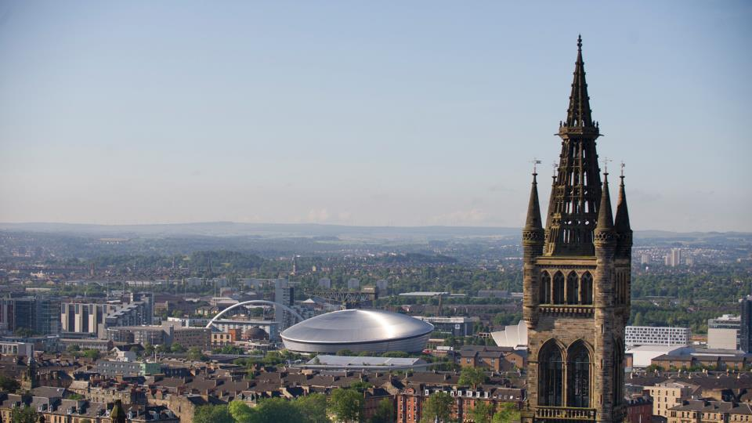



Studying Life Sciences at the University of Glasgow
Dr Chris Finlay: Level 1 Biology Coordinator & Senior Advisor of Studies
Chris.Finlay@glasgow.ac.uk

Slide 2
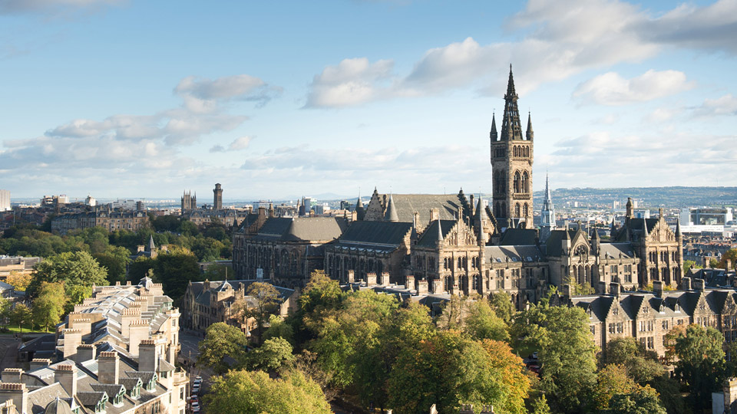
Life Sciences degrees
BSc (three years)
BSc Honours (four years) – Most Common
MSci Honours (five years)
  Integrated Masters degree – an advanced undergraduate degree which includes a one year research-based work placement, taken in Year 4 of the 5-year structure

Slide 3
Life Science at Glasgow
There are currently 4 degree groups encompassing over 20 degree choices:
Animal Biology Group
Level 1 Biology is designed to introduce students to content focussed on each group
Level 2 Biology will continue in more depth
Biomolecular Sciences Group
Human Life Sciences Group
Infection & Immunology Group

Slide 4
Life Science at Glasgow
Animal Biology:
Marine & Freshwater Biology
Zoology
Biomolecular Sciences:
Biochemistry
Genetics
Molecular & Cellular Biology (with Biotech or Plant Scence)

Slide 5
Life Science at Glasgow
Human Life Sciences:
Anatomy
Human Biology / Human Biology & Nutrition
Neuroscience
Pharmacology
Physiology
Physiology & Sports Science / Physiology, Sports Science & Nutrition
Infection & Immunology:
Immunology
Microbiology

Slide 6

Flexibility of choice
Flexibility of Choice
When entering the School of Life Sciences – all degrees are available to you.
Your degree subject is not fixed until your third year
Animal Biology Group
Biomolecular Sciences Group
Human Life Sciences & Sports Science Group
Infection & Immunology Group
Notes:
2010-2011 – 1st year Science students selected 347 different subject combinations

Slide 7
Level 1 Biology
1st Year / Level 1 Biology
A typical First Year Curriculum:
Semester one:
Biology 1A
Chemistry 1 OR Science Fundamentals 1X
Optional Course
Semester two:
Biology 1B (semester two)
Chemistry 1 OR Science Fundamentals 1Y
Optional Course
Common optional courses:
Psychology
Environmental Biology
Current Directions in Life Sci
Geography / Earth Sci
Maths / Statistics
Physics
Languages
Computing Science
Exploring the Cosmos
Notes:
There is a large variation in current biology experience across the class. The courses are designed to give everyone new skills and experience

Slide 8
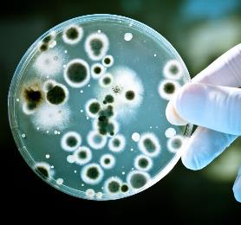
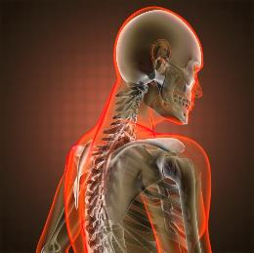
Level 1 Biology – Biology 1A
Biology 1A
1st Semester:
introduces students to cellular systems, both at the unicellular and multicellular level.
Notes:
A comparative investigation of these biological systems highlights the specialisation and variation across organisms.

Slide 9
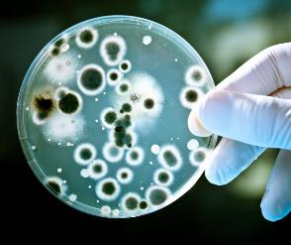
Level 1 Biology – Biology 1A
Biology 1A
There is a weekly lab and lecture series, building week on week:
Unicellular
Lectures:
Cells & Model Systems, Parasitology,
The Immunological Armoury,
Microbiology, Virology, Prokaryotic Life
Labs:
Microscopy, Cell Motility, Diagnosis of Infectious Disease

Slide 10

Level 1 Biology – Biology 1A
Biology 1A
There is a weekly lab and lecture series, building week on week:
Multicellular
Lectures:
Nutrition & Digestion, Circulatory System, Kidney Function, Nervous System, Ecosystems, Immunology & Infections
Labs:
Microscopy, Histology, Dissections (rat & Heart dissection), Skulls, Infectious Disease

Slide 11
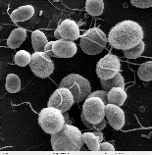
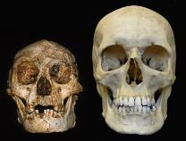
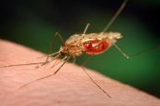

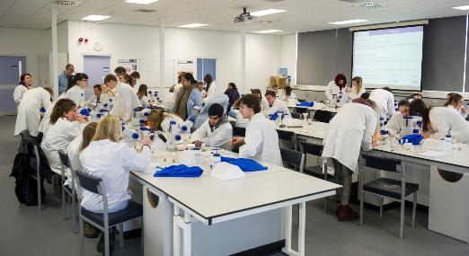
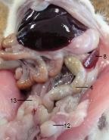

Level 1 Biology – Biology 1A
Biology 1A

Slide 12

Level 1 Biology – Biology 1B
Biology 1B
2nd Semester:
Introduces students to Biology at the molecular and cellular level.
Students carry out detailed investigations of the molecular, genetic and biochemical make-up of biological systems and organisms and relate these to real-life examples of disease, treatments and current research.

Slide 13

Level 1 Biology – Biology 1B
Biology 1B
There is a weekly lab and lecture series, building week on week:
Lectures:
Bioenergetics & Respiration, Photosynthesis, DNA, RNA & Protein Synthesis, Evolution, Genetic Development and Disease, Mammalian Reproduction, Genes & Gene Expression, Plant models, Bioengineering, Food production

Slide 14
Level 1 Biology – Biology 1B
Biology 1B
There is a weekly lab and lecture series, building week on week:
Labs:
Photosynthesis, Protein Structure & Function, Bioinformatics, Genetic Crosses, Mutant models (Arabidopsis), Genetic Disease & Profiling, Stem Cells & Reproductive Ethics

Slide 15
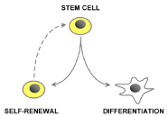
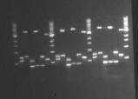

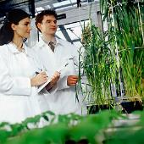
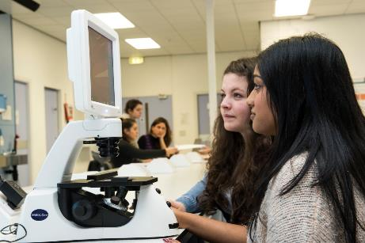
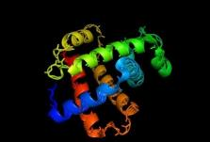
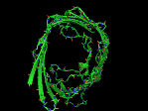

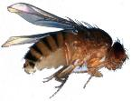
Level 1 Biology – Biology 1B
Biology 1B

Slide 16

Transition/ Direct Entry
Curriculum Matching
Content differences:
Genetic disease, diagnosis, treatment
Comparative physiology investigations
Stem Cells / CRISPR / Bioengineering
When to use model systems
Skills:
Microscopy – calibration and measurement / scale bars
Pipetting – consistency and accuracy
Tissue handling / dissection

Slide 17
Transition/ Direct Entry
Transitioning to HE
Some consistent experiences:
One student in a large class (~650-750 students)
‘Scared’ of maths, stats, data analysis
New assessment requirements (and new assessment scale)
Expected to pick up the new system and processes quickly
Unsure what their chosen degree actually involves
Peer assessment and peer scoring
A lot of students expect that any extra school support that they had will automatically roll over and be in place at the start of their undergraduate studies. It can be put in place but it is not automatic and the student has to trigger the discussion.

Slide 18
Transition/ Direct Entry
Transitioning to HE
Two things that deserve their own slide:
Unsure what specific word we look for in assessments (we don’t look for specific words – this really unsettles a lot of students)
Data analysis – especially when there are multiple, valid ways to interpret the same data

Slide 19
Transition/ Direct Entry
Transitioning to HE
Support:
Skills labs and lectures, e.g. scientific writing, exam preparation etc.
Group work and presentations
On-line quizzes (both for revision and for coursework)
Peer support activities
Biology Teaching Centre
Effective Learning Service
Adviser of Studies
All designed to prepare students for Level 2.

Slide 20

Study Abroad
Study Abroad – 2nd year preferably
Erasmus - Europe
13 universities in 9 European countries to choose from
3 -10 month programmes
Erasmus grant / language tuition available
International opportunities include:
Australia, Canada, Hong Kong, Japan, Korea, New Zealand, Singapore, USA, Central & South America.

