Slide 1
Teaching anthropology in secondary school in the UK

Slide 2


Slide 3
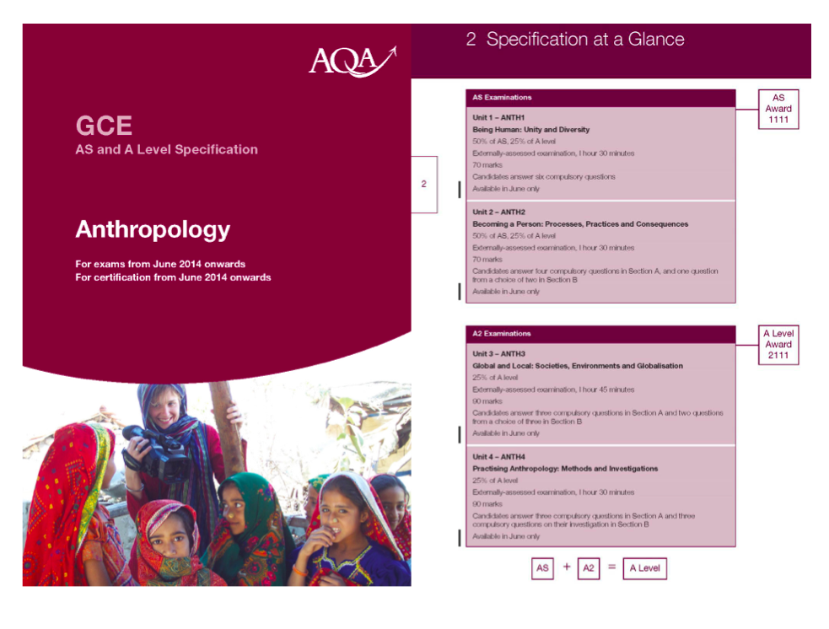

Slide 4

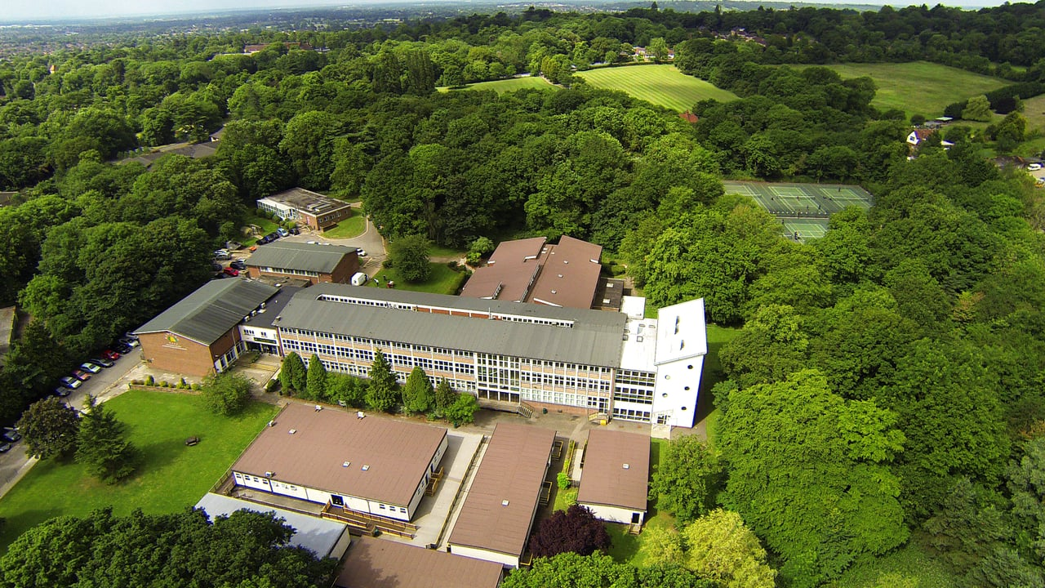

Slide 5

All girls secondary academy school in Stanmore Harrow, North West London
Some of our students have refugee status and come from countries such as Somalia, Afghanistan and Pakistan.
70.3% of our students do not have English as their first language and speak a variety of other languages at home, nationally it is 15.7%.
There are 56 different home languages spoken at Bentley Wood
Range of humanities subjects offered (Anthropology, Sociology, Government and Politics, Psychology)

Slide 6
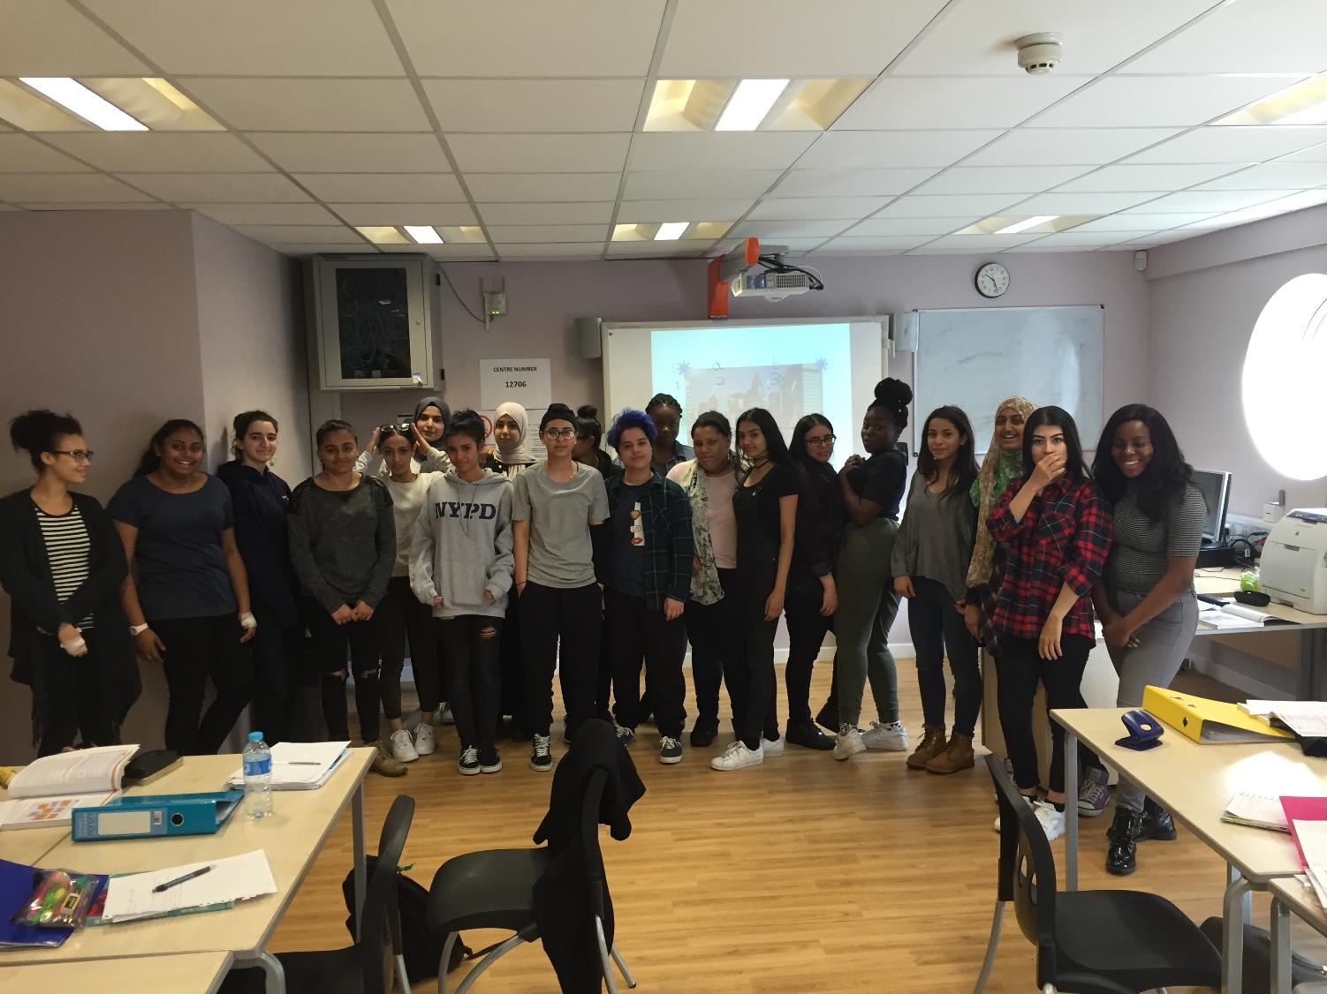

Slide 7
How do we learn?
Experiential learning
Anthropological theories and concepts through reflexivity and Personal Investigations
Visiting British Museum, Pitt Rivers Museum in Oxford, Zoo, Anthropology departments at Universities
Link with Brunel University
Visiting anthropologists talking about their fieldworks
Attending Royal Anthropology events
Anthropology A level conferences
In classroom: Role plays, displays, presentations, filming, watching ethnographies, photography, Zoo, charity events, dance, food, clothing, personal histories

Slide 8
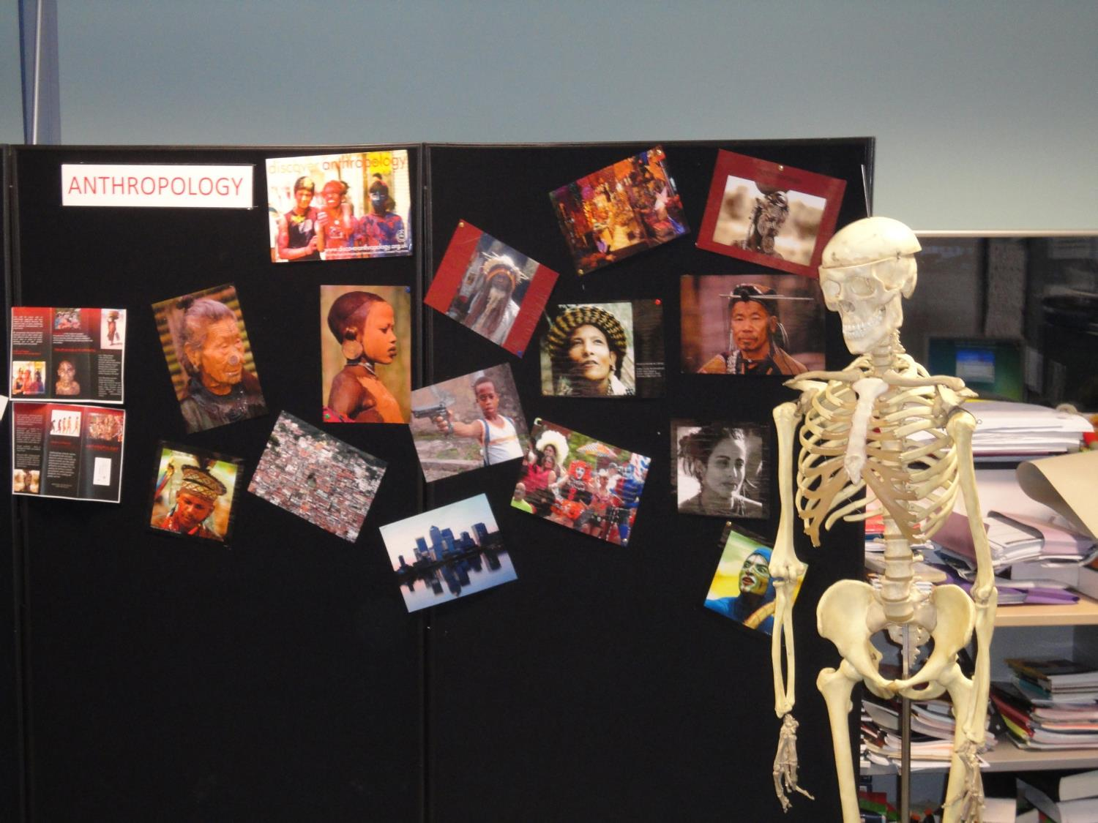
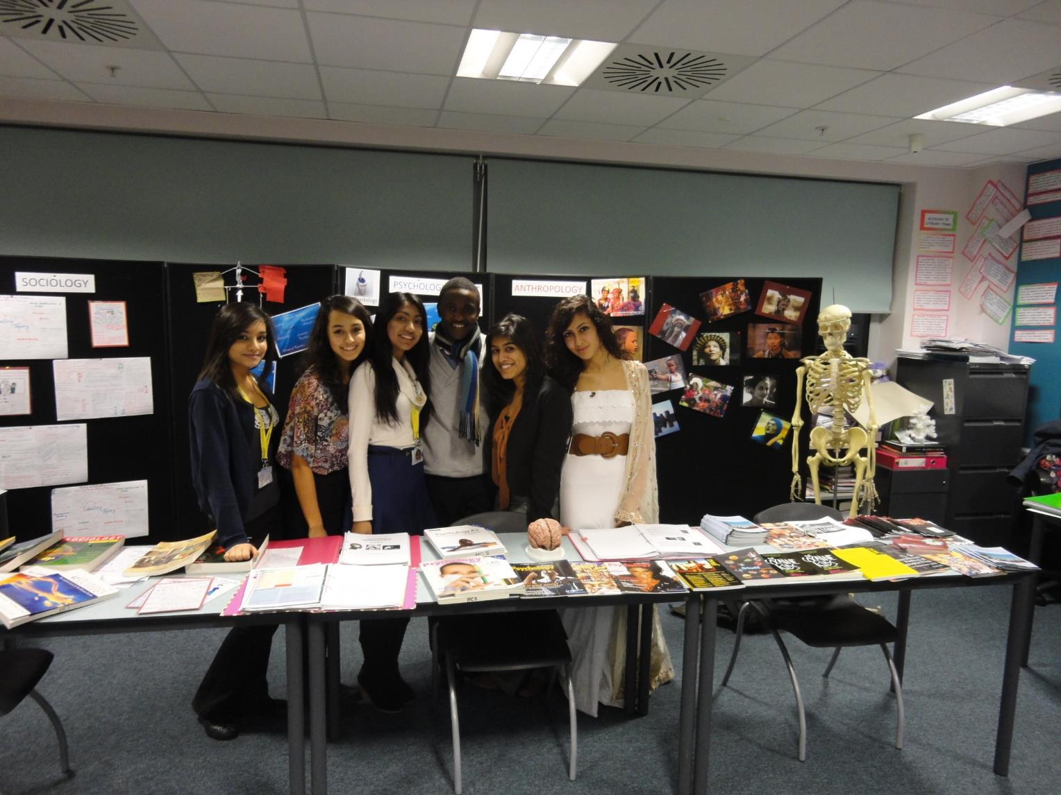

Slide 9
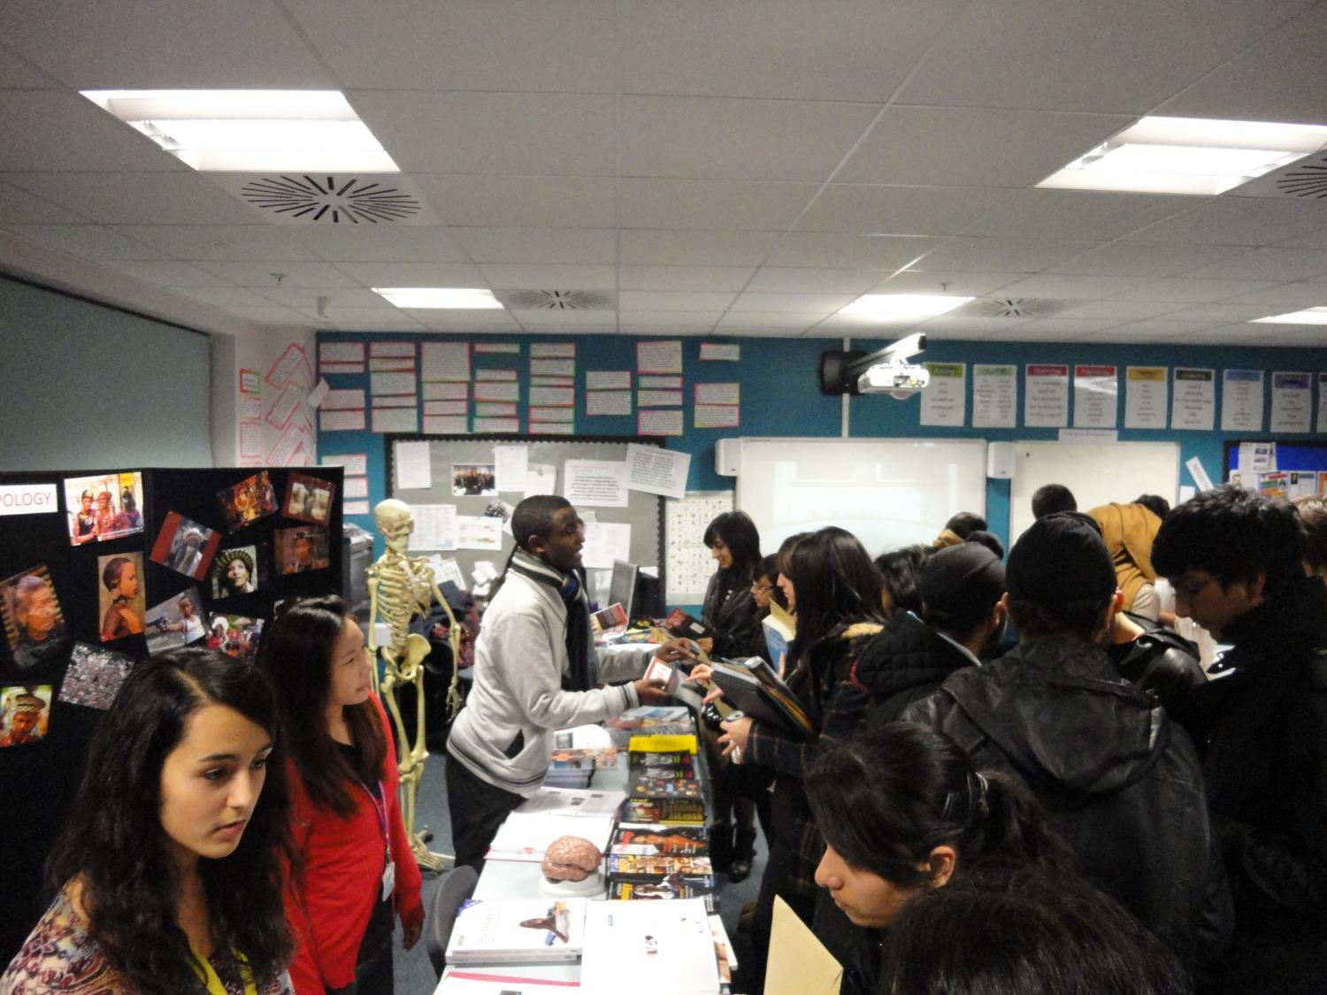

Slide 10
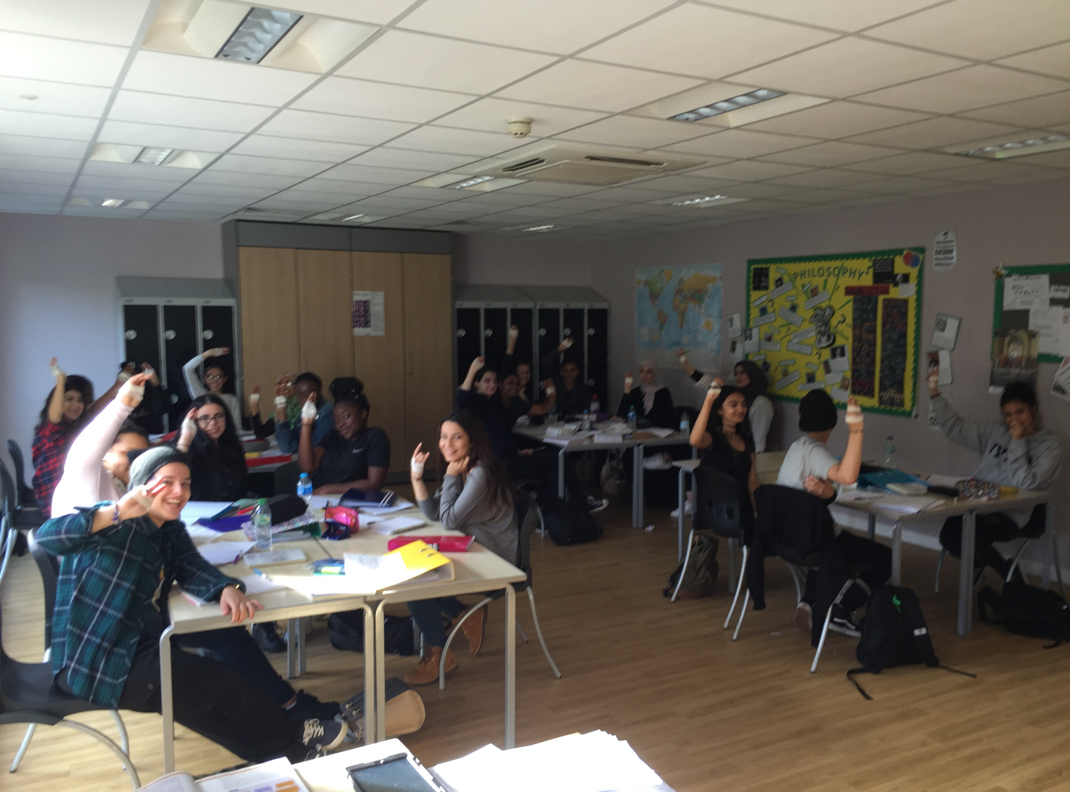

Slide 11
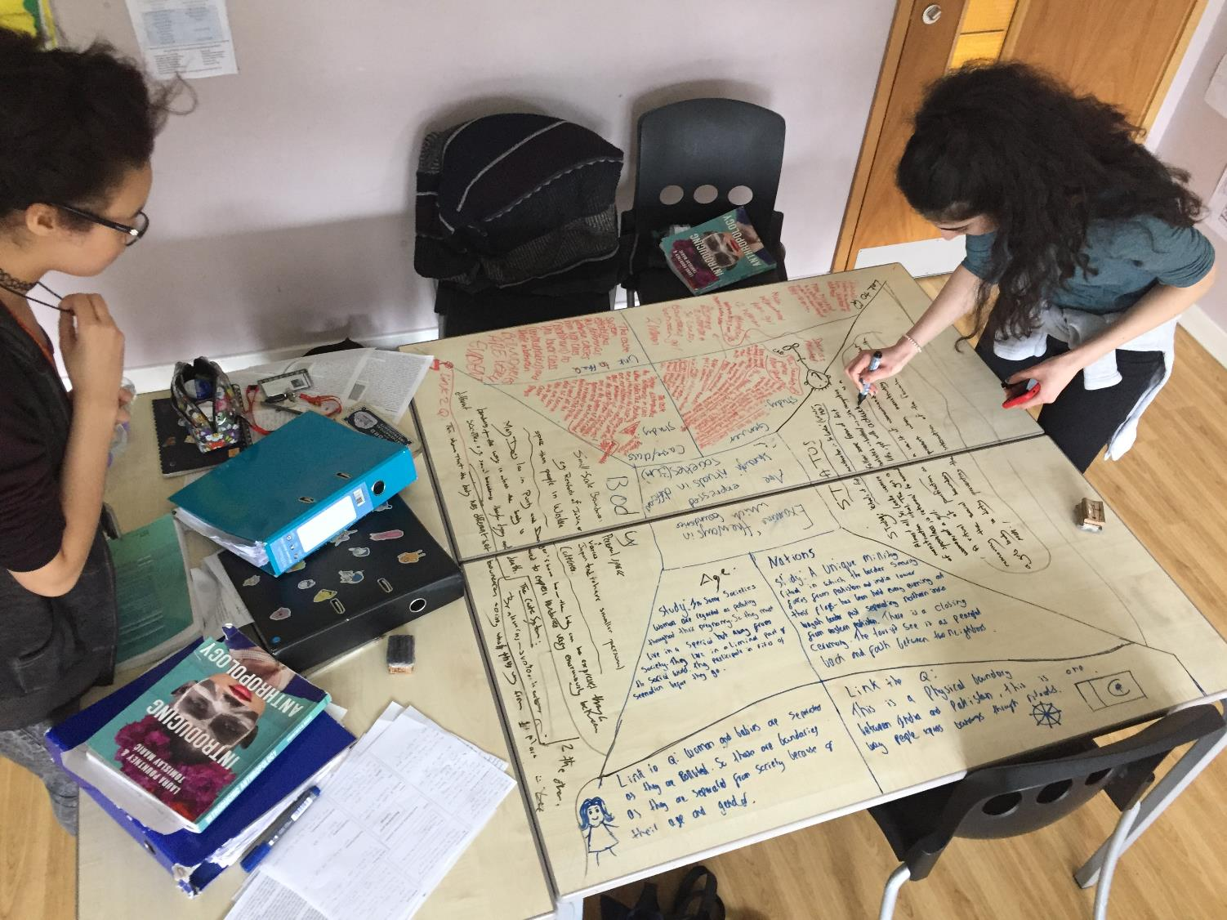

Slide 12
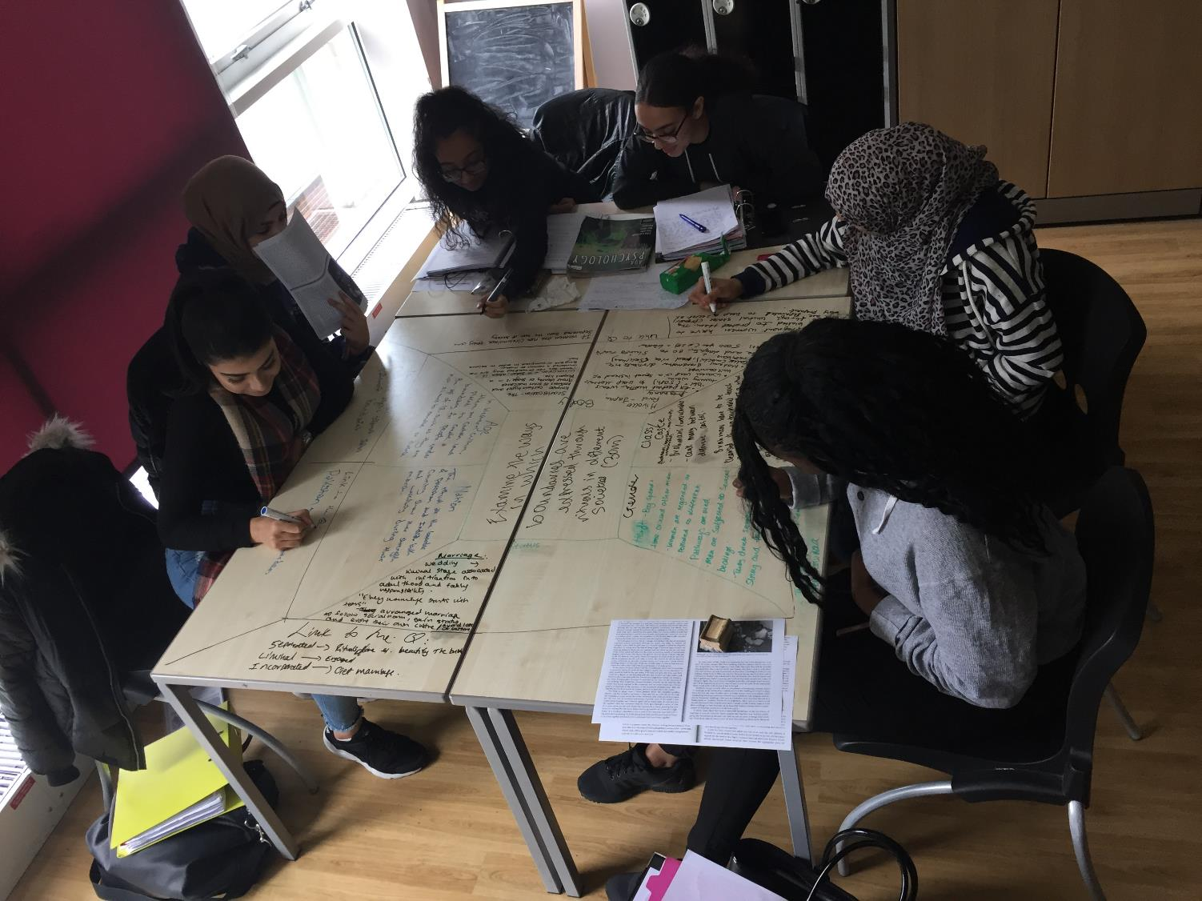

Slide 13
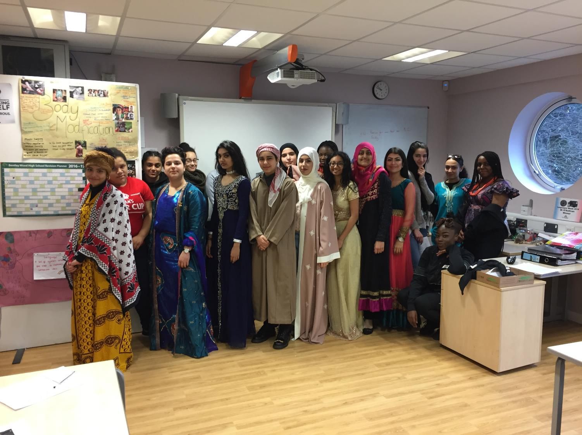


Slide 14
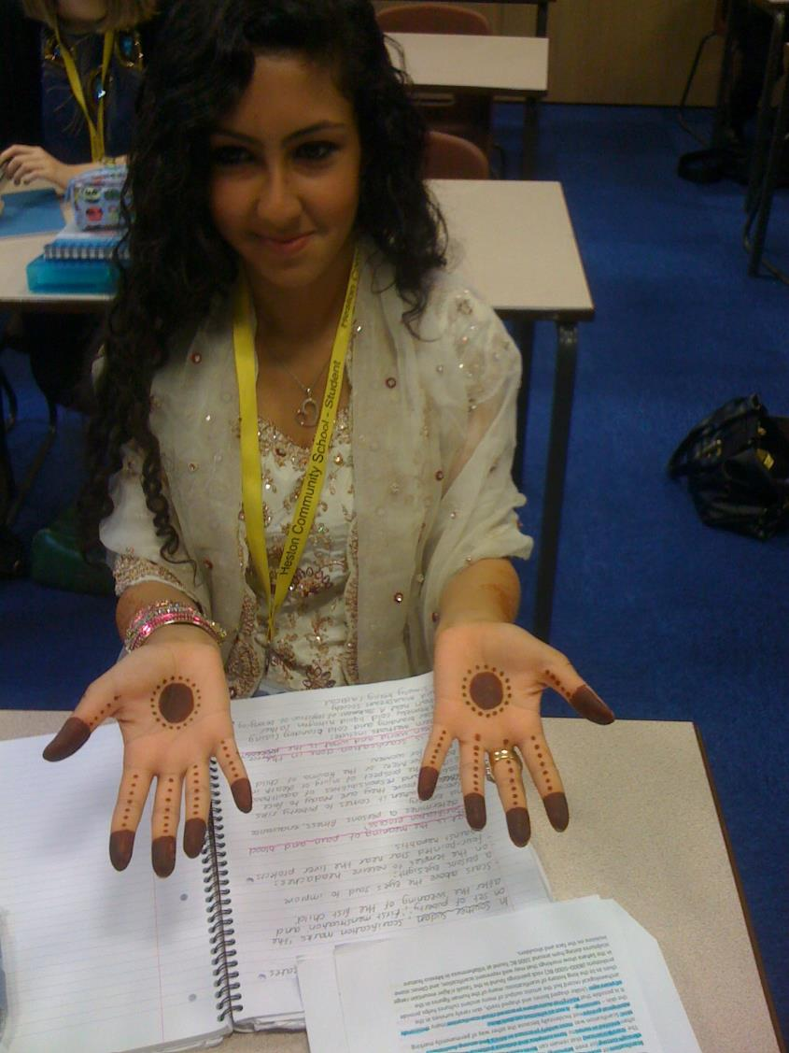

Slide 15
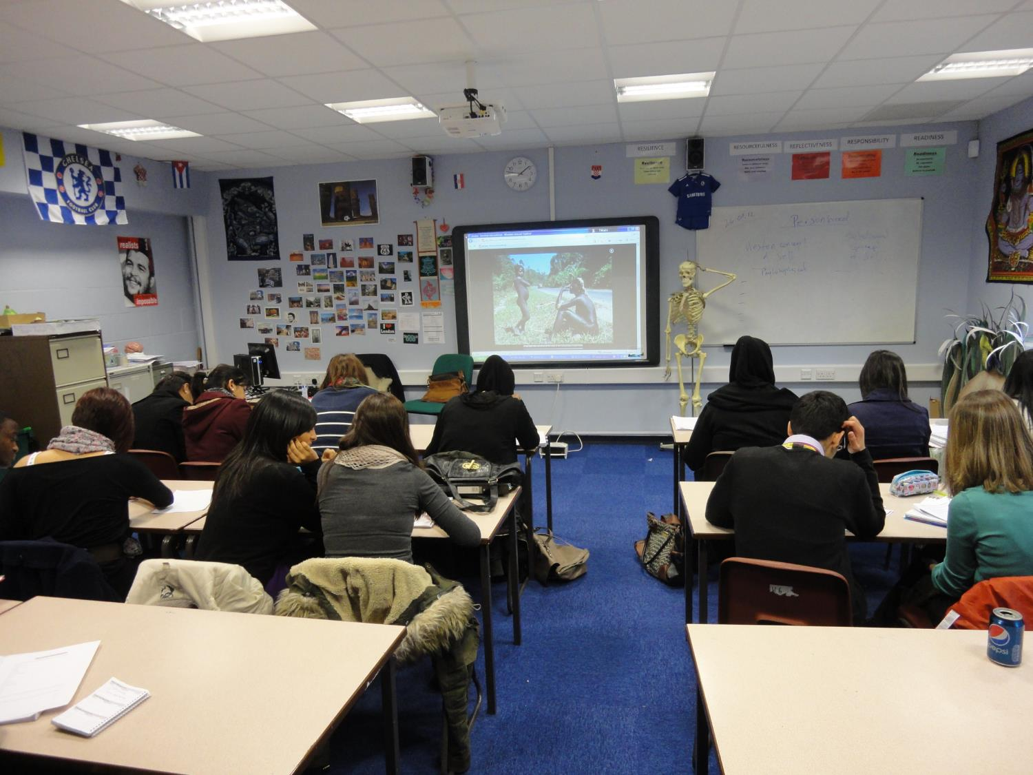

Slide 16
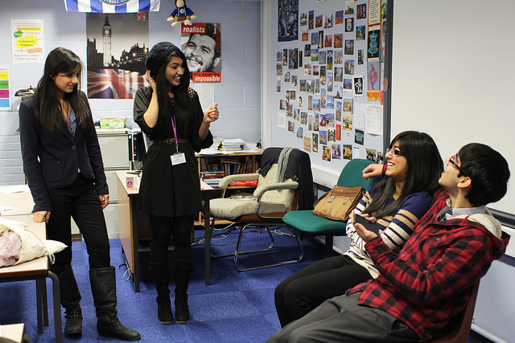
Role Play - polygamy

Slide 17
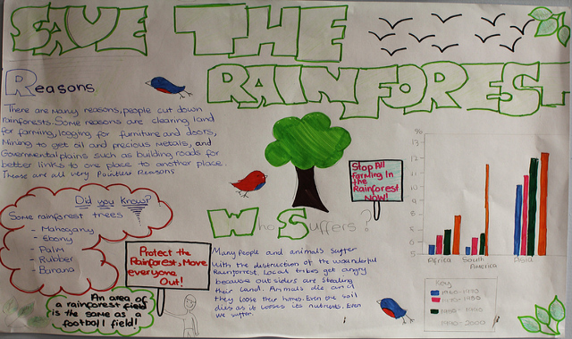
Globalisation - displays

Slide 18
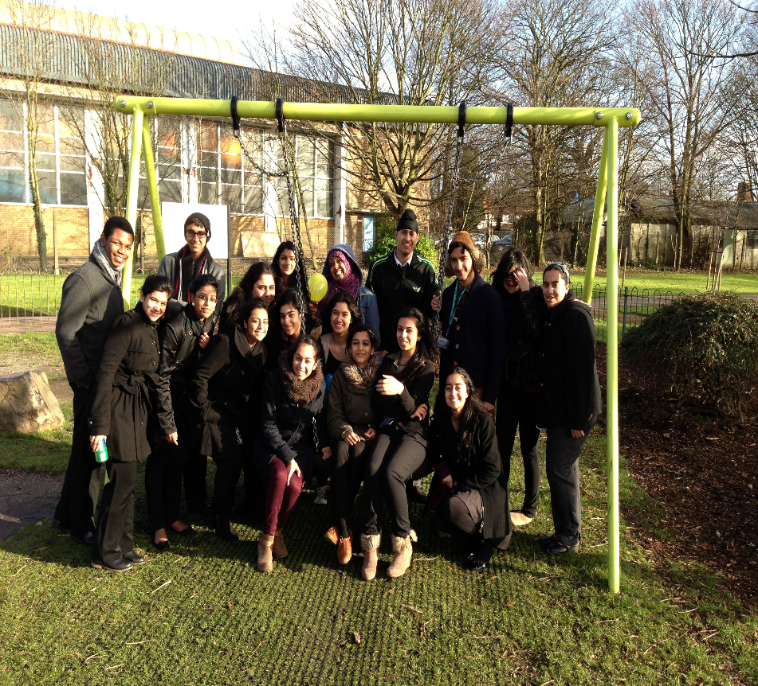
Studying boundaries in local community

Slide 19
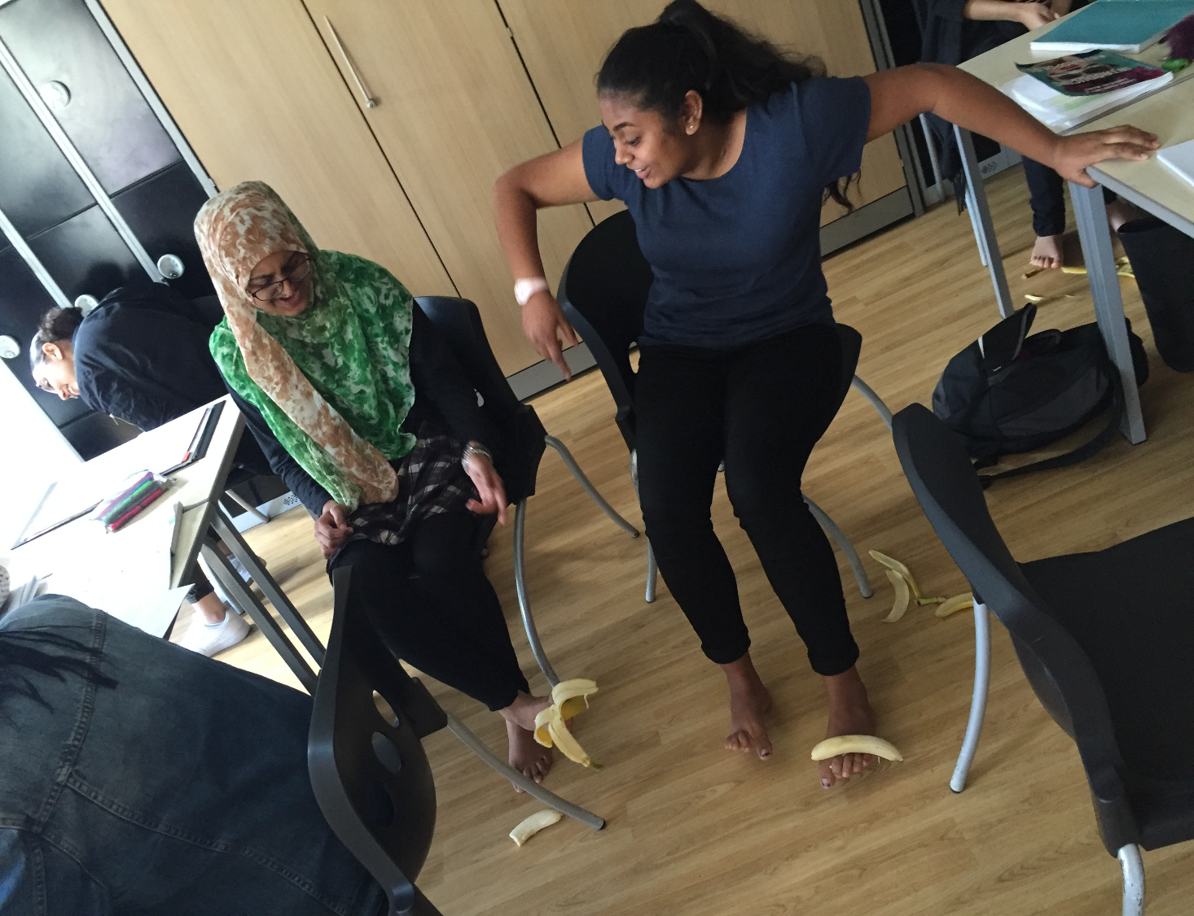

Slide 20
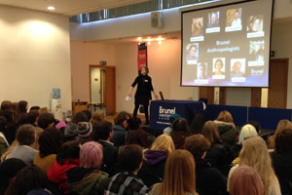
Brunel University A level Anthroplogy conference

Slide 21
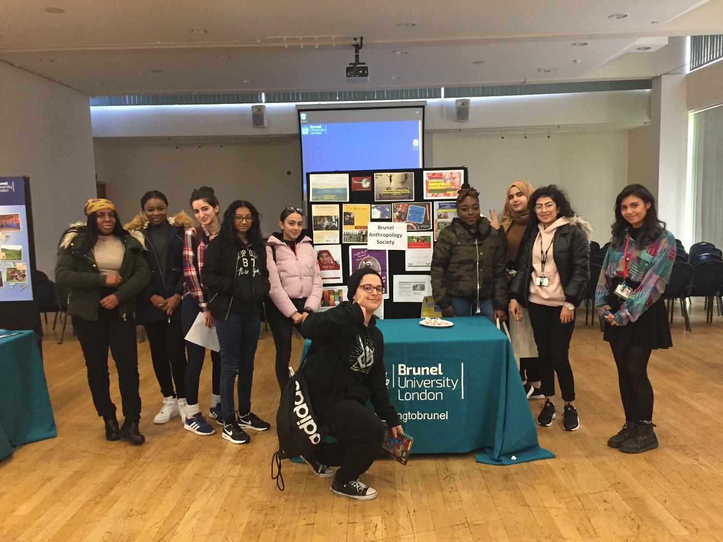

Slide 22
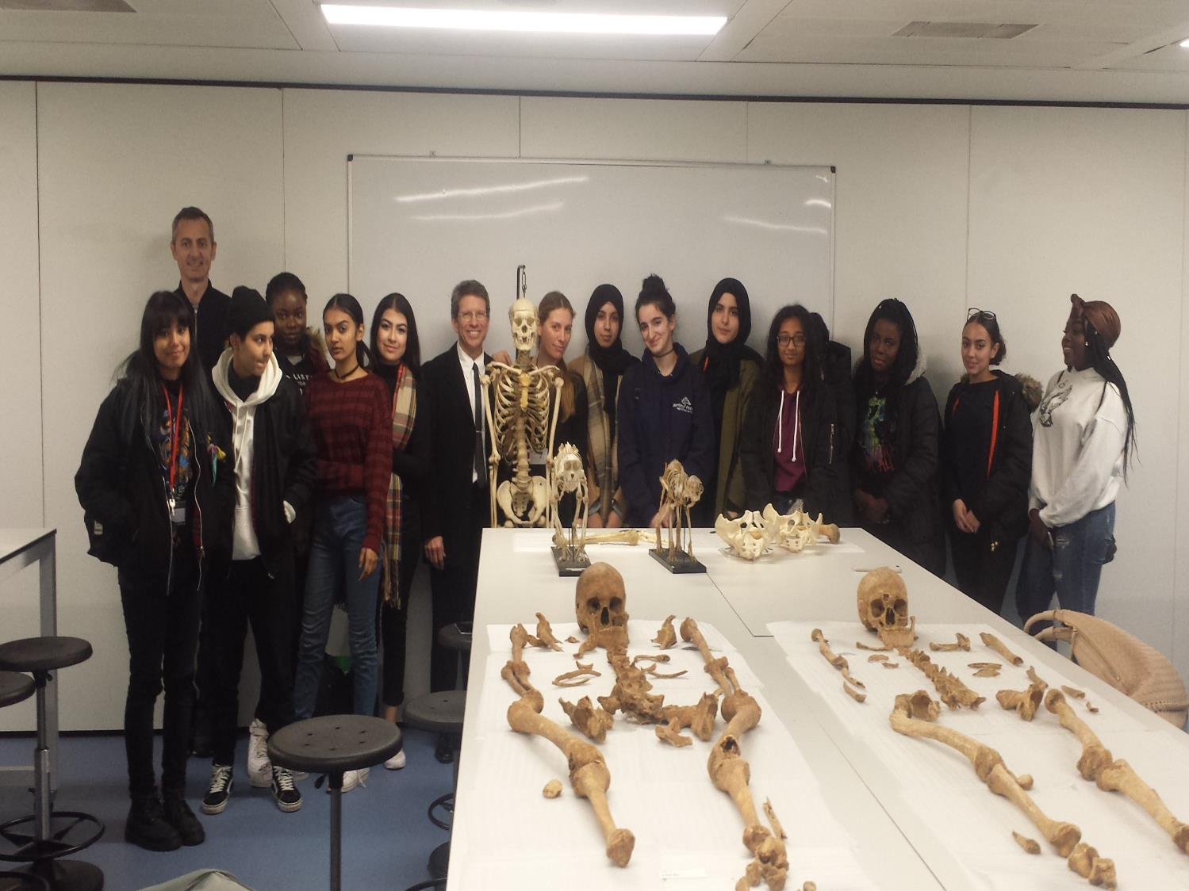

Slide 23
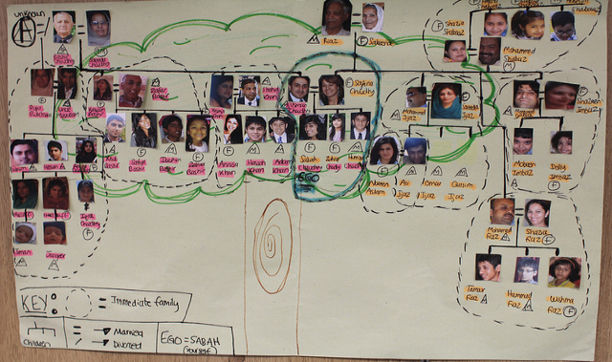
Kinship – Who do you think you are?

Slide 24
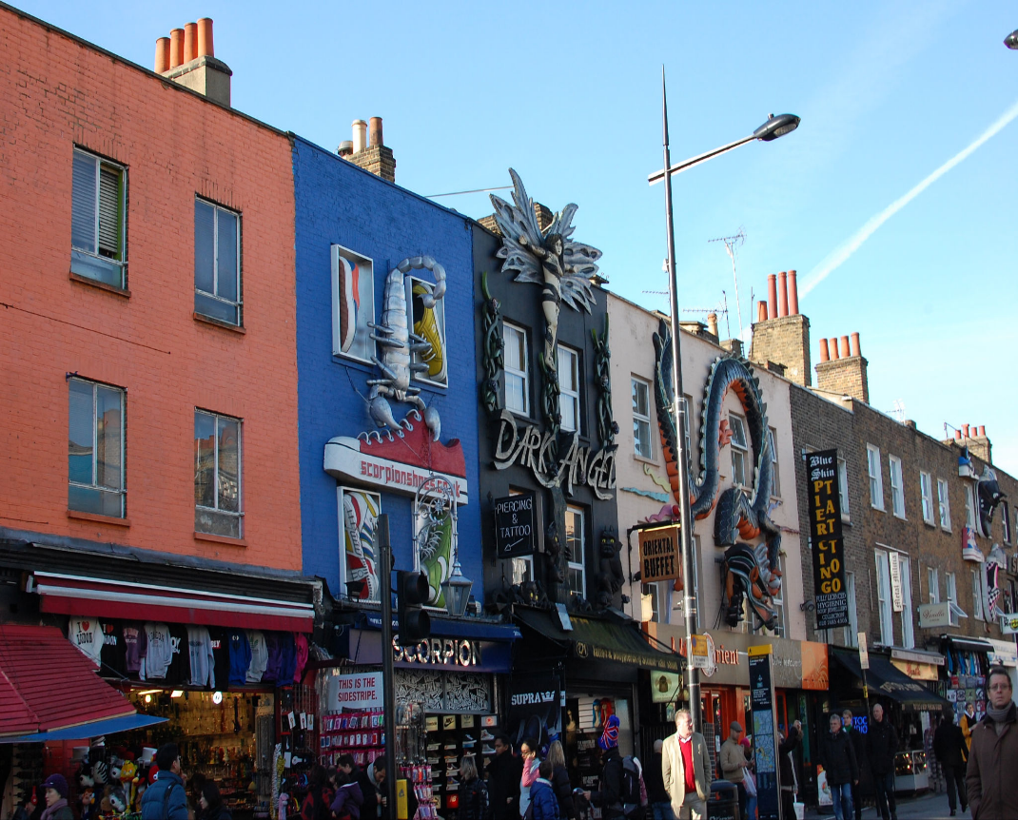
Interviewing at Camden market, London

Slide 25
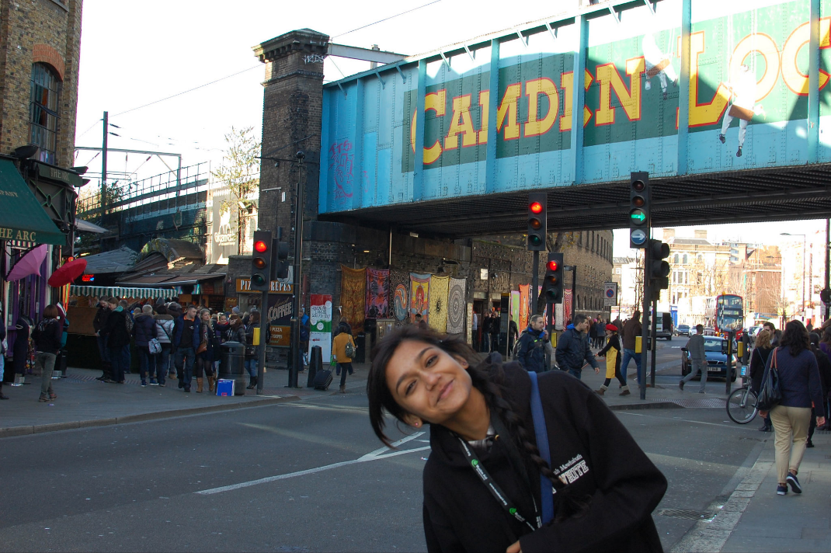

Slide 26
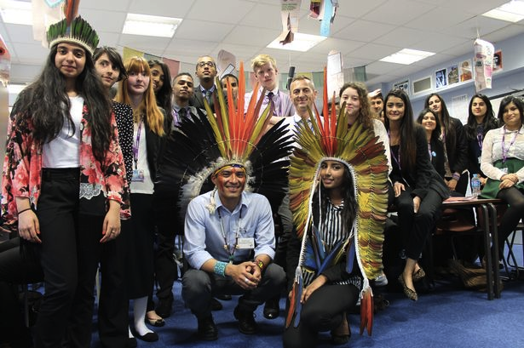
Nixiwaka Yawanawá, an Amazon Indian, talks to pupils about the plight of the Awá tribe in Brazil

Slide 27
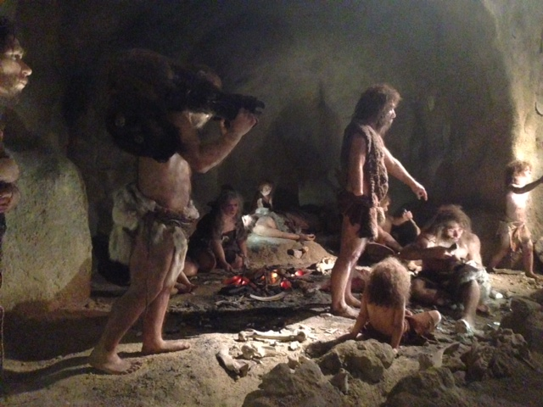
Krapina Neanderthal museum Croatia

Slide 28
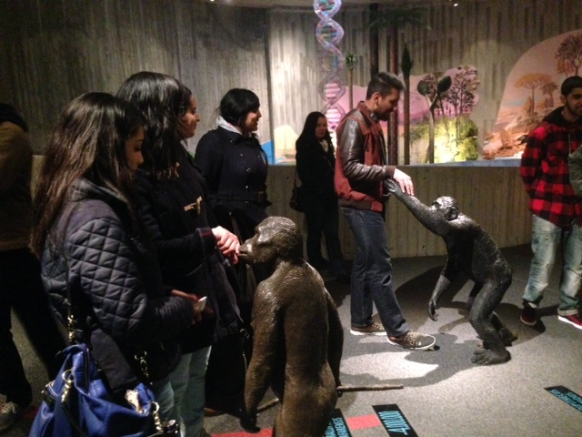

Slide 29
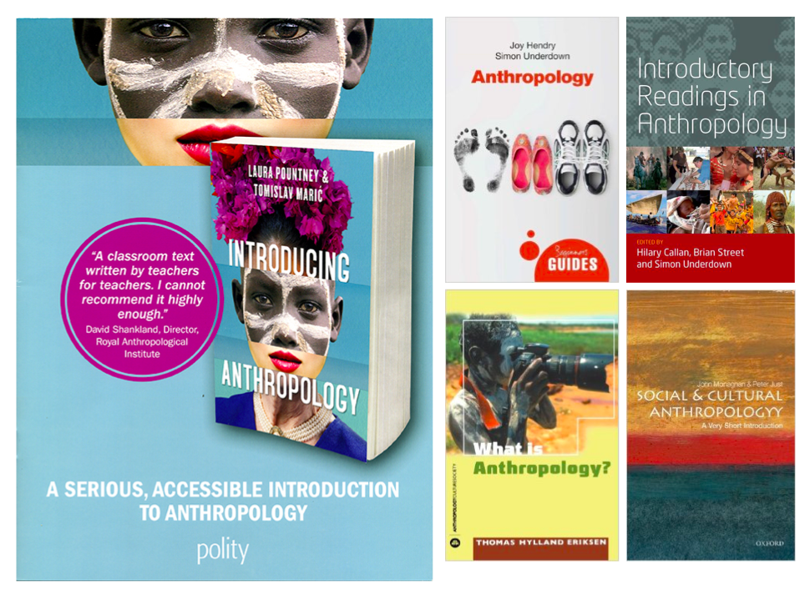

Slide 30
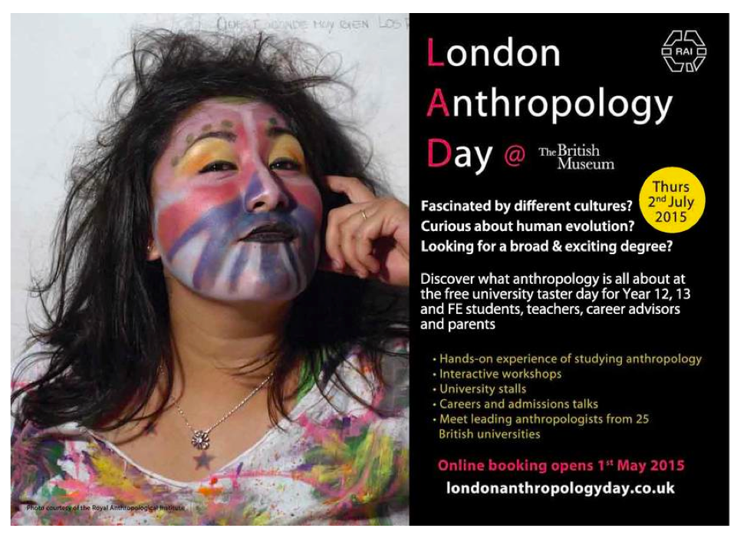

Slide 31
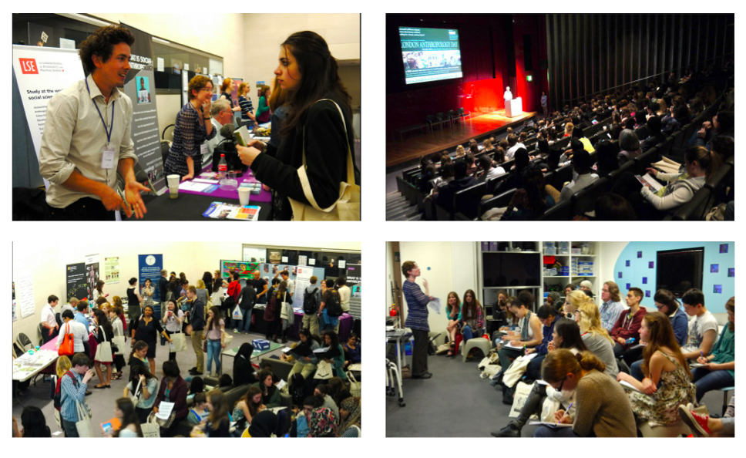

Slide 32
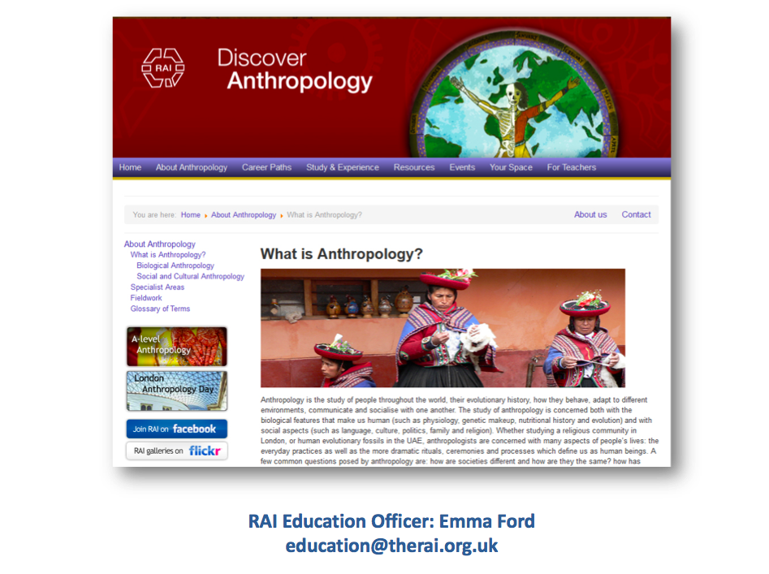

Slide 33

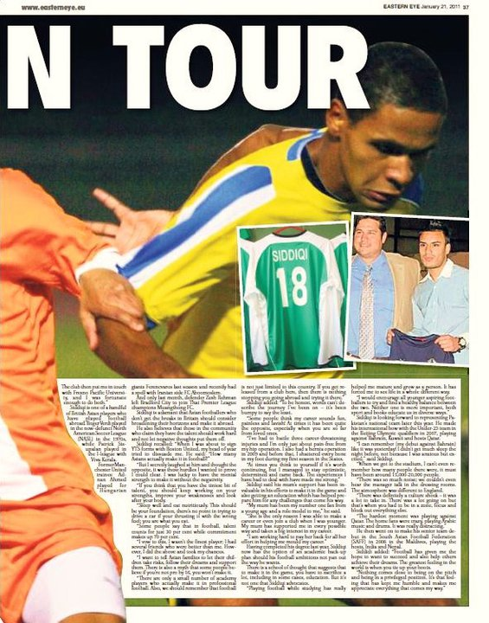
Personal investigation
Studying Hybrid Identity with British Asian footballer Kashif Siddiqi, to see the extent to which identity is distinct or fluid

Slide 34
Example of students presentation – fieldwork issues
Your school is funding you to travel to South America and conduct anthropological fieldwork. You are going to visit a people called the Yanomamo who live in the rainforest of Venezuela. There is no electricity, mobile phones or any modern technology in their village. The nearest town with a hospital, shops and electricity is 200 miles away. The only way you can reach this community is by boat. It takes 5 days to reach the community from the nearest town. You are travelling on your own. You have to stay there for a period of 3 months, where you will conduct a participant study to find out: ‘What is the Yanomamo relationship with nature?’
Plan your journey and explain the issues that you might encounter before, during and after your fieldwork. Consider practical, ethical and theoretical issues before you go, such as:
Before the journey: What do I need to take with me? Food? Medicine? Money? How to get there? Planning the journey?
During the stay at this village: How do I communicate? How do I find relevant information? What if I make a mistake? How do I record the information?
After the journey: How do I leave the community? How do I write the report? What about my own views and beliefs? How do I represent this community?

Slide 35
Benefits of teaching anthropology to pre-university students
Ties in well with equality and diversity agenda
Accessible
Global
Holistic
Fun
Interactive
No set ‘body of knowledge’

Slide 36
The A-level has been playing an increasingly important role in raising public awareness of anthropology
a high proportion of students who took the A-level were choosing to pursue anthropology at university
new career opportunities for teaching anthropology were opening up
many young people (including those who didn’t take the A-level themselves) were being introduced to the discipline and its unique perspective on contemporary issues

Slide 37
How and why do students chose anthropology
An Introduction to A-Level Anthropology
http://www.youtube.com/watch?v=gR6kJk8n1DA

Slide 38
Students presentation at the end of the year
This exercise was designed to asses students knowledge and understanding of anthropological concepts and theories and to make a synoptic link between topics form both unit 1 and 2.
Students have to chose one ethnic group/culture, conduct research and present it to the rest of the class. They had to use a specific themes such as gender differences, ways of thinking, rituals, engaging with nature, social organisation, rituals, globalisation impact etc.

Slide 39
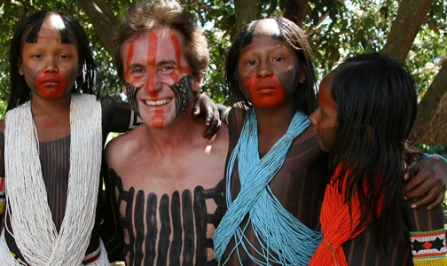
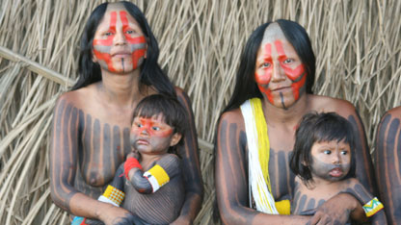
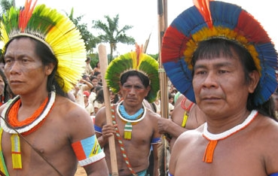
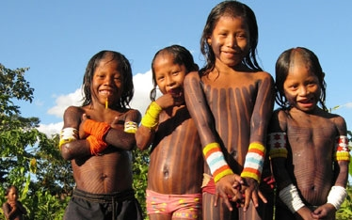
The Kayapo

Slide 40
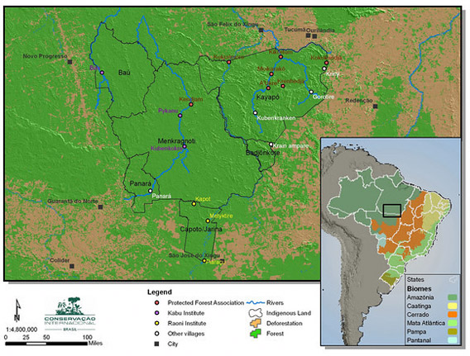
Who: The Kayapo although this is not their actual name, it was given to them by neighbouring tribes meaning ‘those who look like monkeys’.
They call themselves Mebêngôkre, which means "the men from the water hole/place."
Where: plain lands of the Mato Grosso and Pará in Brazil

Slide 41
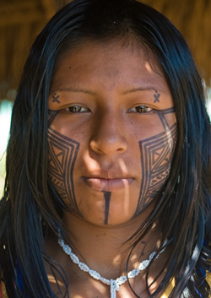
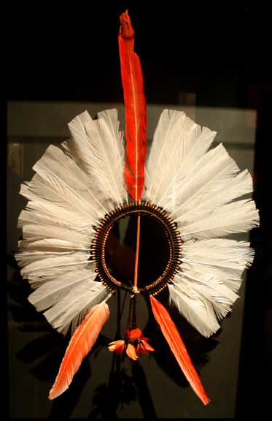
Folklore (Ways of thinking)
The Kayapos believe their ancestors learned how to live communally from social insects (bees) - why mothers and children paint each other's bodies with patterns that look like animal or insect markings (unit two personhood, social memory)
The Kayapo headdress with feathers radiating outward represents the universe. Its shaft is a symbol for the cotton rope by which the first Kayapo, it is said, descended from the sky.

Slide 42
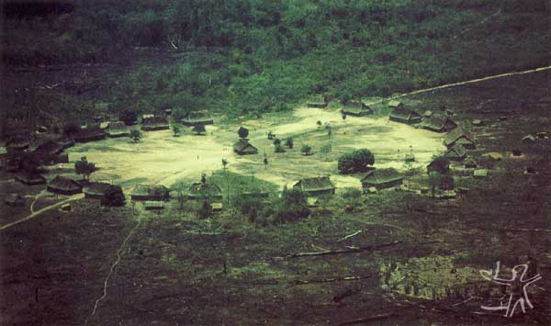
Ways of thinking
Kayapo fields and villages are built in a circle to reflect the Kayapo belief in a round universe. The centre of the world is represented by the central hut, where male political meetings take place and rituals begin. Their homes are then arranged in a circle around this. Between the homes and the central hut is a circle of dry land where they dance and have their ceremonies.

Slide 43
Social organisation
The circle of houses is women’s territory, essentially directed towards ‘female’ concerns. Associated with taboos, the life cycle, kinship and the bonds of formal friendship.
The centre of the village has two parts: the plaza, where most of the public activities unfold, and the men’s house.
The centre - male - activities typically reserved to men – meetings, discourses, and the performance of public ceremonies and rituals
The nuclear family - extreme sense of closeness. If any member of the family does something wrong in the community, it is strongly reflected back into the family as a whole. Well being, injury.
The Kayapó are monogamic. When a man marries, he leaves the men’s house to live under his wife’s roof. Women, for their part, never leave their maternal residence.
Men are allowed to take multiple wives

Slide 44
Gender differences
Patriarchal society - women's place is to have children and prepare body paint for the men
Men have certain privileges that women do not, such as the right to enter the central hut in the villages where business is conducted (Popovic 2011)
Weakness = feminine, reflects dominance in male society
Everything a woman does is seen as less than anything a man does – every task seen as secondary – men are providers
Men do little in raising their children – women’s job, allows me to exert power over women (Turner 2003)
However not all men are equal – elders have more power over younger men – gerontocracy

Slide 45
Female Tasks
The society recognizes a division of tasks based on sex – unit two gender roles
Producing high calorie food
Cultivating crops e.g. sweet potato, maize, sugar cane, bananas, some tropical fruits, cotton and tobacco
Monotonous.
Few times during the year, small groups of women go to the forest to gather wild fruits and palm oil.
When the women are not working in the swiddens, they collect fruits and firewood.
The rest of the time is spent inside or close to the house, where they weave, look after their children or prepare food

Slide 46
Rituals and ROP
Ceremony and ritual is an important part of life.
Kayapo believe that by dancing, they are able to go back to a time of mythical origins, and in so doing, recreate the energy and drive they need in order for life to continue.
When they create a new swidden (crop field) a dance is conducted similar to a give a war dance. Symbolising the war between them and nature.
The Kayapó ritual complex consists of a very particular language:
The rites express the values of the society
Reflect the image the group has of itself, the society and the universe. (identity)
Establish a link between man and nature, in which above all the human-animal relationship is reinforced.

Slide 47
The naming ceremony
Huge honour and production.
The family of the child or children being named must prepare food for the entire village for the day of the ceremony.
Involves days of hunting, gathering, gardening and an enormous amount of cooking in preparation
Days of dancing and singing in the Kayapó language.
Held in high regards by the people and must follow certain procedures as illustrated by Fisher “the ornaments that may be used are specifically defined, as are the order of the proceedings, the sequence of dances, positions of the dancers, and point of origin within the village at which the dance sequence originates and ends.” (Fisher, 2003:120)

Slide 48
The naming ceremony cont’d
Personal names are borrowed from nature. Shamans contact natural spirits which teach them new songs and new names for people to borrow. The songs are also borrowed from the natural world.
During a naming ritual, a child is placed in a position of extreme weakness.
At the start of the ceremony, they are considered unfinished beings.
They are then put through an intense process of socialisation by the means of body painting, dawning intricate ornaments, ritual dances, and finally by being assigned a natural name.
At the end of this process the child is considered a whole human being.

Slide 49
Ways of engaging with nature
The Kayapo are known as a warrior Indian tribe and now, more than ever, they're having to fight to preserve their land as cattle ranchers encroach further and further into Indian territory to make way for pasture. (anthropocentrism)
http://www.youtube.com/watch?v=FrAkd8Ee5so

Slide 50
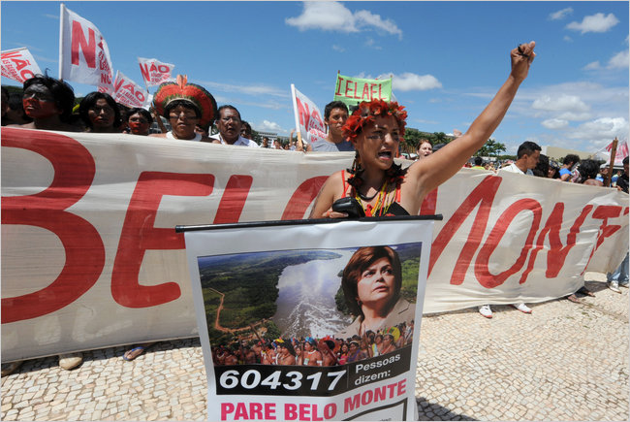
Belo Monte Dam
Brazil's president, Dilma Vana Rousseff, has authorised the construction of a dam that will flood the Kayapo homeland.
It will flood 400,000 hectares of the world's largest rainforest, displacing 20,000 to 40,000 people – including the Kayapó.
http://www.youtube.com/watch?v=umM6z5r2wEs&feature=relmfu
http://www.youtube.com/watch?v=HvbOTrczxAA&feature=related
http://amazonwatch.org/news/2012/0213-urgent-chief-raoni-and-the-kayapo-under-attack

