Slide 2
Understanding Standards Higher Politics:
question paper 1

Slide 3
What this presentation covers
Review the marking grid for the 20-mark extended response question.
Examine the application of this for the allocation of marks to candidate scripts.
Review the marking grid for the 12-mark extended response question.
Examine the application of this for the allocation of marks to candidate scripts.

Slide 4
20-mark extended-response question
2019 question paper 1
Q3 (b)
Traditional grassroots campaign strategies have a much greater impact on the electoral performance of political parties than the use of new technology.
Discuss.

Slide 5
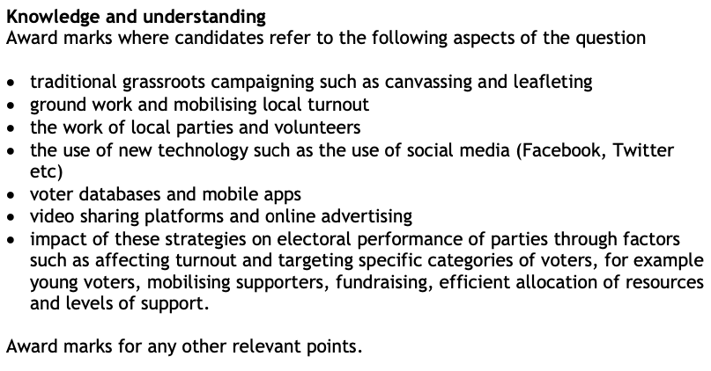
Marking instructions

Slide 6
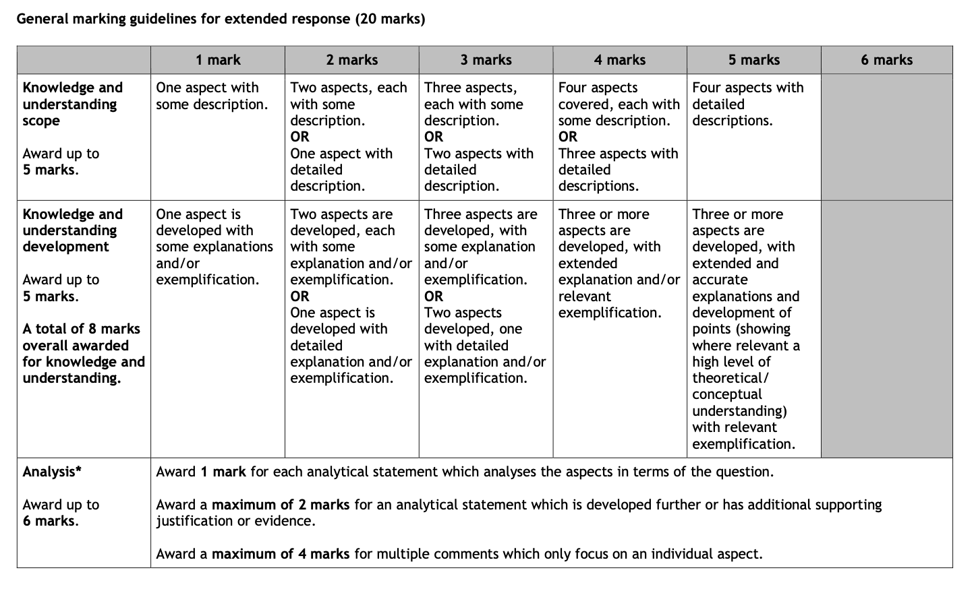
20-mark extended-response question – marking grid

Slide 7
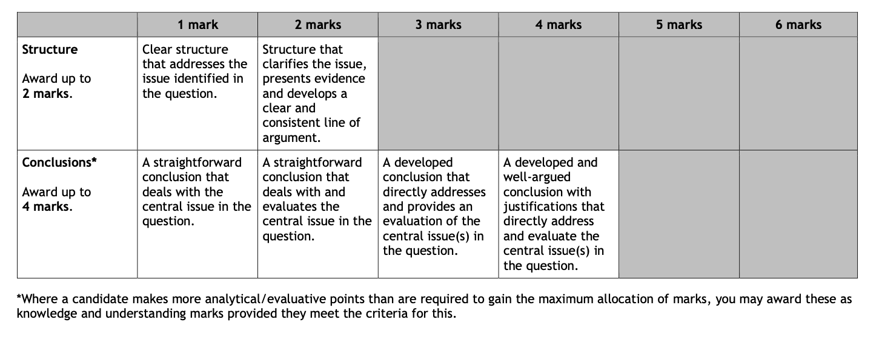
20-mark extended-response question – marking grid

Slide 8
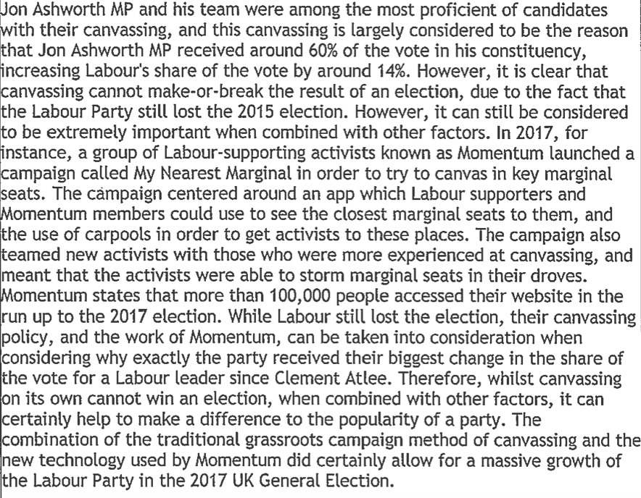
Example 1 – Understanding Standards 2019: Candidate 1

Slide 9
Candidate 1 (cont’d)

Slide 10
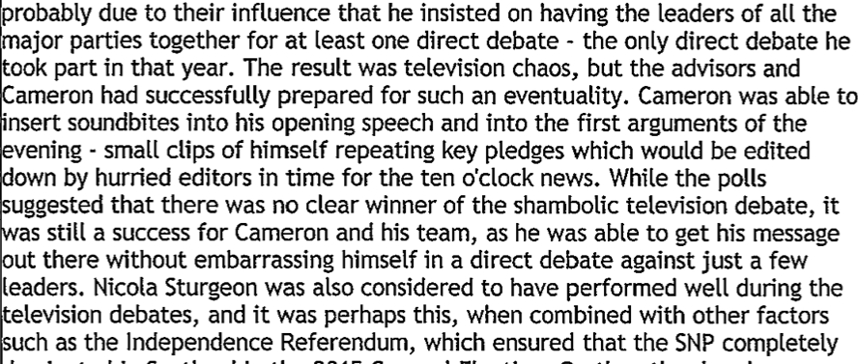
Candidate 1 (cont’d)

Slide 11
Candidate 1 (cont’d)

Slide 12
20-mark extended-response question – marking grid

Slide 13
20-mark extended-response question – marking grid

Slide 14
12-mark extended-response question
2019 question paper 1
Q1 (a)
Analyse the concept of power with reference to the work of Steven Lukes.

Slide 15
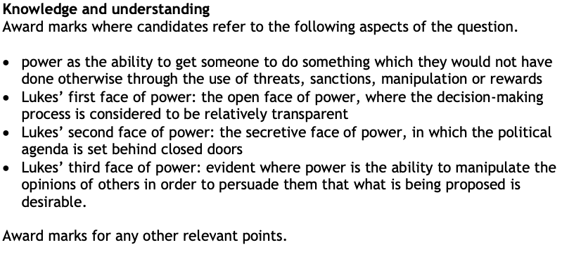
Marking instructions

Slide 16
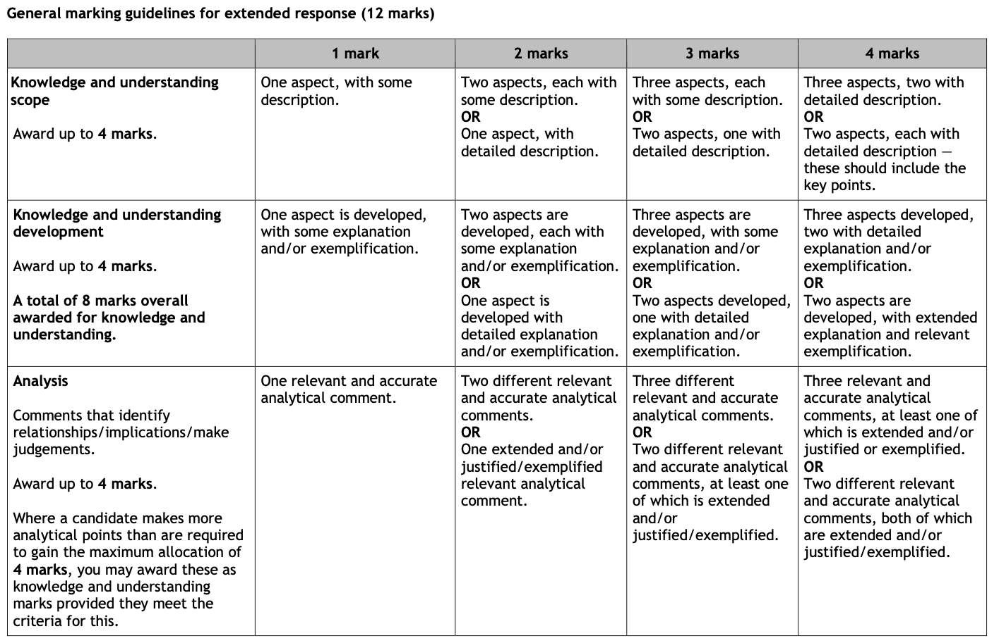
12-mark extended-response question – marking grid

Slide 17
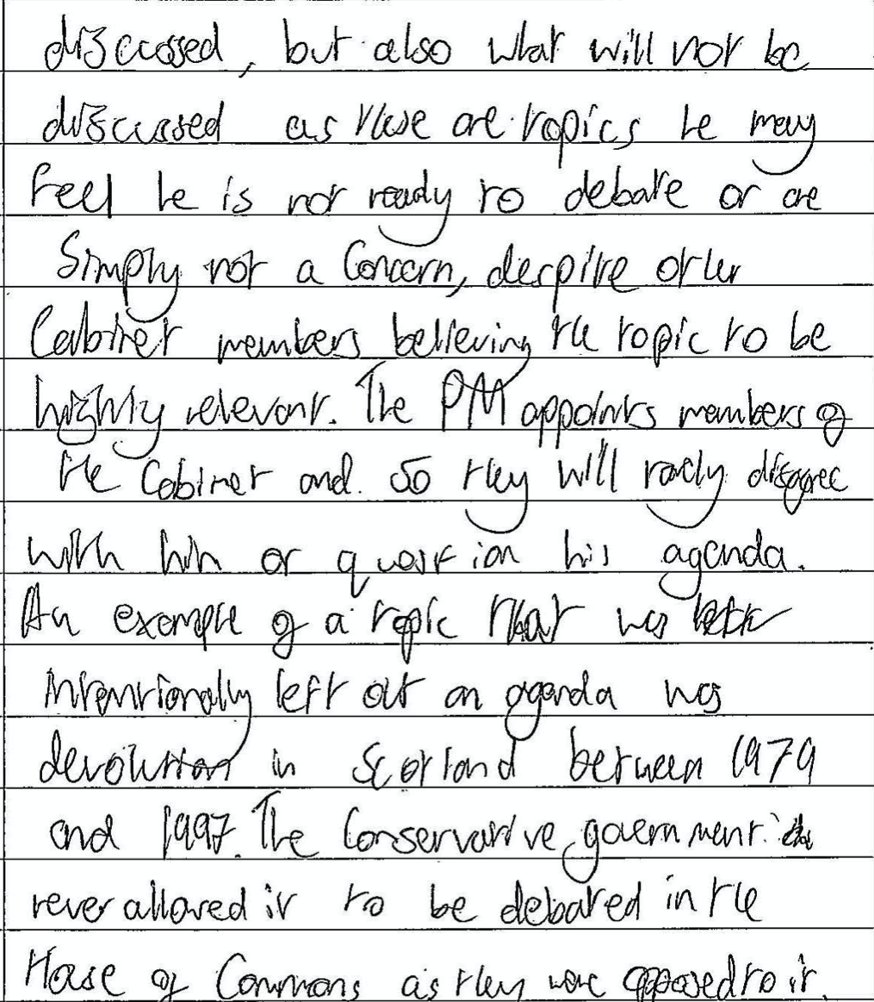
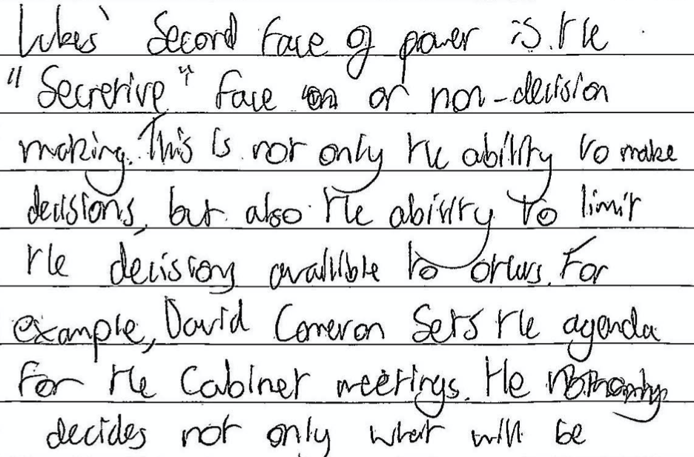
Example 1 – Understanding Standards 2015: Candidate 2

Slide 18
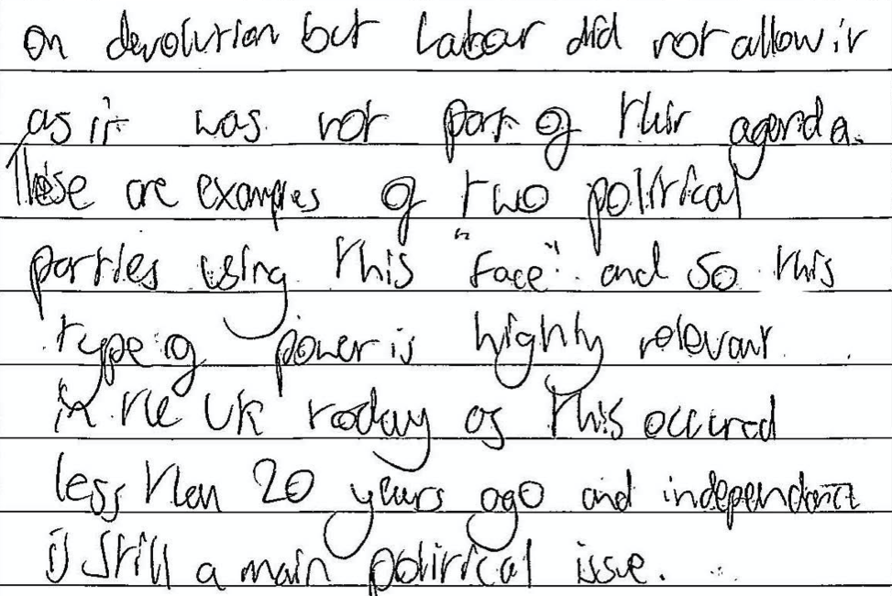
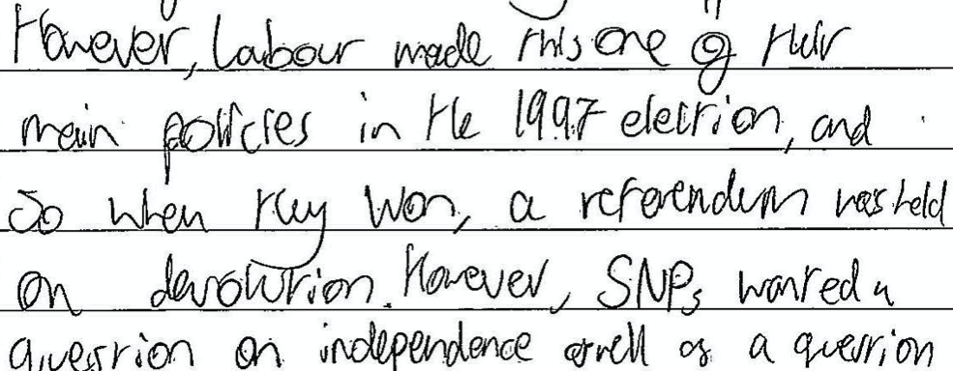
Candidate 2 (cont’d)

Slide 19
12-mark extended-response question – marking grid

Slide 20
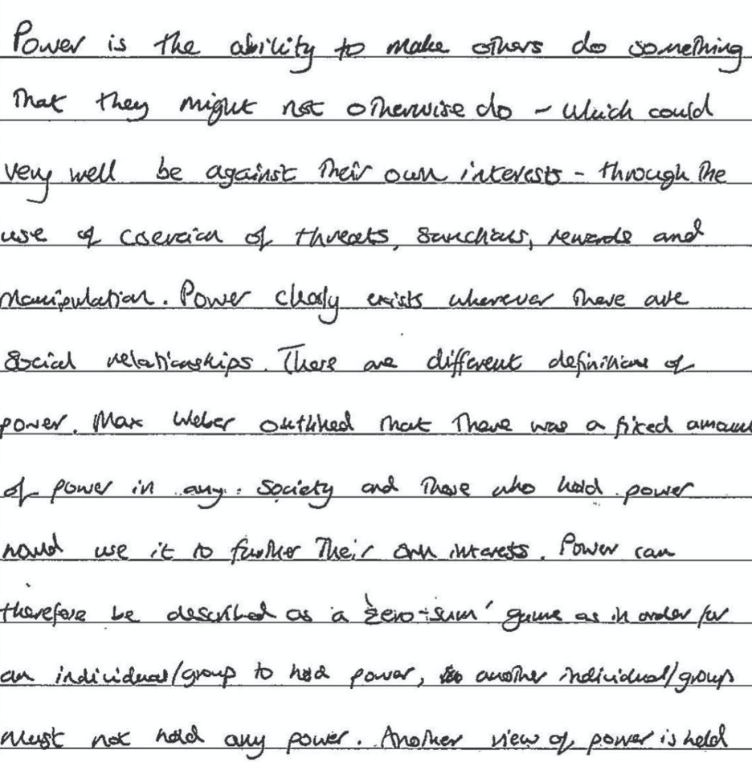
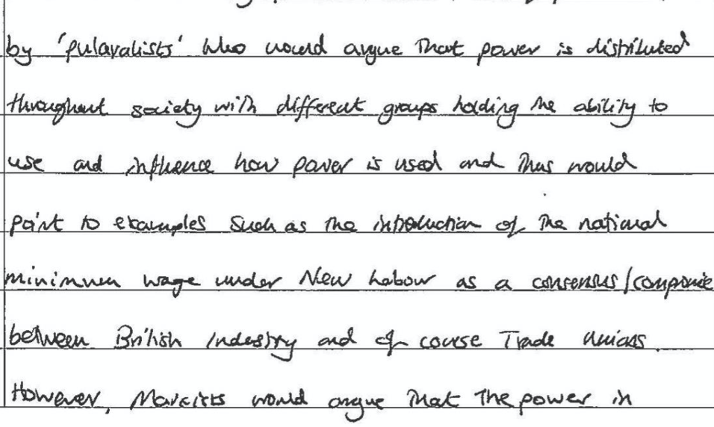
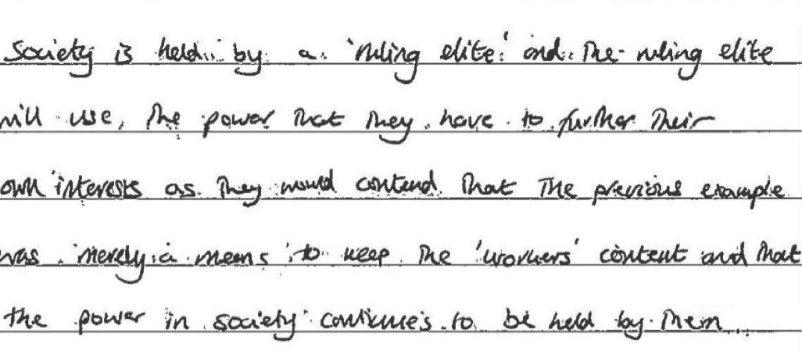
Example 2 – Understanding Standards 2019 (batch 2): Candidate 1

Slide 21
12-mark extended-response question – marking grid

