Slide 2
Understanding Standards Higher Politics:
question paper 2

Slide 3
What this presentation covers
Review the marking grid for the 20-mark electoral data question.
Examine the application of this for the allocation of marks to candidate scripts.
Review the marking grid for the 8-mark comparison of sources question.
Examine the application of this for the allocation of marks to candidate scripts.

Slide 4
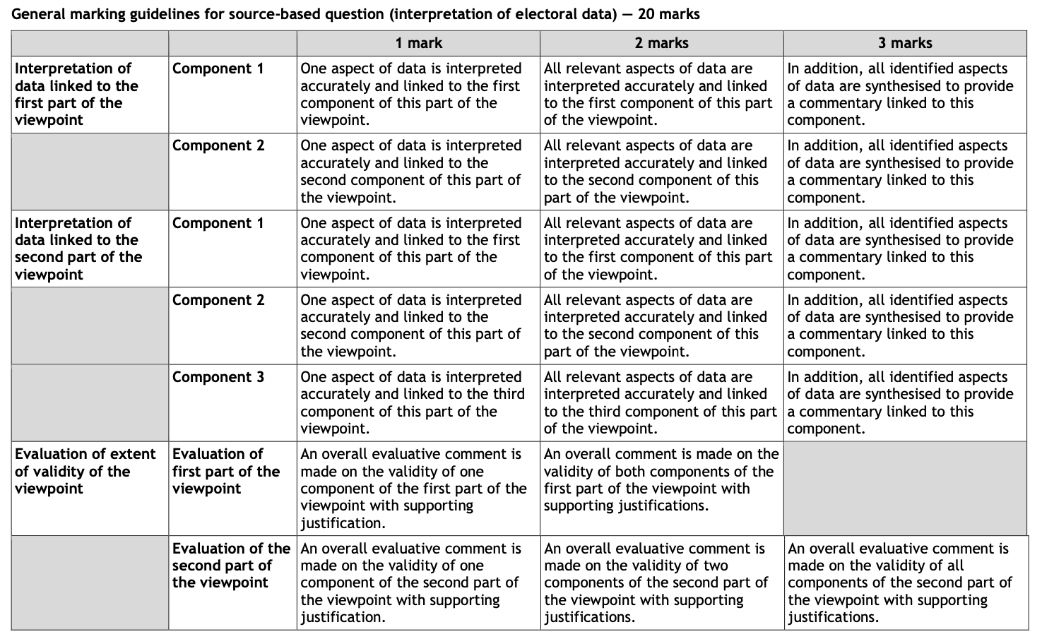
20-mark electoral data question – marking
grid

Slide 5
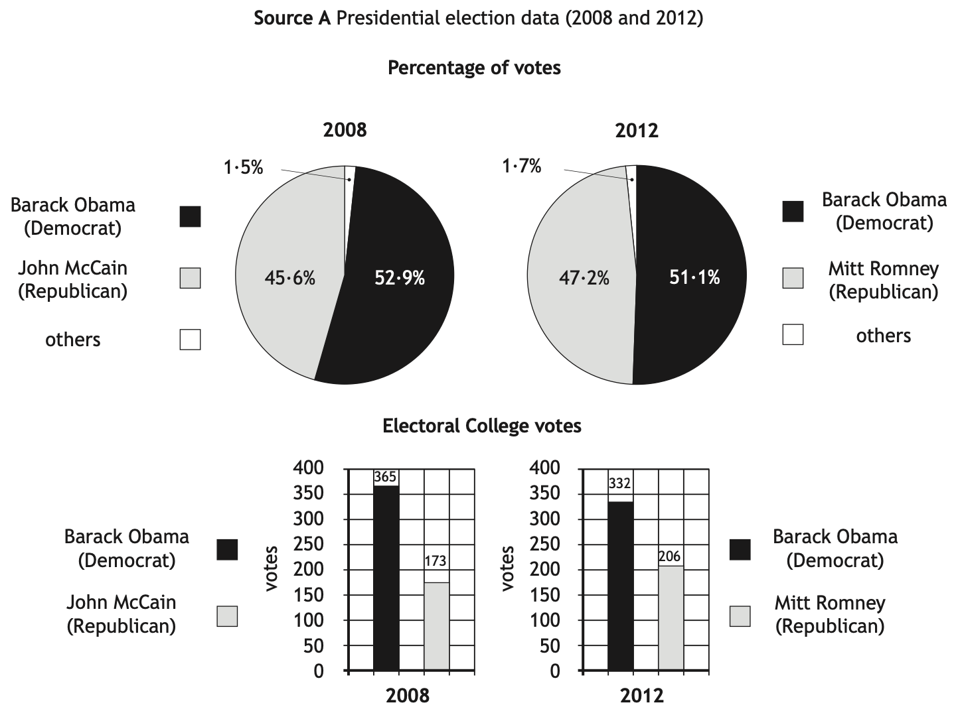
20-mark electoral data question
2019 Paper 2 , Question 2

Slide 6
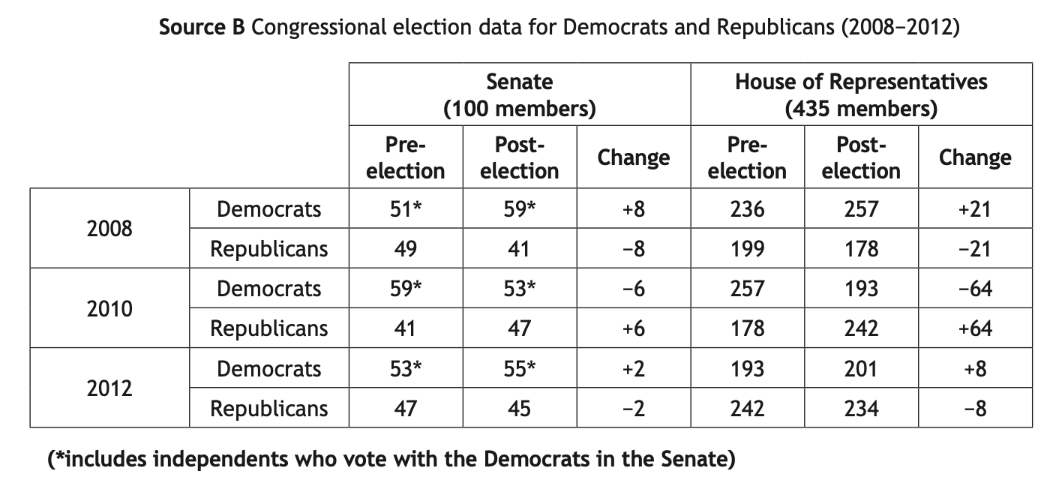
20-mark electoral data question

Slide 7
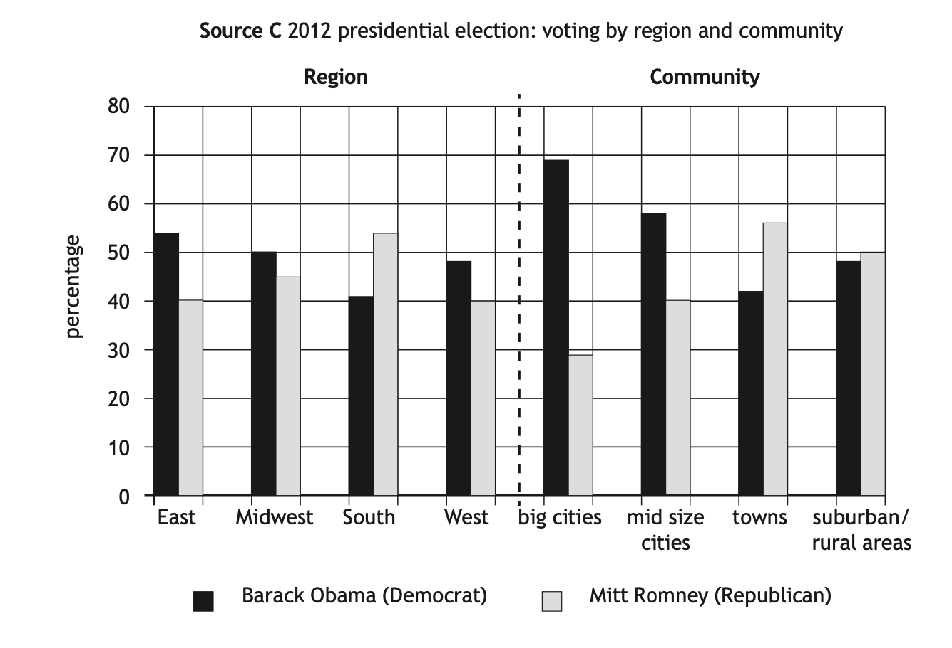
20-mark electoral data question

Slide 8
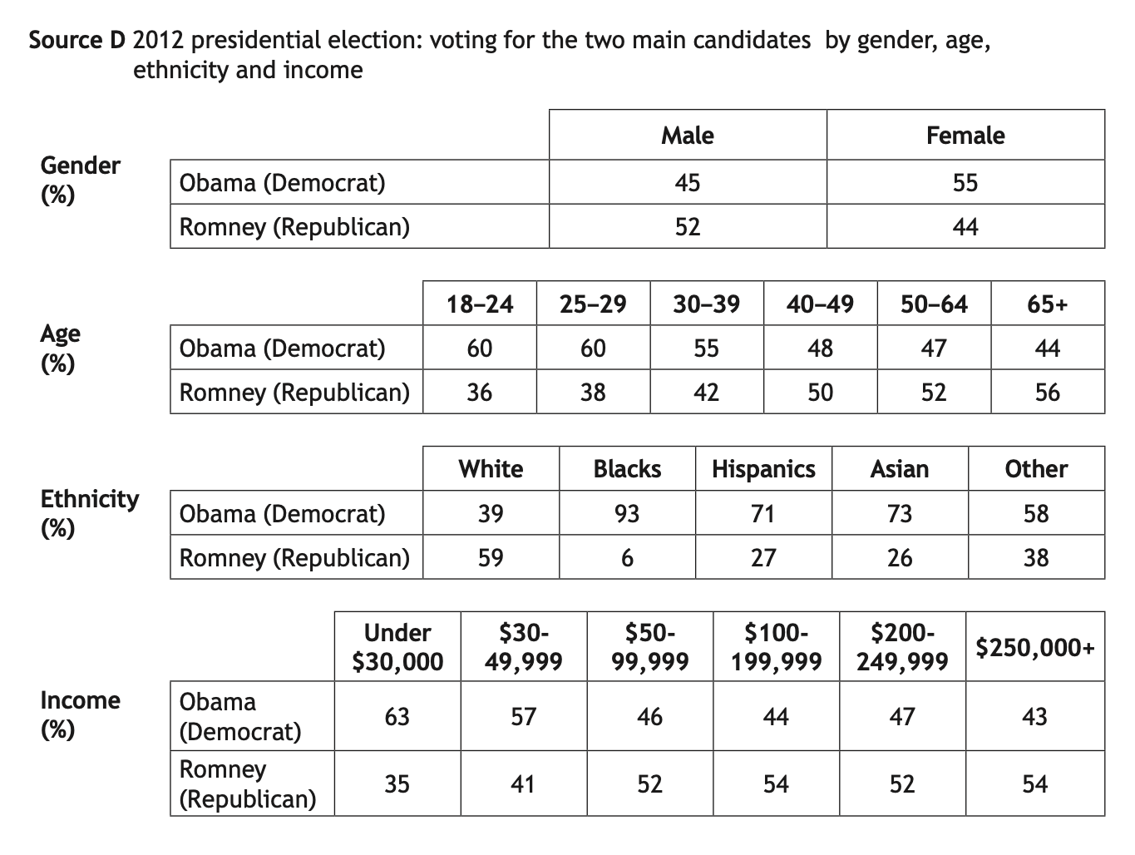
20-mark electoral data question

Slide 9
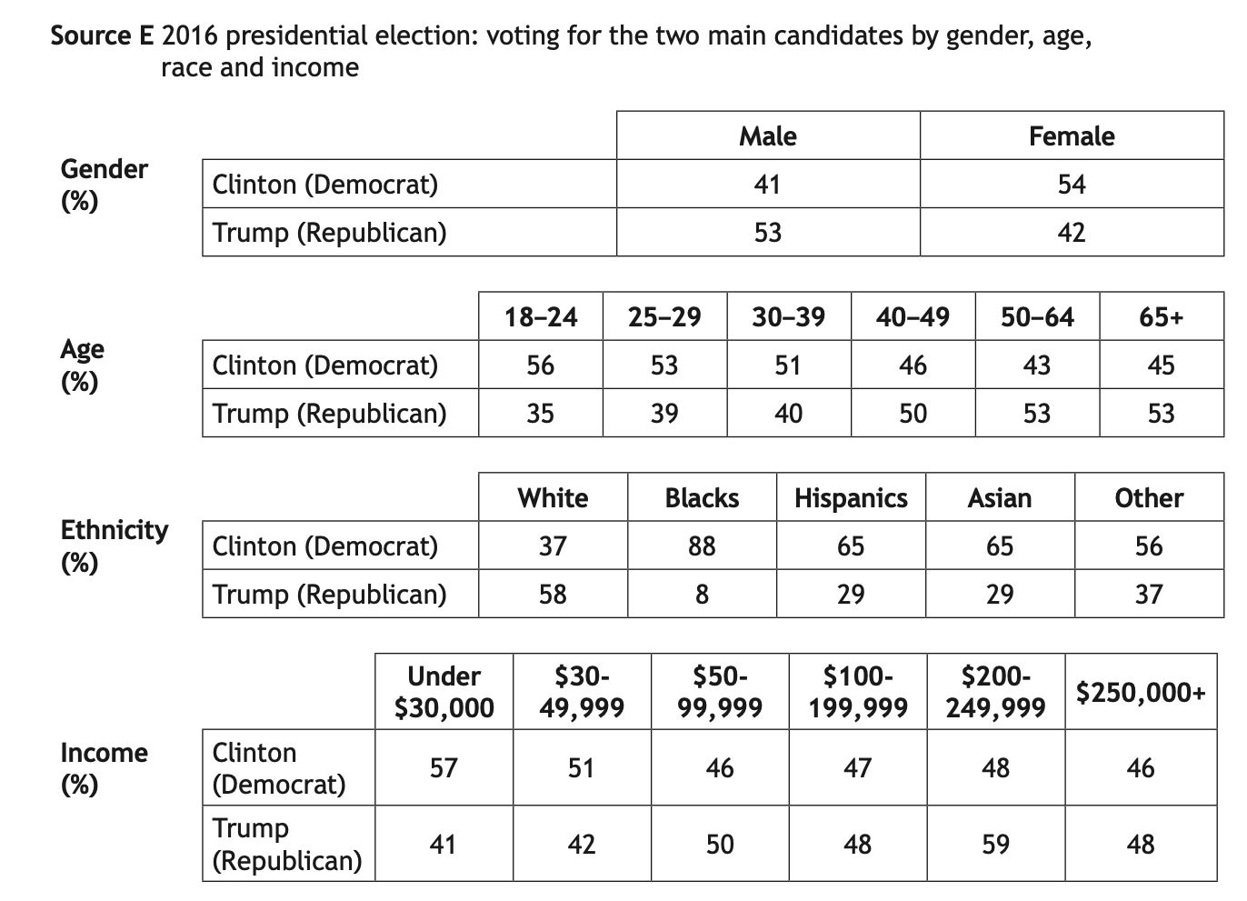
20-mark electoral data question

Slide 10
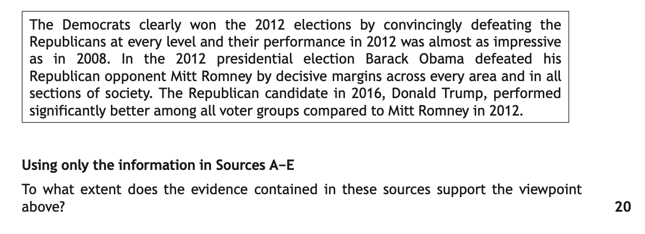
20-mark electoral data question

Slide 11
20-mark electoral data question

Slide 12
20-mark electoral data question – marking
grid

Slide 13
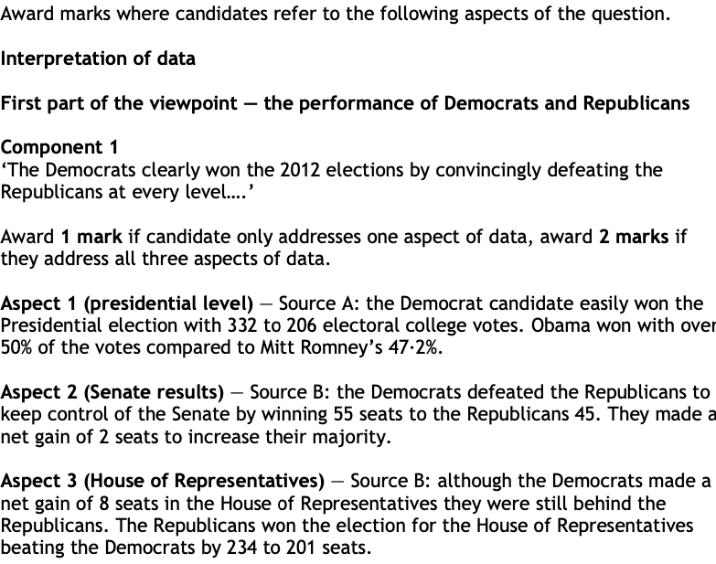
Marking instructions

Slide 14
Marking instructions

Slide 15
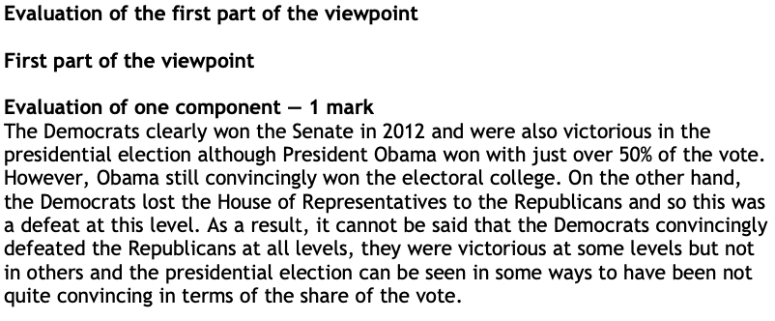
Marking instructions

Slide 16
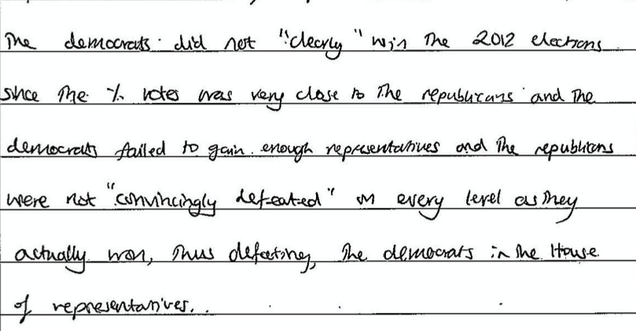
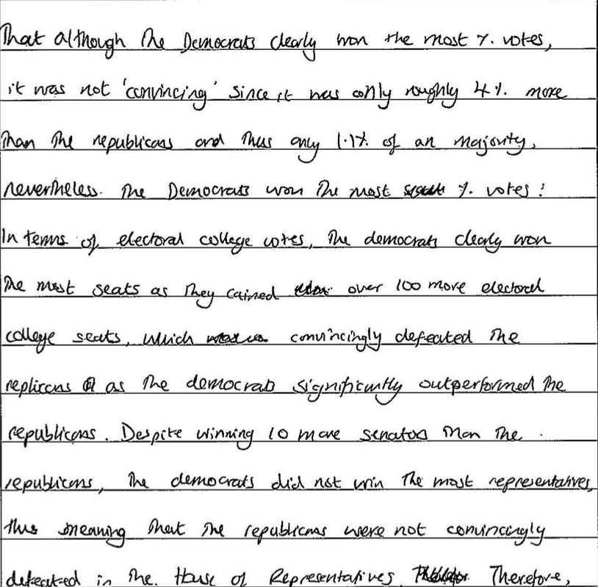
Example 1 – Understanding Standards 2019: Candidate 1

Slide 17
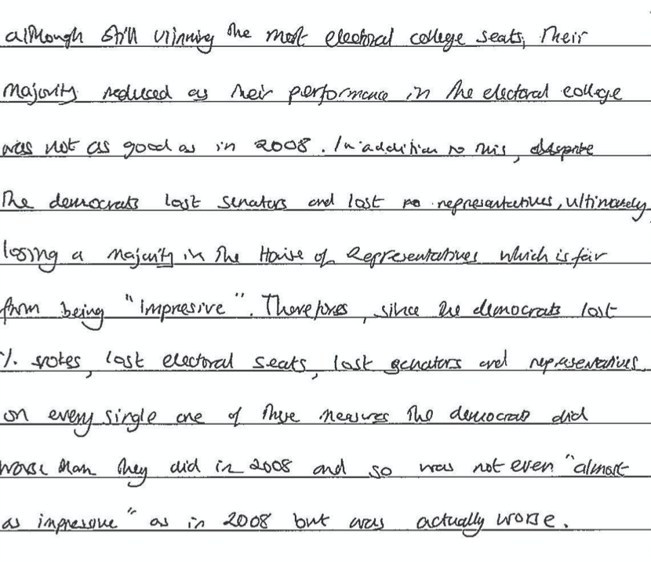
Candidate 1 (cont'd)

Slide 18
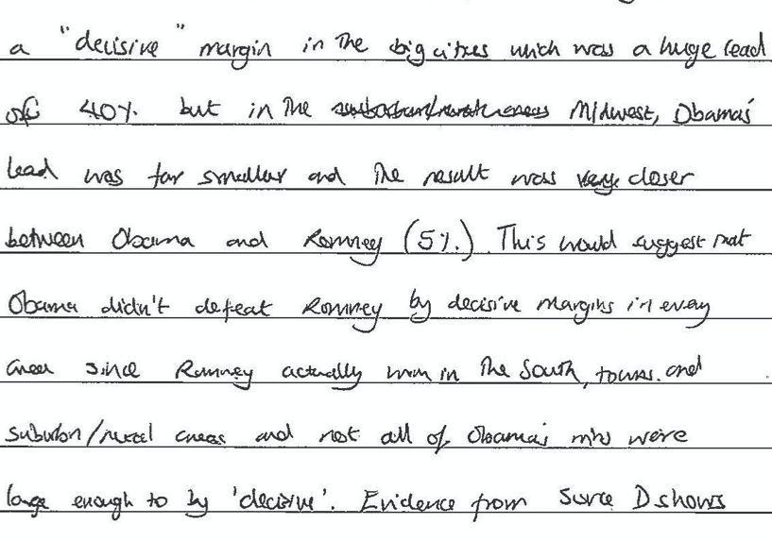
Candidate1 (cont'd)

Slide 19
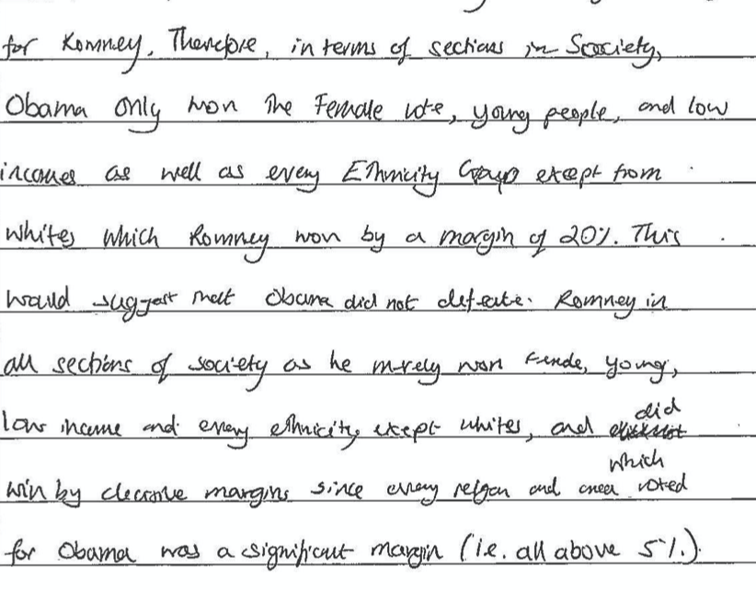
Candidate 1 (cont'd)

Slide 20
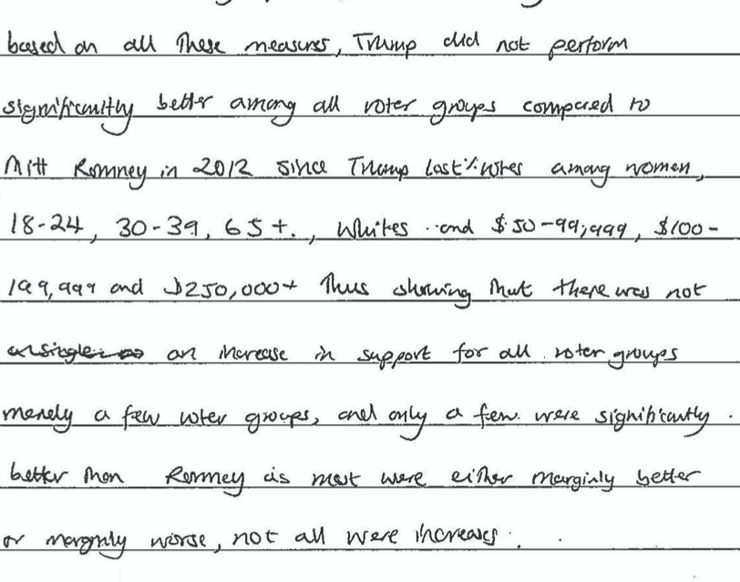
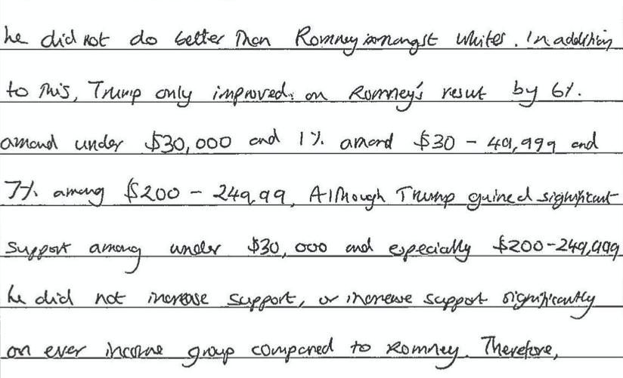
Candidate 1 (cont'd)

Slide 21
20-mark electoral data question – marking
grid

Slide 22
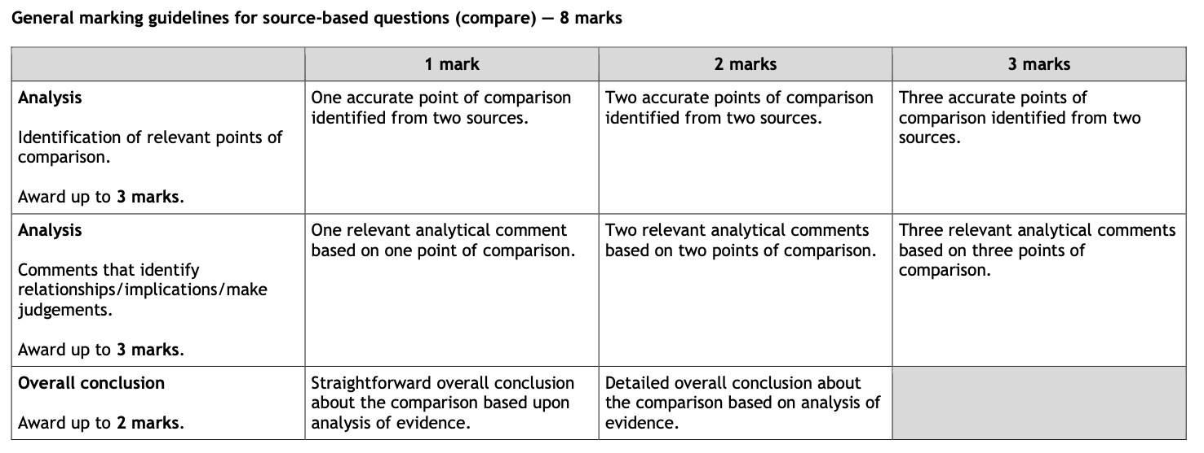
8-mark comparison of sources question
– marking grid

Slide 23
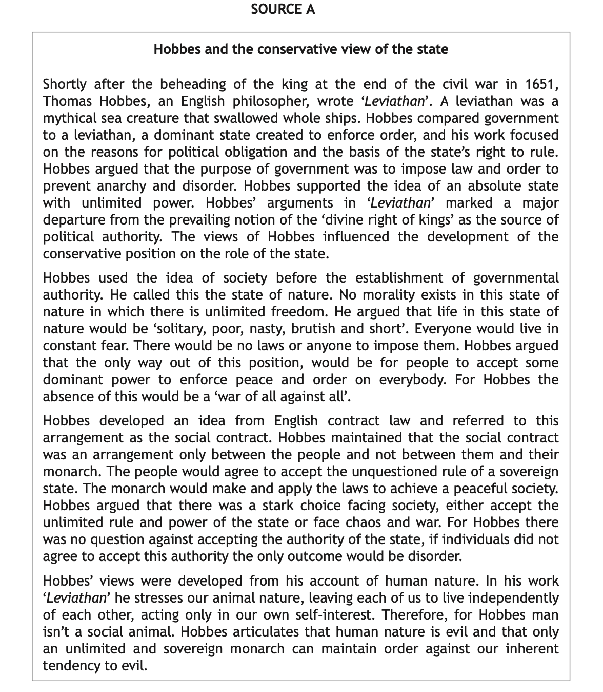
8-mark comparison of sources question

Slide 24
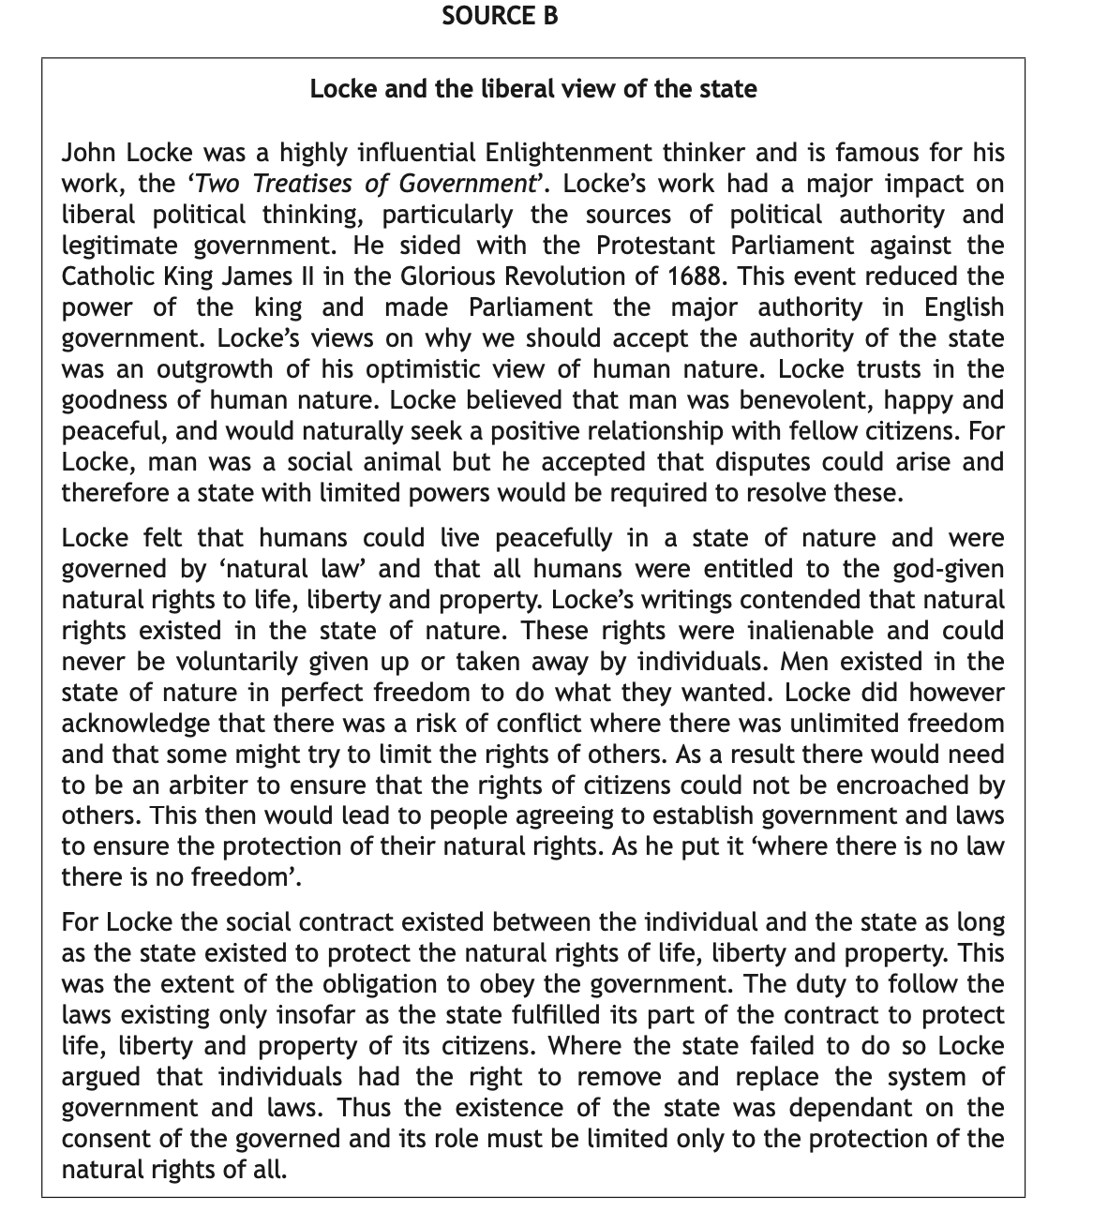
8-mark comparison of sources question

Slide 25
8-mark comparison of sources question

Slide 26
8 mark coparison of sources

Slide 27
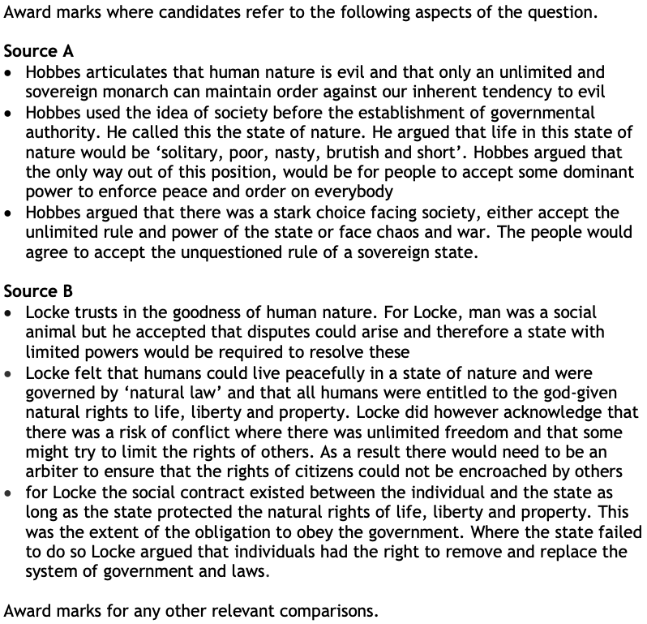
Marking instructions

Slide 28
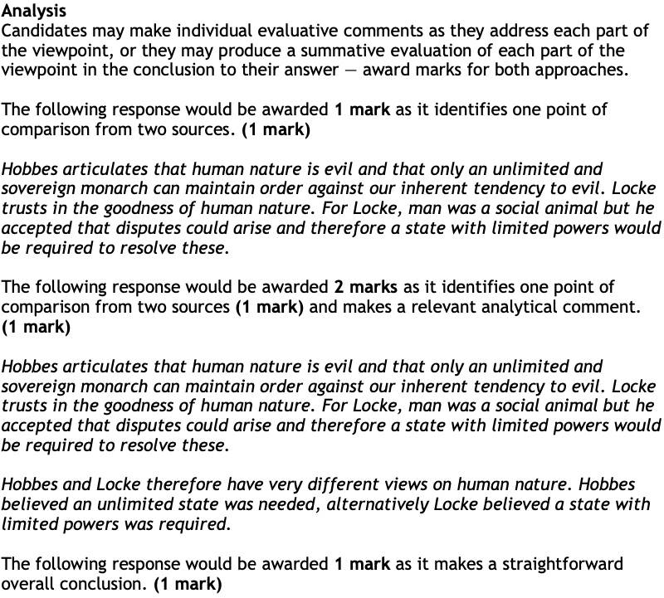
Marking instructions

Slide 29
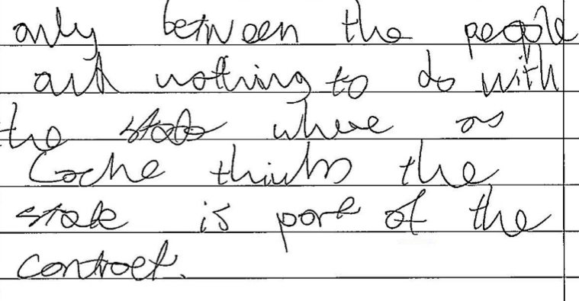
Example 1 – Understanding Standards 2019 (batch 2): Candidate 3

Slide 30
Candidate 3 (cont'd)

Slide 31
Candidate 3 (cont'd)

Slide 32
Candidate 3 (cont'd)

