Slide 2
Understanding Standards Higher Politics
Assessment overview

Slide 3
What this presentation covers
To provide an overview of materials to support centres in applying the national standard.
To identify key aspects for assessment.
To understand the significance of the marking grids.
To support understanding and interpretation of marking instructions.

Slide 4
Resources to support centres
Higher Politics home page:
https://www.sqa.org.uk/sqa/47925.html
Course specification: https://www.sqa.org.uk/files_ccc/HigherCourseSpecPolitics.pdf
Course reports:
https://www.sqa.org.uk/files_ccc/2019HCourseReportPolitics.pdf
Marking instructions: https://www.sqa.org.uk/pastpapers/papers/instructions/2019/mi_NH_Politics_all_2019.pdf
Understanding Standards materials: https://www.understandingstandards.org.uk/Subjects/Politics

Slide 5
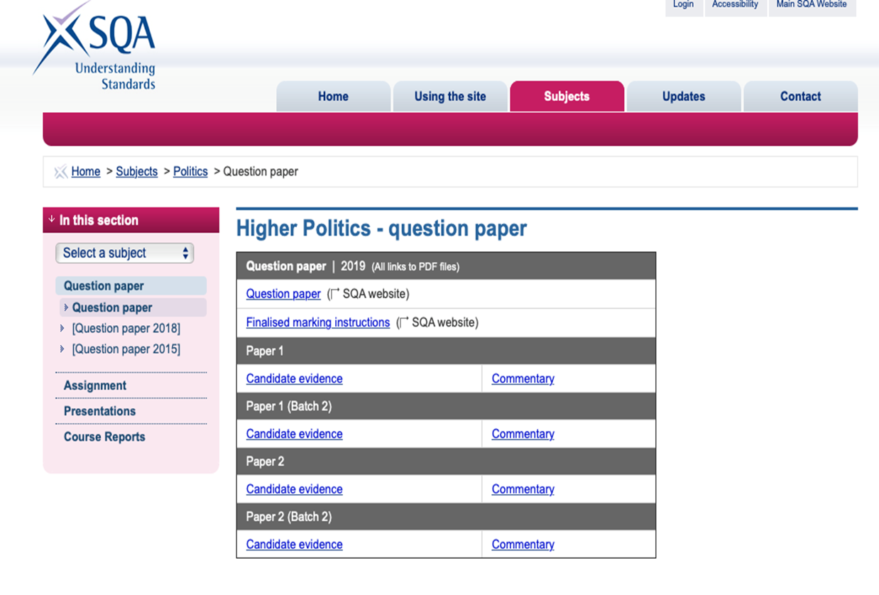
Understanding Standards website

Slide 6
Focus for assessment
Knowledge & understanding
Skills
descriptions
exemplification
explanation
analysing
drawing conclusions
making comparisons
interpreting
synthesising
evaluating
researching information
communicating information

Slide 7
Analysis
links between different components
links between component(s) and the whole
links between component(s) and related concepts
similarities and contradictions
consistency and inconsistency
different views/interpretations
possible consequences/implications
the relative importance of components
understanding of underlying order or structure

Slide 8
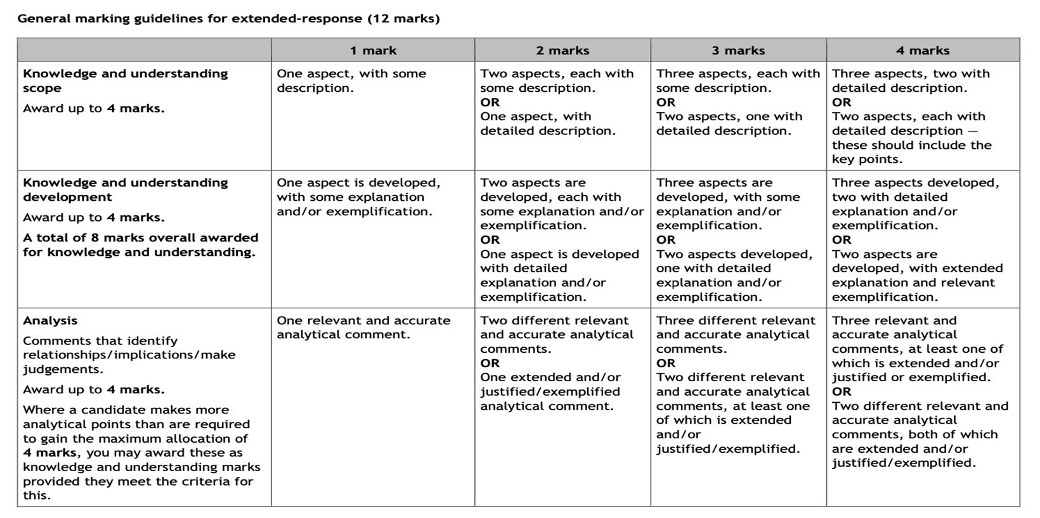
Marking grids (12-mark extended-response)

Slide 9
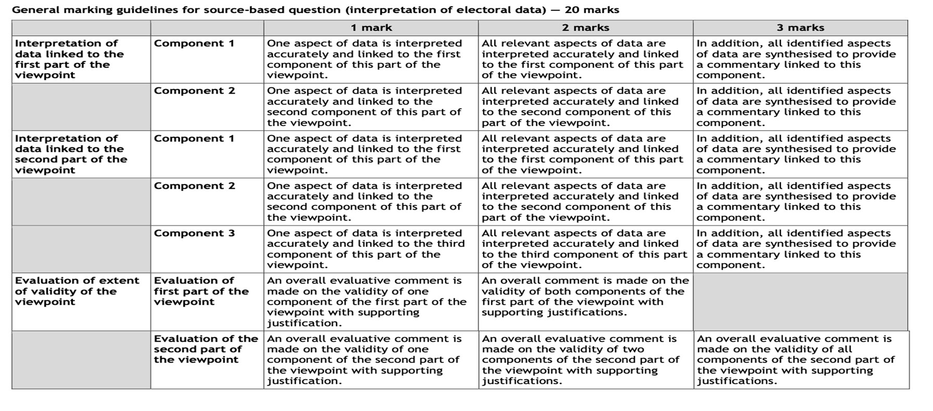
Marking grids (20-mark electoral data question)

Slide 10
Detailed marking instructions – expected content

Slide 11
Detailed marking instructions

Slide 12
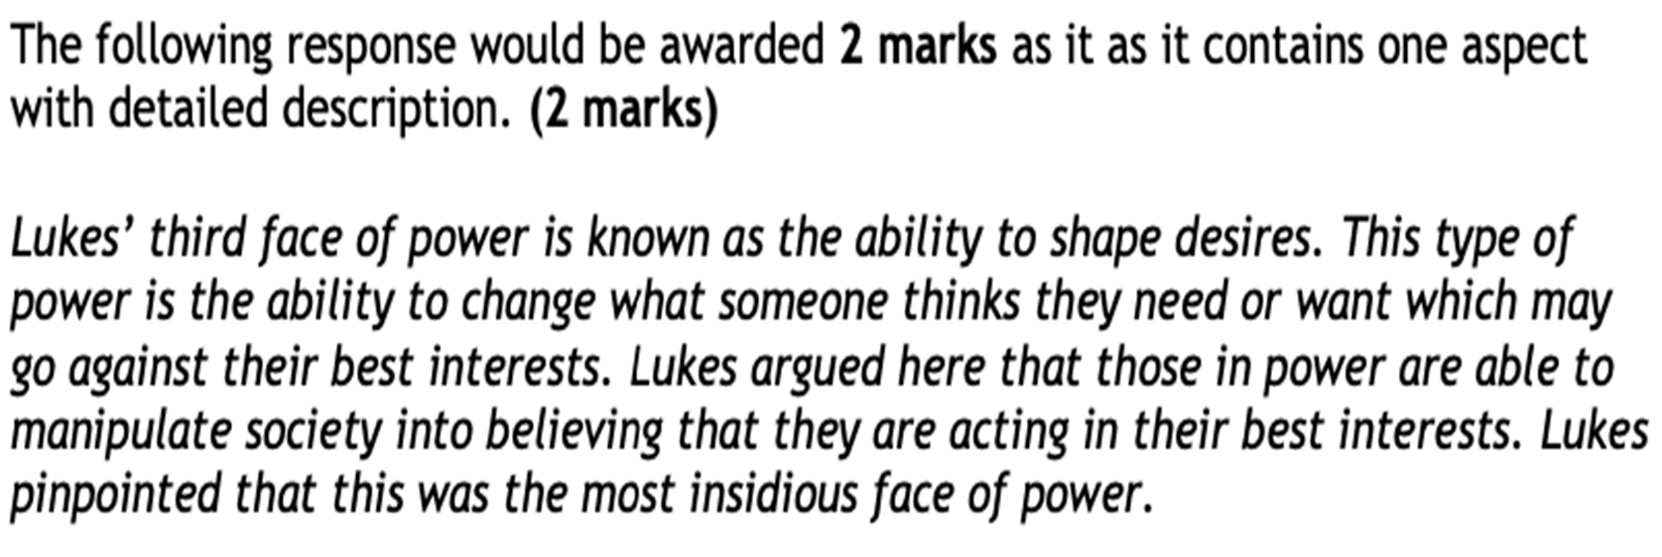
Detailed marking instructions

Slide 13
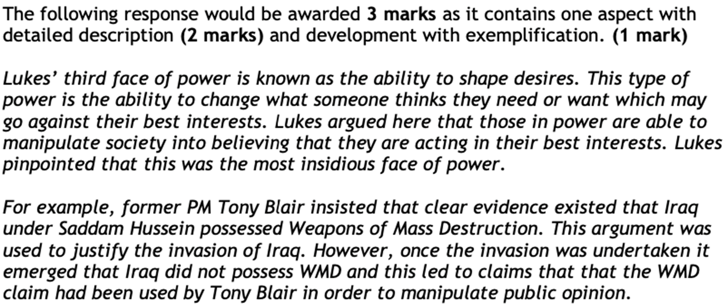
Detailed marking instructions

Slide 14
Analysis

Slide 15
Additional support – presentations
Paper 1
Paper 2
12-mark extended-response
20-mark extended-response
20-mark electoral data question
8-mark comparison of sources question

