Slide 1
Next Generation: HNC and HND Accounting
Qualifications and Community of Practice Launch
27th May 2026

Slide 2
Agenda
New Qualification Design
Tony Hamilton (Qualifications Scotland)
John Elliott (Qualifications Scotland)
Sarah Sutherland (Qualifications Scotland)
David Greentree (Qualifications Scotland)
Delivery Experience
Tracey Marshall / Claire Campaigne (City of Glasgow College)
Sarah Sutherland / Catherine Mitchell (Inverness UHI)
Moving Forward - Community of Practice
John Elliott (Qualification Scotland)
Q&A

Slide 3
Agenda
New Qualifications Design
The Story so far
Design Principles and Aims of the Review
HNC, HND and PDA Frameworks
Unit content
Grading
Meta-skills
Learning for Sustainability
Professional Body Exemptions

Slide 4
The Story so far
Early 2021 HN Next Gen Project Formally initiated
MVP Design Principles established
Nov 2021 First HN Accounting Design Team meeting
  Representation across FE, University and engagement with professional bodies
August 2022 1st year of pilot delivery – Edinburgh College
August 2023 City of Glasgow College join as pilot centre

Slide 5
The Story so far… and beyond
August 2024 UHI Inverness College join as pilot centre
October 2024 Validation of HNC and HND confirmed
August 2025 Limited delivery of validated qualifications
August 2026 Mainstream rollout of HNC and HND
Autumn 2026 Community of Practice established

Slide 6
Design Principles and Review Aims
HNC and HND are discrete 15 credit qualifications
Reduce volume of assessment
Reduce amount of closed-book assessment
Use of larger more holistic units
Extend use of project-based assessment
Introduction and integration of Meta-skills and Learning for Sustainability
Integration of digital delivery and assessment
Develop valid, fair and reliable Grading Models
Consolidate exemptions from professional body qualifications
Retain and consolidate progression to degree programmes

Slide 7
New HNC, HND and PDA Qualifications
HNC Accounting SCQF 7 GT66 47 15 credits
HND Accounting SCQF 8 GV1V 48 15 credits
PDA Financial Accounting SCQF 7 G1Q1 47 4 credits
PDA Management Accounting SCQF 7 GZ5H 47 4 credits
PDA Book-keeping and Payroll SCQF 7 GVLH 47 2 credits

Slide 8
New HNC Framework
Mandatory Units
HNC Accounting GT66 47
Unit title | Code | Credit
Financial Accounting Principles | J6DY 47 | 4
Management Accounting Principles | J6E0 47 | 4
Professional Considerations in Accounting | J8RJ 47 | 3
Total |  | 11

Slide 9
New HNC Mandatory Units
Financial Accounting Principles J6DY 47 – 4 credits
Outcome 1 Record Financial Transactions in books of original entry, Closed-book trial balance and VAT return
Outcome 2 Prepare Financial Statements – sole traders and
Open-book supervised manufacturing partnerships
Outcome 3 Incorporate control mechanisms into a bookkeeping Closed-book system
Outcome 4 Analyse financial statements of a sole trader using ratios
Supervised with access to formulae only
Outcome 5 Accounting information for different types of organisations
Open-book

Slide 10
New HNC Mandatory Units
Management Accounting Principles J6E0 47 – 4 credits
Outcome 1 Materials, Labour, Overheads and Costing statements
Open-book Supervised
Outcome 2 Budget statements and Break-even analysis for
Open-book decision-making
Outcome 3 Variance Analysis
Open-book supervised

Slide 11
New HNC Mandatory Units
Professional Considerations in Accounting J8RJ 47 – 3 credits
Outcome 1 Develop Meta-skills
Open-book
Outcome 2 Ethical Principles and Practices in Accounting
Open-book project
Outcome 3 Design and Develop a Spreadsheet for a Business scenario
Open-book project
Outcome 4 Corporate Governance and Corporate Social Principles in Business
Open-book project
Outcome 5 Sustainability in Business

Slide 12
New HNC Mandatory Units
Additional Marking and Delivery Criteria for Mandatory Units
Use of spreadsheets for calculations mandatory
70% pass threshold for each Outcome
Re-assessment scores capped at 70%

Slide 13
New HNC Optional Units
* 1 credit units are subsets of the 4 credit unit
Unit title | Code | Credit
Accountant in the Business Environment* | J6E2 47 | 4
Economics: An Introduction* | J89C 47 | 1
Law for Business: An Introduction* | J89E 47 | 1
Business Structures and Organisational Culture* | J89F 47 | 1
Leadership and Management in Business* | J89G 47 | 1
Book-keeping and Payroll Applications | J7BN 47 | 2
Personal Taxation | J7BP 47 | 2
Artificial Intelligence | J693 47 | 1
Work-based Learning | J7N3 47 | 3
Total required |  | 4

Slide 14
New HND Framework
Mandatory Units
HND Accounting GV1V 48
Unit title | Code | Credit
Performance Management | J7BD 48 | 4
Financial Reporting and Corporation Tax | J7BC 48 | 4
Business Performance and Managing Risk | J7EH 78 | 3
Total |  | 11

Slide 15
New HND Mandatory Units
Performance Management J7BD 48 – 4 credits
Outcome 1 Rationales for Costing
Closed-book
Outcome 2 Cost statements using Costing techniques
Open-book supervised
Outcome 3 Appraise Capital Investments
Closed-book
Outcome 4 Variance Analysis to reconcile budgeted with actual profit
Closed-book and Open-book supervised

Slide 16
New HND Mandatory Units
Performance Management J7BD 48 – 4 credits
Outcome 5 Short-term decision-making techniques to inform a
Open-book management decision
Outcome 6 Working Capital management techniques
Closed-book

Slide 17
New HND Mandatory Units
Financial Reporting and Corporation Tax J7BC 48 – 4 credits
Outcome 1 Account for transactions and present financial statements
Closed-book for single entities in accordance with FRS102
Outcome 2 Analyse and interpret financial statements and identify
Closed-book appropriate sources of finance
Outcome 3 Apply Corporation Tax Legislation to a company
Open-book
Outcome 4 Conceptual and Regulatory Framework in the UK
Open-book

Slide 18
New HND Mandatory Units
Business Performance and Managing Risk J7EH 48 – 3 credits
Outcome 1 Develop Meta-skills
Open-book
Outcome 2 Statistical Techniques for Data Collection
Open-book project
Outcome 3 Analyse Business Performance using a variety of techniques
Open-book project

Slide 19
New HND Mandatory Units
Business Performance and Managing Risk J7EH 48 – 3 credits
Outcome 4 Risk and uncertainty in decision-making and mitigation
Open-book project
Outcome 2 Concepts behind Big Data and ways of using to improve
Open-book project business performance
Outcome 3 Evaluate MIS within SMEs
Open-book project

Slide 20
New HND Mandatory Units
Additional Marking and Delivery Criteria for Mandatory Units
Use of spreadsheets for calculations mandatory
70% pass threshold for each Outcome
Re-assessment scores capped at 70%

Slide 21
New HND Optional Units
Unit title | Code | Credit
Audit: An Introduction | J7BF 48 | 2
Financial Markets: An Introduction | J7BG 48 | 2
Financial Services: Risk Management | J9E3 48 | 2
Agile Project Management | J6C9 48 | 2
Big Data | J68W 47 | 1
Data Science | J68R 47 | 2
Blockchain | J68X 47 | 1
Total required |  | 4
* 1 credit units are subsets of the 4 credit unit

Slide 22

Grading

Slide 23
Grading
Whole qualification grade replaces graded unit(s)
Holistic grade calculated across mandatory units
Representative of performance across the course rather than a single assessment
Grade calculated on performance across the three mandatory units

Slide 24
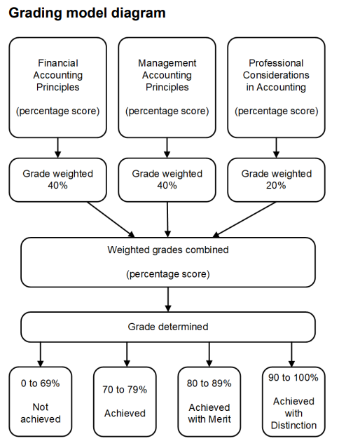
Grading – HNC Accounting GT66 47
Grade Weighting
Financial Accounting Principles 40%
Management Accounting Principles 40%
Professional Considerations in Accounting 20%
Grade Bands
0 – 69% Not Achieved
70 – 79% Achieved
80 – 89% Merit
90 – 100% Distinction

Slide 25
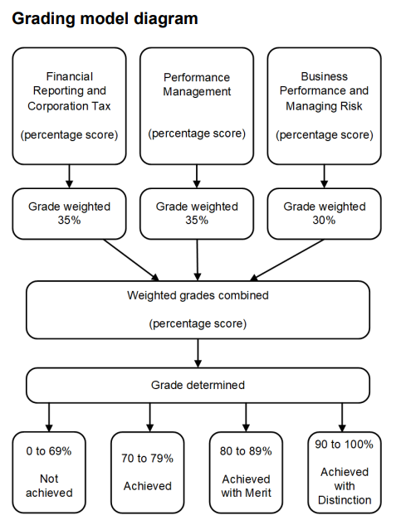
Grading – HND Accounting GV1V 48
Grade Weighting
Financial Reporting and Corporation Tax 35%
Performance Management 35%
Business Performance and Managing Risk 30%
Grade Bands
0 – 69% Not Achieved
70 – 79% Achieved
80 – 89% Merit
90 – 100% Distinction

Slide 26
Meta-skills

Slide 27
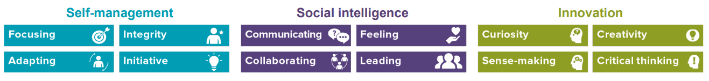
Meta-skills
Meta-skills are innate transferable skills, qualities and abilities that help develop adaptable learners who can be successful in any given context
Opportunities to reflect on and develop Meta-skills are now embedded in all HN NextGen qualifications

Slide 28
Meta-skills
HNC – Professional Considerations in Accounting Outcome 1
HND – Business Performance and Managing Risk Outcome 1
“Learners must produce evidence to show they can:
• self-assess their meta-skills baseline
• create a plan to develop their own meta-skills
• carry out activities to develop and demonstrate their meta-skills
• use reflective practice to monitor and assess the meta-skills they
have improved and developed”

Slide 29
Meta-skills
About reflection and development of Meta-Skills
Not reaching an objective standard
Designed to be evidenced holistically rather than separately
Same criteria at HNC and HND – determined by the learner’s point in their “learning journey” rather than the qualification level

Slide 30

Learning for Sustainability

Slide 31
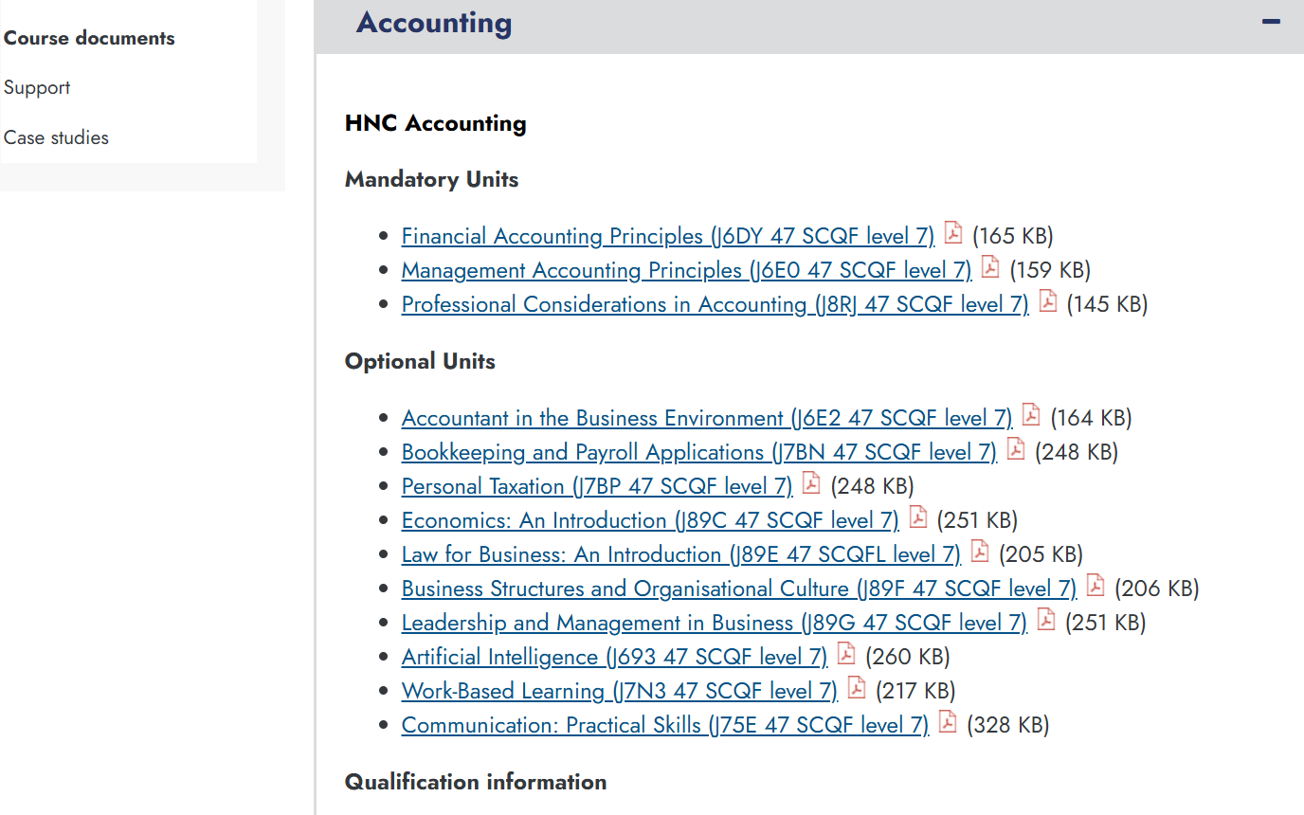
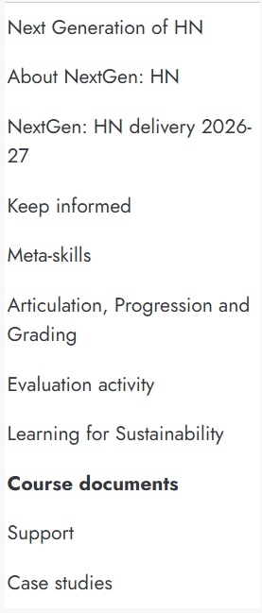
Supporting
Documentation
Educator Guide
Grading Pack
Unit specifications
Links to other support material
https://www.sqa.org.uk/sqa/110487.12552.html

Slide 32
Legacy HNs
Existing HN Accounting website continues
HNC Accounting G9M5 15 ends 31.07.29
HND Accounting G9M6 16 ends 31.07.30
PDA Financial Accounting G8XM 47 ends 31.07.29
PDA Management Accounting G8XK 47 ends 31.07.29
PDA Book-keeping G8XN 47 ends 31.07.29

Slide 33
Professional Body exemptions
Sarah Sutherland

Slide 34
HNC Exemptions
ACCA | ACCA | CIMA | ICAS | AAT
FA1 Recording Financial Transactions | MA1 Management Information | BA1 Fundamentals of Business Economics | Financial Accounting* | Level 2: Principles of Bookkeeping Controls
FA2 Maintaining Financial Records | FMA Management Accounting | BA2 Fundamentals of Management Accounting | Business Acumen* | Level 3: Financial Accounting: Preparing Financial Statements
MA1 Management Information | FFA Financial Accounting | BA3 Fundamentals of Financial Accounting |  | Level 3: Management Accounting Techniques
MA2 Managing Costs and Finance | BT Business & Technology | BA4 Fundamentals of Ethics, Corporate Governance and Business Law |  | Level 3: Business Awareness Unit
FBT Business & Technology | MA Management Accounting |  |  | Level 4: Applied Management Accounting Unit
MA1 Management Information | FA Financial Accounting |  |  | Level 4: Personal Tax Unit

Slide 35
HND Exemptions
ACCA | ICAS* | AAT
PM Performance Management | Reporting & Performance 1 (RP1)* | Level 4: Cash & Financial Management
LW Corporate & Business Law | Business Management & Finance | Level 4: Audit & Assurance
*Students need to complete 5 SCQF credits of non-financial reporting to gain exemption overall

Slide 36
Good Practice
NextGen HN Accounting 2025/2026 Qualification Verification Activity

Slide 37
Study Guide
What they are studying
What they need to achieve to gain the award they want
Skills they are developing – including meta-skills
Relevance to Accounting practice

Slide 38
Student Assessment Tracker
New units with learning outcomes – integrated assessments
New grading system
Keeping students on tract to achieve their targeted overall grade

Slide 39
Student Feedback
No graded units and different achievement criteria
Student development of accounting and meta-skills throughout the programme

Slide 40
Internal Verification
All new units, being delivered for the first time
Higher risk from Centres Internal Verification Policy
New Instruments of Assessment, Standardisation and Pre-Delivery, Sampling, Post-Delivery

Slide 41
Instruments of Assessment
New conditions of assessment
More opportunity for different types of assessment
Contemporary topics and methods of assessment

Slide 42
Pilot Centre Delivery Experience
City of Glasgow College

Slide 43
Student Experience
City of Glasgow College

Slide 44
University of Highlands and Islands

Slide 45

Advantages of writing own assessments
Flexibility
Academic autonomy
Ability to update quickly
Varied evidence
Varied evidence
Better feedback opportunities from students
The bizarre imaginary

Slide 46
The Future
John Elliott

Slide 47
The Future
Full launch August 2026 with the existing qualifications moving into a lapsing period
Community of practice launched
Meet at least twice a year
Opportunity to share experiences, materials and assessments

Slide 48
Community of Practice
What it is:
A place to come together
A place to prevent reinventing the wheel
A place to collaborate
A place to share materials and assessments
You will get out what you put into this
To join email – john.elliott@ext.qualifications.gov.scot
What it is not:
Run or regulated by Qualifications Scotland
A place to seek answers that would normally come from Qualifications Scotland

Slide 49
Q&A

