Slide 1

HN:NextGen Accounting
Development Overview
Sarah Sutherland & John Elliott (SIMs)

Slide 2
PURPOSE
To familiarise you with HN: NextGen Design Principles
Assessment Methods
Grading and mapping overview
LfS overview
Centre Engagement
The journey so far

Slide 3
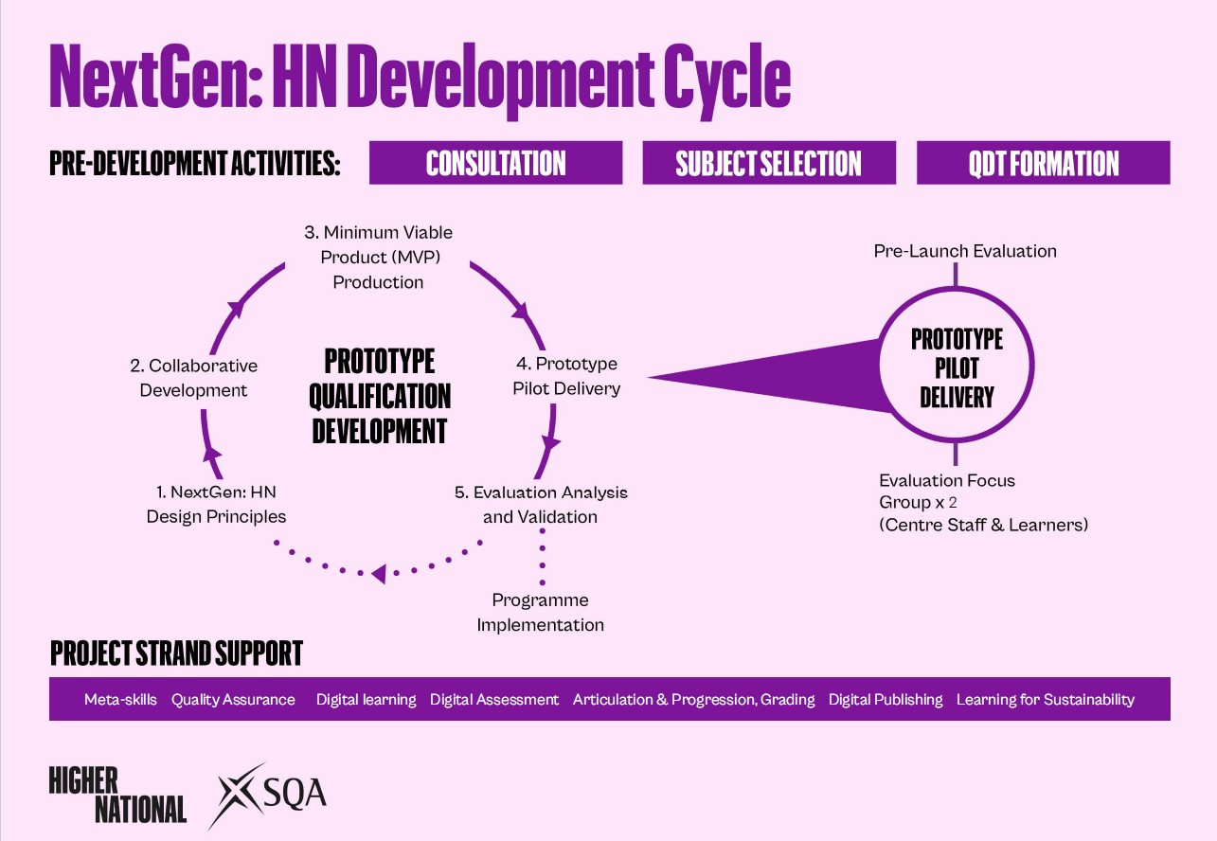
Quality Network
6.10..2022

Slide 4
NEXTGEN:HN DESIGN PRINCIPLES
Purpose of the qualifications remains the same – progression into work, or articulation into HE
HNC/Ds designed to be individual qualifications
To comprise of 120 SCQF credit points at Level 7 and 8 respectively
Larger and fewer units
At least 1 x 3 SQA credit project unit
Address concerns about assessment load
Incorporation of Learning for Sustainability (LfS)
Incorporation of meta-skills
New grading models, no graded unit, whole qualification grading
  Achieved with Distinction
  Achieved with Merit
  Achieved
New supportive approach to external quality assurance

Slide 5

HNC ACCOUNTING
Mandatory Units – SCQF (Level 7)
Financial Accounting Principles (32 SCQF points)
Management Accounting Principles (32 SCQF points)
Professional Considerations in Accounting (24 SCQF points) (Project Unit)
Optional Unit for pilot delivery – SCQF (Level 7)
Accountant in the Business Environment (32 SCQF points)
(Split into 4 x 1 SQA credit units for August 2024)
For August 2024 – SCQF (Level 7)
Bookkeeping and Payroll Applications (16 SCQF points)
Personal Taxation (16 SCQF points)
Work-based Learning (24 SCQF points)
Communication: Practical Skills (8 SCQF points)

Slide 6

DRAFT HND ACCOUNTING
Mandatory Units – SCQF Level 8
Performance Management (32 SCQF Points)
Financial Reporting and Corporation Tax (32 SCQF Points)
Business Performance and Managing Risk (24 SCQF Points) (Project Unit)
Optional Units for pilot delivery – SCQF Level 8
Audit: An Introduction (16 SCQF Points)
Financial Markets: An Introduction (16 SCQF Points)

Slide 7
ASSESSMENT METHODS
Reduction in closed book assessments
Integrated assessments
Projects
Presentations
Digital Assessment
Greater emphasis on research and analysis
Threshold scores
Be creative!!
Notes:
Our current grades have descriptors, but we are improving and updating these to better support understanding of the new grade outcomes

Slide 8
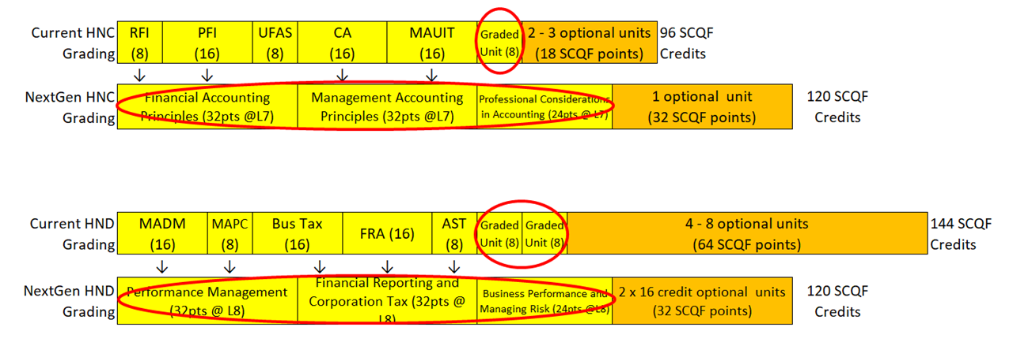
GRADING AND MAPPING

Slide 9
NEXTGEN: HN GRADES
Achieved with Distinction
This candidate consistently demonstrates outstanding knowledge, understanding and application of skills. Thinking and working independently to an exceptional standard, they apply excellent judgement and creative problem-solving skills. They achieve or exceed agreed aims by confidently applying an extensive range of meta-skills and working very effectively with colleagues and peers.
Achieved with Merit
This candidate demonstrates an excellent level of knowledge, understanding and application of skills. Thinking and working independently to a high standard, they demonstrate good judgement and effective problem-solving skills. They achieve agreed aims by applying a broad range of meta-skills and working effectively with colleagues and peers.
Achieved
This candidate demonstrates thorough knowledge, understanding and application of skills. They think and work independently and use their judgement to find solutions to problems. They achieve agreed aims by applying a range of meta-skills and working well with colleagues and peers.
Note: Separate descriptors being developed for HNCs and HNDs aligned to SCQF levels (Level 7 and 8)
Notes:
Our current grades have descriptors, but we are improving and updating these to better support understanding of the new grade outcomes

Slide 10

LEARNING FOR SUSTAINABILITY – UNITED NATIONS SUSTAINABILITY DEVELOPMENT GOALS
Design principles for NextGen Higher National Qualifications (Phase 2 Prototype 2) include the requirement for LfS to be considered and, where appropriate, a common outcome can be included within one of the mandatory units.
Sustainability can be embedded in a qualification in several ways, including directly through developing sustainability-related content and assessment, and/or indirectly through establishing sustainability-related practices within the qualification.

Slide 11
PILOT CENTRE ENAGEMENT
Two Pilot Centres
HNC x 1
HND x 2
EQA
Touchpoint Meetings
External Verification
Notes:
Our current grades have descriptors, but we are improving and updating these to better support understanding of the new grade outcomes

Slide 12

THE JOURNEY SO FAR
Student Experience
Results
Student Feedback
Centre Feedback
Unit Reviews
HEI Engagement
Professional Bodies

Slide 13
PROFESSIONAL BODY RECOGNITION
HNC engagement from May 2022
  Association of Certified Chartered Accountants
  Association of Accounting Technicians
  Chartered Institute of Management Accountants
  Institute of Chartered Accountants in Scotland
HND engagement underway - ACCA confirmed

Slide 14
HNC Exemptions
ACCA | ACCA | CIMA | ICAS | AAT
FA1 Recording Financial Transactions | FMA Management Accounting | BA1 Fundamentals of Business Economics | Financial Accounting* | Level 2: Principles of Bookkeeping Controls (POBC)
FA2 Maintaining Financial Records | FFA Financial Accounting | BA2 Fundamentals of Management Accounting | Business Acumen* | Level 3: Financial Accounting: Preparing Financial Statements (FAPS)
MA1 Management Information | BT Business & Technology | BA3 Fundamentals of Financial Accounting |  | Level 3: Management Accounting Techniques (MATS)
MA2 Managing Costs and Finance | MA Management Accounting | BA4 Fundamentals of Ethics, Corporate Governance and Business Law |  | Level 3: Business Awareness Unit
FBT Business & Technology | FA Financial Accounting |  |  | Level 4: Applied Management Accounting Unit
 |  |  |  | Level 4: Personal Tax Unit

Slide 15
HND Exemptions
ACCA | ICAS* | AAT
PM Performance Management | Reporting & Performance 1 (RP1)** | Level 4: Cash & Financial Management
LW Corporate & Business Law | Taxation*** | Level 4: Audit & Assurance
 | Business Management & Finance
*Currently awaiting confirmation
**Students need to complete 5 SCQF credits of non-financial reporting to gain exemption overall
***Corporation tax element meets ICAS learning outcomes for business tax - currently reviewing Personal Tax unit to see if they can award exemption as long as students complete both units

Slide 16

RESOURCES
Website and SQA Academy Modules
NextGen: HN Website
SQA Academy
Articulation & Progression Webpage
Keep Informed with our NextGen newsletter
Subscribe to NextGen: HN newsletter
Accounting Qualification Information Document
HNC Accounting Qualification Information Document

Slide 17

Feedback

