Slide 1
Natural Selection
(Exotic) Birds do it….
Notes:
Advanced Higher Twilight Biology: Selection.
Kelvin Hall, Glasgow, Tuesday 21st May 2019.
Stewart White
Senior Lecturer in the School of Life Sciences,
University of Glasgow.
Email Address.
Stewart.White@glasgow.ac.uk
Background.
I started by briefly considering one of the “Classic” examples of Evolution by Natural Selection, that of Darwin’s finches. This is quite literally the textbook example of evolution by natural selection and still widely used in general biology textbooks. There is still research being conducted on the finches in Galapagos, much of which has yet to reach the textbooks. I then moved on to cover some lesser-known examples of selection that I think make evolution sound even more impressive. I finished by coming right up to date with examples from recently published research that I think students in Scotland might find more relevant/interesting than textbook examples from long ago and/or far away.

Slide 2
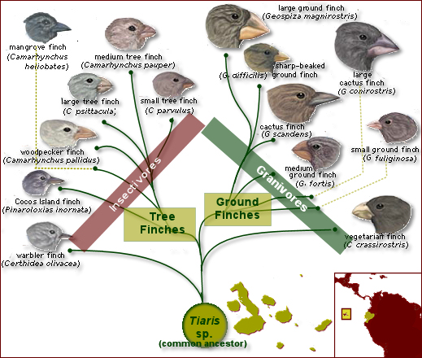
Natural Selection in Birds
Classic textbook example:
  Darwin’s Finches
  At the very base of the theory of Evolution by Natural Selection
  An excellent example, of course…
  Over-used?
“On the Origin of Species…” published in 1859….
Notes:
Section 1. The Textbook case of Darwin’s finches (Slide 2)
The example of Natural Selection that everybody knows about, even non-biologists. All the present day Galapagos Ground and Tree finches evolved form a single species of Tiaris finch, which was the only finch species to reach the archipelago. Of course still important and relevant and an example of not just natural selection but also relevant when covering Island Biogeography and other topics. Arguably an example that is over-used and also the coverage given to it in general biology textbooks never gives the full, up to date story. “On The Origin of Species…” published 160 years ago – time to move on?

Slide 3
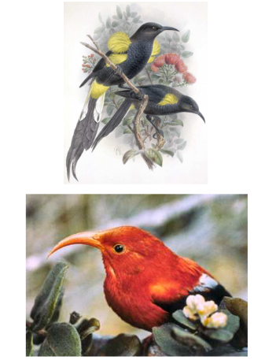
An Alternate Example?
Sympatric species in Hawaii
Strong evolutionary pressure of flower shape on bill morphology
I’iwi (bottom) prevented from feeding on Ohias (Flowers) by dominant ‘o ‘o (top)
When ‘o ‘o extinct in 1900 I’iwi shifted foraging emphasis
Upper mandible has become shorter and bill less decurved in short evolutionary time (Smith et al., 1995)
Notes:
Section 2. An alternative to Darwin’s finches? (Slide 3)
An alternative and much more recent example, which still illustrates natural selection. The I’iwi and ‘o’o were sympatric species on Hawaii. The dominant ‘o’o prevented the I’iwi nectar feeding on flowers of the Ohia plant. The ‘o’o went into extinction in 1900 and in the following century the I’iwi shifted its foraging emphasis towards the Ohia. Selection pressure was so strong that the paper by Smith et al. in 1995 demonstrated that the upper mandible has become shorter and the bill less decurved in the I’iwi to allow more efficient feeding on the Ohia flowers. Overall a much better example as it is more recent and also demonstrates selection over a short and defined time period, rather than the undefined time period of Darwin’s finches.

Slide 4
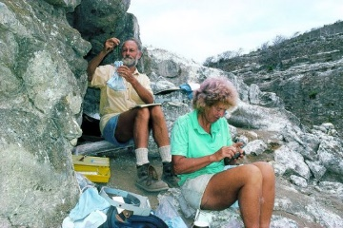
Darwin’s Finches Revisited
Peter and Rosemary Grant
“40 Years of Evolution: Darwin's Finches on Daphne Major Island”
Prolonged observation (from 1973 to 2013) of the Medium Ground Finch (Geospiza fortis) and Common Cactus finch (G. scandens) on Daphne Major
Tagged 20,000 birds (c. 8 generations)
Notes:
Section 3. Darwin’s Finches Revisited (Slides 4 – 6)
Another look at Darwin’s Finches, but from a more modern perspective. A 40 year study from the early 1970’s to the current decade focusing on 2 species of finch on the island of Daphne Major; the Medium Ground Finch Geospiza fortis and the Common Cactus finch G. scandens. 20,000 individual birds of approximately 8 generations were individually marked and followed. A serendipitous, natural, severe drought in 1977 selected for plants with larger seeds, in turn selecting for larger bill size in the finches. This allowed evolutionary change to be demonstrated within the period of the study. In addition the authors studied song as a barrier to reproduction between the 2 closely related species. This is a study which updates the story of Darwin’s finches and takes the research further, but is yet to reach most of the text books.

Slide 5
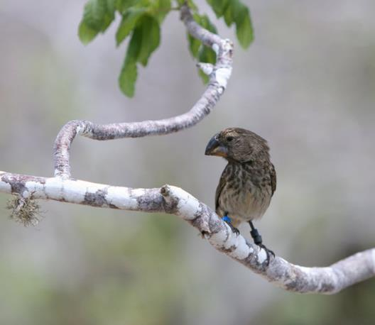
Darwin’s Finches Revisited
Severe drought in 1977:
  Large seeds became more plentiful
  Birds with bigger bills more successful at opening seeds and feeding
  Lasting effect on bill size
  Evolution within the period of study

Slide 6
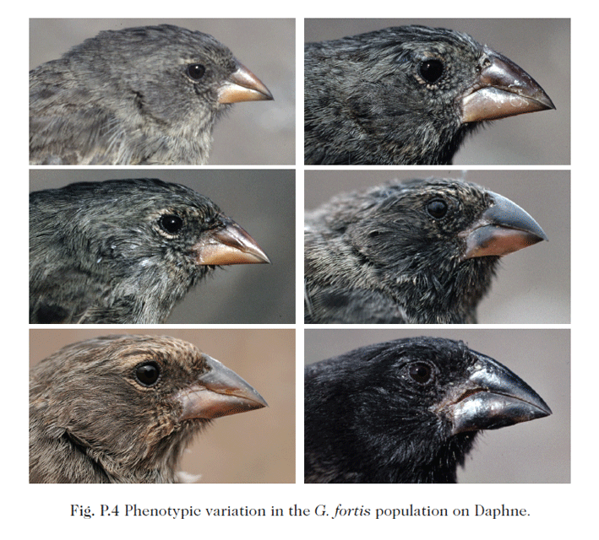
Darwin’s Finches Revisited
Mean bill shape and body size of both finches differed markedly between 1973 and 2002
Song – a learned culturally transmitted trait – acted a as barrier to reproduction between the species.
Rare incidences of misimprinting on song – low levels of gene flow increased genetic variation on which selection acted.

Slide 7
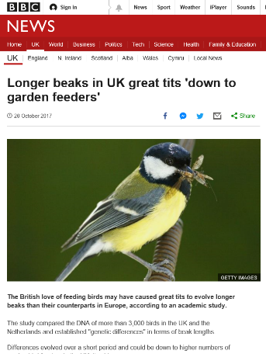
Something Closer in Space/Time?
Study on bill length of Great Tits (Parus major)
Long term study at Wytham Wood, Oxfordshire – 70 years
Published in the journal ‘Science’ in October 2017 (Bosse, et al.)
Picked up by BBC website and various newspapers, including the ‘Guardian’
Notes:
Section 4. Something closer in Space and Time (Slides 7 – 10)
A study on species that should be more familiar to pupils at Scottish schools – a 70 year study of the Great Tit Parus major in Wytham Wood, Oxfordshire. Study picked up by print and online media, in particular the finding that bill length of the birds increased over the period of the study due to the birds accessing garden feeders. An accessible recent study on a common species. Again demonstrates an example of evolution by natural selection and selection happening over a short period of time. Again more to the example than simply an increase of bill size. Also a nice example of how the media pick up scientific research and do not always get things correct. A more realistic summary of the research would be that bill size of UK Great Tits is longer than the birds on mainland Europe but there has been a recent DECREASE in bill length. Final slide acts as a summary to the foregoing and gives a link to an ongoing citizen science project on house sparrows in Glasgow that should interest the students.

Slide 8
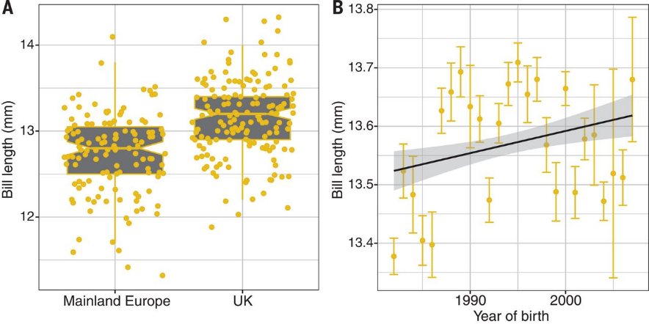
Great Tit Bill Length

Slide 9
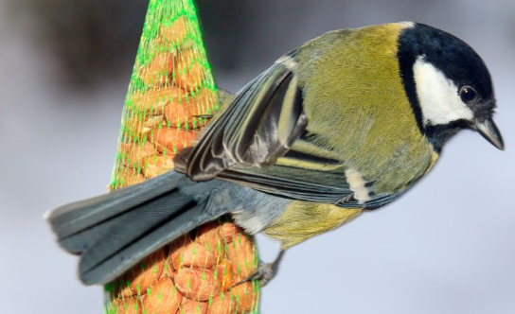
Great Tit Bill Length
Perrier and Charmantier (2018)
  Alternative statistical approach
  Recent DECREASE in bill length in UK birds
  DO have longer bills than Great Tits on mainland Europe
“massively communicated strong assertion* was based on what was rather a speculation by the authors” *By the media

Slide 10
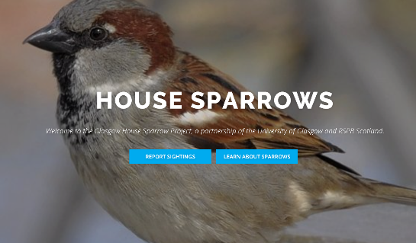
Natural Selection….
A LOT of relevant new research out there
No need to rely on the classic studies, but…
Classic studies are often still being updated
Local studies perhaps resonate more with students
https://www.housesparrowscience.com/
Notes:
Resources.
https://www.researchgate.net/publication/249431722_Evolutionary_Consequences_of_Extinctions_in_Populations_of_a_Hawaiian_Honeycreeper
https://www.wired.com/2016/10/legendary-biologists-clocked-evolutions-astonishing-speed/
https://www.bbc.co.uk/news/uk-41696123
https://science.sciencemag.org/content/358/6361/365.full
https://www.housesparrowscience.com/

