Slide 2
Understanding Standards
Physics (Advanced Higher)
An overview of course assessment

Slide 3
Aims of the presentation
To provide teachers and lecturers with:
an overview of the revised course assessment for Advanced Higher from session 2019-20
information on what is changing and what is not changing
information on the question paper and project components

Slide 4
What this presentation covers
overview of Advanced Higher (AH) course assessment
project
support for candidates during the project
marking instructions for the project
support for teachers and lecturers

Slide 5
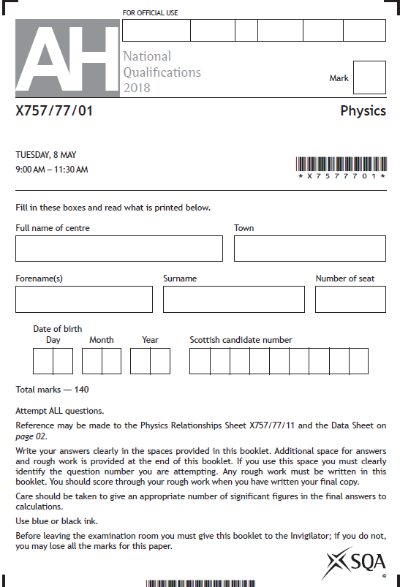
Overview of AH course assessment
Why are changes being made to the course assessment?
Advanced Higher unit assessment
1 Apply skills to carry out an experiment
2.1 Make accurate statements
2.2 Solve problems

Slide 6
Overview of AH course assessment
up to session 2018-19
Component | Marks | Scaled marks | Contribution to course award
Question paper 2·5 hours | 140 Extended response | 100 | 77%
Project | 30 | 30 | 23%

Slide 7
Overview of AH course assessment
from session 2019-20 onwards
Component | Marks | Scaled marks | Contribution to course award
Question paper 3 hours | 155 Extended response | 120 | 75%
Project | 30 | 40 | 25%

Slide 8
Overview of AH course assessment
Question paper
Unchanged:
knowledge and skills assessed
level of demand
conditions for assessment

Slide 9
Overview of AH course assessment
Question paper
Changes:
increased number of marks
duration of the question paper
contribution to course award

Slide 10
Overview of AH course assessment
Course specification
Single document, containing:
course assessment
course content
mandatory knowledge

Slide 11
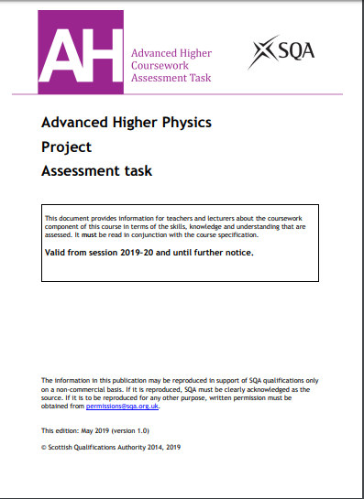
Overview of AH course assessment
Project assessment task
Single document, containing:
instructions for teachers and lecturers
instructions for candidates
marking instructions

Slide 12
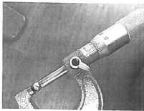
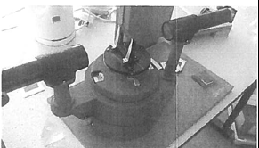
Project
wide choice of topic for experiment
focus on physics
clear progression through levels
good scientific practice takes lead - assessment follows
straightforward marking instructions
experience familiar to candidates

Slide 13
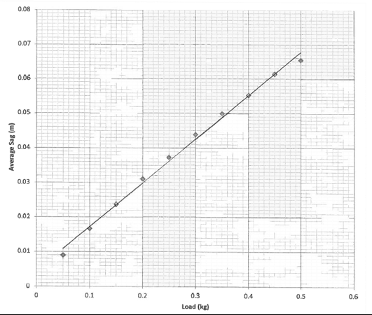
Project
Plan and carry out experimental work that involves collecting numerical data:
typically three or four experiments related to the aim
spending 10–15 hours making measurements and gathering data
Process and analyse their experimental data:
basic numerical processing (calculating mean values and derived values if appropriate)
graphing data
analyse experimental data

Slide 14
Project — daybook
Teachers and lecturers should encourage candidates to use a daybook to maintain a record of their planning, research, experimental measurements and analysis.
It is important that the teacher or lecturer check each candidate’s daybook regularly to monitor progress and give advice.
A well kept daybook is a significant support to candidates in both the planning and organisation of their research, and in the production of their report on the project.

Slide 15
Project — conditions for assessment
The conditions for assessment are designed to:
prevent third parties from providing inappropriate levels of guidance and input
mitigate concerns about plagiarism and improve the reliability and validity of SQA awards
allow centres a reasonable degree of freedom and control
allow candidates to produce an original piece of work
Report writing

Slide 16
Project — conditions for assessment
Research stage | Reporting stage
Experiment Internet / literature research | Report writing
Candidates must work individually. The use of resources, including internet, is not tightly prescribed. Candidates do not need to be directly supervised at all times. Teachers and lecturers: — cannot provide templates for results — cannot provide experimental data — can provide advice on the suitability of topic and aim — can provide advice on safe and correct use of apparatus — can provide reasonable assistance
Experiment
Internet / literature research
Report writing

Slide 17
Project — reasonable assistance
The use of the term ‘reasonable assistance’ is to try to balance the need for support with the need to avoid giving too much assistance.
Teachers and lecturers must be careful that the integrity of the assessment is not compromised.
Teachers and lecturers must not provide model answers or templates specific to the task.
Please refer to the Guidance on conditions of assessment on the SQA website for more detailed advice on what constitutes reasonable assistance.

Slide 18
Project — autonomous working
The project may involve candidates undertaking a larger amount of autonomous work without close supervision than they have previously undertaken.
Although candidates may complete part of the work outwith the learning and teaching setting, the teacher or lecturer should put in place processes for monitoring progress and ensuring that the work is the candidate’s own and that plagiarism has not taken place.

Slide 19
Project – research stage
Choose a topic to investigate.
— physics must be of Advanced Higher level of demand
— experimental work must generate numerical data
— data must lend itself to graphical analysis
— allows candidates to access all of the available marks
Candidate should agree aim with teacher or lecturer, taking account of:
— health and safety
— availability of resources
Teacher or lecturer must not provide wording of aim.

Slide 20
Project – research stage
Unless a centre is presenting a large number of candidates (more than 10), the teacher or lecturer must not allow a candidate to choose a topic that may lead to experimental procedures similar to those being carried out by another candidate in the centre.
There should be no need for candidates in a small class or group to be investigating the same topic.
Centres presenting a larger number of candidates must minimise the number of candidates investigating the same topic.
Every candidate in the centre should have their own individual data.

Slide 21
Project — experimental research
Working individually, candidates will:
plan experiments, make measurements and gather data
spend 10–15 hours taking measurements
typically complete three or four experiments
carry out a number of repeats appropriate to each experiment
use a suitable range and interval of independent variable for each experiment

Slide 22
Project — internet/literature research
Initial candidate research will probably involve gathering information on potential experiments, but may also involve gathering information from internet/literature sources to support their understanding of the underlying physics.
Candidates may carry out research outwith the direct supervision of teachers and lecturers.
Candidates should make a careful note of their sources of information in their daybooks. This will help with the completion of their references later in the project.

Slide 23
Project — experimental research
Teachers and lecturers:
should advise on safe and correct use of equipment
must not provide blank or prepopulated results tables
must not provide candidates with experimental data

Slide 24
Project — report stage
Candidates must produce a report on their investigative work.
The report is produced under some supervision and control, which means:
— candidates work individually
— the use of resources, including internet, is not tightly prescribed
— candidates do not need to be directly supervised at all times, although it is important that the report a candidate submits for assessment is their own work
— teachers and lecturers:
cannot provide templates for results
cannot provide experimental data
can provide reasonable assistance

Slide 25
Support for candidates during the project
Assessment should take place when candidates are ready to be assessed.
Teachers and lecturers must:
ensure candidates understand the requirements of the task by issuing ‘instructions for candidates’ at the outset
exercise their professional responsibility to ensure that the report submitted is the candidate’s own work
ensure that appropriate risk assessment has been carried out and provide guidance on the safe and correct use of equipment
ensure every candidate conducts their experimental work individually — group work is not permitted
Report writing

Slide 26
Support for candidates during the project
Teachers and lecturers must:
agree the choice of topic with the candidate to ensure that:
— it is commensurate with Advanced Higher Physics
— it has associated experimental work that can generate numerical data suitable for the production of scatter graphs
— it will allow candidates the opportunity to access all of the available marks
provide advice on the suitability of the candidate’s aim, taking into account:
— health and safety considerations
— availability of resources
Report writing

Slide 27
Support for candidates during the project
Teachers and lecturers must:
— have regular checkpoint/progress meetings with each candidate to discuss progress by reviewing the candidate's daybook
— put in place processes for monitoring progress and ensuring that the work is the candidate’s own and that plagiarism has not taken place
Teachers and lecturers must not provide:
— a template or model answers at any stage
— an aim
— experimental data
Report writing

Slide 28
Support for candidates during the project
Guidance on producing the report
Title – tell the reader what the project is about.
Contents page – tell the reader where sections can be found.
Abstract – describe clearly the aim and findings of the project.
Underlying physics – show understanding.
Description of apparatus – label diagrams and photographs.
Description of procedures – describe clearly how the apparatus was used.
Data – include sufficient data, which is relevant to the project.
Analysis – include an appropriate analysis of data.

Slide 29
Support for candidates during the project
Guidance on producing the report
Uncertainties – in individual readings and final results.
Conclusions – valid and relate to the aim of the project.
Evaluations – an evaluation of each experiment.
Coherent discussion – of overall conclusion(s) and a critical evaluation of the project as a whole.
Presentation – report with an appropriate structure and references to at least three sources listed near the end of the report and cited in the text, using Vancouver or Harvard referencing systems.

Slide 30
Support for candidates during the project
Word count
The project report should be between 2500 and 4500 words in length, excluding the title page, contents page, tables of data, graphs, diagrams, calculations, references and acknowledgements.
If the word count exceeds the maximum by more than 10%, a penalty of 3 marks out of the total of 30 will be applied.

Slide 31
Marking instructions for the project
Advanced Higher project report
Abstract | States the overall aim and findings | 1 | 1
Underlying physics | Shows understanding of the relevant physics good, reasonable, limited | 4 | 4
Procedures | Labelled diagrams and/or descriptions of apparatus | 2 | 7
 | Clear descriptions of how the apparatus was used to obtain experimental readings | 2
 | Procedures are at an appropriate level of complexity and demand | 3

Slide 32
Marking instructions for the project
Advanced Higher project report
Results (including uncertainties) | Data sufficient and relevant to the aim of the project | 1 | 8
 | Appropriate analysis of data | 4
 | Uncertainties in individual readings and final results | 3

Slide 33
Marking instructions for the project
Advanced Higher project report
Discussion (conclusion(s) and evaluation) | Valid conclusion(s) that relate to the aim of the project | 1 | 8
 | Evaluations of experimental procedures | 3
 | Coherent discussion of overall conclusion(s) and critical evaluation of the project as a whole | 3
 | A report which indicates a quality project | 1

Slide 34
Marking instructions for the project
Advanced Higher project report
Structure | A report with an appropriate structure, including informative title, contents page and page numbers | 1 | 2
 | References to at least three sources cited in the text and listed at an appropriate point in the report | 1
 |  |  | 30

Slide 35
Support for teachers and lecturers
Advanced Higher Physics Course Specification
Advanced Higher Physics Project Assessment Task
example sections of projects
Advanced Higher Physics Specimen Question Paper

