Slide 2
National Progression Awards
Business Education

Slide 3
National Qualification Group Award (NQGA)
National Certificate (NC)
National Progression Award (NPA)

Slide 4
What are NPA’s?
Short programmes of learning designed to assess a defined set of skills and knowledge in a specialist vocational area
Linked to National Occupational Standards (NOS)
Group of Units that complement each other:
internally assessed
SCQF levels 2-6

Slide 5
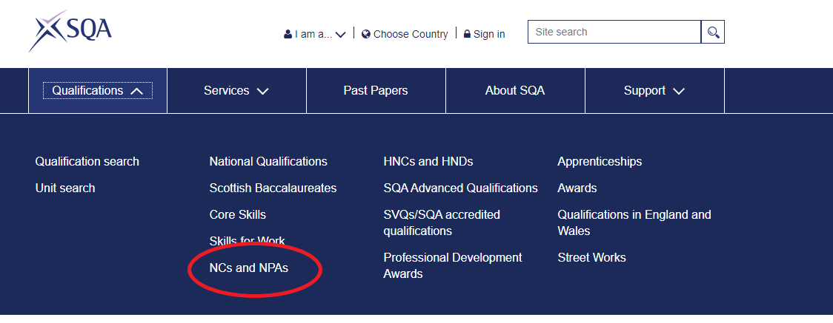
Finding NPA information on SQA website

Slide 6
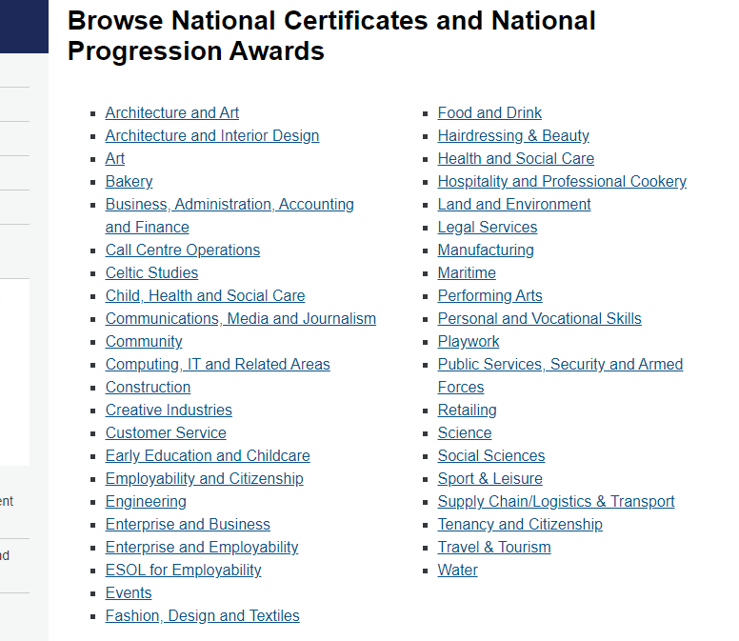
Finding NPA information on SQA website

Slide 7
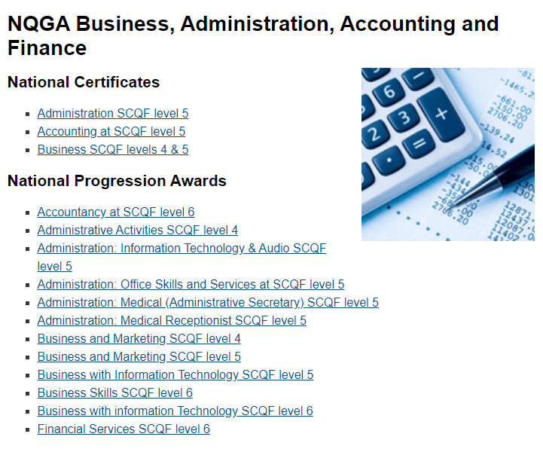
Finding NPA information on SQA website

Slide 8
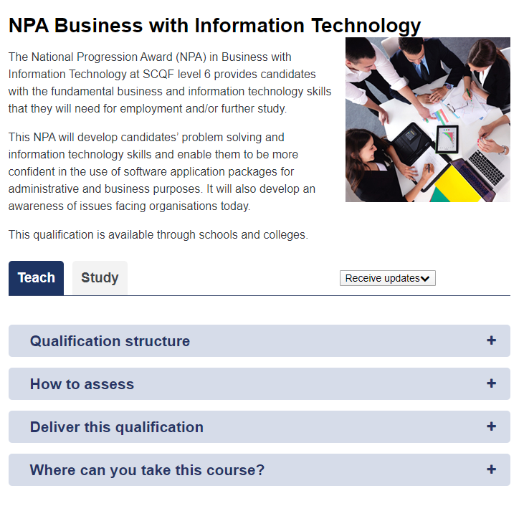
NPA web page

Slide 9
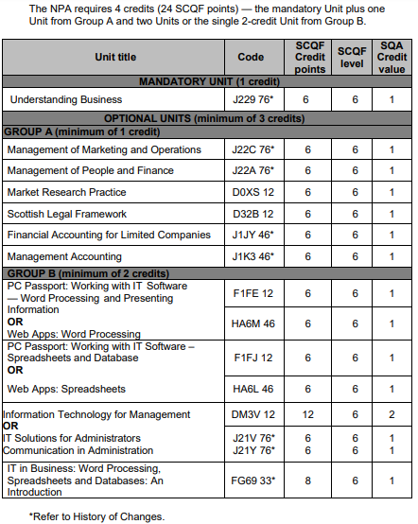
Qualification structure
NPA Business with Information Technology (SCQF level 6)

Slide 10
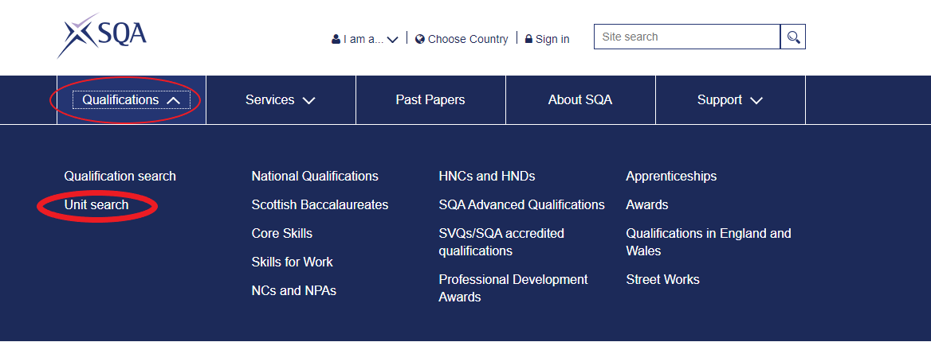
Finding unit specifications

Slide 11
How to know which Group Award is the best choice for your centre?
Timetable:
Size (length) of the group award
Level of the Group Award
Unit delivery over more than one year

Slide 12
How to know which Group Award is the best choice for your centre?
How familiar are you with the unit content and surround:
Are the units in any other awards you may already be familiar with
Reviewing unit specifications
Availability of assessment materials (UASPs are on SQA secure available for some, but not all, units)
Time required for developing learning materials and assessments

Slide 13
Other things to consider
Centre approval:
Pre-approved?
Lead-in time for processing approval application
Candidate enrolment:
To be entered for both units and group award
Verification:
Internal
External
Partnership with college

