Slide 1
Digital Participation
Colin Cook
March 2016

Slide 2

Aims

Slide 3




By way of Background….

Slide 4

And of course…..

Slide 5
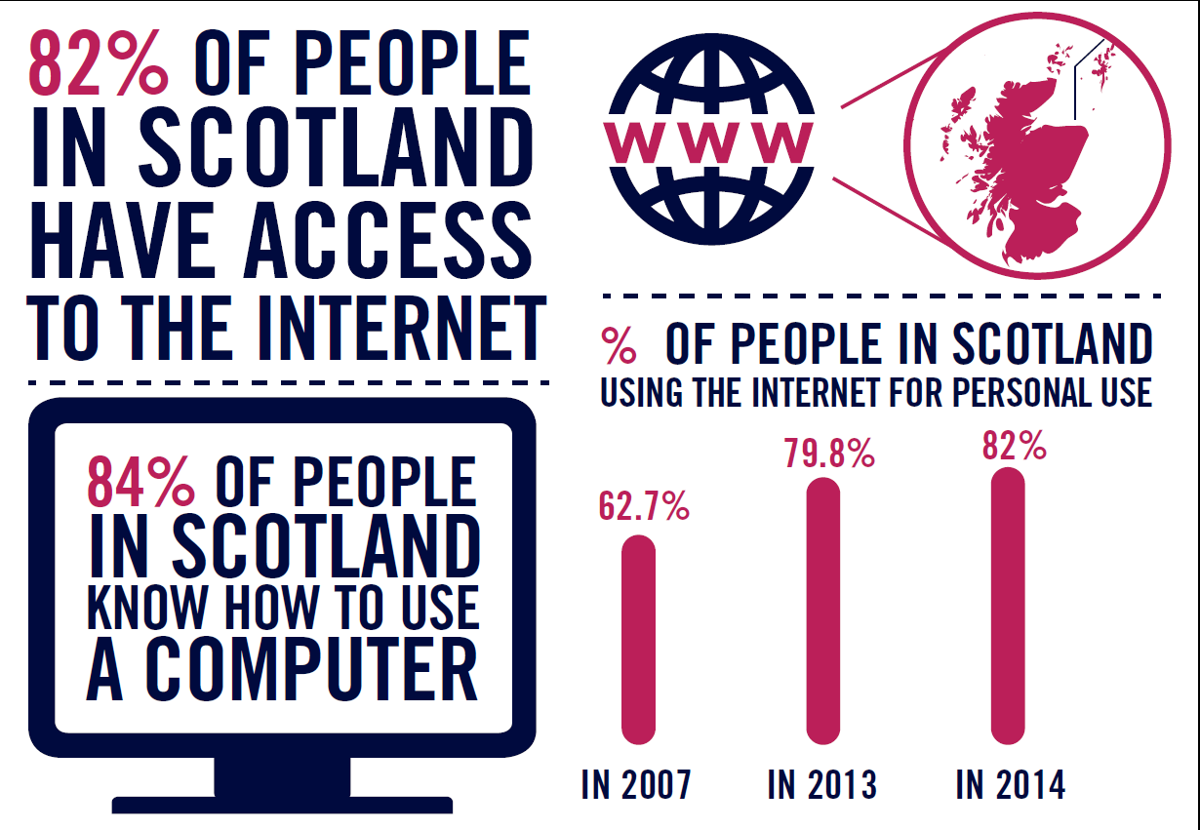

Slide 6

A few asks

Slide 7

A few asks

Slide 8
So then….

Slide 9
Digital Participation Charter
Invest in staff and volunteers
Empower them to help others
Contribute practical support to projects
Work together and coordinate our efforts
Adopt a common language

Slide 10

A few asks

Slide 11

And of course..

Slide 12
Digital Participation
Colin Cook
March 2016

