Slide 1

Bruce Eunson
Scots Language Co-ordinator

Slide 2

A’m here fae Shetland…
A’ll introduce mesel in Shetland dialect:
I hiv been wirkin fir Education Scotland fir ower 5 year noo. Afore dat I wis Dialect Co-ordinator fir da Shetland Islands Cooncil
A’m been publishin poetry an stories in Scots fae I wis in mi teens – it’s a lifelang passion o mine
I spaek, an I write, in Shetland dialect – dat is da regional variety o Scots we use. Sam as Doric in da North East & Orcadian in Orkney, sam as Robert Burns in da 18th Century & Irving Welsh in Trainspotting
for Scotland’s learners with Scotland’s educators

Slide 3
A’m here ta hae a blether aboot…
Promoting the Scots Language and Scottish Studies Awards:
Education Scotland resources are available online on the National Improvement Hub
https://education.gov.scot/improvement/
For resources written and shared by other teachers, there is the Scots Blether on GLOW
http://bit.ly/scotsblether
An if ye still canna finn whit yir luikin fir or needin, email me direct: bruce.eunson@educationscotland.gov.scot
for Scotland’s learners with Scotland’s educators

Slide 4
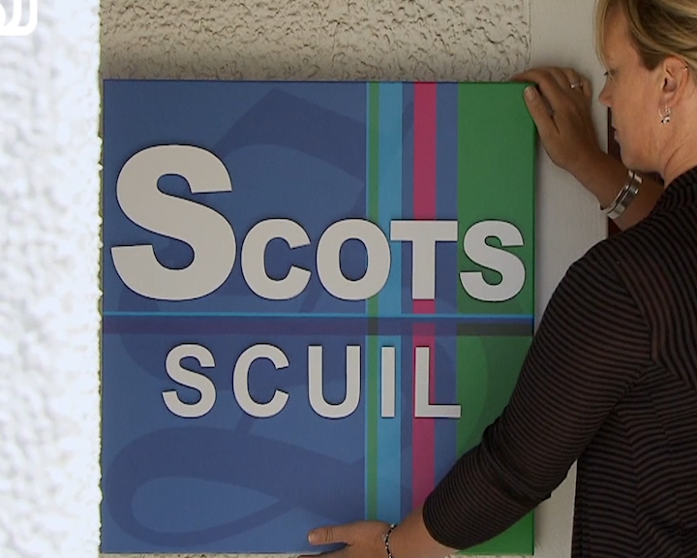
Wan wye ir anither
https://scotlandonscreen.org.uk/resources/lesson-guides/scots-language-learning-journey

Slide 5
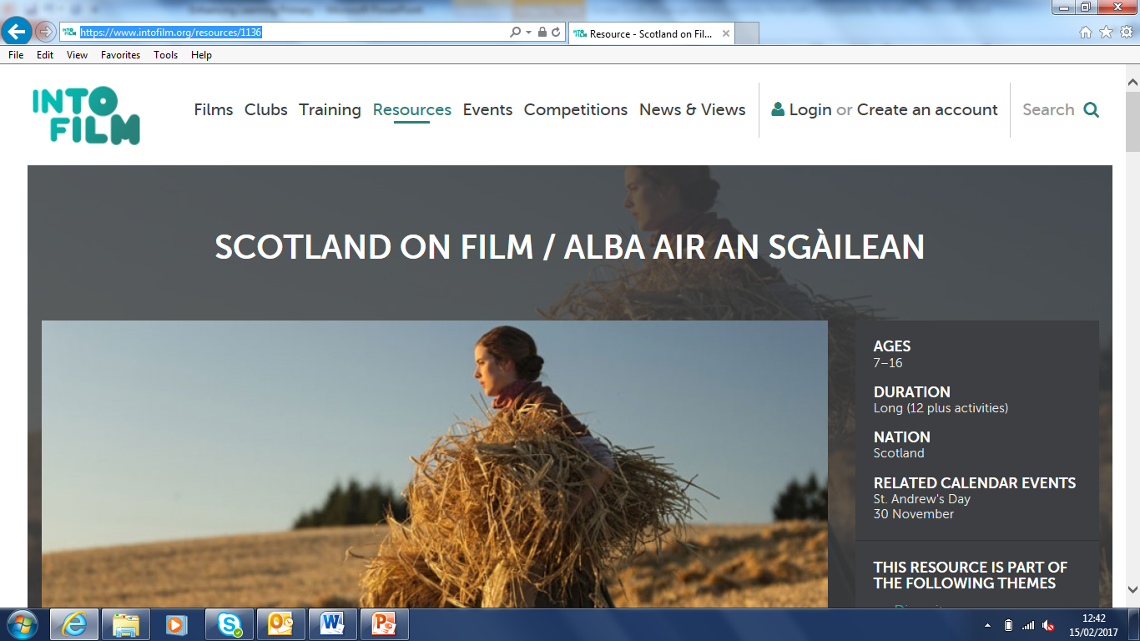
Scotland on Film
https://www.intofilm.org/resources/1136

Slide 6
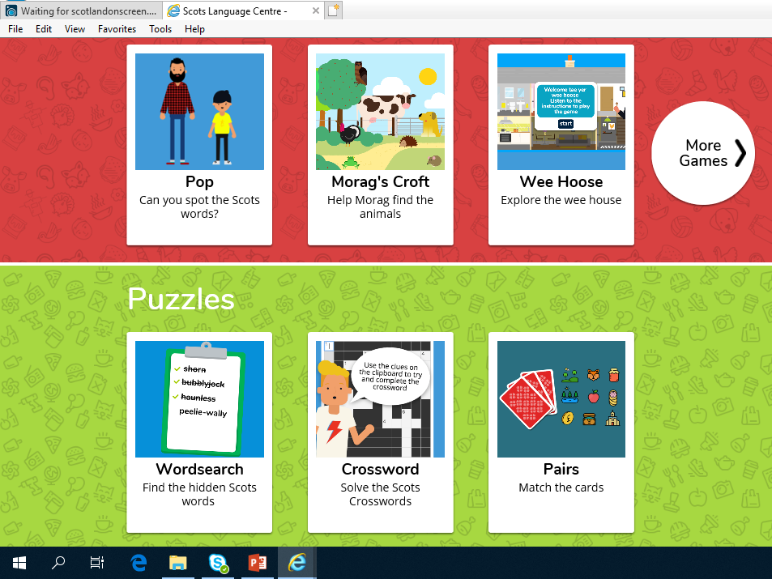
Ah fin it aa a bit ae a fankle…
www.scotslanguage.com/learning
for Scotland’s learners with Scotland’s educators

Slide 7
CPD: Open University in Scotland
New Open Learn course on Scots language
  Approx. 10 hours of study, structured in 20 sections
  Free and accessible to all via OpenLearn Create
Having completed the course, the aim is for learners to:
  understand Scots as a living language;
  understand the history and linguistic development of Scots;
  have more confidence, knowledge and skills in the use of Scots in the classroom;
  have increased awareness of other, related resources and how to access them
for Scotland’s learners with Scotland’s educators
Notes:
The Open University in Scotland (OUiS) and The Open University School of Languages and Applied Linguistics have been working to develop Scots language and literature related resources. This new Scots Language course will be published via The Open University’s new platform OpenLearn Create.
The aim is to contribute to the continuing professional development of teachers (and other tutors). In particular, the course is intended to complement the past and continuing activity of Education Scotland in this field. Alongside the University’s degree level, credit-bearing courses, the Scots Language OER will form part of the wider languages curriculum of the OU.

Slide 8
Ony questions?
for Scotland’s learners with Scotland’s educators
Notes:
Any questions?

