Slide 1
Digital Technologies for Administrators
Problem Solving Approach to Learning and Teaching
June McCamlie

Slide 2
Digital Technologies for Administrators
This new unit, is designed to develop knowledge and skills for today’s administrators. Students will learn not only how to use technology but to understand how technology may be harnessed to provide efficient and effective solutions to administrative functions.

Slide 3
Digital Technologies
Communication Technologies
Social Media
Collaborative Software
Web Services .....
All in a Business Context

Slide 4
Outcomes 1 and 2
Outcome 1
Students are asked to Investigate and explain a range of Information and Communication Technologies.
Outcome 2
Students are asked to investigate and explain the effective use of social software in a modern business environment.

Slide 5
Outcome 3
Outcome 3
Students are asked to demonstrate both cognitive and practical competence using various web services and collaborative software to organise work.
Students will evaluate and present findings and conclusions derived from feedback.

Slide 6
Assessment of Outcomes 1 and 2
Use of Solar Assessment Bank Questions
Multiple Choice and Multiple Response Questions
An issue that is often raised about MCQ/MRQs is can they be used to assess descriptive (or higher order) competence?
The answer is ..Yes they can. Selecting a description is considered cognitively the same as writing a description.

Slide 7
MCQs Example
Which of the following is a freeware, cross-platform and end-to-end encrypted instant messaging application for smartphones?
a. Whatsapp, b. Snapchat c. Twitter d. Facebook
This is a question on Types of social software.
Answer is ‘a’

Slide 8
MRQs Example
You are to carry out research for your manager using the WWW. Which of the following attributes should you consider when validating your source information?
Authority b. Accuracy c. Objectivity d. Browser
This is a question on Validity of source information
Answer is a, b, c

Slide 9
Outcome 3
Assessment using Solar
Students will work collaboratively to undertake tasks based on a business case study/scenario.
They will produce an individual report which will be uploaded to Solar and marked using an on-line, detailed checklist.

Slide 10
Students must investigate, gather and document information to meet the evidence requirements.
The students will undertake investigative research using the Internet and the WWW.
They should know how to authenticate that the information being gathered is valid.
Documenting this research is very important if students want to achieve.
The research will not only be used for this unit, but also Graded Unit 1.

Slide 11
Confucius
“I hear and I forget. I see and I remember. I do and I understand.”

Slide 12
Students should do their own learning
Whole Brain Learning

Slide 13
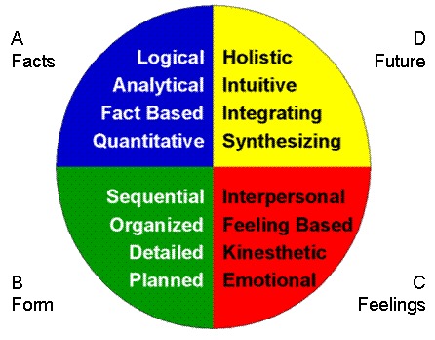
Presenting Information
Use Whole Brain
Logic - Facts and
Figures
Holistic - Graphical
Images

Slide 14
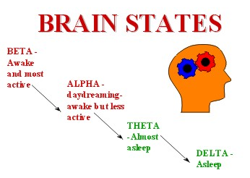
How are your Students?
.
Hope they are
not at this stage!!

Slide 15
Graphical Organisers
Using text as well as graphics can engage more
of the brain and therefore engage the student to
become a more active learner.
Free software packages are available to enable
the drawing of these graphic organisers,
students can upload them to the cloud and
allow access to others in their group to allow
collaborative working

Slide 16
Venn Diagram
Compare and contrast Cloud and Removable Storage
Cloud
Removable
Storage

Slide 17
Same and Different Table (Comparison Table)
Cloud and Removable Storage | Different | Same
Cloud | Students write here | Students write here
Removable | Students write here | Students write here

Slide 18
Tree Diagram

Slide 19
Decision Tree
Yes
Cloud
Storage? Yes
No
No
USB Drive?
Removable?
Fixed?

Slide 20
Holistic Concept Map/Mind Map
A
C
Topic
Ideas,issues et cetera
Ideas ……
Notes
B
Ideas,issues et cetera
Ideas ……
Notes

Slide 21
Flow Diagram
Effect
.................
..........
Cause
Cause
Cause
Not a Not an
Cause Effect
Event
Notes...
Notes...
Notes...
Notes...
Notes...
Notes...

Slide 22
Visual Essay Planning
Pros Cons
So This means

Slide 23
Workshops
Workshop 1
Which Graphic Organisers would be most appropriate for the following tasks?
Workshop 2
Based on Scenario 1 and Scenario 2
Solutions to Consider

Slide 24
Scenario 1 Information Assurance
Access
Accuracy
Intrusion
Timeliness
Permission rights
Goals
Non-repudiation
Networks
Buildings
Information Assurance
Firewalls
Passwords
Products
Perspective
Viruses
Hackers
Procedures
Security Guard
Policies

Slide 25
Scenario 2 Ornamental Plasterwork
Advantages
Disadvantages
Lightweight
Speed on Site
Less mess
Any design or shape catered for
Cost
££££
Breakages – on site & in transit
Casts – buckled/twisting, bent
Very expensive

