Slide 1
Managing Internal Assessment

Slide 2
Summative Assessment
All HND qualifications are summatively assessed using a mix of continuous Unit assessment and Graded Unit assessments
Summative assessment is carried out for the purpose of certification, and provides evidence that the student can meet the standards set out in the Unit Specification.

Slide 3
SQA ASPs
SQA commits to provide an ASP for each mandatory unit
New assessment ASPs only provided if unit specification changes
SQA not resourced to produce annual banks of ASPs
Notes:
(because it’s internal assessment not the exam diet (external assessment))

Slide 4
SQA ASPs
Assessment instruments become out of date
Assessment instruments are used year after year
Solutions become out of date
No re-assessment instrument
Notes:
Solutions become out of date – questions still valid but solution requires to be updated – Data Protection…. Brexit

Slide 5
Writing Assessments
Centres may wish to write their own assessment instruments
Send for prior verification
Use the Unit Specification

Slide 6
Assessment activities
student shows they can complete a task on a pc
student completes calculations
student gives written answers to questions based on a case study
student completes a written project
student answers questions in writing
student makes a presentation
student makes something
Be guided by the Unit Specification and current ASP

Slide 7
The principles of assessment
VALIDITY
Does it measure what it says it should measure?
Think about the type of assessment you use

Slide 8
The principles of assessment
AUTHENTICITY
Does it measure the knowledge/skills understanding of the student?

Slide 9
When is an assessment authentic?
A Unit specification calls for primary and secondary research from students and their own analysis of the research evidence they gathered.
The assessment requires the students to source the research of several recognised academics and to use materials from other sources to reach conclusions about a given subject
The assessment requires the students to create, issue and analyse questionnaires and to use materials from other sources to reach conclusions about a given subject
Notes:
The second one is authentic evidence

Slide 10
The principles of assessment
RELIABILITY
Would this assessment produce the same outcome every time it is used?

Slide 11
Which of the following impacts on an assessment’s reliability?
The Unit Specification calls for open book but the assessment is closed book
The assessment solution/marking guidance asks assessors to “use their own judgment” when making decisions
An assessment that will be delivered under closed book supervised conditions has no time limit for completion specified
Notes:
All these factors impact on reliability

Slide 12
The principles of assessment
CURRENCY
Is the evidence up to date and reflecting current practice?

Slide 13
The principles of assessment
SUFFICIENCY
Does the evidence reflect the Unit/Qualification standards

Slide 14
When might assessments not produce sufficient evidence?
Not all the knowledge specified in the Unit evidence requirements is assessed
All the knowledge/skills have been evidenced but the level of demand in the assessment was lower than defined in the Unit specification
Where it is a reassessment the assessment is not sufficiently different from the original assessment

Slide 15
The principles of assessment
AUTHENTICITY
Does it measure the knowledge/skills understanding of the student?
VALIDITY
Does it measure what it says it should measure?
RELIABILITY
Would this assessment produce the same outcome every time it is used?
SUFFICIENCY
Does the evidence reflect the Unit/Qualification standards
CURRENCY
Is the evidence up to date and reflecting current practice?
More Guidance – SQA Guide to Assessment

Slide 16
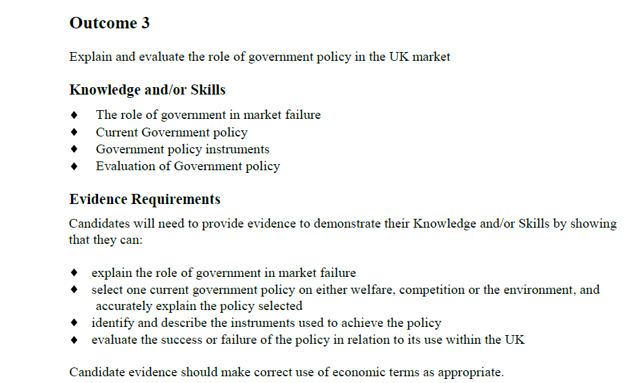
The Unit Specification
Watch the verb

Slide 17
SQA Guide to Assessment provides an explanation of what candidates are expected to do for each “verb”
As well as being useful for designing assessments, this can be given to students.

Slide 18
Writing an assessment
Your Checklist
Have the up to date US beside you at all times
Break each outcome down using the US evidence requirements
Read the evidence requirements carefully – check where it states X and Y as opposed to X or Y
Prepare an activity that enables students to produce the required evidence and will allow the assessor to measure their performance
Check the assessment covers all of the US requirements
Prepare a marking guideline, including any guidance notes and solutions
Have a colleague check it before internal verification if possible

Slide 19
Writing Assessments
Send for prior verification – don’t be scared!
Tick the box to allow assessment to be shared with other centres

