Slide 1
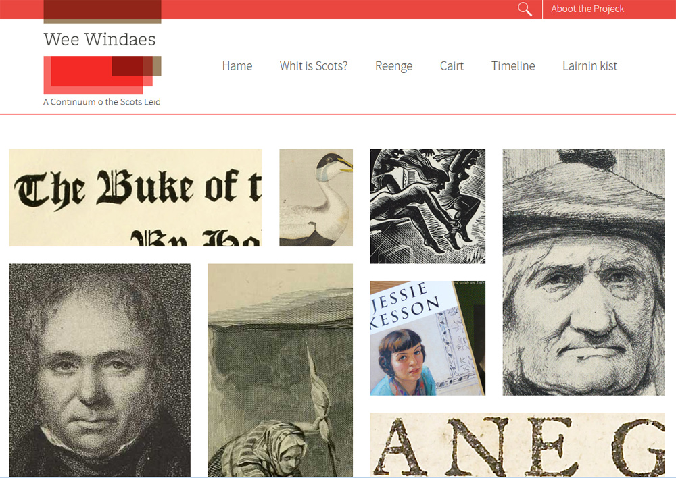

Slide 2
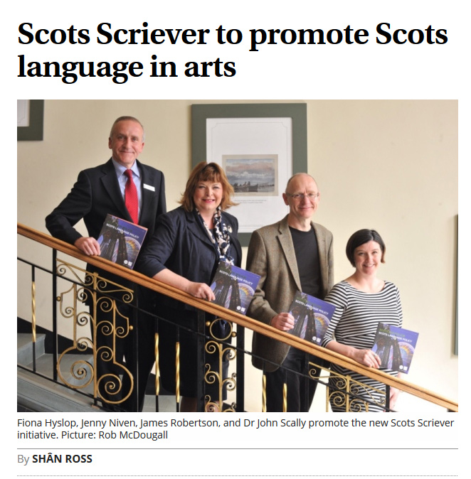

Funded by
The public body that supports the arts, screen and creative industries across all parts of Scotland on behalf of everyone who lives, works or visits there.

Slide 3
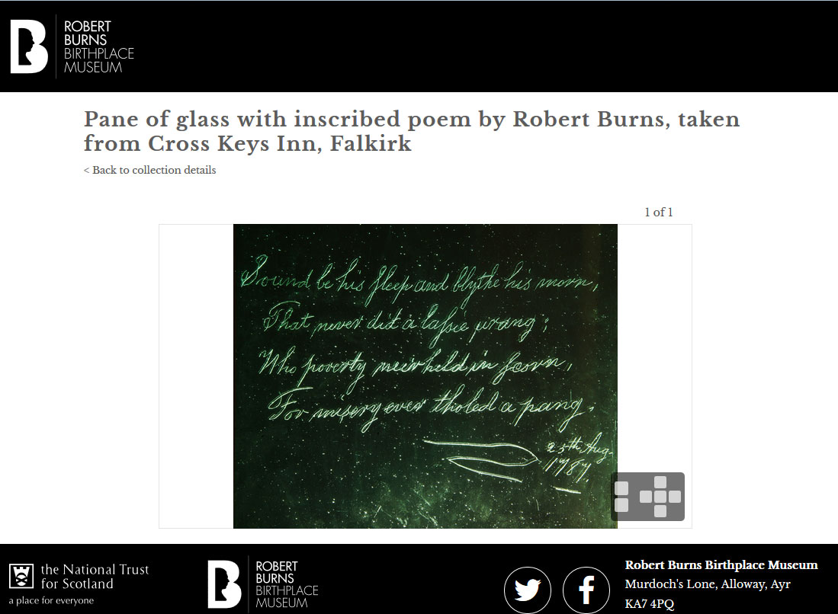

Slide 4
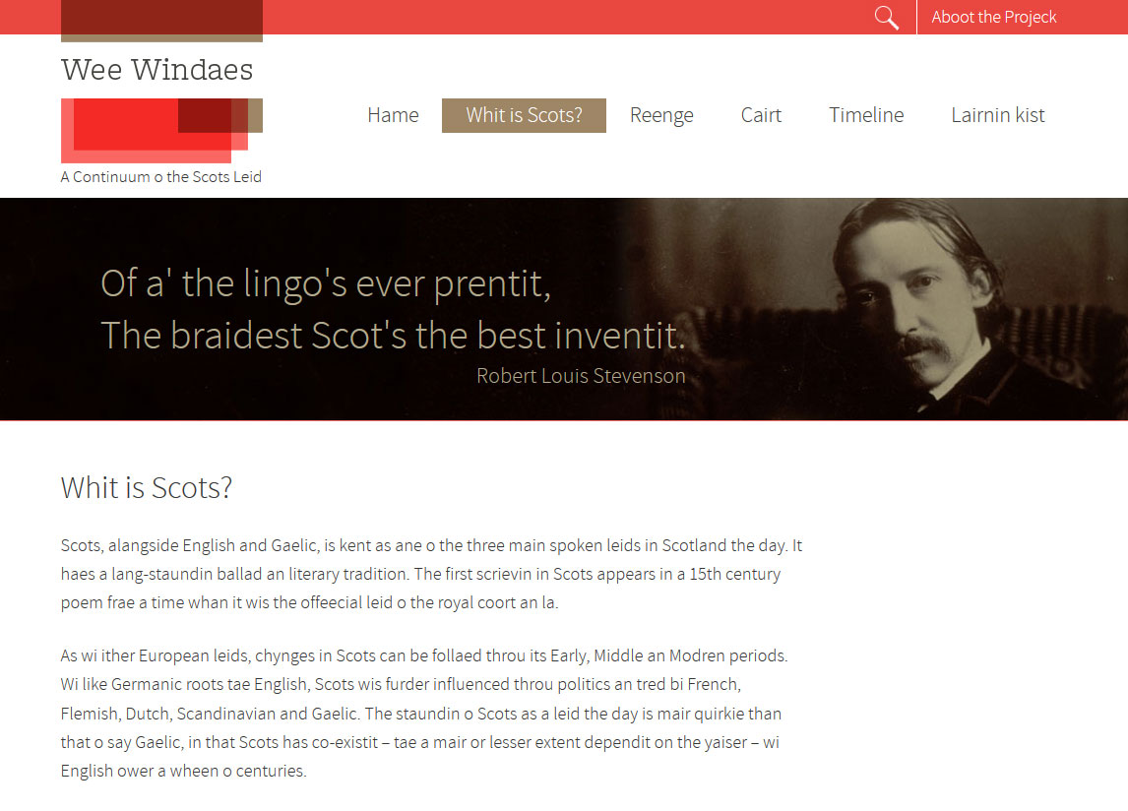

Slide 5
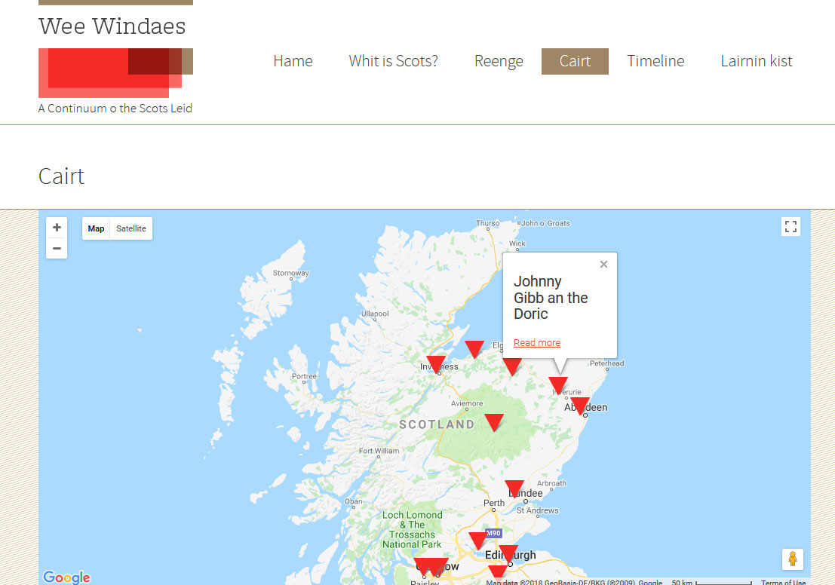
Showcasing the spread of printed items in Scots
The Scots spoken in Northeast Scotland is known as Doric

Slide 6
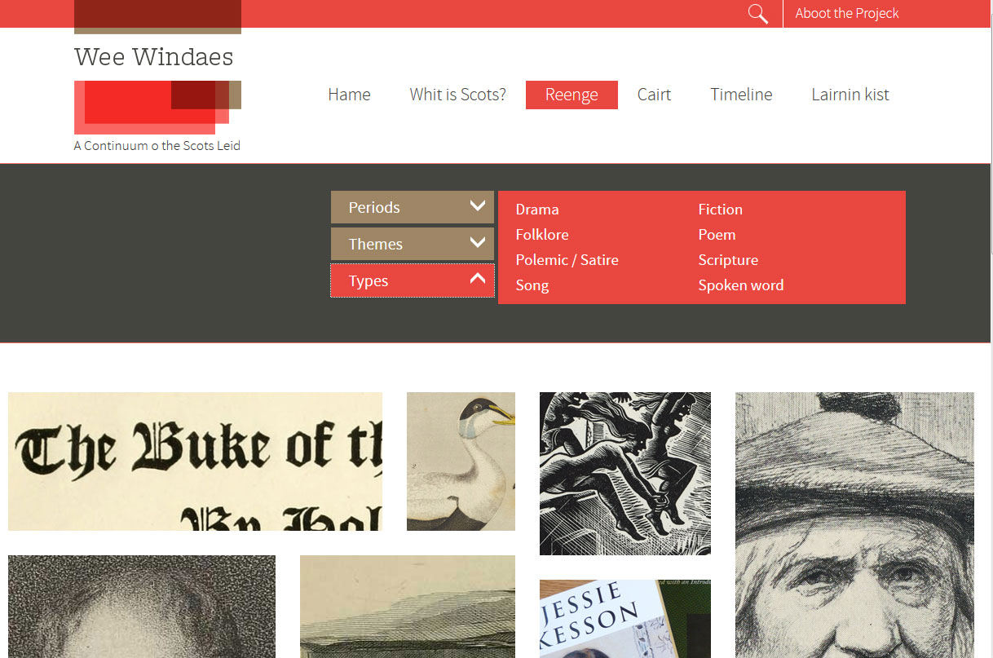

Slide 7
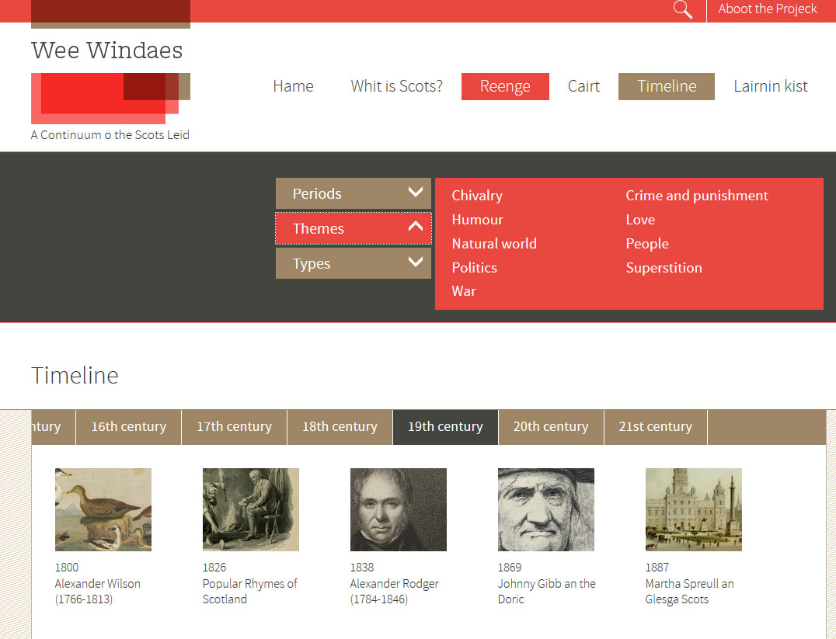

Slide 8
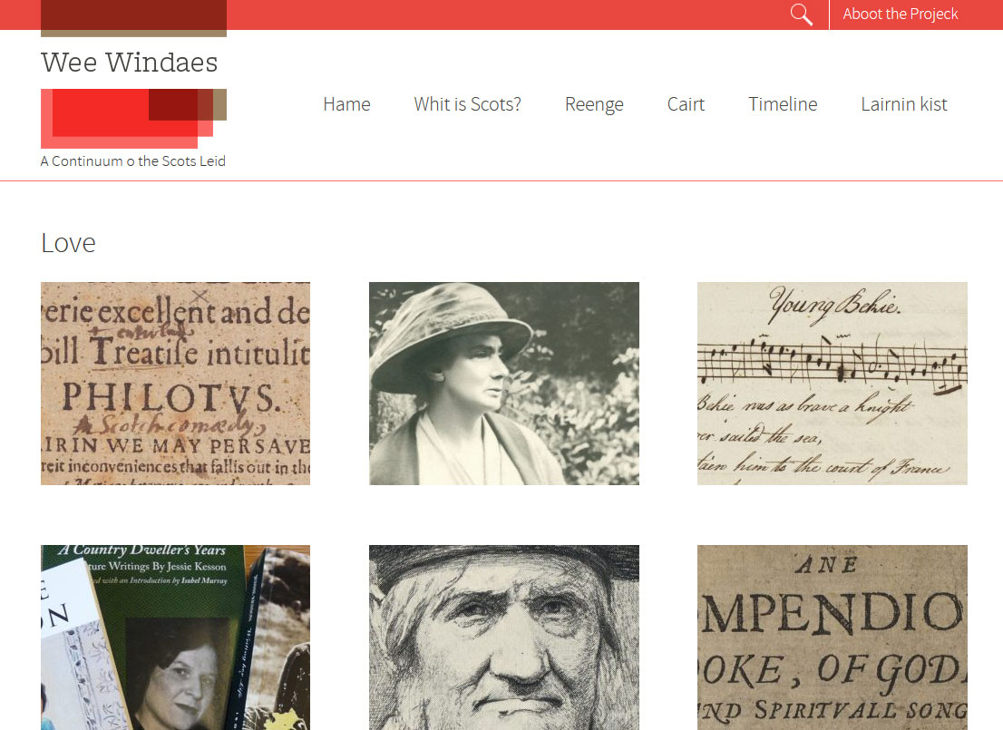

Slide 9
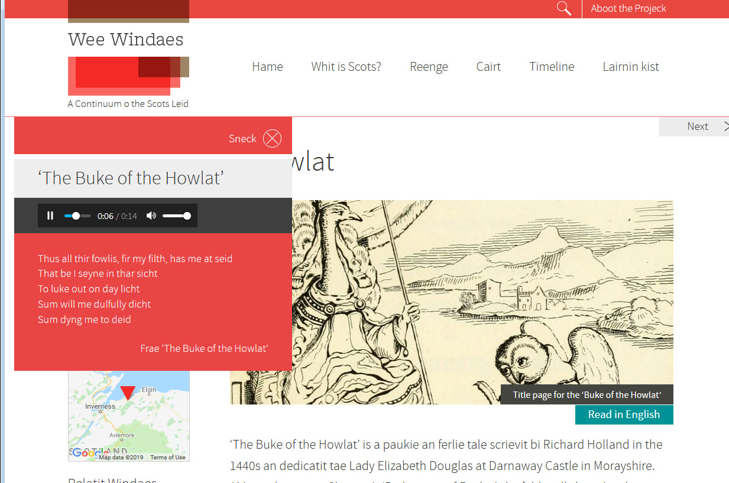

Users can switch seamlessly from Scots to English and vice versa
Each windae has an audio sample

Slide 10
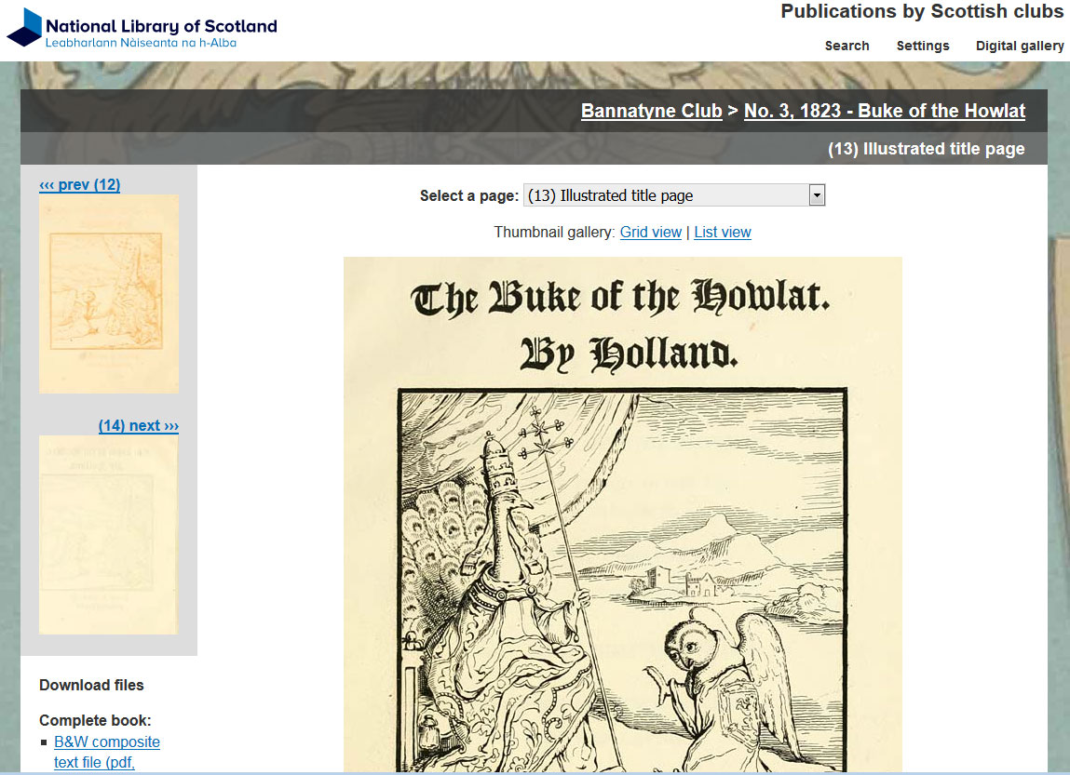

Slide 11
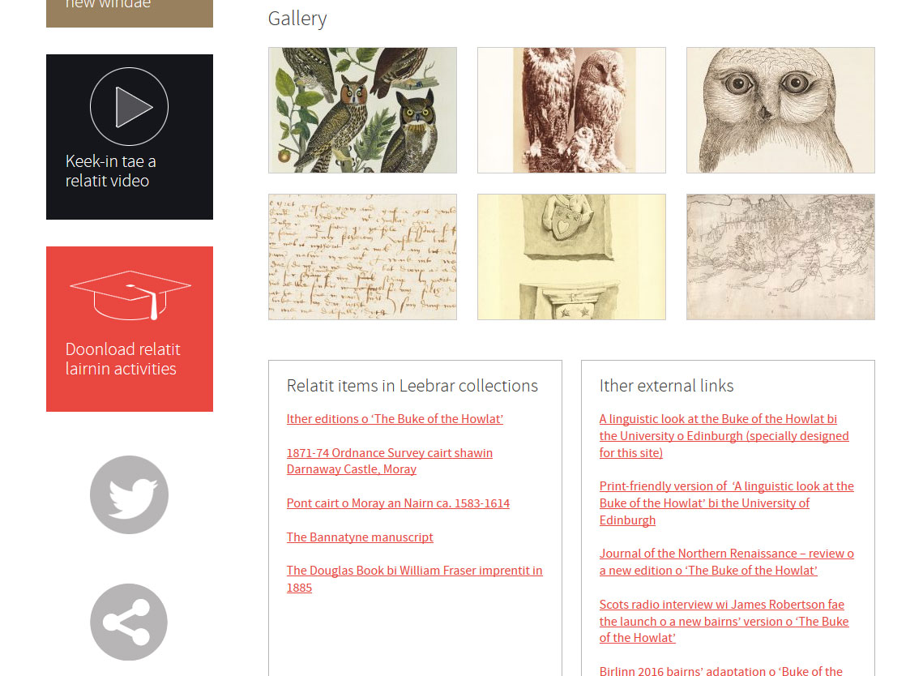
Related items complement each windae’s subject and showcase the breath of our collections
Links to our main catalogue

Slide 12
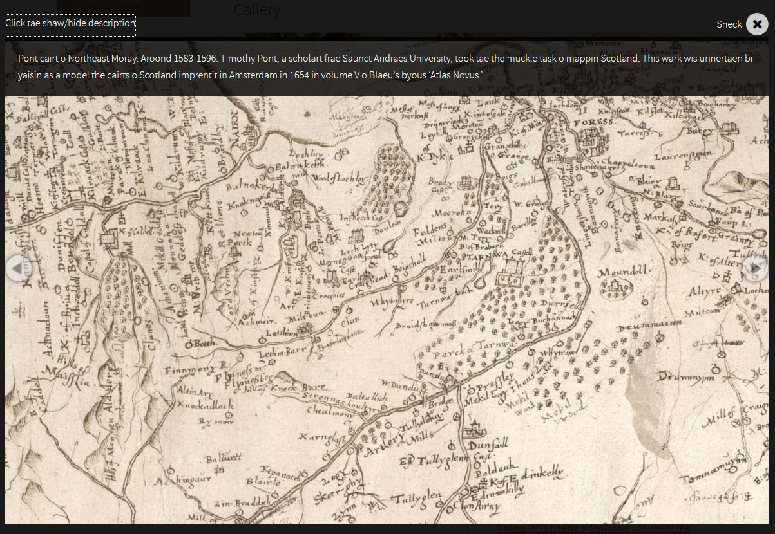
Captions with more information about each item. Users can zoom into the images
Darnaway Castle, possibly where ‘The Buke of the Howlat’ was first performed

Slide 13
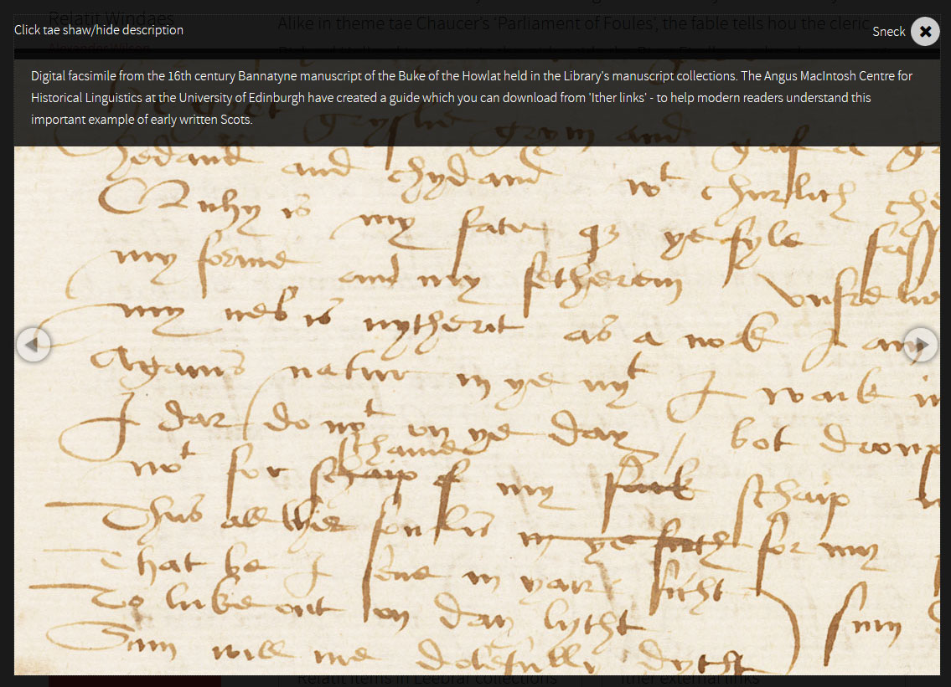

Slide 14
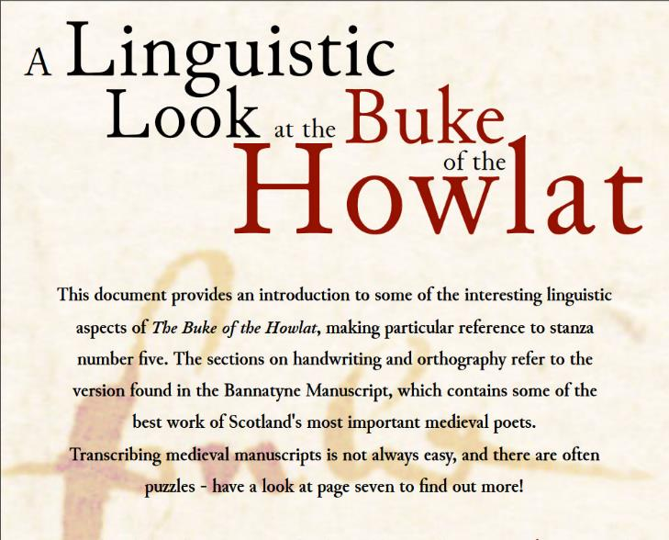
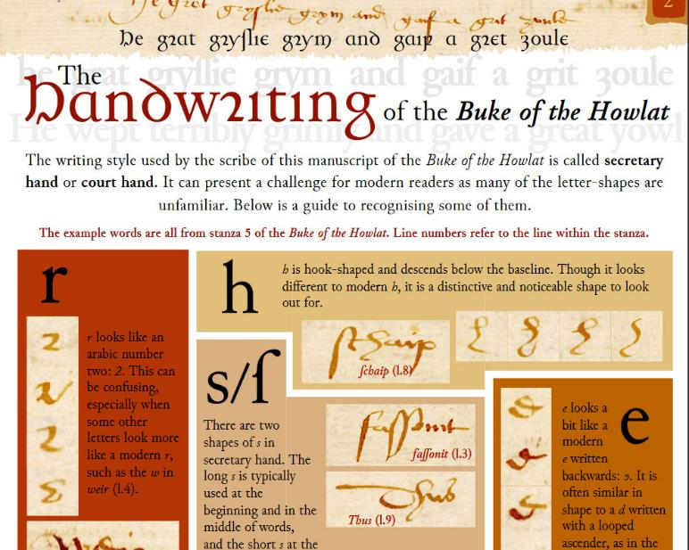
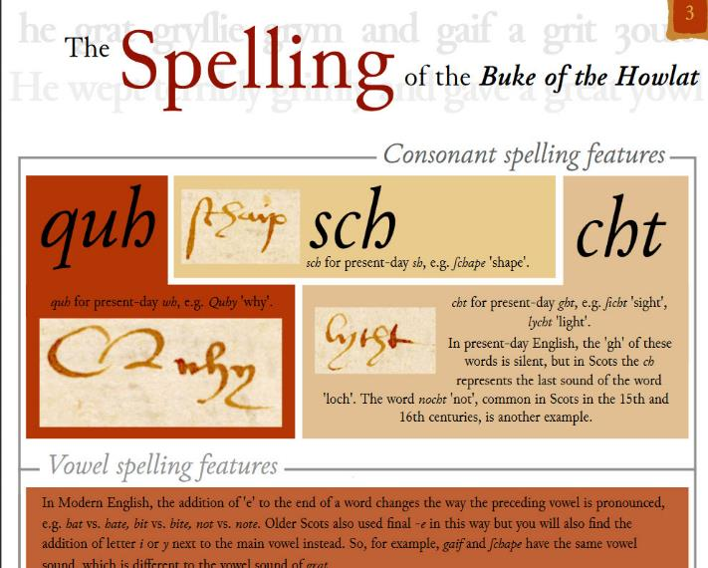



Slide 15
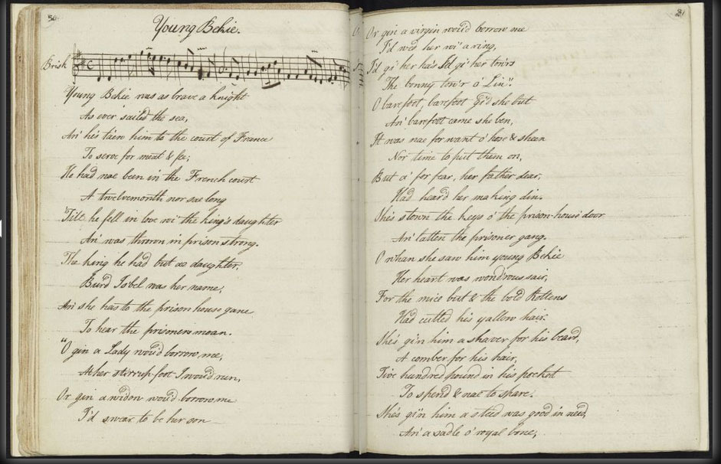
Bringing lost voices back to life

Slide 16
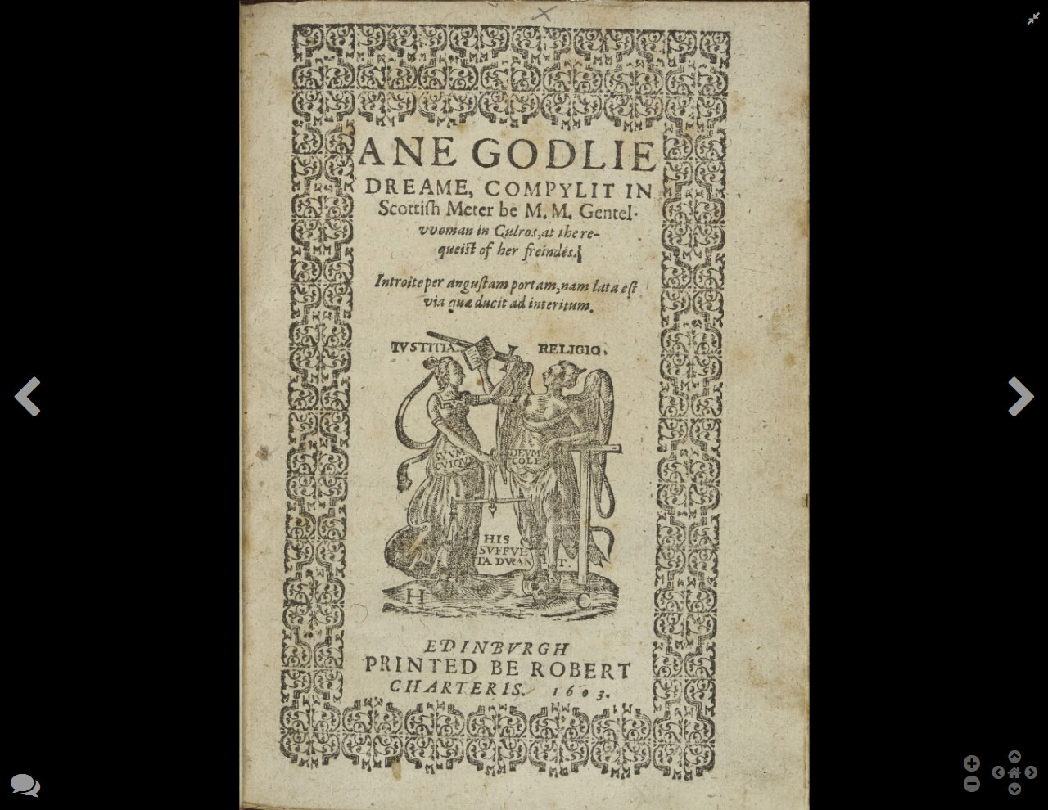
Original 1603 edition made available online in its entirety for the first time

Slide 17
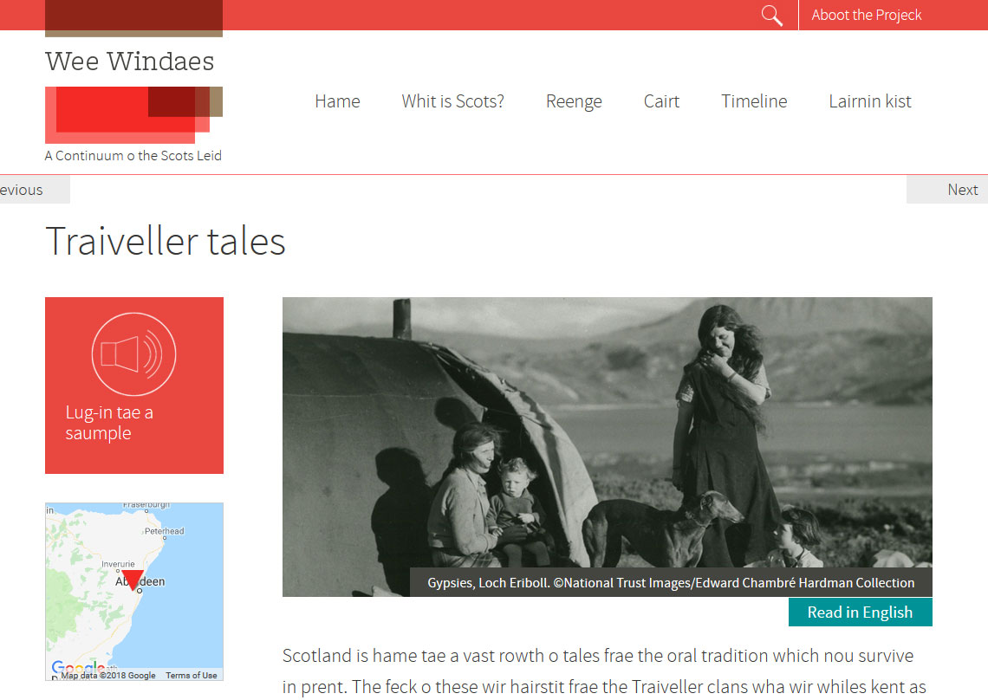
It was important to acknowledge the contribution marginalised communities have made to the Scots language

Slide 18
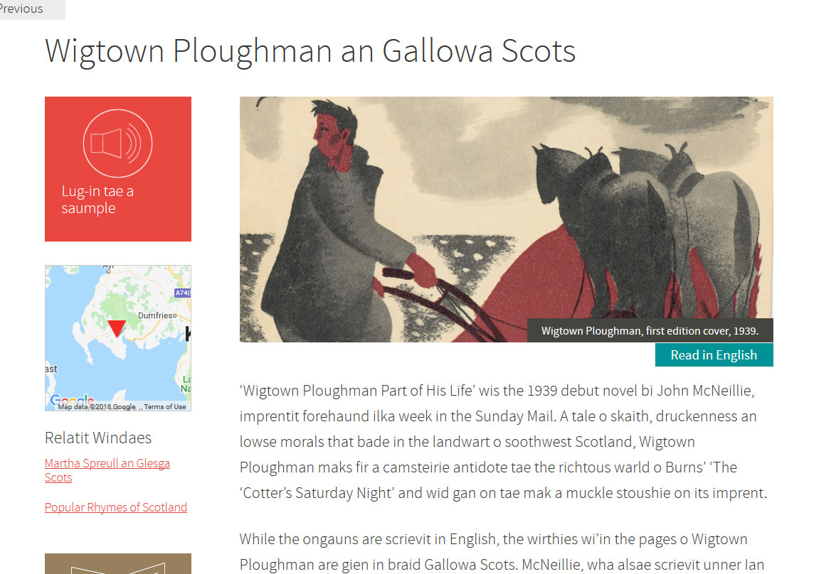
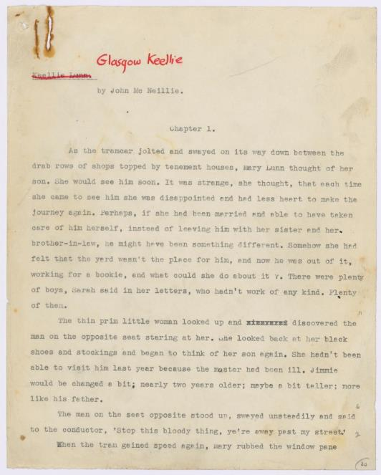
Authors and voices from all walks of life in Scotland have been featured

Slide 19
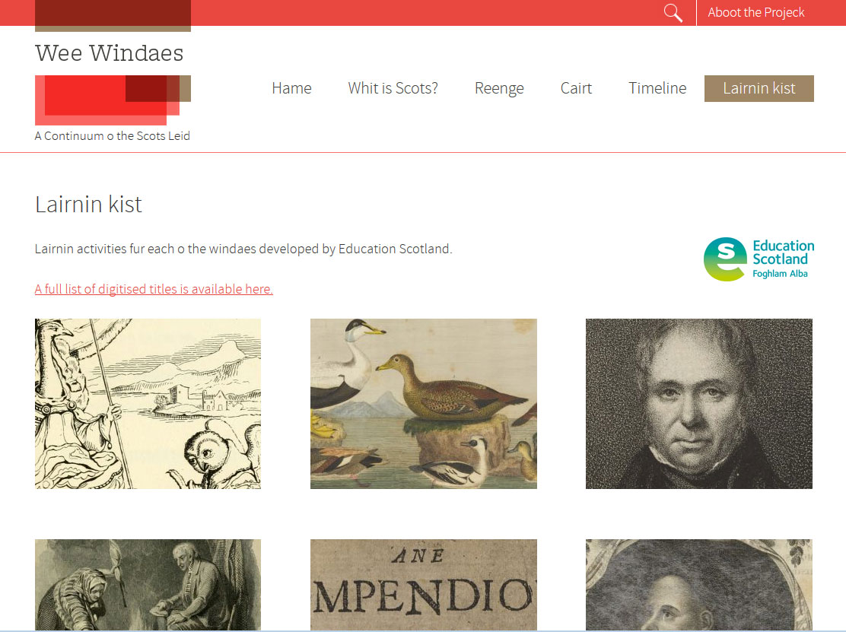
Downloadable PDFs designed by teachers for teachers and mapped to the Curriculum for Excellence

Slide 20

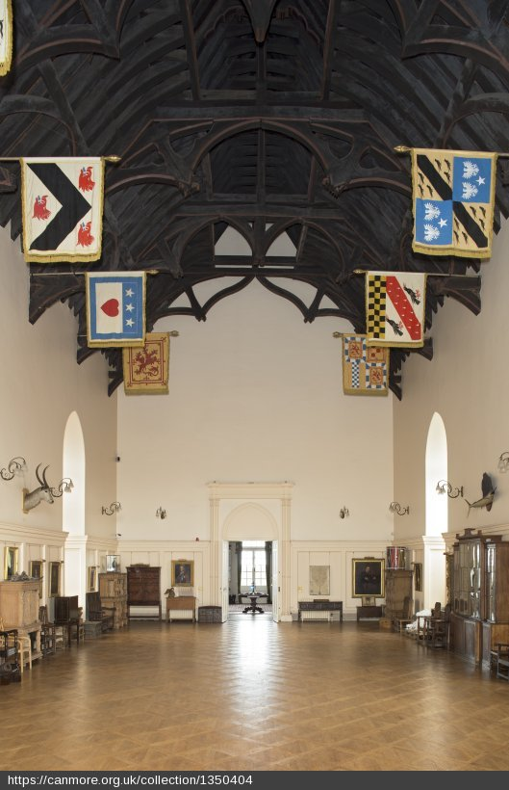
Ensuring Scots language is shared across Scotland and continues to engage audiences in the 21st century
© RCAHMS
© RCAHMS
© RCAHMS

Slide 21


wee-windaes.nls.uk
@nlslearn
Promoting literacy, digital and heritage learning, Scots/Gàidhlig, storytelling and creativity through the collections in the National Library of Scotland.
Keen tae ken mair? Get in touch
a.heywood@nls.uk

