Slide 1

Going Viral: Natural Selection of Infectious Diseases
Claire Donald
MRC-University of Glasgow Centre for Virus Research
21st May 2019
@claireldonald @CVRInfo
Notes:
Advanced Higher Twilight Biology: Selection.
Kelvin Hall, Glasgow, Tuesday 21st May 2019.
Claire Donald
Postdoctoral Research Scientist, MRC-University of Glasgow Centre for Virus Research
University of Glasgow
Email address.
Claire.Donald@glasgow.ac.uk
Background.
Diseases spread by mosquitoes are a major issue in many parts of the world. They can have a huge medical, veterinary and economic impact in areas where mosquito life cycles are supported. Unfortunately, due to the rise in global temperatures, deforestation and increased travel and trade, mosquitoes are able to find new areas to live in and are bringing these diseases with them. This presentation will focus on the viruses spread by mosquitoes, and Zika virus in particular. Zika virus was a relatively obscure virus that was initially discovered in Uganda in 1947 but rose to prominence in 2016 after a significant outbreak in the Americas. What lead to this emergence has been a key question for scientists ever since and has resulted in many asking which virus outbreak will strike next?

Slide 2
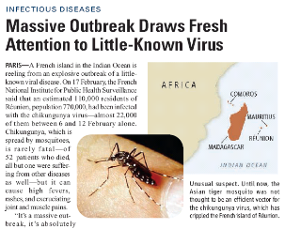
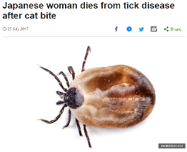
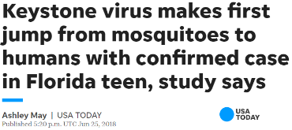
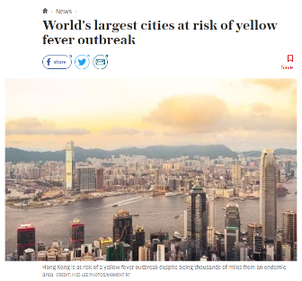
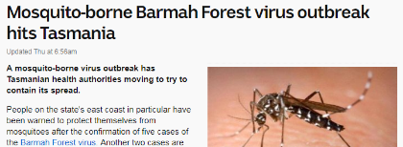
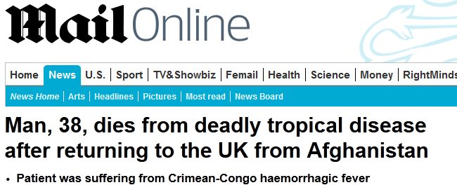
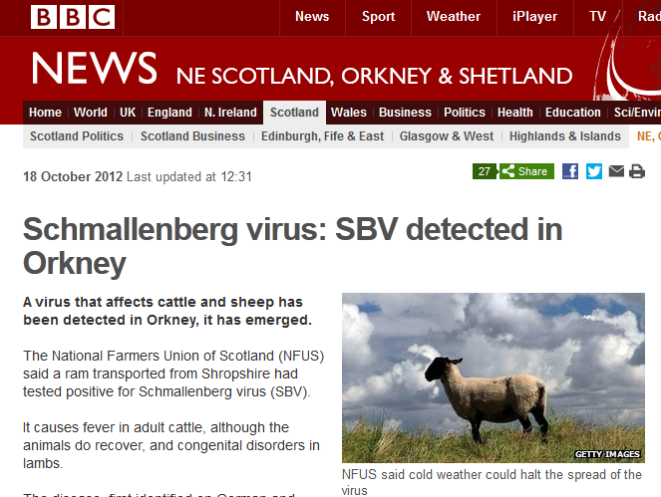
Notes:
2
These are a selection of example newspaper cuttings which describe recent outbreaks of diseases spread by arthropods (such as mosquitoes, ticks and midges). This is to highlight how important it is to study this class of viruses.

Slide 3
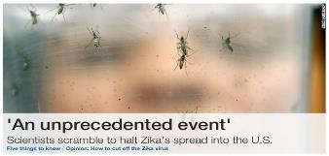
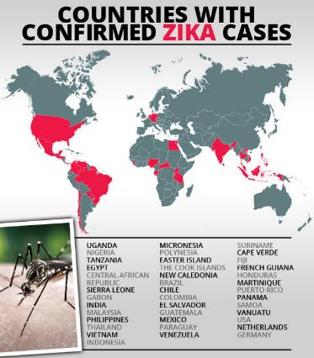
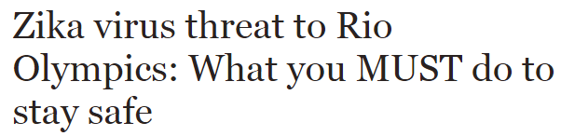
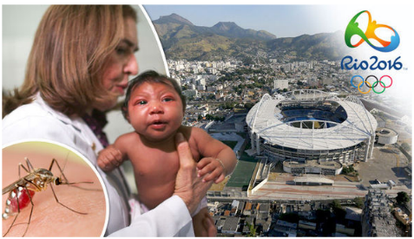
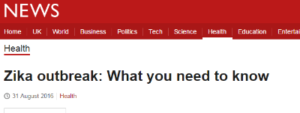
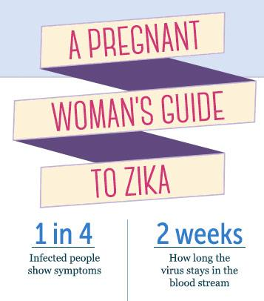
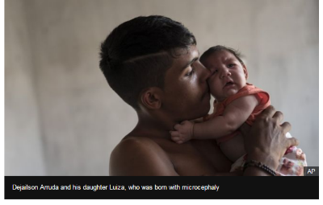
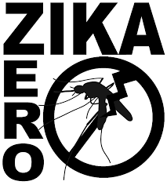
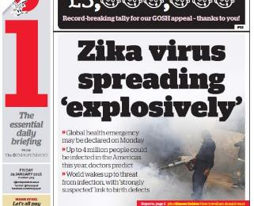
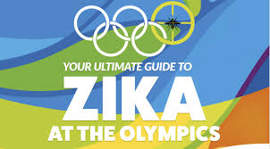
Notes:
This slide shows a selection of media articles and images associated with the Zika virus outbreak, particularly illustrating the impact on the Olympics, as well as on infants diagnosed with microcephaly. The animation on this slide is a graph demonstrating the sudden increase in publications related to Zika virus since 2015.

Slide 4
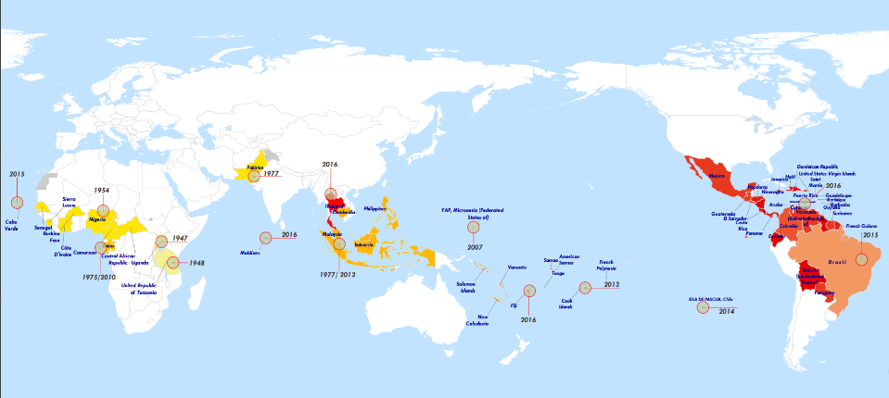
Worldwide Spread
Uganda,
1947
Nigeria,
1954
Yap,
2007
Micronesia,
2009-2013
South America,
2015
World Health Organisation, 2016
Notes:
A history of Zika cases. The key events are that it was first discovered in Uganda, in the Ziika forest, in 1947, the first human cases were in Nigeria in 1954, the first large Zika virus outbreak was documented on the island of Yap in the southwestern Pacific Ocean. Further outbreaks in French Polynesia in 2013 with around 9 thousand cases, New Caledonia, the Cook Islands and Easter Island in 2014 and the Americas in May 2015 beginning in Brazil. The Brazilian ministry declared a public health emergency in Nov 2015 and following the spread of Zika virus in several Southern and Central American and Caribbean countries in Jan 2016, the WHO declared ZIKA an international public health emergency on the 1st Feb 2016 which lasted until 18th Nov 2016.

Slide 5
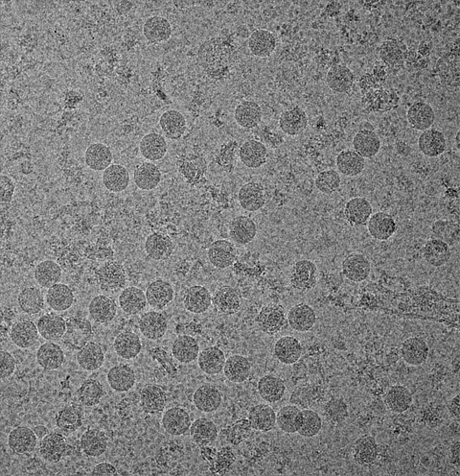
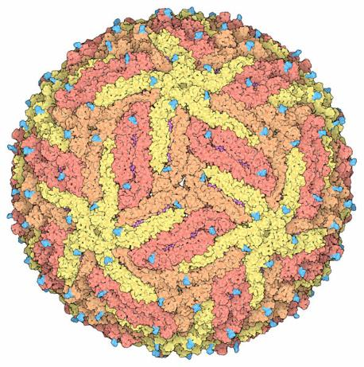
Virus Structures
[Purdue University/Rossmann/Kuhn]
[PDP-101.rcsb.org]
Notes:
These are images of what the virus particle looks like. We can visualize what viruses look like using electron microscopes; this allows us to look at structures by magnifying them 100,000 times. The dense circles in the image on the left are virus particles. The image on the right is a computer rendered image showing the level of symmetry found in the particle.

Slide 6
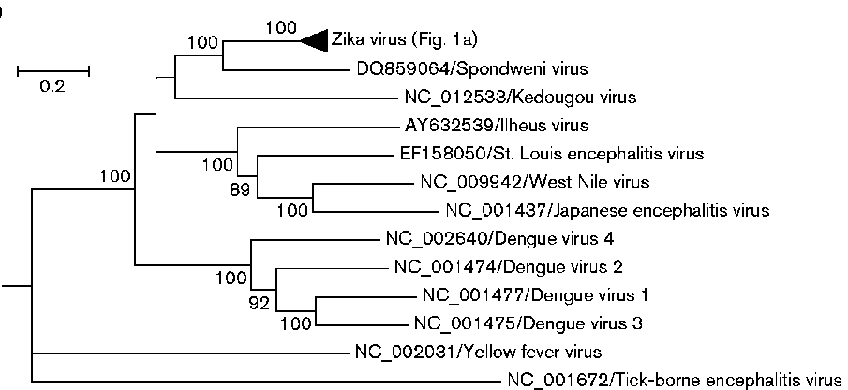

Family Tree
Family: Flaviviridae
Genus: Flavivirus
Notes:
This is Zika’s family, or phylogenic, tree. It is closely related to other well known pathogenic viruses such as dengue, West Nile or yellow fever viruses.

Slide 7
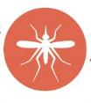
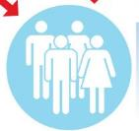

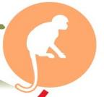
Transmission
TRANSMISSION
Humans
Primates
Chimpanzees
Monkeys
Baboons
Mosquitoes
Notes:
An illustration showing the most common mode of Zika virus transmission- through the bite of an infected mosquito. The mosquito takes a blood meal from an infected vertebrate host. The pathogen passes to the gut with the meal to be digested. The first thing the virus must do is infect the epithelial cells of the gut wall to escape the midgut and cross into the haemocoel (the equivalent of the circulatory system). Once in the haemocoel, it can spread throughout the insect’s body and infect other tissues on its way to the salivary glands. When the salivary glands are infected the virus needs to replicate to sufficient titres in order to be transmitted to a susceptible host when the mosquito takes its next blood meal. This process takes days. The mosquito’s saliva contains the virus as well as molecules that numb the bite site in the vertebrate and modulate local immune responses. The virus then spreads from there through the body of the vertebrate and infects cells in the organs and blood vessels.

Slide 8
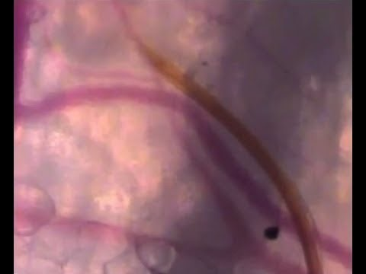
Anyone hungry?
Credit: Choumet et al, 2012
https://youtu.be/MbXSPacvuak
Notes:
A YouTube video (filmed using a camera underneath the skin) showing a mosquito feeding

Slide 9





Alternative Transmission Routes
Lab acquired
Mosquitoes
Blood transfusion
Mother to baby
Sexual
Notes:
In addition to mosquito transmission, Zika virus can also be spread through other routes.

Slide 10
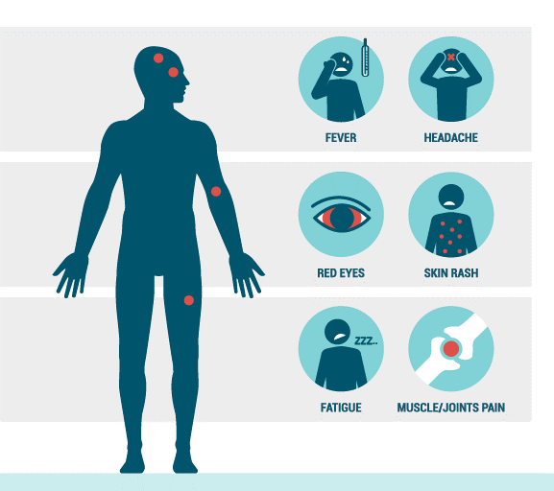
Classical Symptoms
Notes:
Infographic demonstrating the symptoms of classic Zika disease.

Slide 11
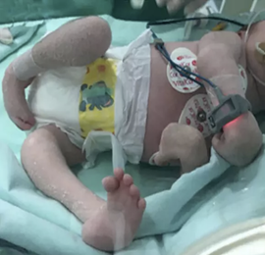
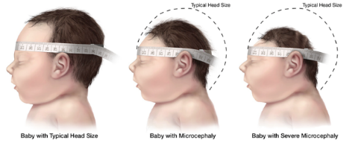
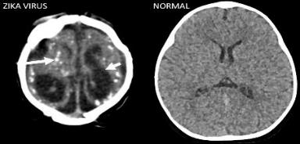
Further Complications
Congenital Zika Syndrome:
Severe microcephaly - the skull has collapsed
Decreased brain tissue – brain damage
Damage to the back of the eye
Curved joints
Rigid limbs
Microcephalic Healthy
Notes:
The 2015/2016 outbreak has been characterized by an increase in neurological syndromes which were not previously documented for Zika infections. This includes congenital Zika syndrome which is a pattern of birth defects with 5 distinct features.
Severe microcephaly in which the skull has partially collapsed
Decreased brain tissue with a specific pattern of brain damage, including subcortical calcifications
Damage to the back of the eye, including macular scarring and focal pigmentary retinal mottling- scarring, pigment changes
Congenital contractures, (curving of the joints) such as clubfoot or arthrogryposis – joints with limited range of motion
Hypertonia (damage to the central nervous system- namely upper motor neuron lesions) restricting body movement soon after birth – too much muscle tone restricting body movement soon after birth

Slide 12
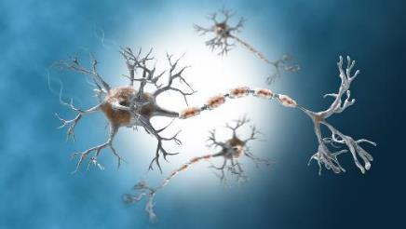
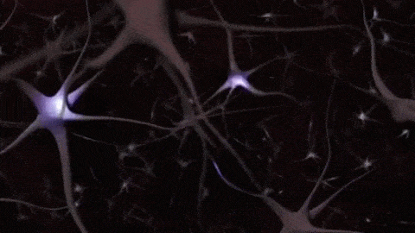
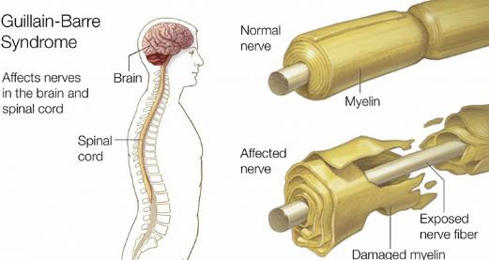
Further Complications
Guillain-Barré Syndrome (GBS):
Muscle weakness in the arms and legs
due to immune system attacking the nervous system
GBS is strongly associated with ZIKV, however only a
small proportion get GBS
Notes:
There was also an increase in Guillain-Barre Syndrome which is a muscle weakness caused by the immune system attacking the peripheral nerves and in severe cases the muscles that control breathing.

Slide 13
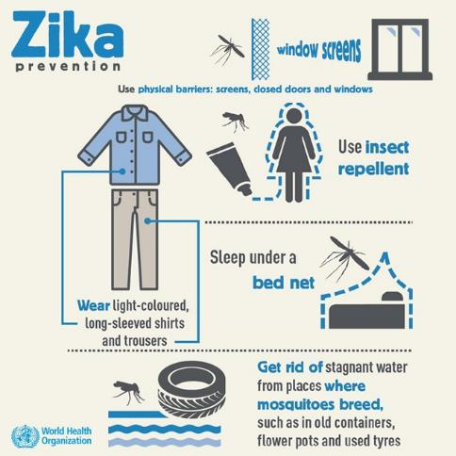
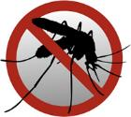
Treatment Options
No vaccine or treatment
Protect yourself from mosquito bites
Treat the symptoms
  Rest and drink plenty of fluids to prevent dehydration
Notes:
Currently there are no specific antivirals or preventative vaccines against Zika infections so the best way to defend against it is to prevent yourself being bitten.

Slide 14
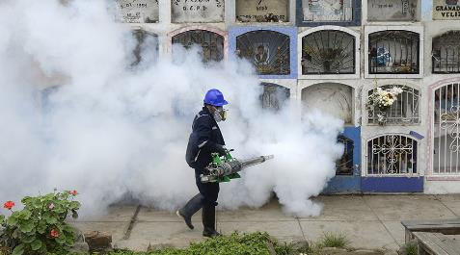
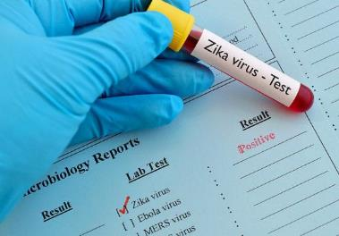
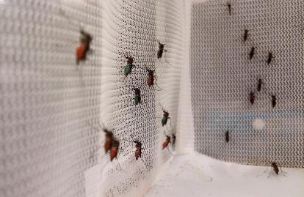
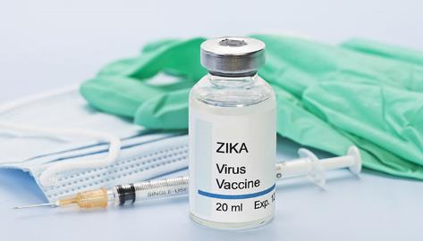
The Future of Zika Virus
Mosquito Control
Surveillance
Vaccine development
Research
Notes:
Whats next for Zika virus? Many consortiums and collaborations have been established as a result of the outbreak. Despite a fall in cases and the absence of continued media coverage, research is still on going to place us in a better position to understand Zika virus as well as similar viruses which may arise in the future.

Slide 15
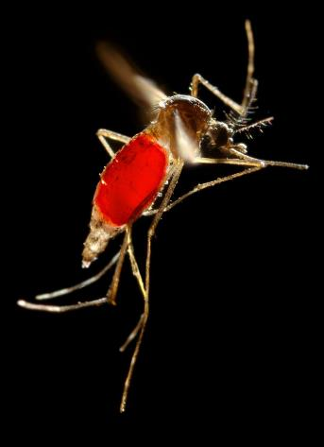
Thank you!
Notes:
Resources
https://www.gla.ac.uk/researchinstitutes/iii/cvr/events/public%20engagement/resources/
https://www.gla.ac.uk/researchinstitutes/iii/cvr/events/public%20engagement/virusesacenturyofdiscovery/
http://theconversation.com/whatever-happened-to-the-zika-virus-82618

