Slide 1
Quality Network Event
SVQ Business and Administration
8th October 2021

Slide 2

Programme
SVQ Business & Administration
Review Update Larisa Puk, Instructus
Senior External Verifier Update Donnie Carthew, SQA
Break (10 minutes)
Centre Presentations Susan McKay, Orkney UHI
Monica Black, Limelight Careers
Mhairi Quinn, Virtual Learning Academy
Clare Munro, Cheryl Sutherland
Forth Valley College
Open Discussion All

Slide 3
SVQ Business and Administration
Guidance and Support Materials
SVQ Business and Administration webpage
Candidate Guidance (generic)
Assessment Guidance
Candidate Portfolios
Qualification Verification Summary Reports (QVSRs)
Frequently Asked Questions (FAQs)
Network Event Presentations and Materials
Links to:
Understanding Standards
Guidance for FA in Business Skills (SDS)

Slide 4
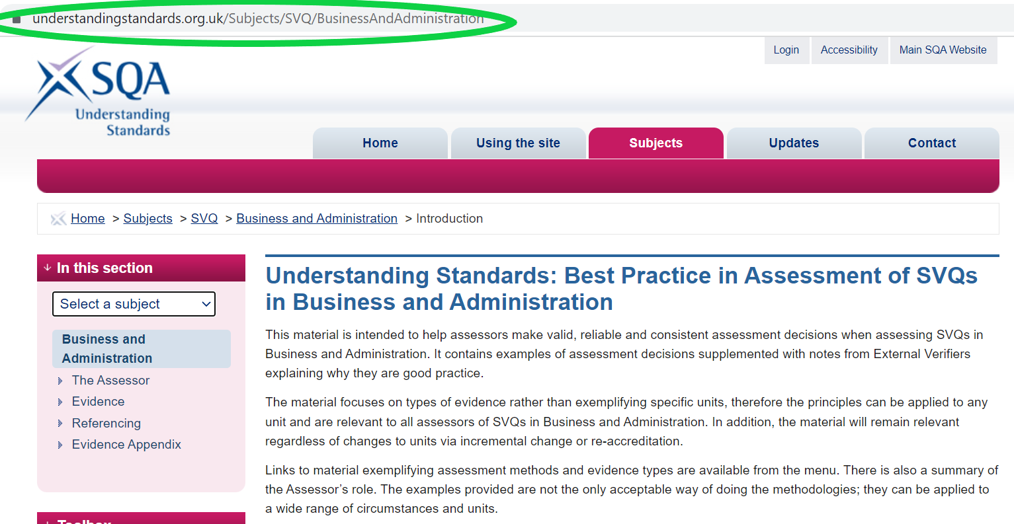
Understanding Standards:
SVQs in Business and Administration

Slide 5
Business and Admin SVQ Review
Milestones:
Review of NOS (complete)
Review of Qualification Structures (ongoing)
SCQF Credit Rating of Units and Structures ,
Approval of Structures and SCQF Credit Rating
SQA Re-accreditation of revised SVQs (Existing SVQs lapse 31.05.2022)
Outputs:
SCQF 4 SVQ to be withdrawn
New SCQF 5 SVQ circa June 2022
New SCQF 6 SVQ circa June 2022
SCQF 8 SVQ no change, extend to align with 5 & 6
FA in Business Skills updated

