Slide 1
An open resource-sharing service for the college sector in Scotland
Jackie Graham

Slide 2
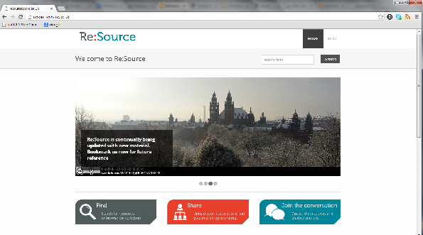
Re:Source A new open resource-sharing environment for the college sector
Developed and hosted by Mimas
Supported by SQA, Education Scotland, JISC Regional Support Centre
Notes:
Allan: Logo and a screenshot if required

Slide 3
Open
- everyone can find materials without login
- everyone can 'Join the Conversation' within the WordPress blog area
- all staff can share files or web links
- resources shared under easy-to-use open licences (Creative Commons)
- will provide access to Jorum (UK FE and HE materials) and other sources of OER

Slide 4
For colleges
resources tagged by unit codes, superclasses and SCQF levels (also blog area is fully searchable)
can support college communities
integrates with Moodle VLE
seamless login to share resources via college sign-in
COLEG content being migrated

Slide 5
Contact Details
www.resourceshare.ac.uk
Tel: 01786 892000
info@collegedevelopmentnetwork.ac.uk
www.collegedevelopmentnetwork.ac.uk
Follow @ColDevNet on Twitter
facebook.com/collegedevelopmentnetwork

Slide 6
Question 1
What are the issues around the sharing of materials in your subject area?
need
demand
access

Slide 7
Question 2
What are the main barriers to effective sharing?

Slide 8
Question 3
How could Re:Source help?

