Slide 1
Looking back to move forward – Verification Review
Business Network Event 2025

Slide 2
Looking back to move forward
A Qualification Verification Summary Report (QVSR) overview of past verification activity:
The presentation aims to:
Provide external feedback from 2023/24 verification
Identify evidence for external verification
Identify good practice
Identify where improvements might be made

Slide 3
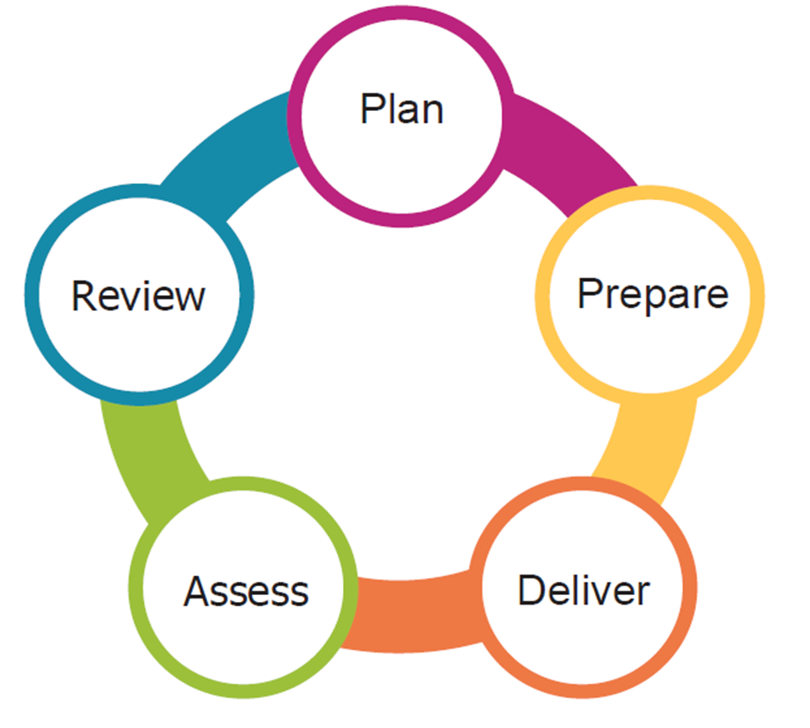
Looking back to move forward
Circle of Success – ‘Looking back to move forward – Verification Review and Business Units Update’
Feedback to SQA
SQA feedback
Internal feedback

Slide 4
Looking back to move forward.
The QVSR format:
The units verified
Evidence submitted
Good practice
Specific areas for development
The information in this presentation is based on verification activity in 2023/24 for VG’s 254 Business Management , 258 Economics and 390 Business
Graded Units.

Slide 5
1. Units verified
Business Management (VG 254)
Managing People and Organisations
Business Culture and Strategy
Managing Business Culture and Strategy
Business Fundamentals with Emerging Technologies
Project Management: Strategy, Decision Making and Risk
Business Graded Unit (VG390)
Graded Units 1 & 2
Economics (VG258)
Economic Issues: An Introduction
Economics: Micro and Macro Theory
and Application
Economics: The World Economy

Slide 6
Resources Criterion 2.1: Assessors and internal verifiers must be competent to assess and internally verify, in line with the requirements of the award
2. Evidence: CV’s/resumes, CPD records, certificates, staff information sheets, awards.
3. Good practice:
Explanations of the benefits and implementation of learning gained from CPD events.
4. Specific areas for development:
Participate in more external events.
Evidence of updating subject knowledge

Slide 7
Resources Criterion 2.4: There must be evidence of initial and ongoing reviews of assessment environments; equipment; and reference, learning and assessment materials
2. Evidence: Review policies, resource and equipment lists and checks, minutes of meetings, VLE and resource lists, teaching resources, IV records including pre-delivery checks, ASP/US update records.
3. Good practice:
Formal process and each element having matched evidence.
4. Specific areas for development:
Submitting details of the review process that is contained in the centre/quality manual.
Need to evidence all criterion elements.

Slide 8
Candidate Support Criterion 3.2: Candidates’ development needs and prior achievements (where appropriate) must be matched against the
requirements of the award.
2. Evidence: Admissions policy, details of induction, study skills, workshops, support services, staff availability, study groups, mentoring schemes, PDP.
3. Good practice:
Extended/staggered induction
Access to support services
Workshops
Personal academic tutors.
4. Specific areas for development:
Scheduling of candidate induction
Providing a range of evidence.

Slide 9
Candidate Support Criterion 3.3: Candidates must have scheduled contact with their assessor to review their progress and to revise their assessment plans accordingly
2. Evidence: Timetable, tutorial support and records, teaching and assessment schedules, PDP records, staff contact details, contact records, assessment feedback, personal academic tutor records, support services, minutes of meetings.
3. Good practice:
Quality of personal academic tutoring
Quality of assessment feedback, strengths and weaknesses
Individual/personal learning planning that encourages reflection goal setting and engagement
Access to support
4. Specific areas for development:
Better feedback on performance
Improving personal academic tutor
systems

Slide 10
Internal Assessment and Verification Criterion 4.2: Internal assessment and verification procedures must be implemented to ensure standardisation of assessment
2. Evidence: IV policy, assessments, unit specification, marking schemes, staff handbook, IV/standardisation records, minutes of meetings, assessor summary IV reports.
3. Good practice:
Evaluation, analysis and suggestions to improve future practice in IV records and reports
Assessor/IV summary reports
Action setting flowing from internal verification.
4. Specific areas for development:
Explanation of judgements on marginal candidate performance
in IV records.
Evidence that external/internal verification
feedback is being used to inform
future practice.

Slide 11
Internal Assessment and Verification Criterion 4.3: Assessment instruments and methods and their selection and use must be valid, reliable, practicable, equitable and fair
2. Evidence: Assessments, unit specification, marking guidance, pre-delivery IV checks, minutes of meetings, assessor/IV reports, quality/IV manual.
3. Good practice:
Detail in IV records showing understanding
Evaluative accounts of delivery and assessment of individual units that can inform future practice.
4. Specific areas for development:
Better recording of discussions in records
Evidence of using external/internal feedback
to inform future practice.

Slide 12
Internal Assessment and Verification Criterion 4.4: Assessment evidence must be the candidate’s own work, generated under SQA’s required conditions
2. Evidence: Plagiarism/malpractice policies, candidate handbook, referencing guide, induction, authenticity checks and declarations, internal verification records, invigilation records, assessment attendance records/sheets, AI policy.
3. Good practice:
Range of checks including electronic plagiarism checks and questioning.
4. Specific areas for development:
Continual review of the threat of AI.

Slide 13
Internal Assessment and Verification Criterion 4.6: Evidence of candidates’ work must be accurately and consistently judged by assessors against SQA’s requirements
2. Evidence: Candidate work, feedback, details in IV records/minutes, assessor/IV reports, class results.
3. Good practice:
Explanation of assessment decisions to candidates
Strengths and weaknesses of candidate work
Cross marking/assessing to aid consistency in assessment.
4. Specific areas for development:
Better feedback to candidates
Better recording in IV records how marginal
assessment decisions are determined.

Slide 14
Internal Assessment and Verification Criterion 4.7: Candidate evidence must be retained in line with SQA requirements.
2. Evidence: Evidence retention policy, data handling policy, disposal details, details of storage facilities, storage records, access records, staff responsibilities
3. Good practice: No specific examples
4. Specific areas for development:
Evidence showing clearly that the retention policy is being implemented.

Slide 15
Internal Assessment and Verification Criterion 4.9: Feedback from qualification verifiers must be disseminated to staff and used to inform assessment practice.
2. Evidence: Course meeting minutes, staff responsibilities, flow charts, IV records, pre-delivery checks, distribution records, records of staff discussing and acting upon QV feedback.
3. Good practice:
Specific events held to discuss QV feedback
Evidence that external and internal feedback is used to inform future practice.
4. Specific areas for development:
Use of external and internal feedback.

Slide 16
Key Points – Looking back to move forward
Better use of external and internal evaluative feedback to improve future practice.
Interpreting verification recommendations.
Working with external verification recommendations.
Explanation of judgements on marginal candidate performance in internal verification records.
Reviewing, developing and revising
candidate induction
personal tutor systems and mentoring schemes.
individual/personal learning planning to encourages reflection and goal setting.
Improving feedback on assessment
performance.

Slide 17
Business Network Event - 2025
As in years past,

Slide 18
Last slide

