Slide 1
SVQs in Business and Administration
Network Events
May 2019
Notes:
Welcome to SVQ BA Network Event - Thank you for coming along. I hope you will find today very worthwhile.
I am TH QM for subject, those of you who have been to these events before will probably remember me. If you do remember me you may also remember that SM was previously QM for this area.
Back in the Autumn she did a BR - for those who know who that is (moved to International – still on organisation). New colleague Caitlin - now the main port of call at SQA for queries about the standards.
We’ve been having these events for over 10 years now and the numbers are always very healthy, never more so than this year, so that’s very positive and I always feel that’s down to yourselves – delegates who come ready to engage in a positive way in discussion and collaboration.
Today is about sharing practice about Assessment – SQA sharing guidance, but mostly practitioners sharing with each other - as you all have that shared experience of being in each others’ shoes and facing similar types of situations and challangeds.
My plan for today - is to say as little as possible – the feedback from other evens has tended to be that the SQA update from me is the least interesting part of the day – that’s fine. I absolutely DON’T take that personally.
But we’ve invited speakers who I’m sure you will find much more interesting than me – but of course there will be ample time to discuss anything you want to raise throughout the course of the day – and we have a workshop activity for after lunch that I’m sure will stimulate some of that discussion.

Slide 2
Programme
1000 Welcome/SQA Update Tony Hamilton (QM, SQA)
1015 Senior EV Update Donnie Carthew (SEV, SQA)
1045 OneFile – Learning Hub John Docherty (OneFile)
1115 Tea/coffee break
1145 Standardising use of OneFile in a centre James Davidson (FV College)
1215 Lunch
1315 Performance Evidence Workshop Donnie Carthew/all
1400 Tea/coffee break
1430 Knowledge Evidence Workshop Donnie Carthew/all
1515 Plenary / Close
Notes:
So – I’ll run through the programme quickly. I’m going to provide a few brief updates on frameworks and apprenticeships
Then I’ll hand over to Donnie the senior EV who will talk to you about the things he’s seen in centres – the things he’s seen in centres that are repeatable in public - and I’m sure he as some good examples of things he’d like to highlight and share with you.
Following that we have John Docherty from One File – One File is a specific e-portfolio package.
I was at a College Development Network meeting in March where John gave a presentation and demonstrated some of the features of the package – I found it very interesting.
Now, this isn’t about a specific package it’s about thinking about assessment in general and ways that can be done, whether electronically or not.
After that we have a tea/coffee break for half an hour, a chance for you to chat and make some contacts.
Then we have James Davidson from Forth Valley college (and his colleague?) who’s kindly agreed to come along and present.
James uses OneFile in his centre and is leading a project to standardise delivery and assessment of SVQs across the different subjects offered by the college – so has perspective
Again, this is not about a specific package, it’s about ways of capturing and referencing evidence that could be useful for you to think about and relate to your own delivery – hopefully it will consolidate what you do or give you new ideas, or a bit of both.
James has some examples of live candidate evidence which are really interesting and bring the presentation to life.
We than break for lunch
In the afternoon, we have two related workshops – where we’ll get you into groups and discuss appropriate types of Performance Evidence and coverage for some of the most common optional units – and after another break – the same for Knowledge evidence.
And at the end of that we’ll have some time for some final questions before we head off for the day.

Slide 3
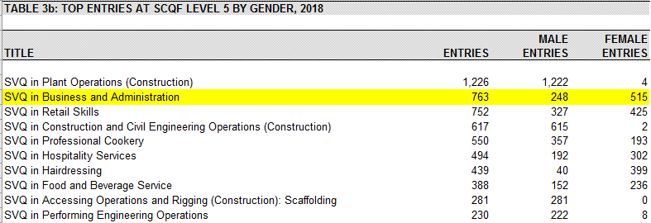
SVQ Uptake – SCQF Level 5
Notes:
To kick-off I’m going to quickly run through some stats on uptake – you have them printed in your packs so I don’t need to go into great detail here.
SCQF 5 (Level 2 in old speak) – is 2nd highest SQA SVQ by uptake for SCQF 5, so uptake continues to be strong even with the introduction of Foundation Apprenticeship at SCQF 6

Slide 4
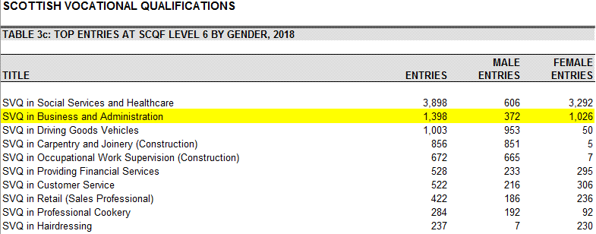
SVQ Uptake – SCQF Level 6
Notes:
SCQF level 6 (Level 3 in old speak) – again 2nd highest SQA SVQ for uptake – with Social Services and Healthcare way out in front driven by registration requirements – it means Business and Admin is effectively “best of the rest” – if uptake = best.

Slide 5
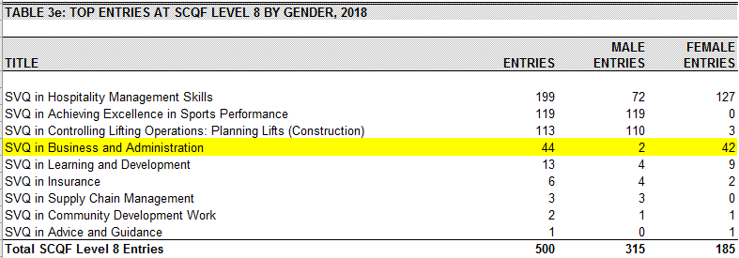
SVQ Uptake – SCQF Level 8
Notes:
Good to see Business & Admin as 4th highest SCQF 8 SVQ after less than 2 years, although numbers drop away sharply after that.
As with other Business & Admin SVQs, there’s a big gap between male and female candidates which is interesting, although that’s been the case for many years.

Slide 6
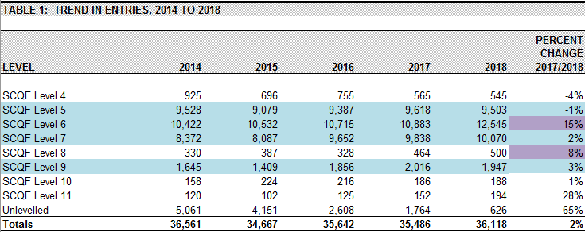
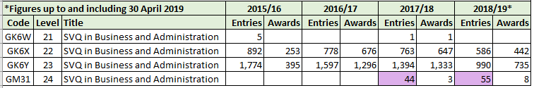
SVQ Uptake – All SVQs
Notes:
This is trend in entries across all SVQs from 2014 to 2018 (not just B&A).
Two interesting figures I thought I’d highlight in purple -
Level 6 15% increase from 17 to 18, way above any previous increase – due to FAs?
Level 8 – Business & Admin coming on stream may account for the rise in uptake uptake as the 44 or 55 entries translates as roughly 10%?
That’s really just speculation as we don’t have data on the drivers behind entries, that’s something I imagine SDS will have some data on.

Slide 7
Business and Administration Apprenticeships
Foundation Apprenticeship
  Business Skills SCQF 6
Modern Apprenticeships
  Business and Administration SCQF 5
  Business and Administration SCQF 6
Technical Apprenticeship
  Business and Administration SCQF 8
Graduate Apprenticeships
  Business Management SCQF 10
  Business Management: Financial Services SCQF 10
Notes:
Just a reminder for you of the various Apprenticeships available.
Graduate Apprenticeships don’t involve SQA directly as they are designed around degree programmes with workplace assessed elements that are not SVQs – not in Business Management anyway.

Slide 8
Lapsing Dates
All four SVQs in Business and Administration are due to lapse on 31.05.2020
There will either be new Frameworks to replace the existing ones from 01.06.2020 or the current Frameworks will be extended
Notes:
There was a meeting on Wednesday 1 May of the three nation representatives with all of the organisations who have been appointed to review standards and qualifications. Instructus (CFA) was one of these.
The next stage of identifying development work being done over the next year will see these delivery partners competing for project work.
We have yet to learn what projects will be in the competition stage. If Business and Admin is included, there is no presumption that Instructus will be the organisation taking this forward.
It seems that it could be late June or even July before we know who is doing what.
It’s unlikely that there will be new NOS and qualification structures in time for a reaccreditation in May 2020, in which case they will be extended.
A review of the qualifications structures and NOS could also encompass the Assessment Strategy in terms of any changes we might want to see there.

