Slide 1
HN BUSINESS NETWORK
ASSESSMENT SUPPORT PACKS – SUPPORTING CENTRES
John Kelly
28th February 2017

Slide 2
Using ASPs to support centres in Assessing
Unit Specifications
Assessment Support Packs/Exemplars
ASPs as a support:
What?
How?
Why?
Just do it!

Slide 3
ASSESSMENT
Unit Specification
This is the key document for delivery of any course/unit. The spec sets out:
Unit Purpose
Outcomes
Knowledge/Skills
Evidence Requirements
Assessment Guidelines

Slide 4
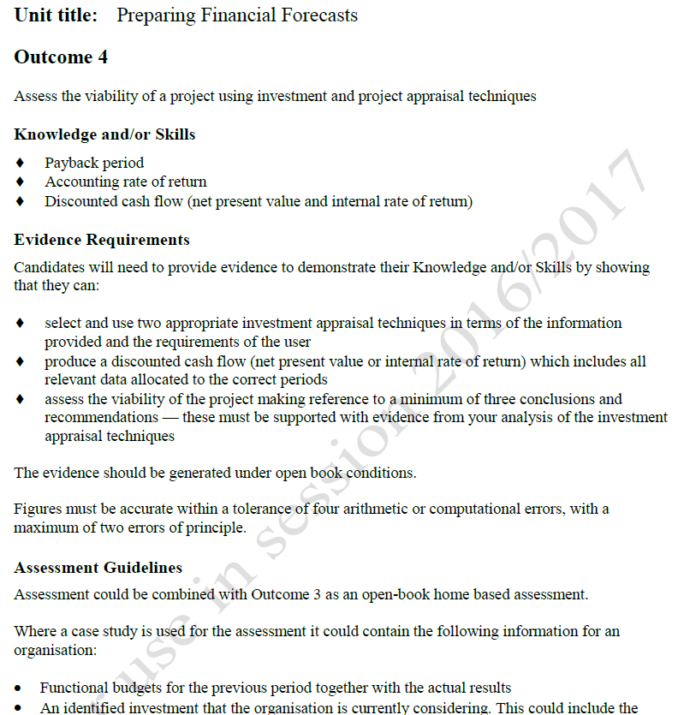
UNIT SPECIFICATION
Outcome
Knowledge/Skills
Evidence Requirements
Assessment Guidelines

Slide 5
ASSESSMENT SUPPORT PACK/EXEMPLAR – WHAT?
What it says on the tin, support for assessing students on a unit. Supports us to -
generate evidence which demonstrates that learners have achieved all Outcomes and Knowledge and/or Skills for the Unit
provide exemplification of the standard of performance expected of learners achieving the Unit, ie as a benchmark

Slide 6
ASSESSMENT SUPPORT PACK/EXEMPLAR – WHAT?
Can also be used to –
help centres develop an appropriate assessment for the Unit.
give teachers/lecturers/assessors new ideas .
provide a staff development tool .

Slide 7
ASSESSMENT SUPPORT PACK/EXEMPLAR – HOW?
Generate Evidence –
The instrument identified in the ASP is simply used as the instrument of assessment.
“Centres should note that using it does not automatically guarantee successful external verification. It is the centre’s responsibility to make sure that all the appropriate internal quality assurance procedures are satisfactorily followed. “

Slide 8
ASSESSMENT SUPPORT PACK/EXEMPLAR – HOW?
Exemplification –
Provides an example of an instrument of assessment which meets the standard required by the Unit Specification.
Minor amendments around the edges can be made without a requirement for Prior Verification.

Slide 9
ASSESSMENT SUPPORT PACK/EXEMPLAR – HOW?
Developing an assessment –
Using the ASP, centres can develop their own assessments.
Likely that this will involve the necessity of Prior Verification.

Slide 10
ASSESSMENT SUPPORT PACK/EXEMPLAR – HOW?
Provide New Ideas –
Ideas on approaches to assessment…...
Note security.

Slide 11
ASSESSMENT SUPPORT PACK/EXEMPLAR – HOW?
Staff Development Tool –
Staff training
Mentoring
Course/unit reviews
Note security.

Slide 12
ASSESSMENT SUPPORT PACK/EXEMPLAR – WHY?
Ensuring assessments are valid, reliable and practicable.
Updating assessments.
Merged colleges and systems.
Considering staff turnover and succession planning.
Changing circumstances and delivery.

Slide 13
JUST DO IT!
Consider Unit Specifications provided (2).
Consider example of ASP and example of Exemplar.
Consider how both ASP and Exemplar can be used for each of the key aims of support assessment:
Generating evidence
Exemplification
Developing new assessments
Providing new ideas
Tool for staff development

Slide 14
JUST DO IT!
Report back with comments.
Report back with examples.

