Slide 1
HN Administration and Information Technology
Network Support Event
Wednesday 21 February 2018

Slide 2
Programme
SQA Update
SEV Update
Delivering Digital Technologies for Administrators
SOLAR demo
Lunch
Graded Unit 1 marking task 1
Break for tea/coffee and networking
Graded Unit 1 marking task 2
Plenary/Close

Slide 3
HNC/D Administration & IT Uptake
SQA Annual Statistical Report 2016
HNC AIT 8th – 764 entries (-17 / 2015)
HND AIT 11th – 467 entries (-3 / 2015)
2017 Report due for publication April 2018
Source: https://www.sqa.org.uk/sqa/57518.8313.html

Slide 4
HN AIT Review – start/end dates
New
HNC Administration and IT GM10 15 start date 01.08.17
HND Administration and IT GM0Y 16 start date 01.08.17
Lapsing
HNC Administration and IT G9M7 15 end date 31.07.19
HND Administration and IT G9M8 16 end date 31.07.19
Transition arrangements in place to allow for progression from lapsing HNC to new HND (refer to Group Award Specification https://www.sqa.org.uk/sqa/files_ccc/Group_Award_Specification_GM1015_GM0Y16.pdf

Slide 5
HN AIT Review – major changes
Digital Technologies for Administrators HH82 34 replaces Office Technologies F7J9 34
IT in Business Spreadsheets HH83 34 assessment reduced
ITIB WPPA HH84 34 assessment reduced
RFT HH81 33assessment reduced – new Outcome 3
Presentation Skills HH85 35 assessment reduced
AIT Graded Unit HH9N 34 modest impact from new Digital Technologies unit – SQA Assessment via SOLAR

Slide 6
Digital Technologies for Administrators
Aim – to develop a new unit commensurate with up to date technologies used in modern business organisations
Design – to allow flexible targeted delivery and assessment
(eg social software, web service, collaborative software not Facebook, Survey Monkey, Google Docs)
Allows centres/students to use resources available to them
Future proofs as much as possible
Assessment – SQA SOLAR or Centre-devised portfolio
SQA SOLAR – Dynamically generated multiple choice automatically marked and prior-verified for Outcomes 1&2. Outcome 3 case study eportfolio.
Centre-devised portfolio – Allows assessment to be customised according to centre/student needs

Slide 7
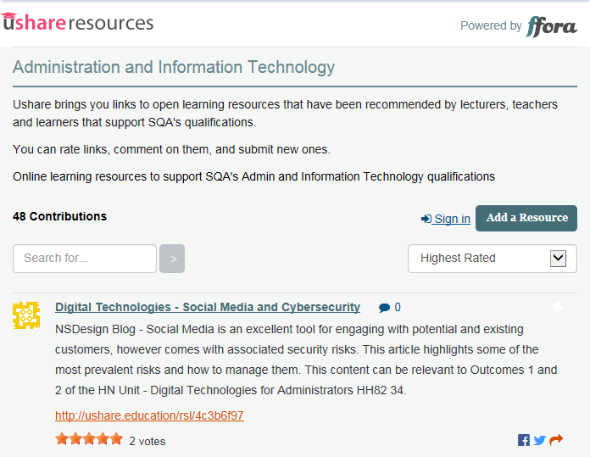
Ushare
Homepage https://ushare.education/Ushare/Home
Foot of HN AIT page https://www.sqa.org.uk/sqa/25688

Slide 8
Security of Assessments – Graded Units
ASPs for Graded Units 2 and 3 available on SQA secure
Graded Unit 1 via SOLAR – closed book examination
Graded Unit 2 – closed book examination
Graded Unit 2 - All ASP materials must be retained in the centre – i.e. question papers & responses
Graded Unit 3 – project based on case study
Bank of ASPs not renewed annually

Slide 9
Understanding Standards
http://www.understandingstandards.org.uk
Marked scripts with EV annotations for Graded Units 1&2
Live assessments so password protected
Must be stored securely
Username/password can be obtained from:
mycentre@sqa.org.uk

Slide 10
Keeping informed
HN Administration and IT webpage https://www.sqa.org.uk/sqa/25688
To receive email alerts when content you are interested in has been updated on SQA’s website, subscribe to MyAlerts at www.sqa.org.uk/myalerts
Centre News – SQA’s weekly update for centres, To subscribe to our newsletters, go to http://mailer.sqa.org.uk

Slide 11
Follow us online
YouTube – SQAonline
Facebook – Scottish Qualifications Authority
Twitter - @sqanews

