Slide 1
HN Administration and Information Technology
Network Support Event
Thursday 21 February 2019
Qualifications Manager
Tony Hamilton

Slide 2
Programme
SQA Update
SEV Update
Delivering and Assessment of Digital Technologies for Administrators
SOLAR GU1
Tea/coffee
Managing Internal Assessment
Lunch and Networking
SQA Assessment Futures Project
Tea/coffee
Putting Social Media to Work
Plenary

Slide 3
Old Awards
HNC Administration and IT G9M7 15 end date 31.07.19
HND Administration and IT G9M8 16 end date 31.07.19

Slide 4
Understanding Standards
http://www.understandingstandards.org.uk
Marked scripts with EV annotations for Graded Units 1&2
Live assessments so password protected
Must be stored securely
Username/password can be obtained from:
mycentre@sqa.org.uk

Slide 5
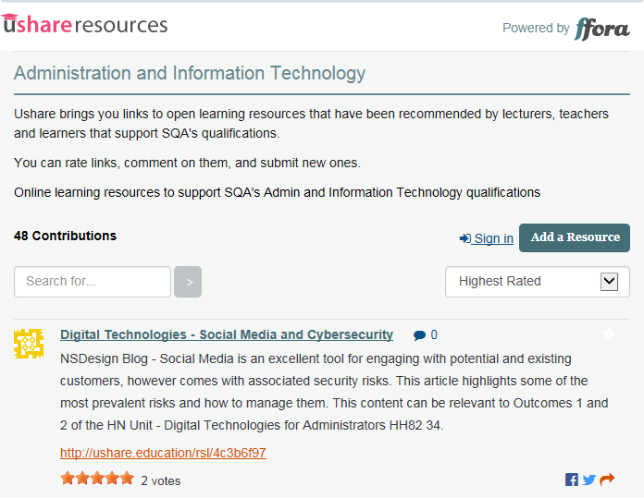
Ushare
Foot of HN AIT page https://www.sqa.org.uk/sqa/25688

Slide 6
Keeping informed
HN Administration and IT webpage https://www.sqa.org.uk/sqa/25688
Centre News – SQA’s weekly update for centres, To subscribe to our newsletters, go to http://mailer.sqa.org.uk

