Slide 1
SVQs in Business and Administration
Network Events
May 2018

Slide 2
Programme
1000 Welcome
SQA Update
Assessment Decisions and Presenting Evidence
1045 Senior QV Update
1115 Break
1145 Use of PSR Utility as Evidence Capture Tool
1215 Lunch and Networking Opportunity
1315 Workshop: Preparing for a QV Visit
1430 Q&A
1500 Close

Slide 3
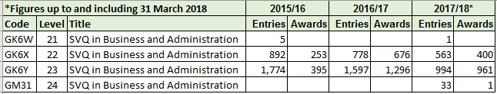
Current SVQs in Business and Administration
Title | Code | Start date
SVQ 1 Business and Administration (SCQF 4) | GK6W 21 | August 2015
SVQ 2 Business and Administration (SCQF 5) | GK6X 22 | August 2015
SVQ 3 Business and Administration (SCQF 6) | GK6Y 23 | August 2015
SVQ 4 Business and Administration (SCQF 8) | GM31 24 | August 2017

Slide 4
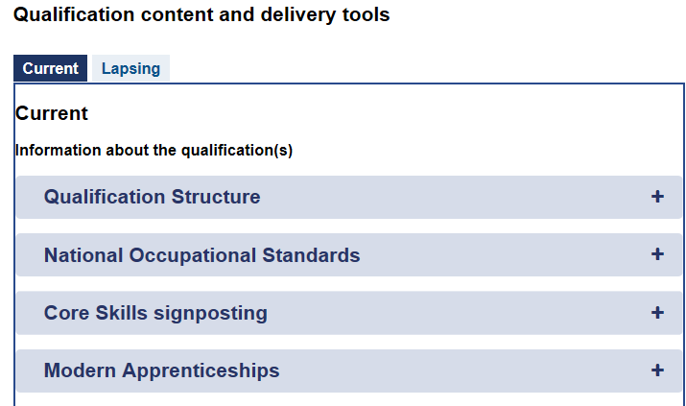
Business and Administration SVQ (SCQF 8)
Technical Apprenticeship start date July 2017
SVQ in Business Administration at SCQF Level 8 (GM31 24)
Additional Career Skills* SVQ Units at SCQF Level 7 or above to a minimum of 15 SCQF credits from the approved list
*Career Skills units drawn from Business and Administration, Management, Customer Service and Enterprise.
Link to Technical Apprenticeship Framework (and MA Frameworks) available on SQA SVQ Business and Administration website:

Slide 5
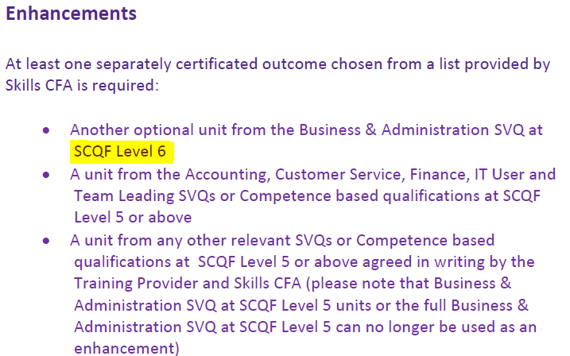
SCQF Level 6 MA – Change to Enhancements
From April 2017 – All Business and Administration Enhancement units must be SCQF Level 6 for the SCQF Level 6 MA

Slide 6
E-Skills IT User units
Survey of centres regarding accessibility of IT User units for Business and Administration candidates was undertaken in September 2017
Responses received from 45 centres
Survey highlighted significant barriers to completion of units:
Database Software
Word Processing Software
Spreadsheet Software

Slide 7
E-Skills IT User units
Survey information was shared with Skills CFA
Skills CFA agreed the issue is worthy of further research
However can’t be undertaken at this time as requires funding from Devolved Nations or another source
Funding from Devolved Nations limited and likely to be prioritised for wholesale review of NOS suites and SVQ structures

Slide 8
E-Skills IT User units
Suggested alternatives:
Produce Documents and Design and Produce Documents units may provide alternatives for Word Processing and Spreadsheet competences
Collate and Organise Data and Analyse and Report Data could be linked to Databases and Spreadsheets
Other possibilities may exist

Slide 9
Assessment Decisions and Presenting Evidence

Slide 10
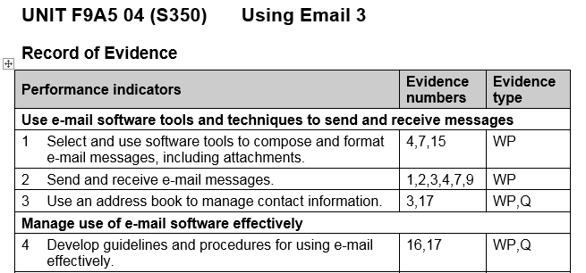
Some PIs are more equal than others
PIs 1 & 2 – simpler and more straightforward than 3 and 4
PIs 1 & 2 – Work Product evidence occurs naturally with few barriers
PIs 1 & 2 – value in seeing various examples
PI 4 – more complex task pulling together a different aspects of competence and knowledge (eg comms, knowledge of procedures)
PI 4 – little value in repeating this task (supplement with Qs)

Slide 11
Some PIs are more equal than others
PIs 3 & 4 – Evidence of how this was pulled together. WP (emails, research, drafts) and/or Supporting Evidence (Qs, Personal statement)
An Evidence number against a PI/K denotes relevance – it does not imply full coverage. “Full coverage” comes from consideration of all relevant evidence
Competence over time should be evident over the span of
the unit rather than meaning multiple evidence for every PI

Slide 12
Simulation and/or Supporting Evidence
PI 4 Develop guidelines and procedures for using email effectively
Many/most Administrators are not responsible for providing guidelines on use of email as part of their routine duties
Assessment Strategy states “Simulation and/or Supporting Evidence may be used by exception to fill small gaps where Performance Evidence does not occur naturally but the unit is part of the candidate’s normal work duties”
This is one of nine PIs
Candidate(s) could be asked to create such guidelines to demonstrate competence although these may not be formally adopted by colleagues
Accountability is an important aspect of RWE. Tasks should be meaningful and candidates should have responsibility for corollaries

Slide 13
Annotation of Work Product Evidence – Example 1

Slide 14
Annotation of Work Product Evidence – Example 2

Slide 15
Annotation of Work Product Evidence – Example 3

Slide 16
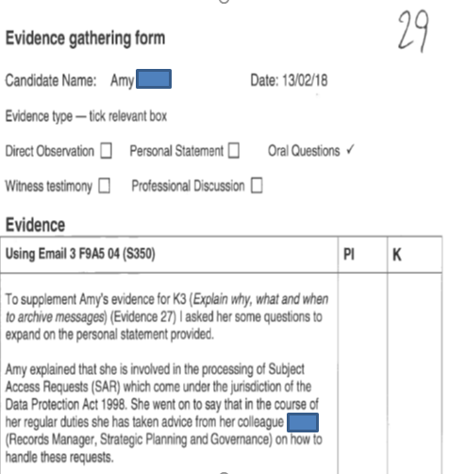
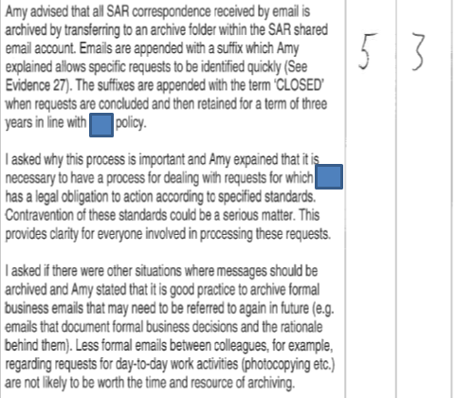
Questioning to supplement PIs and Knowledge
Good example – Records what was discussed (not a checklist), referenced to PI/K, referenced to other evidence, placed in context (refers to interactions with colleagues and explains who they are)

Slide 17
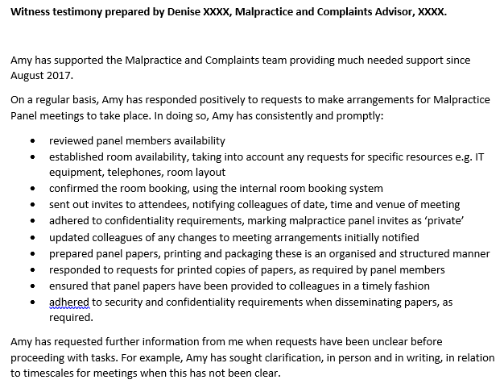
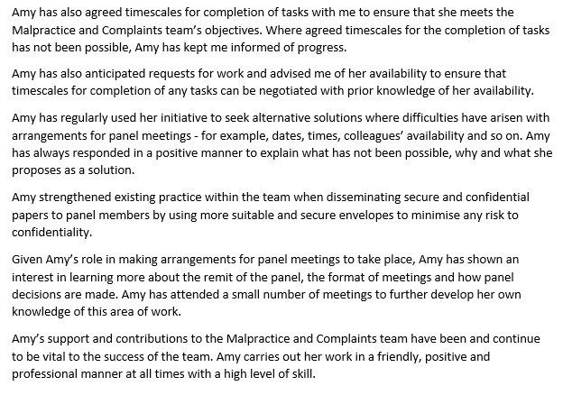
Witness Testimony
Pros – Detailed, specific, placed in context, extensive
Cons – not referenced to PIs/K, not referenced to other evidence (eg WPs)
A good example but could be strengthened with better referencing
Take care with use of bullet points (i.e. shouldn’t just be a checklist)
This example uses narrative to expand on bullet points

Slide 18
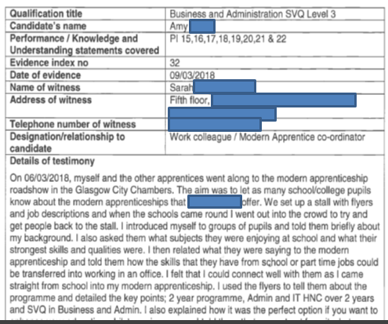
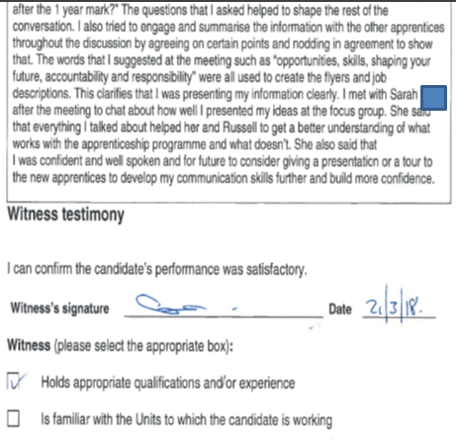
Personal Statement signed as Witness Testimony
Excellent example – Referenced to PIs, referenced to other evidence, relationship of witness to candidate clearly defined, detailed, specific, extensive, placed in context, background information re witness provided and signed and dated for authenticity

