Slide 1
HN Administration and Information Technology
Network Support Event
Tuesday 7 March 2017

Slide 2
Programme
SQA Update
SEV Update
Limited Review Update
Lunch
Delivering and Assessing Digital Technologies
SOLAR – Online Assessment of Graded Unit 1
Break for tea/coffee/networking
Graded Unit Workshop
Plenary and Close

Slide 3
SQA Update
Uptake figures
Formative Assessments
Security of ASPs
Ushare
Understanding Standards
Notes:
.

Slide 4
HNC/D Administration & IT Uptake
SQA Annual Statistical Report 2015
HNC AIT 8th – 781 entries ( -168 / 2014 (4th) )
HND AIT 10th – 470 entries ( - 46 / 2014 (9th) )
2016 Report due for publication April 2017
More information http://www.sqa.org.uk/sqa/77197.html

Slide 5
Formative Assessments
ASPs/AEXs for old units made available for formative assessment – available on SQA Secure site
Potential for use as mock assessment for Graded Units
Some changes to GUs however may still be useful preparation for exam technique etc.
Assessments available for all mandatory units except Communication, ICTinB, DIWAT and new Digital Tech unit
However…. Health warning:
Some units have changed significantly over time so centres need to judge appropriateness for their students
Formative assessment more than “mock exams” – building blocks for learning
Centres can develop their own assessment

Slide 6
Prior verified assessments
When centres submit assessments for prior verification there is the option to make available on SQA secure site
These are then listed under ‘Prior Verified Instruments of Assessment’
These assessments (and ASPs) can be used for assessment, ideas for developing assessments and CPD
Current AIT mandatory prior verified assessments available:
ITIB Spreadsheets (F84V 34)* entering lapse period 31July 17
ITIB Advanced Databases (F848 35)

Slide 7
Security of Assessments – Graded Unit 1
Three ASPs each for Graded Units 1, 2 and 3 available on SQA secure
All ASPs available are valid for use
Bank of ASPs not renewed annually
All ASP related materials must be retained in the centre – i.e. question papers & responses
Where an ASP is withdrawn SQA will notify centres and issue guidance

Slide 8
Security of Assessments - Online
Several instances of assessment material posted to document sharing websites
Most were examples of student work/responses
Sites usually have paywalls or requirement to share for access – but some are free
Factors to consider when such material found: - Assessment conditions (i.e. open-book less of a problem), is it the ASP itself or notes?
Depending on these ASP may or may not be withdrawn

Slide 9
Security of Assessments - Online
Barriers to management of leaked material:
Proliferation of sites
Sites auto replicate documents - “whack-a-mole”
Sites spread globally – jurisdiction?
Can SQA claim copyright on student work?
Sites exist purely to share “academic” works making co-operation less likely
Realistically it’s not possible to ensure all materials are removed once posted

Slide 10
Security of Assessments - Online
SQA exploring the issue
Removal of materials may be pursued in some cases but cannot be 100% effective – resource intensive
Briefing students against using such material is a more effective strategy
Students may be complacent to the risk of detection and therefore dissuaded when risks explained
Students becoming more IT literate therefore awareness of such sites only likely to increase
Problem is not going away

Slide 11
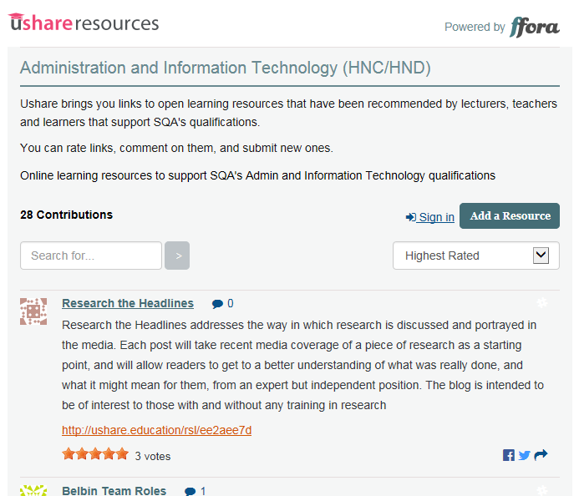
Ushare (foot of SQA HN AIT webpage)

Slide 12
Understanding Standards
http://www.understandingstandards.org.uk
Marked scripts with EV annotations for Graded Units 1&2
Live assessments so password protected
Must be stored securely
Username/password can be obtained from:
mycentre@sqa.org.uk

Slide 13
Keeping informed
To receive email alerts, when content you are interested in has been added to or updated on SQA’s website, subscribe to MyAlerts at www.sqa.org.uk/myalerts
Look out for Centre News – SQA’s weekly update for centres, and our monthly e-newsletter on the new National Qualifications.
To subscribe to our newsletters, go to http://mailer.sqa.org.uk

Slide 14
Follow us online
YouTube – SQAonline
Facebook – Scottish Qualifications Authority
Twitter - @sqanews

