Slide 1
HN Business
Network Support Event
Tuesday 28 February 2017

Slide 2
Programme
SQA Update
SEV Update
Developing and Customising Assessments from SQA ASPs
Lunch
Graded Unit 1: Marking Exercise
Break for tea/coffee/networking
Guidance on approaches to Word Counts
Plenary and Close

Slide 3
HN Business – SQA Update
Uptake figures
Impact of HN AIT Review – ITIB Spreadsheets
Security of Assessments
HN Enhancement project
Ushare
Understanding Standards
Notes:
Hello everyone. It’s good to see some familiar faces and not so familiar faces.
Uptake figures – as usual
Impact of HN AIT Review – ITIB Spreadsheets and ICT in Business have been reviewed
Security of Assessments – challenges facing us all – SQA and centres
HN Enhancements project – a few figures on the uptake and what the future might hold
Ushare and Understanding Standards – really just a reminder where you can access those materials.

Slide 4
HNC/D Business Uptake
SQA Annual Statistical Report 2015
HNC Business 7th – 810 entries ( -29 / 2014 (7th) )
HND Business 1st –1451 entries (+141 / 2014 (2nd) )
2016 Report due for publication April 2017
More information http://www.sqa.org.uk/sqa/77197.html
Notes:
Just some statistics to update you on uptake of the qualifications…

Slide 5
ITIB: Spreadsheets
Background:
Unit designed to develop knowledge and skills to customise solutions to business problems/processes (i.e. not a purely technical unit)
Belongs to Admin & IT cognate group
Updated as part of HN Admin & IT Review
Feedback from HN Business survey also informed changes
Unit criticised for heavy and cumbersome assessment
Notes:
ITIB Spreadsheets – mandatory Unit in HNC and HND Business.
Unit designed to develop knowledge and skills …. This is critical. It’s not just a technical unit about tinkering with spreadsheets and carrying out exercises in a spreadsheet package – the purpose is to equip students with IT and problem solving skills to apply their knowledge to a business situation requiring a solution.
Important that the unit assesses what it claims to assess for validity of the assessment i.e. IT in Business – as stated in the aims of the unit.
Belongs to Admin & IT cognate group so writers came from that area
Updated as part of recent HN Admin & IT Review
Feedback from HN Business survey and some others in the Business area, although comments tended to be fairly similar from both
Unit criticised for heavy and onerous assessment

Slide 6
ITIB: Spreadsheets
Unit specification issues:
Issues of over-assessment linked to perception of teaching to assessment
Unit spec is an assessment standard not a tool for policing centre delivery
Bolder actions needed to significantly reduce assessment
Unit often asks for tasks to be repeated (e.g. use three methods of averaging)
This drives over-assessment and complexity
Notes:
When it came to addressing the criticism by reducing assessment we got into the situation – as has often been the case in the past - where writers were reluctant to remove or reduce content for the fear that it won’t be covered in teaching.
I don’t have evidence to say that teaching to assessment is a big problem – although we do get comments that centres often don’t have the time they feel they should for delivery. But I think that centres generally try to do the right thing – but I can understand why writers might feel like that
The purpose of a unit specification is to provide the standard that should be met by assessment. An ASP (or previously Assessment Exemplar) are an exemplification of one assessment that meets that standard – an ASP covers other things and John Kelly will cover that later on.
A unit specification is not a tool for policing centre delivery – and trying to “force” centres to cover things in delivery through helps drive this overassessment by trying to police it in this way.
We can’t reduce assessment if our thinking is – we need to include everything we would like to see taught in the assessment – it’s just not possible. If you think about it, I’m sure you can appreciate that.
So…. Bolder actions needed to significantly reduce assessment by focusing on the critical knowledge, skills and evidence needed to meet the aims of the Unit and deciding what was not critical or could be reduced.
In the end .. We didn’t remove very much in the way of content but significantly reduced the volume of content asked for.
Existing unit often asks for tasks to be repeated (e.g. use three methods of averaging).
This drives over-assessment and complexity as when it comes to writing an assessment… I need to come up with a scenario that requires the mode, median and mean, or whatever… Rather than selecting the most appropriate one for a scenario and then justifying why you chose that over alternatives… that way showing knowledge of other possibilities.

Slide 7
ITIB: Spreadsheets
ASP issues:
Many criticisms related to the ASPs
ASPs break down tasks into step by step instructions directing students rather than engage holistic problem solving
Assessment can be a pursuit of the “correct figures” in example solution rather than using knowledge and skills to customise a solution
Notes:
Regarding the SQA ASPs…
Many of the criticisms were about ASPs not the unit specification – remember the ASP is only one possibility
I was involved with editing and signing off the existing ASPs, so with the benefit of hindsight and the time to sit down and review them things can always be improved –
ASPs tend to break down the tasks into a series of step by step instructions… which takes away a lot of the holistic problem solving ASP…. ..
Assessment can also be a pursuit of the “correct figures” rather than have they demonstrated the knowledge and skills in using the spreadsheet to create a solution but have perhaps interpreted something in the question a little differently but with some justification.
Database example?

Slide 8
ITIB: Spreadsheets
Changes made:
Assessment content reduced (not Knowledge & Skills)
Requirement to repeat tasks removed or minimised in Unit specification
Evaluation of data/information across entire assessment task (Outcome 3) rather than repeated per Outcome
New ASP will require students to interpret the scenario to identify solutions rather than be directed to tools/functions
ASP to contain more guidance on making judgements than
presenting the “correct” figures
Notes:
So changes that were actually made:
- Outlined in your pack – table of unit changes covering the statement of standards of the unit
Assessment content reduced – not much in Knowledge & Skills
Requirement to repeat tasks removed or minimised - Remember – standardisation is about assessing evidence requirements at the right level – not every student doing the exact same thing.
Evaluation of data/information consolidated in one Outcome. The previous Unit asked for this to be done for Outcomes 2 and 3, which is really a duplication, so in the new unit, this is included in Outcome 3, so a meaningful evaluation and analysis can be done over the entire assessment.
New ASP will basically require students to work out what functions and tools to use, as much as is possible – rather than be told to “create a column, give the column a title…” etc. etc.
Because of that the guidance on suggested solution will contain more guidance on the critical factors on making assessment judgements – the ASP will probably have figures as an example which in all likelihood will

Slide 9
ICT in Business
Minimal changes to reduce assessment
Iain Walker will summarise changes in afternoon session

Slide 10
Security of Assessments – Graded Unit 1
Four ASPs for Graded Unit 1 available on SQA secure
All ASPs available are valid for use
Bank of ASPs not renewed annually
All ASP related materials must be retained in the centre – i.e. question papers & responses
Where an ASP is withdrawn SQA will notify centres and issue guidance

Slide 11
Security of Assessments - Online
Several instances of assessment material posted to document sharing websites
Most were examples of student work/responses
Sites usually have paywalls or requirement to share for access – but some are free
Factors to consider when such material found:
- Assessment conditions (i.e. open-book less of a problem), is it the ASP itself or notes?
Depending on these ASP may or may not be withdrawn

Slide 12
Security of Assessments - Online
Barriers to management of leaked material:
Proliferation of sites
Sites auto replicate documents - “whack-a-mole”
Sites spread globally – jurisdiction?
Can SQA claim copyright on student work?
Sites exist purely to share “academic” works making co-operation less likely
Realistically it’s not possible to ensure all materials are removed once posted

Slide 13
Security of Assessments - Online
SQA exploring the issue
Removal of materials may be pursued in some cases but cannot be 100% effective – resource intensive
Briefing students against using such material is a more effective strategy
Students may be complacent to the risk of detection and therefore dissuaded when risks explained
Students becoming more IT literate therefore awareness of such sites only likely to increase
Problem is here to stay

Slide 14
HN Enhancements Pilot
A pilot project allowing centres to use assessment methods more aligned with those likely to be encountered in Higher Education degree programmes
To facilitate, SQA developed ASPs using approaches that do not adhere completely with existing design principles

Slide 15
HN Enhancements Pilot
Business Law: Intro – 14 centres registered 15/16
- Reduced Assessment (with sampling)
- Closed book Exam with cut-off score
Economic Issues: An Introduction – 14 centres registered 15/16
- Reduced Assessment (with sampling)
- Closed book Exam with cut-off score
BCS / Behavioural Skills for Business – 4 centres registered 15/16
- Combined Assessment (with sampling)
- Part A: Coursework Assessment with cut-off score
- Part B: Closed book Exam with cut-off score
Graded Unit 2 / Research Skills – 12 registered 15/16
- Combined Assessment
- Project Investigation with cut-off score

Slide 16
HN Enhancements Pilot
Centres require to register (see contact details below)
Alternative Assessments continue indefinitely
SQA Policy team reviewing HN policies and processes
Considering how ‘Enhancement’ approaches can be embedded in mainstream going forward
More clarity will be provided towards the end of the year
For more information contact:
hnenhancementpilot@sqa.org.uk

Slide 17
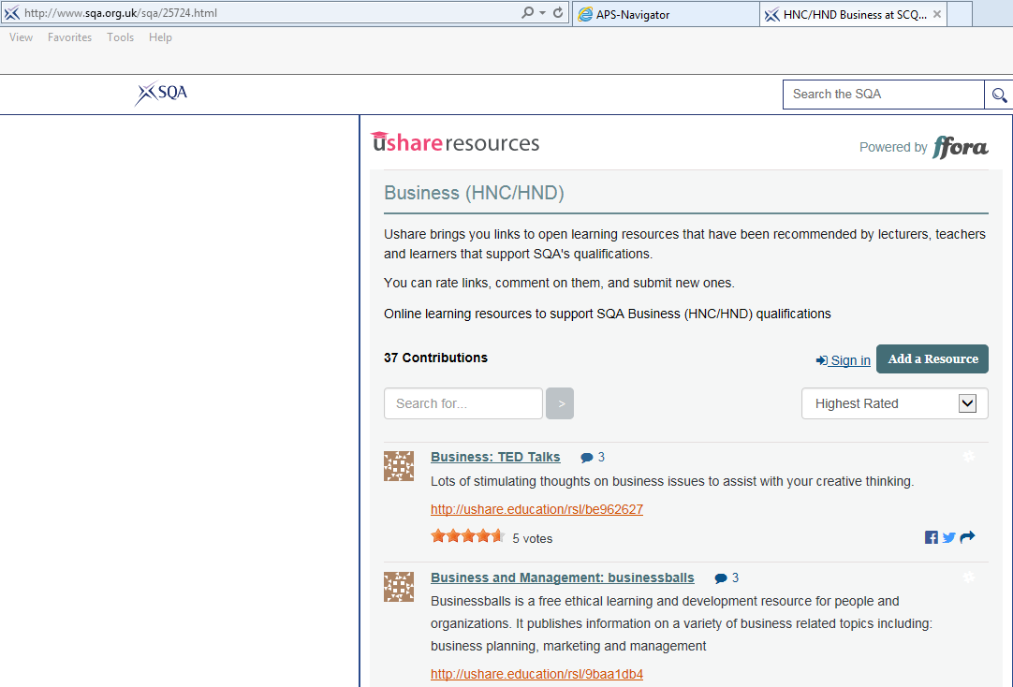
Ushare (foot of SQA HN Business webpage)

Slide 18
Understanding Standards
http://www.understandingstandards.org.uk
Marked scripts with EV annotations for Graded Units 1&2
Live assessments so password protected
Must be stored securely
Username/password can be obtained from:
mycentre@sqa.org.uk

Slide 19
Keeping informed
To receive email alerts, when content you are interested in has been added to or updated on SQA’s website, subscribe to MyAlerts at www.sqa.org.uk/myalerts
Look out for Centre News – SQA’s weekly update for centres, and our monthly e-newsletter on the new National Qualifications.
To subscribe to our newsletters, go to http://mailer.sqa.org.uk

Slide 20



Follow us online
YouTube – SQAonline
Facebook – Scottish Qualifications Authority
Twitter - @sqanews

