Slide 1
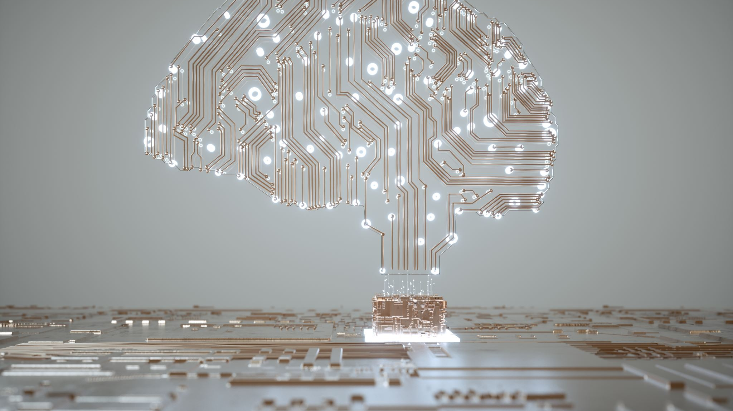
Artificial Intelligence in Education
Sarah Sutherland
UHI Inverness

Slide 2

Why did the accountant cross the road?

Slide 3

  To get to the other side of the ledger!

Slide 4
Why did the accountant quit his job?

Slide 5

  He lost his balance!!

Slide 6
History of Artificial intelligence

Slide 7
Artificial intelligence in education
Roots in 1950s – researchers began exploring the possibility of building machines that could learn and reason like humans
Landmark moments
1950 Claude Shannon released “Programming a Computer for Playing Chess”
Throughout the 60s and 70s work continued on AI although slowed in the 80s
Major breakthrough in 1997 – Deep Blue
Rise of Big Data in the early 2000s saw renewed interest in AI
Now being used in language processing, robotics, autonomous vehicles and education

Slide 8
Artificial intelligence in education

Slide 9
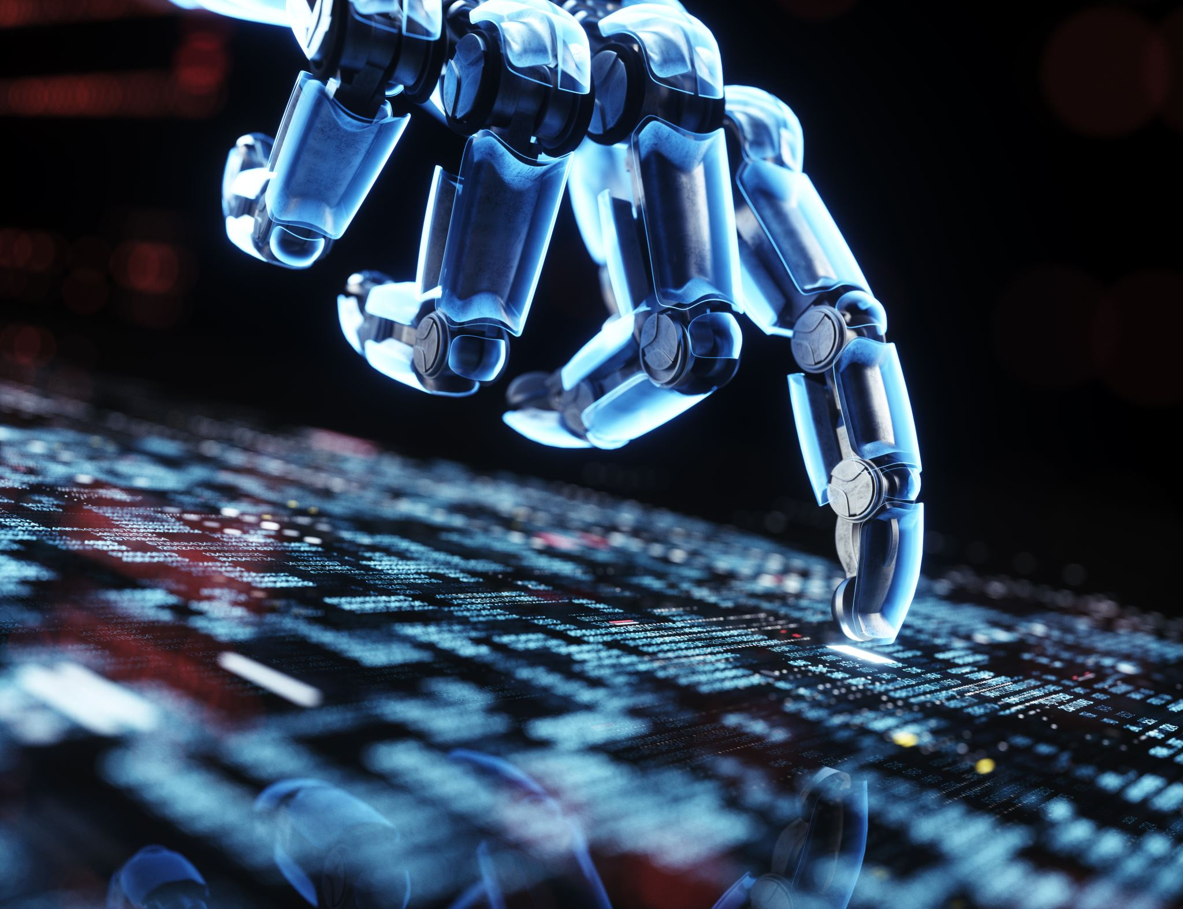
AI in Education
The Good…
Personalised learning
Intelligent tutoring systems
Automated grading
Chatbots
Predictive Analysis

Slide 10
AI in Education
The Bad…
Bias and Discrimination
Dependence on technology
Loss of Personal Interaction
Privacy Concerns
Cost

Slide 11

AI in Education
“academics have generated responses to exam queries that they say would result in full marks if submitted by an undergraduate”
(Hern, 2022)

Slide 12

Chatbot or student?
Simple to calculate: ARR is easy to calculate as it only requires basic financial data such as the initial investment and the average annual accounting profit.

Slide 13
Chatbot or student?
Ignores the time value of money: ARR does not take into account the time value of money, which means that future cash flows are not discounted back to the present day.

Slide 14
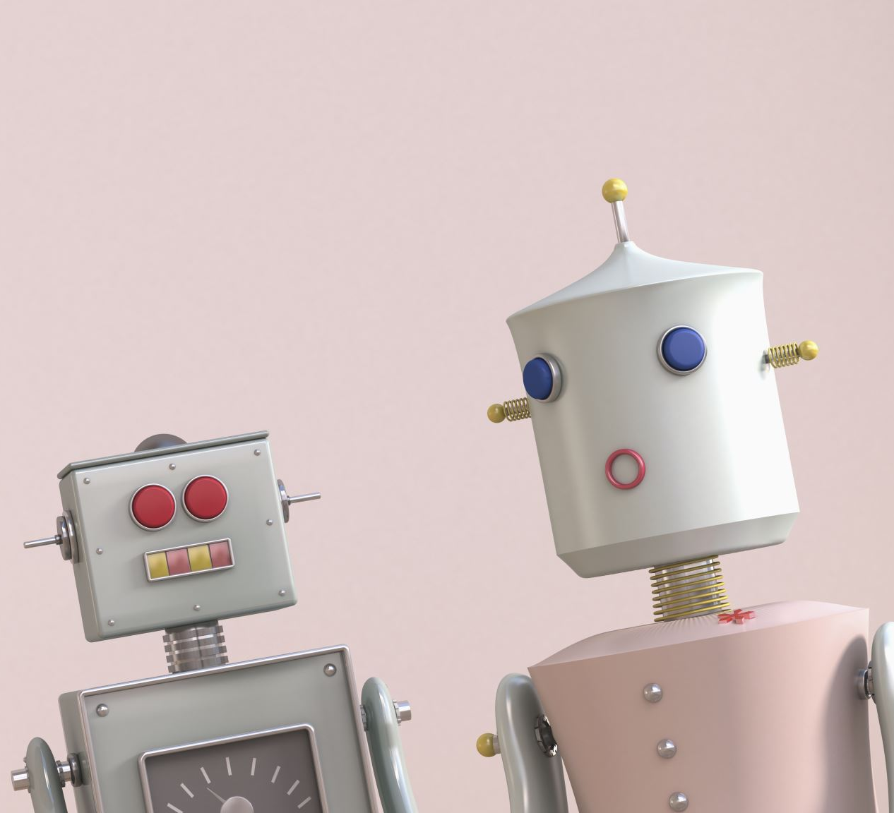
AI Chatbots
Openai.com
ChatGPT
Chai
Dataconomy

Slide 15
How to minimise use of ai in unsupervised assessments
Continue to use plagiarism detecting software – Turnitin are already addressing this
Promote academic integrity through assessment briefing
Show their workings
Discussion meetings
Post on discussion boards
Vary assessments

