Slide 2
SVQ Social Services (Children and Young People) SVQ Social Services and Healthcare Wednesday 28 November 2018 – Dundee Thursday 29 November 2018 – Glasgow

Slide 3
Presenter
David Watt
Qualifications Manager
Humanities, Care and Services
Tel – 0345-213-5577
Email – David.Watt@sqa.org.uk

Slide 5
Welcome and Introduction
Domestic Arrangements
Overview of the Day

Slide 6
SVQ Care and Child Care Update
Presenter – John Currie
Senior External Verifier
SVQ Care (82) and SVQ Child Care (84)

Slide 7
SSSC Update
Presenter – Kerry Cannon
Learning and Development Adviser
Scottish Social Services Council (SSSC)

Slide 8
SSSC Update
Presenter – Kerry Cannon
Learning and Development Adviser
Scottish Social Services Council (SSSC)

Slide 9
#lifechangingwork in social services
Qualifications and career pathways

Slide 10
A trusted, skilled and valued workforce
What is the Scottish Social Services Council?
We are the regulator for the social service workforce in Scotland. Our work means the people of Scotland can count on social services being provided by a trusted, skilled and confident workforce.
What do we do?
We protect the public by registering social service workers, setting standards for their practice, conduct, training and education and by supporting their professional development. Where people fall below the standards of practice and conduct we can investigate and take action.

Slide 11
Did you know?
120,000 individuals registered with SSSC. (November 2018)
Nearly 30,000 support workers in care at home and housing support registered or in process of registering. 50% more than we expected by this time.
Of registered support workers in care at home/housing support, 40% have already met qualification condition.
By 2020, an estimated 11,000 new roles available to increase capacity for delivery of 1,140 hours of funded Early Learning and Childcare.
The number of qualification conditions due (for those currently registered) will increase significantly in the next five years. Key groups are support workers in care homes, housing support, care at home.
At the moment, most registrants (85%) meet their qualification requirement early, e.g. in less than the five years given.
The most popular qualification route in social services is work-based (SVQ).

Slide 12
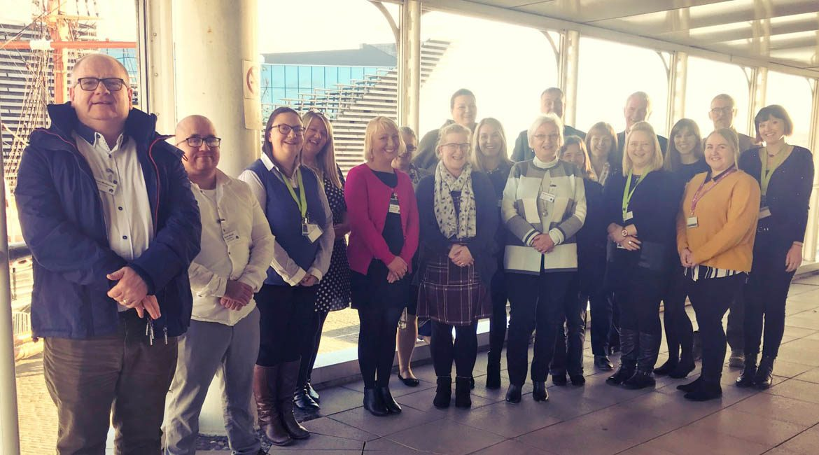
Promoting careers in social services

Slide 13
ssscnews.uk.com/2018/11/01/sssc-careers-resources/

Slide 14
A better understanding of career pathways in social services
“How we understand and plan for our social care workforce is critical to the whole ambition of integrated high-quality services, to the staff we value and the outcomes for our citizens.”
National Health and Social Care Workforce Plan, Part 2
Recommendation 6:
Develop proposals for enhanced career pathways recognising the context of the developing multidisciplinary, integrated workforce environment.

Slide 15
Pathways
learn.sssc.uk.com/careers

Slide 16
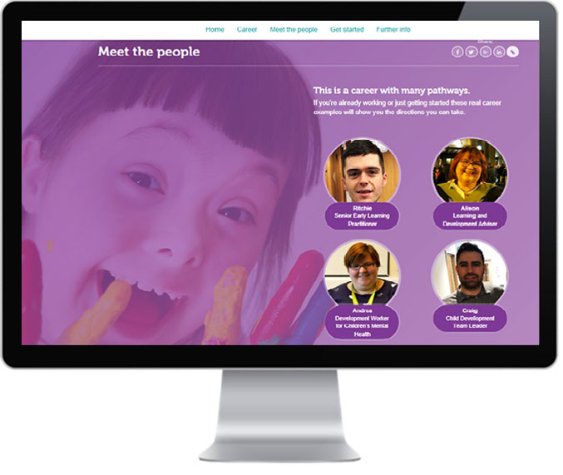
learn.sssc.uk.com/childcarecareers

Slide 17
A new careers website for social services
A new SSSC microsite to launch in Spring 2019:
Children and young people’s settings
Health and social care
Social work and criminal justice
Showcasing the sector, it’s people (through real career stories), the qualification pathways and continuous professional learning (including enhanced and integrated roles).
#LifeChangingWork

Slide 18
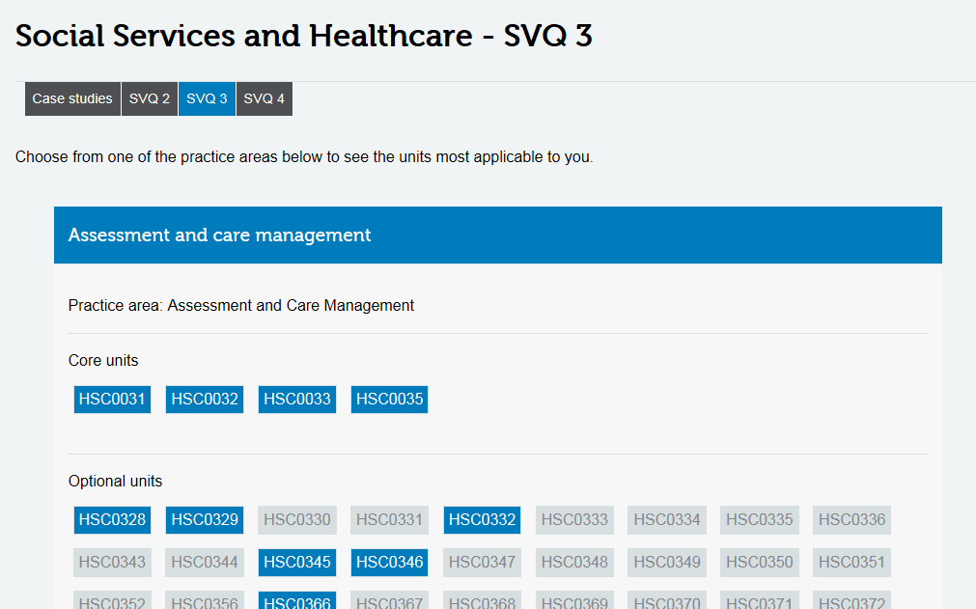
All SVQs have the same core areas:
Rights and safeguarding
Effective communication
Health, safety and security
Reflective practice
(there are hundreds of National Occupational Standards!!!)
learn.sssc.uk.com/nos

Slide 19
Professional Development Awards
Some examples:
PDA Health and Social Care Supervision at SCQF level 7
PDA Health and Social Care: Administration of Medication at SCQF level 7
PDA in Scrutiny and Improvement Practice (Social Services) at SCQF level 10 – for Care Inspectors
Explore the full range on the SQA Care pages - www.sqa.org.uk/sqa/45285

Slide 20
?

Slide 21
Kerry.Cannon@sssc.uk.com
01382 346189
@KerryCannon

Slide 22
Care as a Career …
Fiona Gleghorn
Interim Manager
©The Care Training Consortium

Slide 23
Care as a Career …

Slide 24
Aim ……
To encourage individuals to choose CARE as a career
Increase the retention of current workforce within CARE
Promote CARE positively

Slide 25
Where we came from
2002 company was founded
Local recognition of a need to upskill and train carers
Variety of training needs were identified
Personal care
Mandatory training
Known as The Care at Home Training Consortium Ltd and is a charity and social enterprise
Expanded in 2006
Workforce expanded
Working now with Care homes, voluntary and independent sector
Now also offering wider training portfolio
SQA centre offering SVQ Health & Social Care level 2 – LMA
Company continues to expand
Team of assessors and trainers working across D&G and other parts of Scotland
Also a 2 year post funded by Carers Strategy to look at Care Aware Training
Raising awareness with healthcare providers of the role Unpaid Carers play in providing care to our communities

Slide 26
A National problem
The shape of Scottish society and the health and care needs of our communities locally are changing. People are living longer, healthier lives and as the needs of our society change, so too must the nature and form of our public services.
In the next 10 years, the number of people in Scotland aged over 75 is likely to have increased by over 25%.
In the same period, it’s also estimated that nearly two-thirds of people will have developed a long-term condition by the age of 65.

Slide 27
Local Problem
For Dumfries & Galloway, the crucial difference is that in tandem with the projected drop in the 0 - 29 age group from 48.1K to 36.1K,
The projected overall population will also drop from 145.8K to 131.7K.
However, the 60+ age group is projected to rise from 36.6K ( 36%of general pop.) to 48K ( 38% of general pop) by 2020
(Integration Board Carers Strategy 2017, D&G Age Concern Forum Report 2017)

Slide 28
So, what do we do ?

Slide 29
Start them young !!!!!

Slide 30
CTC Care Roadshow
CTC is promoting Care as a career within schools across the region by delivering “Care Roadshows” in schools,
We hope this may then lead to increasing the number of carers for the future,
By planting the seeds early and promoting care as a career.
CTC has provided the roadshow to a number of schools in Dumfries and Galloway.
Include service partners to tell some of their stories about a career in care
Notes:
CTC invites representatives from our partners who provide care, to attend the roadshow to talk about their career pathway from a carer, to progression to managers or supervisors. We highlight that to further your career you can gain qualifications whilst working.
30

Slide 31
Workshops takes place with practical session including:
Learning CPR
Vital signs
Medication
Sugar contents
Infection Control
Discuss SVQ pathways and Professional development
Notes:
Learning CPR, using Resuscitation Annie’s
Vital signs – the taking of, and importance of the correct measurements of blood pressure, pulse etc
Medication – administering medication appropriately, the use of creams, inhalers etc
Sugar contents – scanning food and drink packets, to see how much sugar these contain
Infection Control - washing hands appropriately and looking at the results using a glow box.
The feedback from students has been very encouraging as they have enjoyed the practical workshops and CTC have given them a little insight into the care industry.

Slide 32
Duke of Edinburgh Award
CTC are actively promoting that students undertaking their Duke of Edinburgh Awards and could undertake their service part in a care environment.
Our service partners are encouraging this and have facilitated placements
Notes:
This is monitored by a dedicated member of staff within the students chosen working environment. This also allows the student to experience the care industry and hopefully “plant seeds” for their future careers.

Slide 33
Grow their own
We encourage providers to take on younger staff.
They are often reluctant
Provide mentorship and good role modelling
Provide a structured induction/ professional development pathway

Slide 34
Those choosing a Career Change

Slide 35
Step in to Care
Step in to Care is a programme that has been delivered by CTC on several occasions previously when funding has been available.
partnership working with an other training agency, Job Centre, Holywood Trust
The course is for unemployed people who are looking to either change careers or learn new skill to enable them to gain employment in the care sector.
The course can be delivered over two weeks or 10 days over a number of weeks

Slide 36
The course consists of 10 days training including:
Roles and Responsibilities & Record Keeping
Support and Protection of Vulnerable Groups
Working with Challenging Behaviour
Personal Hygiene and Skin Care
First Aid
Looking After Someone with Dementia
Chronic Conditions
Food Safety
Communication Skills
Confidence Building
Health and Safety & Risk Assessment
Moving and Handling
Notes:
These topics are covered as they are current topics recognised as essential or have a high focus in current care environments.
Funding for this has previously been generated from a number of sources. If funding was gained, then this would cover the cost of training, PVG’s and lunch for the attendees.
At the end of the training the learners receive a certificate for each course. They are also guaranteed an interview with a Care Home or Care Provider and are able to go on a placement with their preferred provider e.g. Learning Disabilities, Care at Home or Care Homes.

Slide 37
Harnessing The Unpaid Workforce..

Slide 38
Training for Unpaid Carers
Since 2014 CTC has been given funding from the Carers Strategy. (via NHS commissioning)
To deliver free short courses for the Unpaid Carer.
Region wide via the network of Carers Centres
This project has been extremely successful across Dumfries and Galloway.
Notes:
Participants have found these sessions very worthwhile as they have been able to meet with people in similar situations to themselves or it has allowed them time to come out of their stressful situations at home and have some “me time”.
Often, we can signpost them onto other organisations that can meet their needs better than we can.
SOMETIMES …

Slide 39
Topics so far
Dementia Awareness
Safer Moving and Handling
Stress Awareness
Epilepsy Awareness
Managing Challenging Behaviour
Changing Relationships
First Aid
Medication Awareness
Coping with Difficult Situations
Assertiveness
Reiki

Slide 40
Delivery Model
Delivery Can be
Group delivery in a workshop format
Individualised / bespoke
One to one
Part of the funding for Unpaid Carers has been reserved to provide emergency Moving and Handling training to allow families to be trained in the use of moving and handling equipment, to allow the person they care for to be discharged from hospital sooner if a health professional has not been available.
Evaluation so far is good …
Notes:
This has stopped someone bed blocking within the hospital setting and benefits the whole family as they can all be available for the training. CTC still has some funding available to deliver this service, so it is free for the time being. When the funding ceases, this service would still be available at an affordable cost to the NHS and would be considerably cheaper than keeping someone in hospital unnecessarily bed blocking

Slide 41
The wider community
CTC also works with the local LGBT Plus Community
bespoke training particularly in relation to LGBT communities as well as similar sessions to other Unpaid carer programme
Reacting to local surveys of this community and its unpaid Carers
Sessions were well attended , well evaluated around meeting their needs
Notes:
.

Slide 42
The existing Workforce

Slide 43
Oh but … I'm just a carer
Need to feel valued …
Not in a dead end job
Investment in development

Slide 44
Step Up Step Down
Carers are a vital partner in the delivery in Health and Social Care in people in Residential Care.
As we all know traditional care services are overwhelmed, hospital beds are full and not enough people are training within the medical/nursing professions to support the future health needs of our growing elderly population.
We MUST invest in those established in the profession to retain this valuable resource
Notes:
A Step Up/Step Down programme took place using funding from Putting You First. A further test of change in the form of a structured competency based training programme took place to support the long term sustainable model of Step Up/Step Down. The programme offered carers the opportunity to be trained to undertake physiological measurements of vital signs of service users whose clinical condition appears to be deteriorating and suffer from any of the following: - Chronic Obstructive Pulmonary Disease (COPD), Diabetes, Stroke, Coronary Heart Disease, Urinary Tract Infection and those who have a high-pressure area risk score.

Slide 45
The Brief ……
To develop the existing workforce
CTC provided a Step Up/Step Down programme using funding from Putting You First.
A test of change in the form of a structured competency based training programme took place to support the long term sustainable model of Step Up/Step Down
.

Slide 46
Our Vision for Step Up/Step Down
Our vision is that all the training delivered under this programme will build a knowledgeable workforce
that can detect deterioration in service users by monitoring their vital signs i.e. blood pressure, pulse, temperature, respiratory rate, blood sugars, urinalysis and saturation levels.
The workforce taking part will gain confidence, competency and knowledge in identifying the deterioration of the Service Users health and well-being and being able to take appropriate action.

Slide 47
The programme offered carers the opportunity to be trained to undertake physiological measurements of vital signs of service users whose clinical condition appears to be deteriorating and suffer from any of the following: -
Chronic Obstructive Pulmonary Disease (COPD),
Diabetes
Stroke
Coronary Heart Disease
Urinary Tract Infection and those who have a high-pressure area risk score.

Slide 48
Expected outcomes?
The training will prevent unnecessary admissions to hospital shifting the focus of institutionalised care to the Home and community based services. This will enable the service user to have more choice and control of their health outcomes and care.
The workforce will be well informed and knowledgeable in relation to the six chronic conditions as detailed in the summary above. The workforce will be confident and competent to undertake physiological measurements.
Work alongside Community Nursing who ‘signed off’ the competencies
Notes:
Benefits and to whom: -
There are huge benefits in that the workforce will be well informed and knowledgeable in relation to the six chronic conditions as detailed in the outline above, and the workforce will be confident and competent to undertake physiological measurements.
They will receive the theoretical background to understand what are the normal perimeters in relation to temperature/pulse/respiratory rate/blood pressure/blood glucose monitoring (T, P, R, BP, BM’s), Urinalysis and oxygen saturation levels.
The Carers will be competent at recording the information accurately and to know how often to review the service user, they will understand some common reasons that may cause the deterioration in vital signs and will recognise when deteriorating vital signs require medical intervention and then have the knowledge of who to contact appropriate to the service user.

Slide 49
Story so far …
East of our region has embraced the concept
3 residential homes have taken part, training 3 separate cohorts of 12 staff
Working with Community Nurses to gain competence / confidence
Monthly practice of baseline Vital signs
Reduced numbers of unnecessary hospital admissions

Slide 50
And the rest ………..
SVQ
Wide training Portfolio

Slide 51
Partnership working to build a Competent, Resilient Workforce
Individuals and Community
Partnership organisations
Schools and education
Notes:
There is a need to work together to provide education , information , knowledge , and support to develop a workforce who can cope with ever increasing demands
All of the above depends on this …
Need to work together with ;
Schools and education
Community
Partnership organocations
Individuals
To build a resilient competent workforce

Slide 52
Common Knowledge
Presenter – Bert Lawrie
External Verifier
SVQ Care (82) and SVQ Child Care (84)

Slide 53
Common Knowledge
Starting point is the SQA Guidance that should be read in conjunction with the Assessment Strategy.

Slide 54
Assessors Role
In line with the L&D9Di Unit, it is the responsibility of the assessor to work with candidates to identify gaps in knowledge and skills before starting assessment.
Are your candidates in the appropriate job role?
What if any extra support do candidates need to reach the right level of competence?

Slide 55
Planning and Holistic Assessment
Integration of knowledge and practice is fundamental.
Identify opportunities for “integration” through careful planning.
Integration of workplace activities and knowledge is critical to success.
Essential that assessors adopt a range of methods in the evidence gathering process.

Slide 56
Assessing the Common Knowledge
Emphasis must be in candidates reflective accounts of practice for the majority of evidence.
When unable to do so then use “focused, pieces of work. However, candidates MUST be able to apply the focused work to their “real work” practice.
Knowledge CANNOT be inferred from direct observation. You must use other assessment methods.

Slide 57
What works well?
Candidate is well prepared at the outset, perhaps through a “Readiness for Assessment” tool.
Candidates training has been matched to the standards and linked to real work activities.
Following observation the assessor checks and confirms knowledge through oral questioning and professional discussion.
Assessors written feedback, directs candidate to future opportunities to meet gaps in common and/or specific knowledge.

Slide 58
Qualification Verifiers Findings 1
Over assessment is commonplace and never challenged by Internal Verifier.
Candidates/assessors provide multiple/numerous examples for each knowledge point.
Assessors set candidates focused pieces of work/assignments/written questions when the knowledge point has already been met within reflective accounts.

Slide 59
Qualification Verifiers Findings 2
Assessors continue to “Directly Observe” knowledge despite the guidance.
Assessors directly observe “every unit”.
Some centres continue to assess single units or limit the amount of evidence generated by “holistic assessment”.
Assignments and written questions continue to be set for numerous knowledge points INSTEAD of gaps or Performance Criteria “not easily incorporated into accounts of practice”.

Slide 60
Qualification Verifiers Findings 3
Products are valuable “sources of evidence” particularly for higher level awards but assessors must make clear links and provide written explanations on how the product meets the Unit evidence requirements.
Copies of products shouldn’t be included, it’s YOUR written explanation on the contribution the product makes to your final assessment.

Slide 61
Any Questions

Slide 62
Presenter
Mark Hood
Training and Development Manager
Appointee Management
Tel: 0345-213-5365
Email: mark.hood@sqa.org.uk

Slide 63
Continuing Professional Development (CPD) and the SQA Academy Course

Slide 64
Definition – Continuing Professional Development (CPD)
“CPD is the conscious updating of professional knowledge and improvement of personal competence throughout your working life. Conscious implies that CPD is a state of mind rather than a set of rules or a programme of study”.

Slide 65
The Concept – Continuing Professional Development (CPD)
Continuing Professional Development (CPD) is about how you use a variety of learning experiences to develop yourself professionally and personally.
There is a common principle in how you approach CPD, whether you think in terms of self development or lifelong learning. It is about the learning and development that you undertake and the method you use to reflect on and record this learning.

Slide 66
SQA’s CPD Model – Personal Development Plan (PDP)
Personal development planning is the process of:
establishing aims and objectives (or goals) - what you want to achieve or where you want to go, in the short, medium or long-term in your career
assessing current realities
identifying needs for skills, knowledge or competence
selecting appropriate development activities to meet those perceived needs.

Slide 67
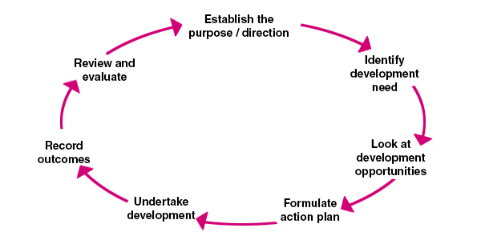
Personal Development Cycle

Slide 68
SQA’s CPD Model – Continuing Professional Development Record (CPDR)
The sequential stages of Continuing Professional Development Record (CPDR) are:
Identify the date of the activity took place.
What did you do that contributes to your Continuing Professional Development (CPD)?
What did you learn from this activity that relates to some aspect of your Continuing Professional Development (CPD)?
How would you implement this learning?
Is there any further action?
Advise on the number of CPD hours completed.

Slide 69
Any Questions

Slide 70
“Ushare”

Slide 71
Objectives
Introduction to Ushare
How to register
How to upload links

Slide 72
SQA – Ushare
A new electronic platform for sharing general resources. (Learning and Teaching)
Vocational subject areas
Platform has been available since May 2015

Slide 73
SQA – Ushare
Health and Social Care (since Nov 2015)
SQA has added some useful links
Delegates encouraged to add useful links
Notes:
Health and Social Care option designed for centres offering HN and SVQ qualifications in this broad area
Between SQA and delegates enrolled 30 plus contributions have been added.
Course –
CPD for centre staff/students participating HNCs/SVQs in Social Services, Childhood Practices and Healthcare 2018/2019 –
Take the opportunity to review the links that are on the site. If you use something please add something by return.
Upload new links to the site.

Slide 74
SQA – Ushare
How do you access this website? – Page 5
How do you register for this site?
Notes:
Refer delegates to handout.

Slide 75
SQA – Ushare – Weblink
https://ushare.education/Ushare/Home

Slide 76
Ushare as a Resource
Continually use links on site
Users of site add links to the site – Page 7
Notes:
Popular links will be kept on the site.
The site is moderated by SQA staff. Inappropriate links will not be allowed.
Links are normally moderated within a 24 hour period.

Slide 77
SQA Academy – Course
CPD for centre staff/students participating in HNCs/SVQs in Social Services, Childhood Practices and Healthcare
Joining a course on SQA Academy – Page 8

Slide 78
SQA Academy
CPD for centre staff/students participating in HNCs/SVQs in Social Services, Childhood Practices and Healthcare 2018/2019
All legislation and guidance has been reviewed and updated where appropriate
Notes:
42 different legislative topics

Slide 79
CPD for centre staff/students participating in HNCs/SVQs in Social Services, Childhood Practices and Healthcare 2018/2019
SQA will only commit to revising course for the 2019/2020 academic session if its is deemed valuable by staff and students.
Academic Session | Number of Participants | Increase/Decrease
2015/2016 | 394 | Not Applicable
2016/2017 | 138 | 256 (Decrease)
2017/2018 | 243 | 105 (Increase)
2018/2019 | ? | ?
Notes:
Course –
CPD for centre staff/students participating HNCs/SVQs in Social Services, Childhood Practices and Healthcare –
394 participants (10 November 2016)
138 participants (12 October 2017)

Slide 80
Number of Candidates and Centres
Academic Session | Qualification | Number of Candidates | Number of Centres
2018/2019 | SVQ Social Services (Children and Young People) GH5V 22 GH5W 23 GH5X 24 | 1027 (31 October 2018) | 175 (2 November 2018)
2018/2019 | SVQ Social Services and Healthcare GH5Y 22 GH60 23 GH61 24 | 1985 (31 October 2018) | 288 (2 November 2018)

Slide 81
CPD for centre staff/students participating in HNCs/SVQs in Social Services, Childhood Practices and Healthcare 2018/2019
General Data Protection Regulation
Blue Print for 2020 – Expansion of Early Learning and Childcare in Scotland
Academic Session | Number of Legislative Topics | Increase/Decrease
2015/2016 | 36 | Not Applicable
2016/2017 | 40 | 4 (Increase)
2017/2018 | 42 | 2 (Increase)
2018/2019 | 44 | 2 (Increase)

Slide 82
CPD for centre staff/students participating in HNCs/SVQs in Social Services, Childhood Practices and Healthcare 2018/2019
Literature on your table – “SVQ Update – Autumn/Winter 2018”.
Email from SQA Events Team:
Evaluation
SVQ Update – Autumn/Winter 2018
Recording Booklet for Course

Slide 83
Any Questions

Slide 84
Writing Effective Observation Reports
Wednesday 28 November 2018
Presenter – June McCamlie
Senior External Verifier
Thursday 29 November 2018
Presenter – John Carr
Depute Lead Verifier

Slide 85
Persuading the Reader
Consider the various audiences and their
needs from your reports.
Candidates.
Centre internal verifiers.
Qualification Verifiers.
Employers.

Slide 86
Persuading the Reader
Hotel Report.
Offering an ideal and idyllic location for your holiday.
This modern and well equipped hotel offers easy
access to the resort and all it’s amenities.
The staff are professional and attentive and will create
a pleasant and relaxing atmosphere throughout your
stay.

Slide 87
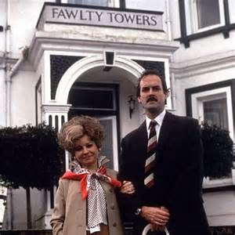

Slide 88
Writing Effective Observation Reports
Write evidence-based, factual, evaluative statements – don’t express personal opinions.
Write in full sentences, not in note form.
Check spelling and grammar.
Ensure all terminology is current and correct. Avoid acronyms.
Avoid over-personalisation, use formal third person.

Slide 89
Persuading the Reader
When writing evidence-based evaluative observation
statements within a report, make sure that the evidence
you have examined, observed or scrutinised supports your
evaluations.
Group Activity 1. Evaluative Statements

Slide 90
Persuading the Reader
Group Activity 1
Albion Rovers vs Airdrie
Instructions:
1 Nominate someone to report back from your group.
2 Read the information provided.
3 Within the group, agree a response to each question.

Slide 91
Persuading the Reader
Sometimes things are not what they seem.
Giorglo Varasi wrote the following evaluative statement
within a report in 1178 about ‘Gerardo di Gerardo’.
“He surveyed the site thoroughly before laying the foundation
stones for the bell tower. Gerardo took great care and attention to
ensure that the structure was sound, compact and stable. His
professionalism, meticulous approach to detail and planning
ensured a well constructed bell tower that will stand the test of
time.”

Slide 94
Any Questions

Slide 95
Question and Answer Session

