Slide 1
SVQ Business and Administration Network Event
May 2016
Discussion Forum 1

Slide 2
Range/Scope - Triangulation
‘Range’ and ‘Scope’ are terms for criteria used in the past (pre-2005) relating to quantity and types of evidence that are no longer mandatory
Incompatible with holistic assessment – inflexible and leads to over assessment
Doesn’t fit with holistic tasks (e.g. organising a meeting, negotiation etc)
Not possible to foresee all possible evidence types (inflexible)
Multiple evidence items don’t guarantee competence over time
Competence over time should be considered holistically (i.e. at Unit level rather than for each PI and K) and should occur naturally as candidates progress

Slide 3
Range/Scope - Triangulation
Triangulation supercedes Range and Scope
Triangulation = Performance evidence backed by supporting evidence
Reduces reliance on single sources of evidence
Provides greater insight into candidate performance i.e. the wider picture
Supporting evidence such as organisational/team structure is useful even though not mapped to PIs, also putting Personal Statements/Reflective Accounts in context. Adds to the “wider picture” and increases confidence in competence
Holistic element to judgement – “is the candidate competent at the level?”
Ultimate objective is to provide credible and robust evidence of competence

Slide 4
Candidate Support Packs
‘Would SQA produce Support Packs for Business & Admin SVQs?’
Used in SVQ Management as learning material for Knowledge
Resource investment v Return question:
Very resource intensive
SQA’s core function is assessment not training therefore a “bonus”
Contrary to holistic assessment although fine for training
SVQ Management has more emphasis and greater volume of Knowledge that can’t be covered by performance so more need for discrete ways of capturing it
A few of the Management Units concerned are imported to Business & Admin Levels 3 and 4 so packs could be used if centres see value
Understanding Standards material (exemplification of holistic assessment methodology) more appropriate for Business & Administration
Understanding Standards material can be applied universally not restricted to specific Units

Slide 5
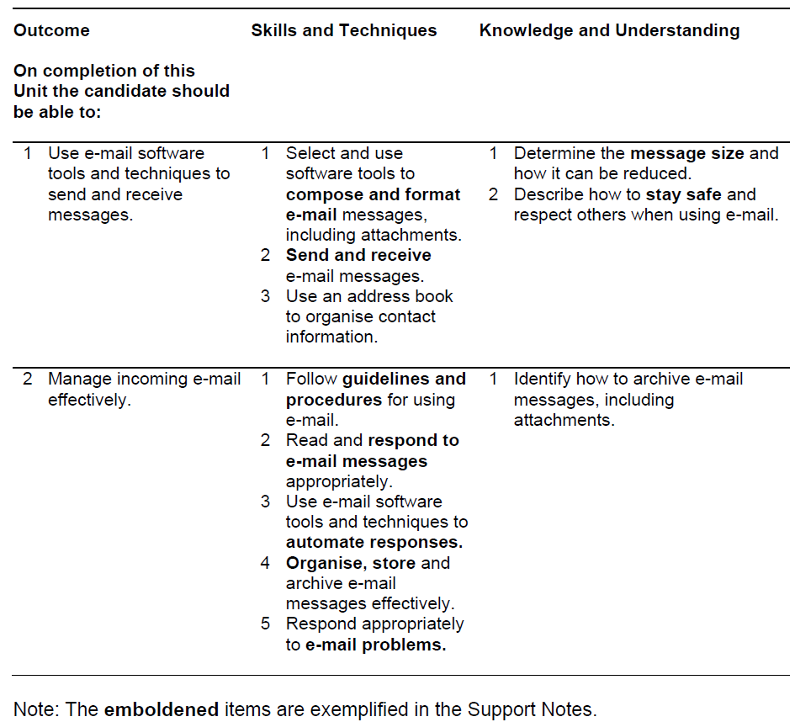
Imported IT Units
‘Guidance on IT Units – will these be revised?’
Performance
Knowledge

Slide 6
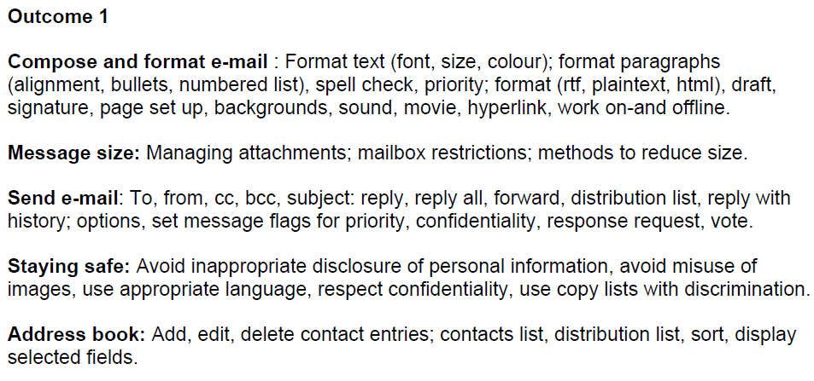
Imported IT Units

Slide 7
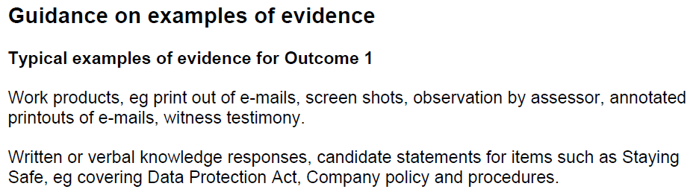
Imported IT Units
Witness testimony = Performance but should be supported by direct evidence of performance i.e. work product and/or observation
Can be used for performance by exception to cover contingencies where
Performance evidence does not occur naturally
Performance
Knowledge

Slide 8
Length of time to complete
‘What is a typical length of time for a candidate to complete?’
Depends on many factors:
Candidate engagement/motivation/experience
Access to candidate (E-Portfolios can help)
‘Range’ and quality of evidence produced by the candidate
Assessor support
Currency could be an issue – Guidance/rule of thumb 2 years BUT the key question is ‘does the evidence relate to current performance?’ i.e. have they moved jobs/duties changed etc?
SQA 10 week rule – certification cannot take place within 10 weeks of SVQ entry to allow window for External Verification
Open to question:
Higher level SVQs take longer than lower levels?
Level of candidate balances requirement for greater depth of evidence?

Slide 9
Lapse/End/Completion/Certification dates
‘What is the difference between these dates?’
Lapse date is point where no further new entries accepted and SVQ enters ‘lapse period’
Lapse period allows active candidates time to complete
End date is last date for resulting candidates – effective end date of the SVQ
Completion date is centre’s estimate for candidate completion – does not impact on when certification occurs but is used to schedule External Verification
Certification date is the date when SQA issued certificate
Retention of Evidence
Retain portfolios for 3 weeks after completion date
If candidate(s) not complete by then retain evidence and update completion date
If selected for External Verification then retain evidence for visit

Slide 10
Evidence across more than one unit
‘Are there examples of units that combine well for holistic assessment?’
i.e. The same activity/evidence covers more than one unit
An example:
Support meetings/Plan & organise meetings
Produce documents/Design & Produce documents
Use a diary system
e.g. Email exchanges (actively – Level 3) clarifying meeting requirements, circulating agenda/actions/minutes, updating e-diares with meeting schedule, location info etc.
What examples do you have in centres?

Slide 11
Foundation Apprenticeship – Business Skills
Skills Development Scotland (SDS) commissioned Skills CFA to develop according to SDS Design rules
SQA provided advice on qualification content
SDS Design Rules:
Overall SCQF Level 6
Between 48 – 65 SCQF Credit points
Split between classroom and work-based components – NQ, SVQ and other work-based units
2 year programme – schools/college/employer partnership S5-S6
Content = Units from NPA Business & IT and SVQ Business & Administration + new NQ work-based Unit
Aim to be available for delivery August 2017

Slide 12
SVQ Business and Administration Network Event
May 2016
Discussion Forum 2
E-Portfolios
Frequently Asked Questions

