Slide 1
SVQs in Business and Administration
  Network Support Event
  May 2016

Slide 2
Programme
10.00 SQA Qualification Officer Update
10.20 SQA Senior EV Update
10.45 Q&A Feedback Session 1
11.30 Networking Activity
12.15 Lunch
13.15 Q&A Feedback Session 2
14.00 Close

Slide 3
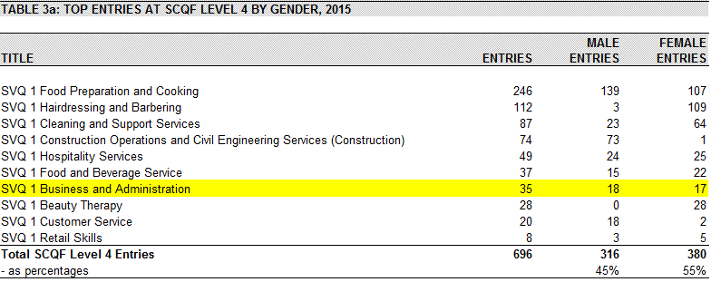
Uptake statistics http://www.sqa.org.uk/sqa/63001.html
SCQF 4 (Level 1) – 7th 35 entries

Slide 4
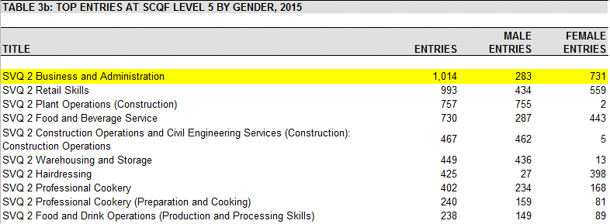
Uptake statistics http://www.sqa.org.uk/sqa/63001.html
SCQF 5 (Level 2) – 1st 1014 entries

Slide 5
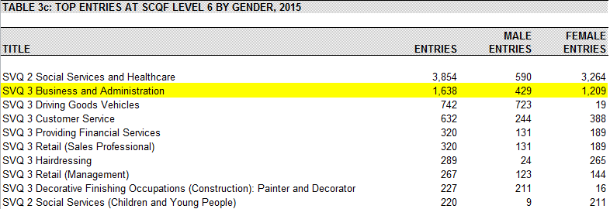
Uptake statistics http://www.sqa.org.uk/sqa/63001.html
SCQF 6 (Level 3) – 2nd 1638 entries

Slide 6
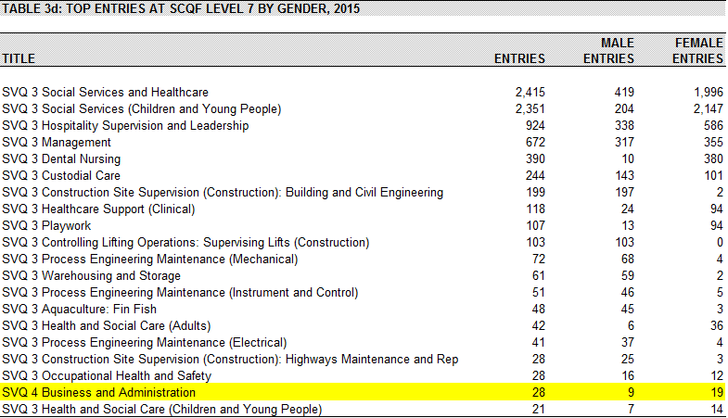
Uptake statistics http://www.sqa.org.uk/sqa/63001.html
SCQF 7 (Level 4) – 19th 28 entries

Slide 7
Qualification Updates
Level 2 and 3 Incremental Change bedded in
  Long term plan to update SQA certification system (1 year+)
  Remove need for manual processing of results
Level 4 framework revised
  Overall SCQF Level 8
  Assessment Strategy same as for other levels
  Same structure – 3 Mandatory 5 Optional units
    Optional units split into two groups (B & C)
    Only one restricted combination
  Greater range of optional units including:
    Enterprise
    Social Media
    Management & Leadership

Slide 8
Qualification Updates
Level 4 Apprenticeship
Apprenticeship = SVQ + Enhancements (Core Skills/additional units etc.)
At SCQF Level 8 Technical Apprenticeship rather than MA
Technical Apprenticeship Enhancements = “Career Skills” Units (i.e. additional SVQ units)
New Technical Apprenticeship will have to be developed by SDS/CFA
Probable timescale November/December 2016
SQA re-accreditation of SVQ – Early 2017
Re-accreditation delayed due to funding implications

Slide 9
Support Materials
Assessment Guidance
Candidate Portfolios
Candidate Guidance
Frequently Asked Questions
Understanding Standards
Material and links available on SVQ Business and Administration webpage
http://www.sqa.org.uk/sqa/74741.html

Slide 10
Assessment
Validity
“the extent to which the assessment measures what it claims to measure ”

Slide 11
Assessment
Key to validity is the use of the assessment
An assessment may be invalid for one use but valid for another
Assessment instruments introduce artificiality and irrelevance; and are limited to a snapshot in time
Many qualifications are concerned with ranking of performance (i.e. grading). This increases potential for error so should be justified by the use.

Slide 12
Assessment
Primary use of SVQ assessment is to demonstrate occupational competence
No better method of assessing competence than evidence of actual performance in the workplace
Evidence can be gathered over a much longer period of time strengthening confidence and therefore validity
Grading/ranking performance is not a concern, we are interested in competence at the relevant level, not “more competent, highly competent etc.”

Slide 13
Assessment
All assessment is professional judgement

Slide 14
Keeping informed
To receive email alerts, when content you are interested in has been added to or updated on SQA’s website, subscribe to MyAlerts at www.sqa.org.uk/myalerts
Look out for Centre News – SQA’s weekly update for centres, and our monthly e-newsletter on the new National Qualifications.
To subscribe to our newsletters, go to http://mailer.sqa.org.uk

Slide 15



SQA Online
YouTube – SQAonline
Facebook – Scottish Qualifications Authority
Twitter - @sqanews

