Slide 1

SQA Event Edinburgh
Scots in Pairtnership
Scots Language at Banff Academy

Slide 2
Culture
responsibility
empathy
Literacy
listening
response to texts
Ambition
Confidence
Self esteem
Wellbeing
Achievement
Attainment
using Scots
Creating texts
Comprehension
Considering meaning, purpose and audience
Resilience
Scotland’s place in the World
appreciation of richness of culture
fun, participation
Improved links between generations
The Scots Language

Slide 3
Foo div we engage wi Scots at Banff Academy
1/ Primary / secondary transition workshops
2/ A unit in S1 Scottish Studies
3/ SQA Scots Language Award S4-6
Lessons, visitors, trips and projects

Slide 4
Nummers
80+ pupils received the SQA Scots Language Award as a senior elective
> 1000 juniors engaged with Scots / Doric in Scottish Studies S1-2
30+ students have had creative Scots work published in papers / websites
1 pupil nominated for young Scots speaker of the Year

Slide 5
Past
“Changed days we used tae get a dirl wi a ruler if we spoke in wir ain tongue” Harry, 20th Sept 2016
“It wisna fit a said at wis wrang, it wis the wey a said it” Man at Elphinstone Talk, May 2016

Slide 6
Present - Bairns’ blethers
“that’s exactly fit ma granda says, he uses those words. I speak more to my granda, now that we have the Doric to talk about – it’s interesting”
“I aye spik in Doric fan I’m textin an messagin ma pals”
“Aroon aboot here, wi say words like gade, cuv an gadgie fan wi spik tae folk wi kain.”
Fan I look doon I park aneath ma, I see a park o gimmers chawin the girse. I pond his a pair o green heided dyooks sweemin aroon in it. Files it gets gye caal kines, an I can hear I win fusslin through the trees.

Slide 7
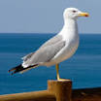
Scurry
Peullie
Peul
Fisher hens
Any ideas?
Gow
Seamaw
Whitemaw (Orkney)

Slide 8
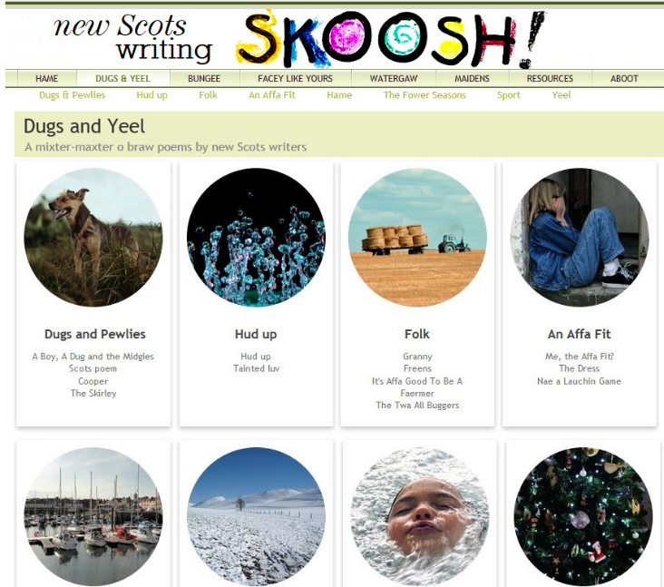

Slide 9
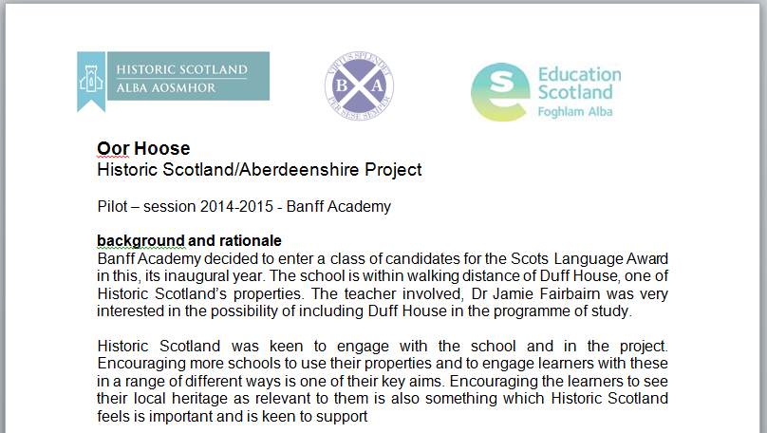


Slide 10
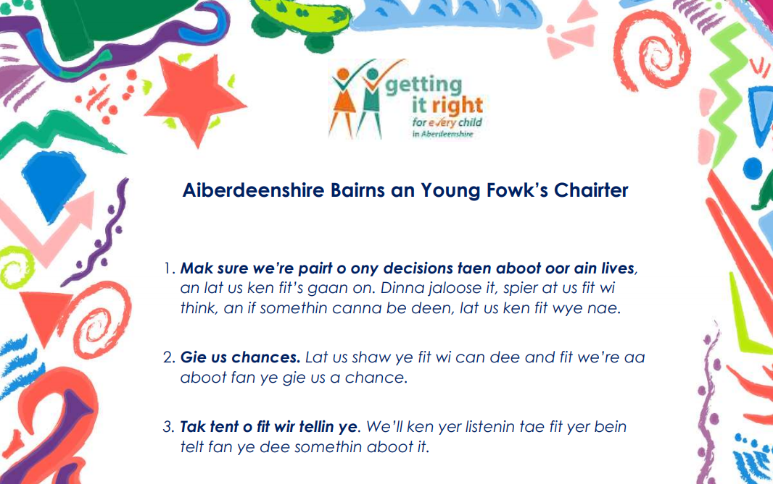

Slide 11
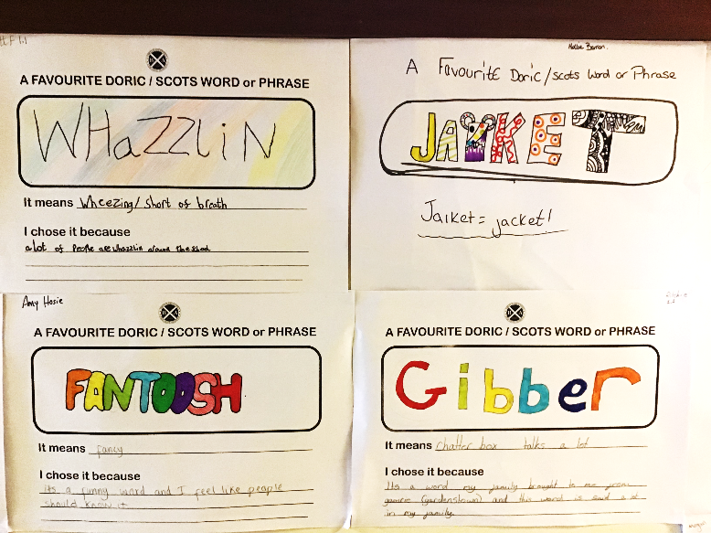
Doric wikk – teachers too

Slide 12
Elphinstone Institute
Visiting talks, explaining ethnographic methods
PhD studentship – Claire Needler
BERA grant
Research project
Caged Beastie

Slide 13

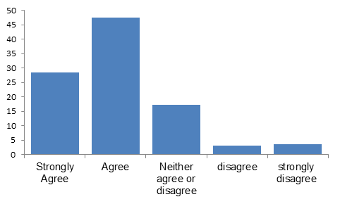
When I am around the school I hear Doric Scots often

Slide 14
When do people speak more / less Doric?
Pupils speak most Doric when speaking to parents, and then to friends.
If the friend spoke less Doric they are aware and would adjust to speak less Doric and more English.
Pupils speak more Doric in group-work than they do when presenting to the whole class.
Pupils would significantly tone down Doric to speak to the Head teacher
The majority of pupils would use Doric when applying for a job in the local area, but would shift to English for jobs further afield. This support the notion of Doric still being the language of work for many in the community.

Slide 15
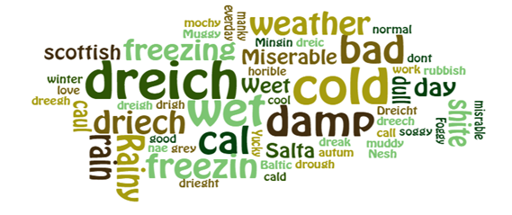
What do you call damp weather?

Slide 16
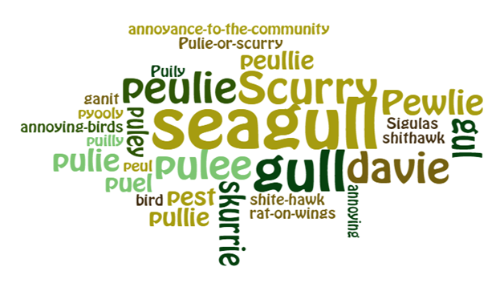
What do you call a seagull?

Slide 17
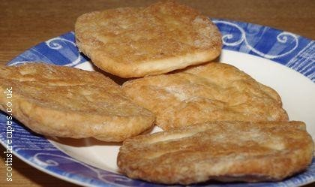
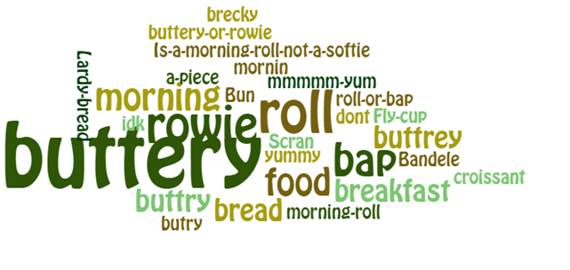
What do you call this?

Slide 18

Understanding, speaking and writing in Scots
Results:
97% surveyed understand most or some Doric
81% surveyed speak a lot or some Doric
68% surveyed can read Doric or some Doric
55% surveyed can write Doric or some Doric

Slide 19
Conclusions
Pupils have significant potential to use skills in Doric / Scots.
There is good scope for improving reading skills
There is significant scope for greatly improving writing literacy skills.
Doric is frequently used to write on social media, particularly Whatsapp and Snapchat.
Doric and Scots language skills are beneficial to literacy, as well as building self-esteem and cultural knowledge.

