Slide 1
Twilight Biology: Selection
Kelvin Hall, Glasgow, Tuesday 21st May 2019
Notes:
Advanced Higher Twilight Biology: Selection.
Kelvin Hall, Glasgow, Tuesday 21st May 2019.
Kevin O’Dell
Professor of Behavioural Genetics & Dean of Public Engagement,
University of Glasgow.
Email address.
Kevin.Odell@glasgow.ac.uk
Slides, Summary and Resources.
I covered four brief stories that could be used in class to enthuse the students about selection. They were:
Total Colourblindness in the Tropical Paradise of Pingelap.
An Infectious Cancer and Evolving Resistance to it in Tasmanian devils.
The Evolution of Lactose Tolerance in Recent Human Evolution.
The Appearance and Spread of Blue Eyes in Europeans.

Slide 2
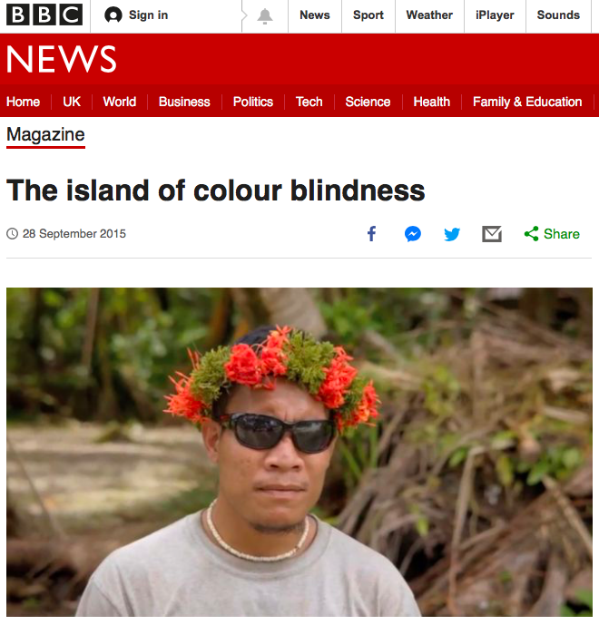
https://www.bbc.co.uk/news/magazine-34346428
Notes:
1: Total Colourblindness in the Island of Pingelap. (Slides 2-5).
On the Pacific island of Pingelap the frequency of total colourblindness (effectively the inability to see any colour) is around 10%. In any other population it’s about 1 in 30,000. So why is this, especially as the condition (which is caused by a mutation in one gene) means that in very bright light affected people have great difficulty seeing anything at all as they are hypersensitive to light. It’s because in 1775 a catastrophic storm killed most of the people on the island causing a population bottleneck. Among the few survivors was the ‘king’ who it’s believed carried the mutation. It’s a good example of ‘founder effect’. It may also be that one of the privileges of being the king means he had a disproportionately high number of offspring. There is also some evidence that affected individuals are at a selective advantage when diving, as in relative darkness their vision is said to be sharper. Think of how we see in relative darkness, where our vision has very little colour.

Slide 3
Where is Pingelap?
Pingelap is a Pacific Ocean Atoll in the federated States of Micronesia.
It comprises three islands, with a total land area of under 2km², and a population of 250.
See https://www.nationalgeographic.com/photography/proof/2018/01/pingelap-island-colorblindness-micronesia/

Slide 4
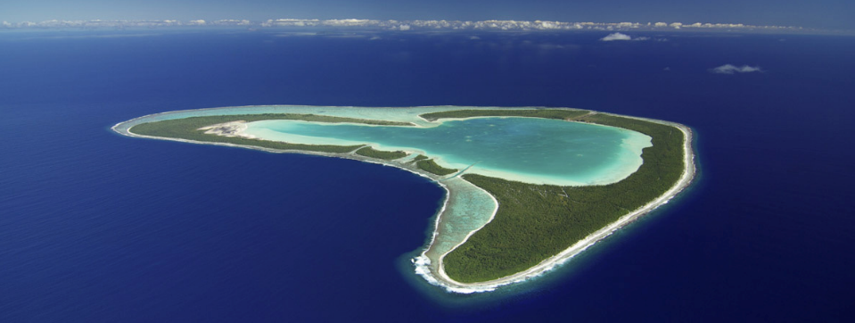
Why Pingelap?
According to legend a devastating storm around 1775 caused a population bottleneck. One survivor was the king. It’s believed he carried a rare mutation for an extreme form of colour blindness, called achromatopsia. It’s an example of founder effect.
On the island it’s at a frequency of 10%, elsewhere it’s one in thirty thousand.
See Steve Jones at https://www.youtube.com/watch?v=WCKB2ZgUzsI

Slide 5
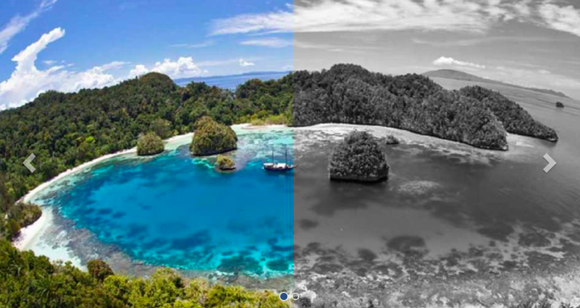
What can they see?
Does it convey a selective advantage?

Slide 6
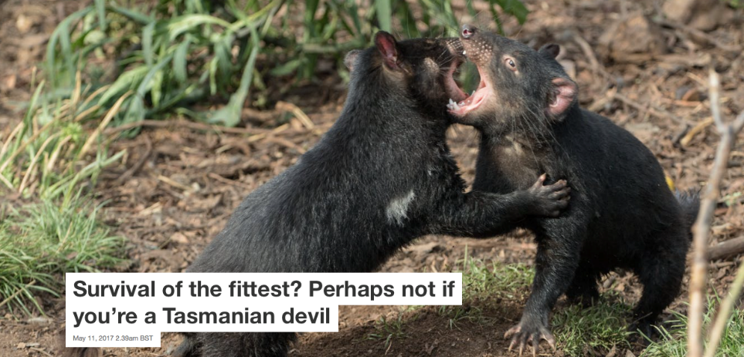
Tasmanian Devils
https://theconversation.com/survival-of-the-fittest-perhaps-not-if-youre-a-tasmanian-devil-76402
Notes:
2: An Infectious Cancer in Tasmanian devils. (Slides 6-9).
Tasmanian devils are a carnivorous marsupial that only lives in Tasmania. In 1996 in the northeast of the island it was noticed that several individuals had a very aggressive mouth cancer. This is a very unusual cancer in that it can be transmitted between individuals by biting. We can tell the cancer only has a single source by sequencing the whole genome of the cancer (the DNA of the cancer in different individuals is very very similar). The cancer can transfer between individuals in part because Tasmanian devils are quite inbred, so cells from different individuals are not recognized as being foreign, and therefore escape the attention of the immune system. So in the last 23 years the population of Tasmanian devils has fallen by 90% as the cancer has spread across the island by biting. The Tasmanian devils will become extinct unless humans intervene to save it. However, there is some evidence that surviving Tasmanian devils are evolving the ability to detect the cancer (recognizing it as foreign) and evolving the ability to mature early (so they have offspring before they die). This is a good opportunity to ask students ‘what would they do to help Tasmanian devils survive’.

Slide 7
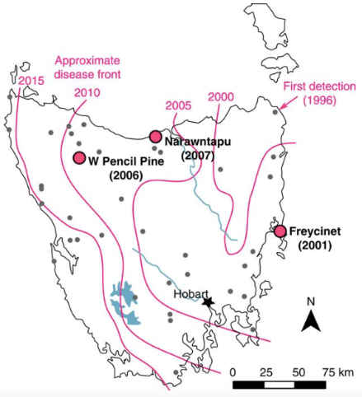
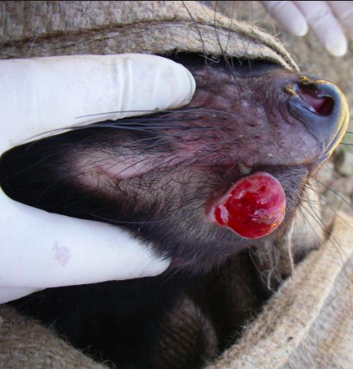
Deadly Facial Tumour Disease Progression

Slide 8
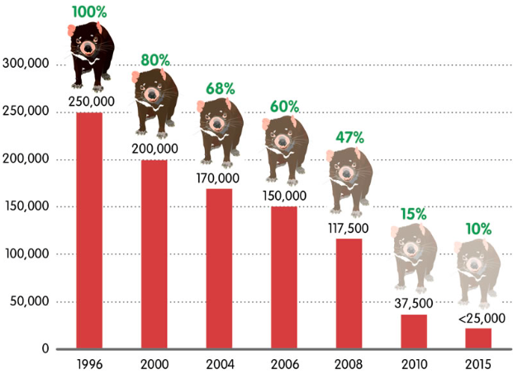
Tasmanian devil Population Decline

Slide 9
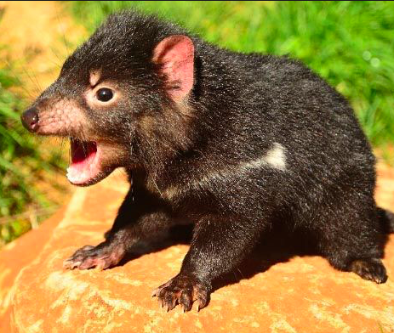
How Can Tasmanian devils Survive?
Maybe use as a discussion topic?
With Human Intervention
Capture and isolate uninfected individuals
Develop treatment or cure
Cull affected individuals
Via Natural Selection
Develop resistance (recognise cancer as foreign)
Mature more quickly

Slide 10
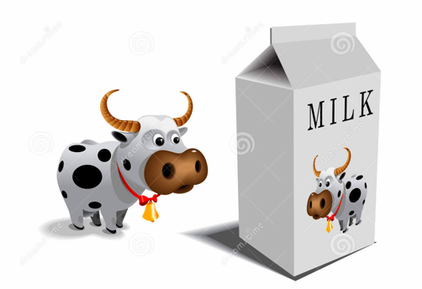
Lactose Intolerance
Notes:
3: The Evolution of Lactose Tolerance in Humans. (Slides 10-12).
Historically all humans were lactose intolerant. Our ancestors evolved to drink their mothers’ milk in the first few months or years of life. So the human lactase gene (which encodes the enzyme lactase that breaks down lactose, the sugar found in milk) would only be switched on (transcribed and translated) in the first few weeks and months of life. Think of this in terms of being an efficient use of the gene, only being switched in when it’s needed. However, when human populations starting drinking the milk of their domestic animals they’d be consuming lots of lactose they couldn’t break down, so this would be used by gut bacteria (who have their own lactase) and produce a lot of gas as a by-product. So when mutations randomly arose in the control region of the human lactase gene meaning the gene was transcribed and translated throughout life, this would be selected for as these individuals could use the lactose throughout their lives and not have the unpleasant side effects. So lactose tolerance (also known as lactose persistence) is the derived/mutant form of the gene that around 90% of people of European decent have today. Similar events occurred in other populations in different parts of the world for the same reasons. Clearly you’ll have some lactose intolerant students in your class, so you might want to tread carefully with this information.

Slide 11
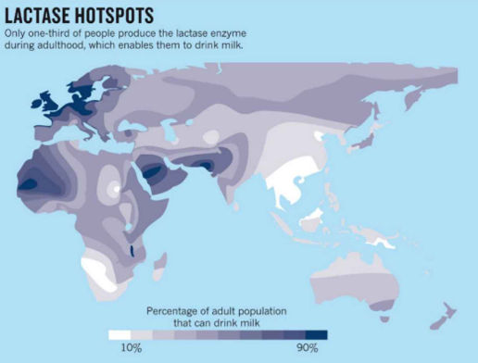
Lactose Intolerance

Slide 12
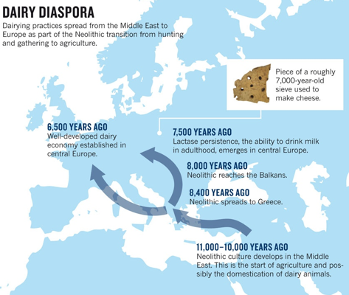
Lactose Intolerance

Slide 13
Eye Colour
Nature vs Nurture?
Is your eye colour entirely genetic or environmental in origin?
Notes:
4: The Spread of Blue Eyes in Europeans. (Slides 13-16).
Eye colour and pattern is complex and probably involves DNA variation at 70 or more genes. Most of these differences are quite subtle. However, one gene that has a major effect on eye colour is a gene that confers blue or brown eye colour. Most people are comfortable in saying they belong to a blue (light) colour or brown (dark) colour group. Historically all humans had brown eyes, and whilst blue eyes are much more common in people of European descent but can arise in any population. Interestingly, DNA sequencing of the blue/brown gene reveals that most blue eyed Europeans have exactly the same mutation, suggesting that this mutation arose only once in history. The best interpretation of this data is that this blue eye mutation arose in a person who lived near the black sea in south central Europe 6000 to 10000 years ago. Note that as the blue mutation is recessive, your brighter students will spot that blue-eyed parents cannot have brown-eyed kids. However, there are mutations in other genes that can cause blue eyes, so you can explain that parents with blue-eye mutations in different genes can have brown-eyed children (think of this in terms of a complementation test). There is no definitive answer as to why blue eyes has become so common in northern Europe, so you could get the students to speculate on why that might be.

Slide 14
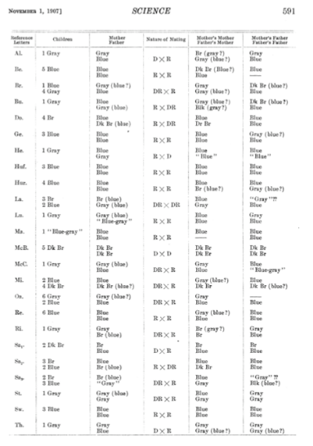
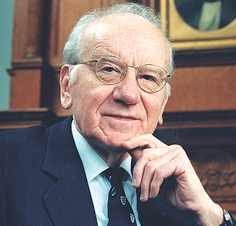
Brown eyes or Blue eyes?
Davenport & Davenport (1907) Heredity of eye colour in man. Science 26: 589-592.
Victor McKusick: 1921-2008

Slide 15
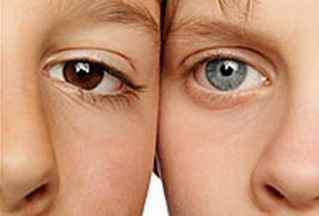
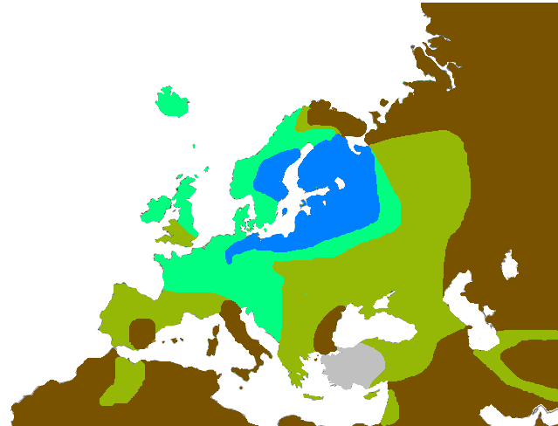
Eye Colour
80% blue
50-80% blue
20-50% blue
0-20% blue

Slide 16
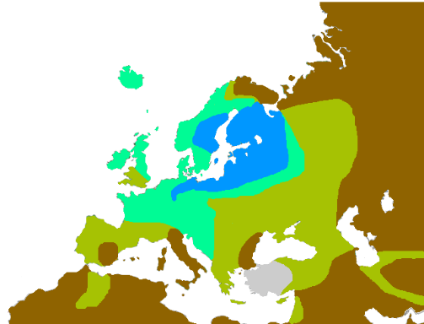
Where do Blue Eyes come from?
Genetic analyses suggests the blue-eye mutation arose near the Black Sea about 6,000 to 10,000 years ago

Slide 17
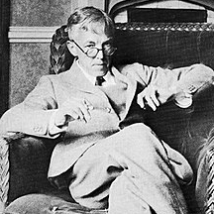
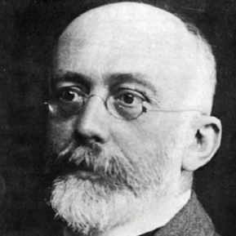
Hardy-Weinberg Equilibrium
Godfrey Harold Hardy
1877-1947
Wilhelm Weinberg
1862-1937
Notes:
I also briefly discussed some of the difficulties we find in teaching Hardy-Weinberg Equilibrium, and how we generally teach the topic by giving the students datasets to work through. I’m in the process of preparing a set of questions to help school students address HWE, and once this is ready I’ll post it on the SQA website.

Slide 18
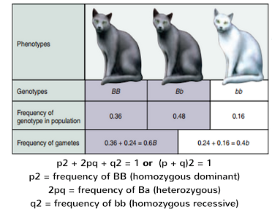
Hardy-Weinberg Equilibrium
The assumptions underlying Hardy–Weinberg equilibrium are:-
organisms are diploid
only sexual reproduction occurs
mating is random
population size is infinitely large
allele frequencies are equal in the sexes
there is no migration, gene flow or selection

Slide 19
Hardy-Weinberg Equilibrium
Godfrey Harold Hardy
1877-1947
Wilhelm Weinberg
1862-1937

Slide 20
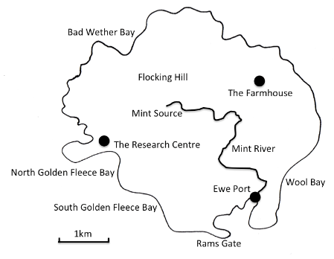
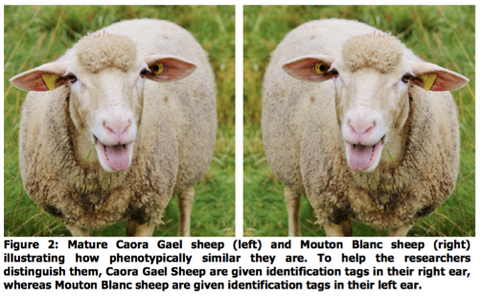
Teach HWE using worked examples
Eilean Caora Gael (White Sheep Island)
There is not necessarily a right answer, just a better argument

Slide 21
Teach HWE using worked examples
Eilean Caora Gael (White Sheep Island)
Heterozygous sheep are at a selective disadvantage, because……?
The two strains of sheep prefer to mate with their own kind.
The two strains of sheep tend to mate with their own kind because they are geographically isolated either because they eat different foods (seaweed on the beach, grass on the land) or because of a geographic barrier.
It is only a few years since ten years sheep arrived on the island, so there hasn’t been enough time for the sheep to become mixed-bred.
Prior to arriving on the island the sheep evolved different mating seasons.
The sheep have evolved different metabolisms to deal with the fact they have different diets, and as a consequence heterozygous sheep (which perhaps don’t digest either food source very well) are at a selective disadvantage.
There are a lot of other plausible possibilities.
Notes:
Resources.
1: Pingelap.
https://www.nationalgeographic.com/photography/proof/2018/01/pingelap-island-colorblindness-micronesia/
https://www.youtube.com/watch?v=WCKB2ZgUzsI
2: Tasmanian devils.
https://theconversation.com/survival-of-the-fittest-perhaps-not-if-youre-a-tasmanian-devil-76402

