Slide 1
Darren Monckton
sexual selection of male horn size in Soay sheep

Slide 2
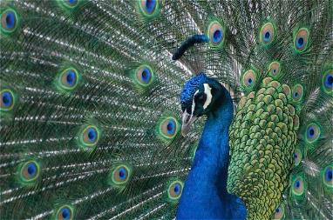
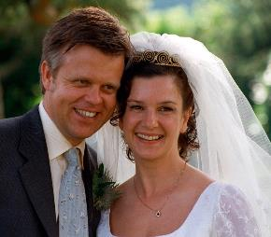
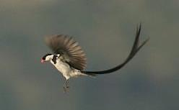
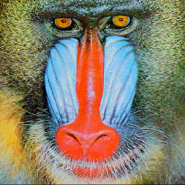
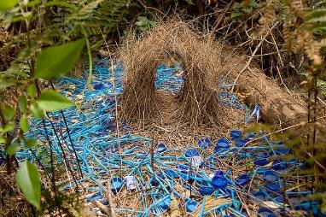
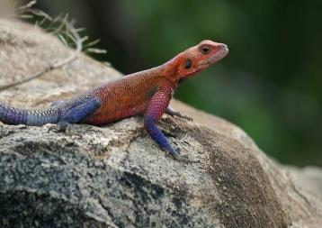
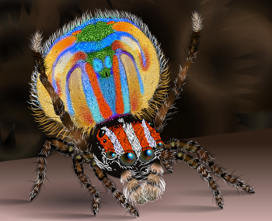
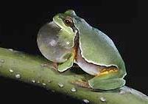
inter-sex sexual selection

Slide 3
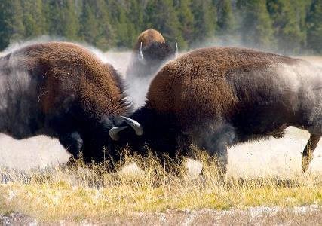
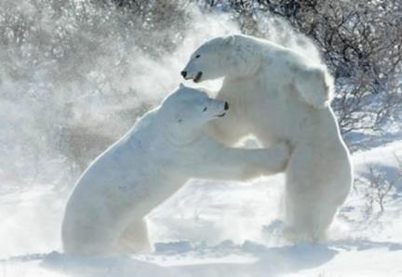
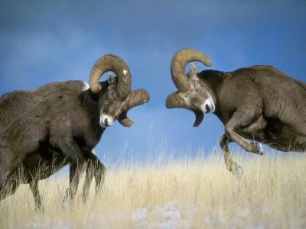
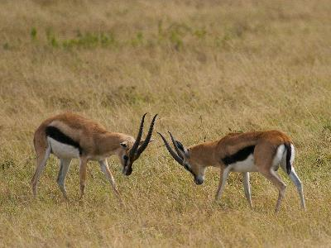
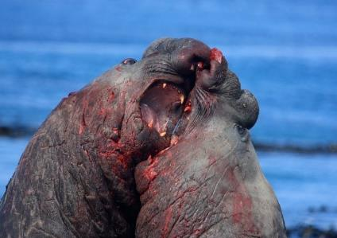
intra-sex sexual selection

Slide 4
natural selection should drive a sexually selected feature to fixation?
• why are many sexually selected traits not driven to fixation?
• trait is driven by variation in many different genes with small effects and complex interactions
• trait is constrained by other fitness effects

Slide 5
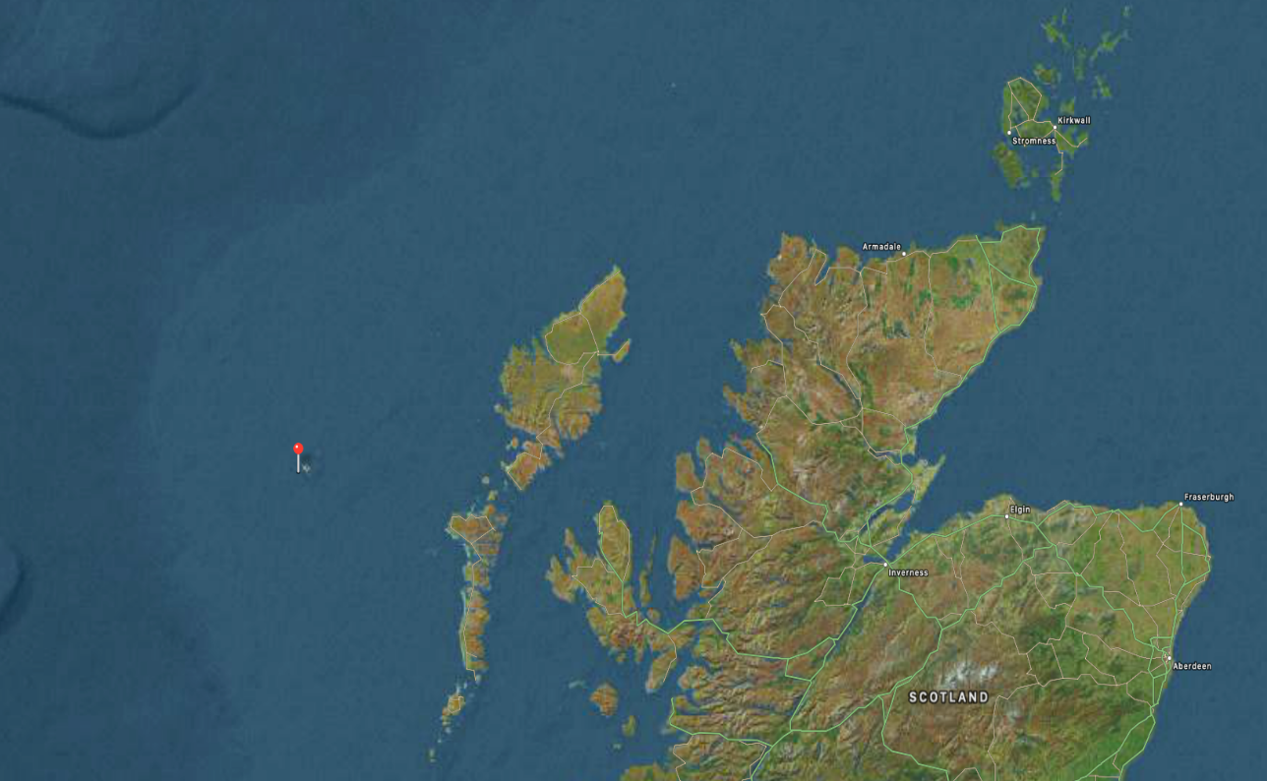
St Kilda

Slide 6
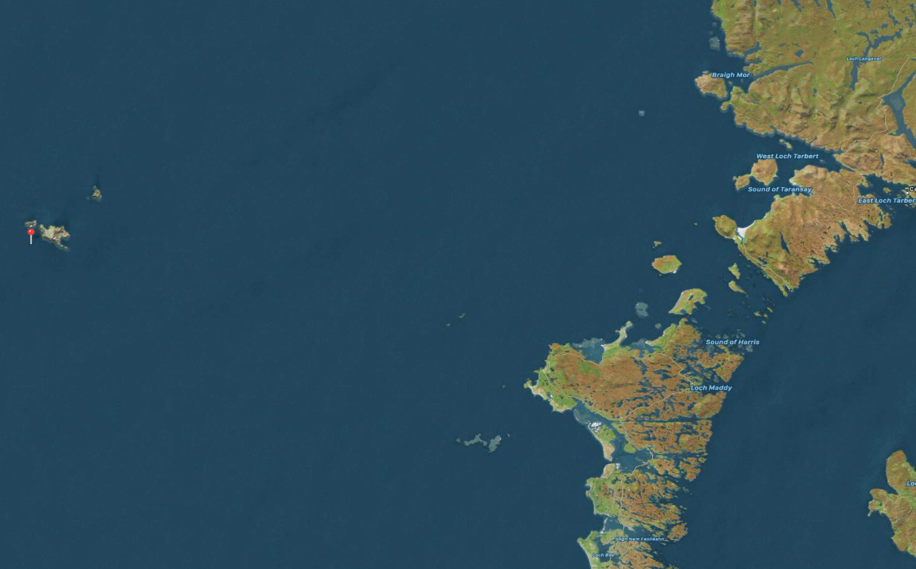
St Kilda

Slide 7
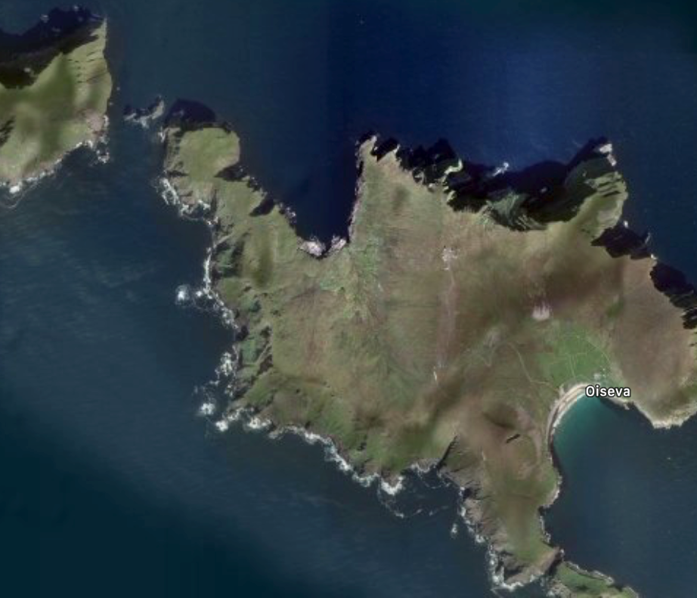
St Kilda

Slide 8
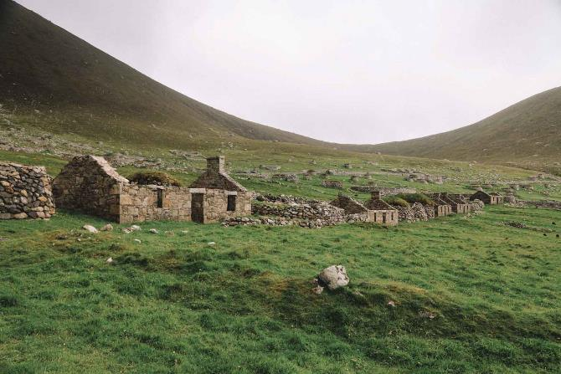
St Kilda

Slide 9
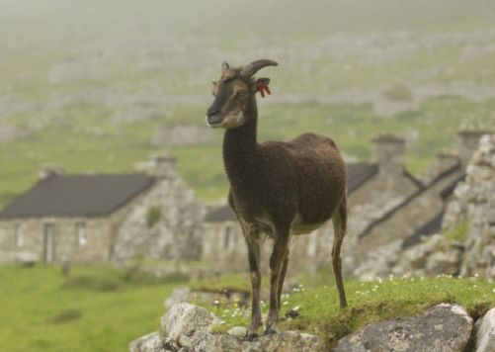
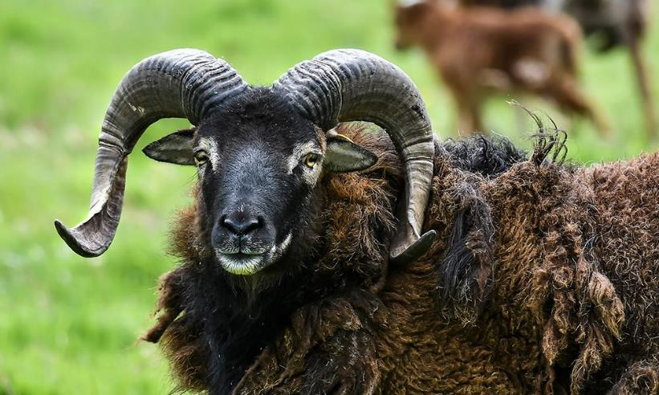
Soay sheep

Slide 10
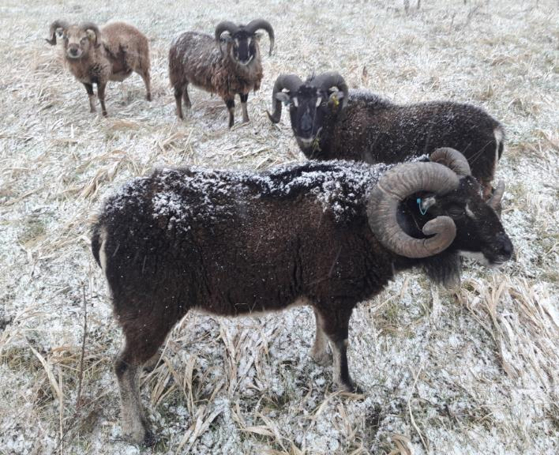
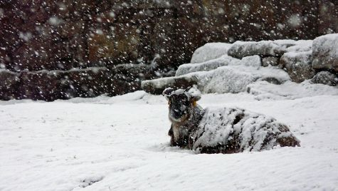
winter

Slide 11
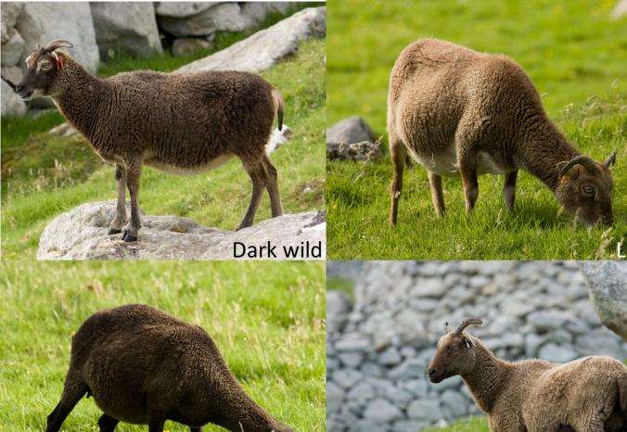
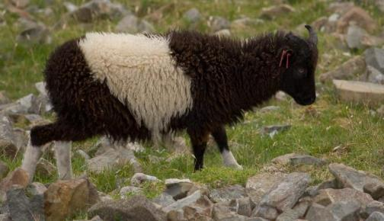
coat colour variation

Slide 12
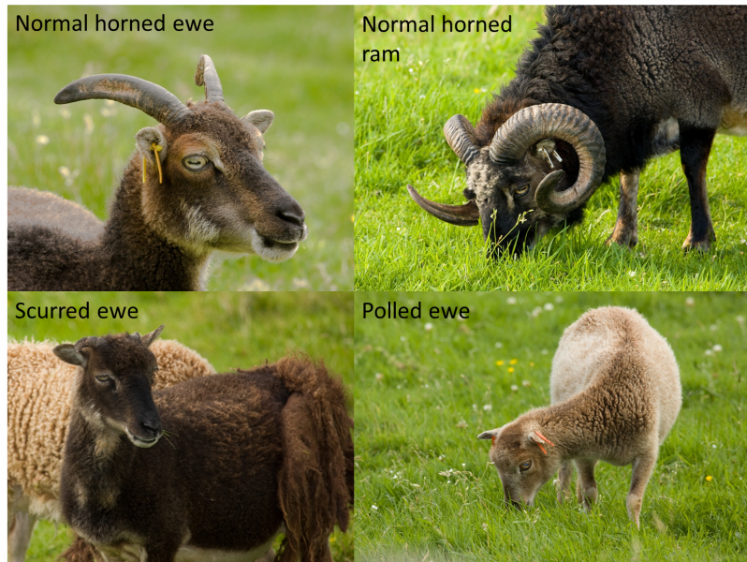
horn variation

Slide 13
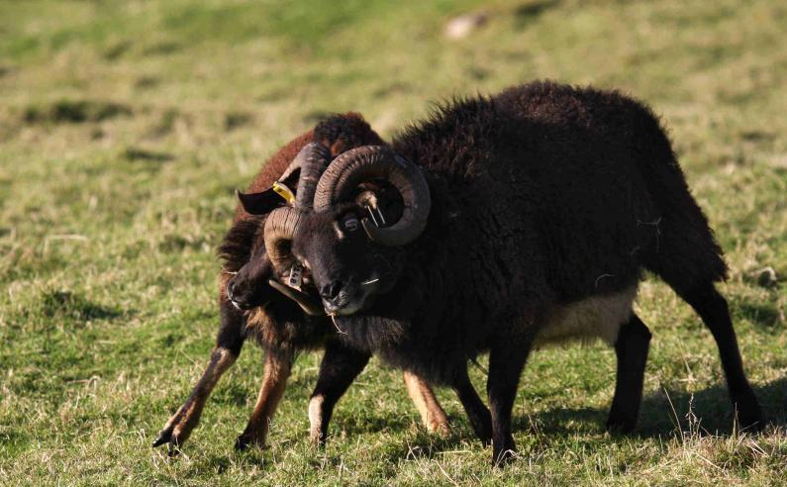
rutting

Slide 14
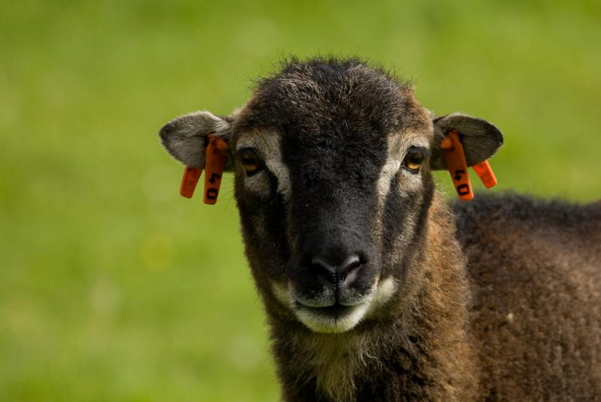
a highly studied population

Slide 15
• 1,750 sheep monitored and 5,880 sheep sampled over a 21-year period

Slide 16
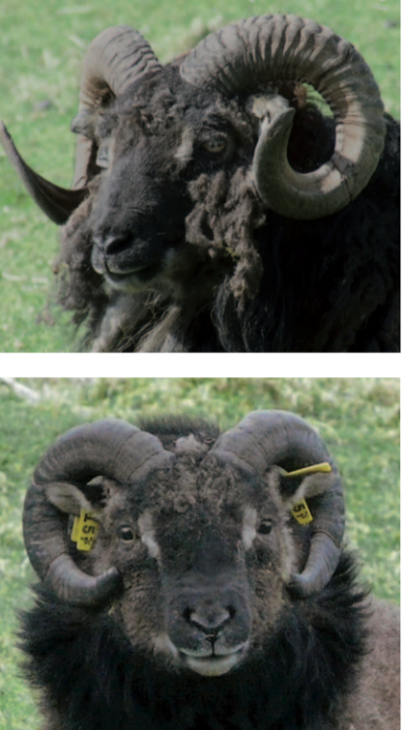
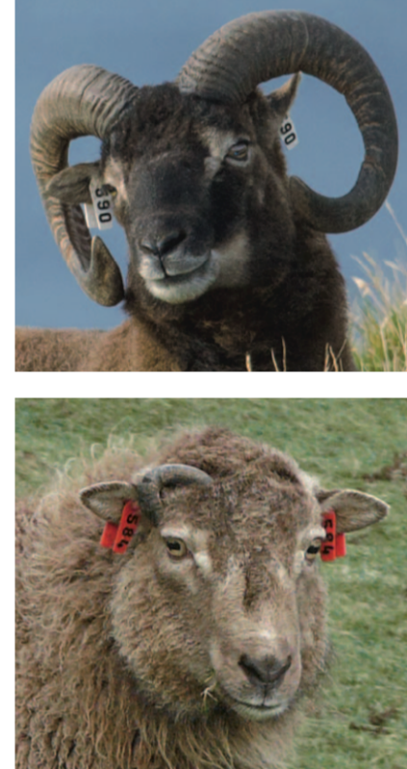
horn variation in males is largely driven by variants in the RXFP2 gene
Ho⁺/Ho⁺
Ho^{P}/Ho^{P}
Ho⁺/Ho^{P}
Ho^{P}/Ho^{P}

Slide 17
horn variation in males is driven by variants in the RXFP2 gene
RFXP2 genotype

Slide 18
male reproductive success
• large horned males produce the most offspring in any one season

Slide 19
male survival
• large horned males are the most likely to die during any one year

Slide 20
fitness
fitness
~
survival
+
reproductive success

Slide 21
male fitness
• intermediate horned males produce the most offspring during their lifetime

Slide 22
a heterozygote advantage
• a heterozygote advantage for male sheep maintains RXFP2 diversity
• effects on survival constrain horn size

Slide 23
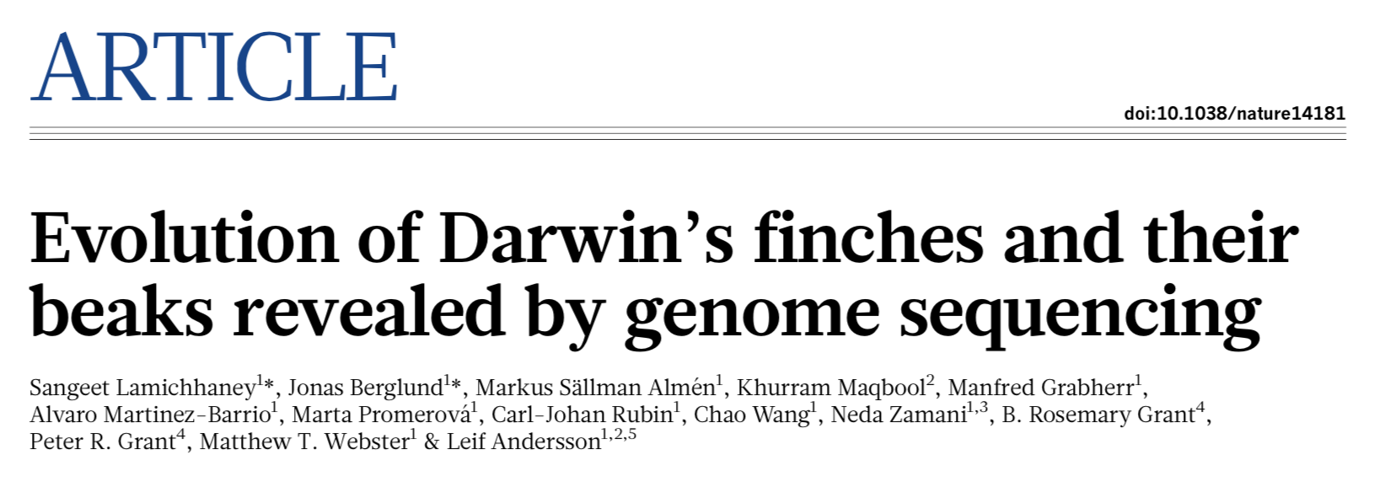
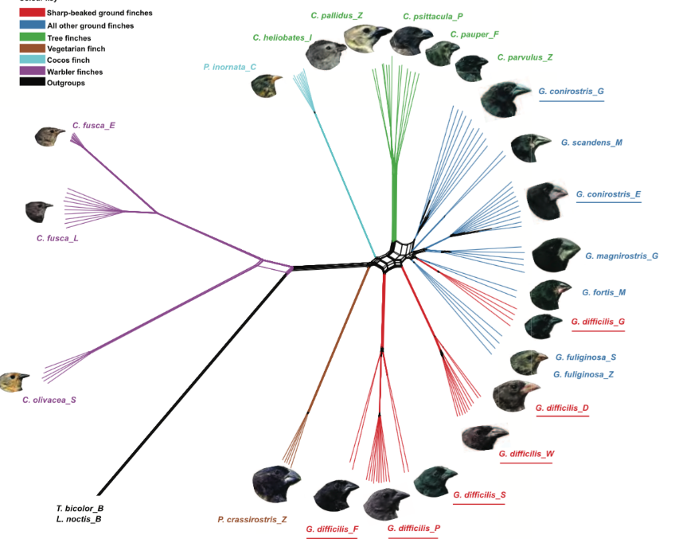
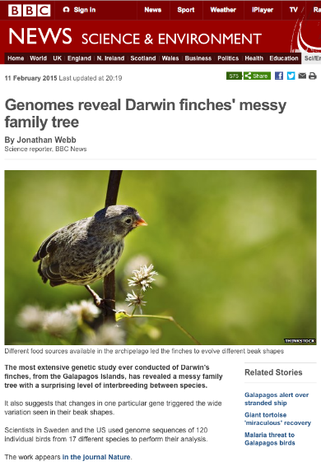
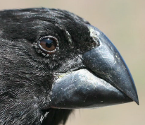
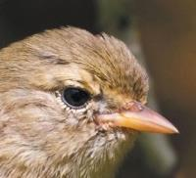
Darwin’s Galapagos island finches

Slide 24
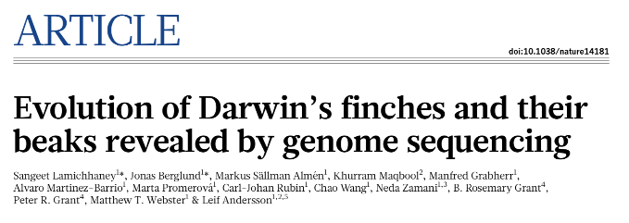
Darwin’s Galapagos island finches

Slide 25
Darwin’s Galapagos island finches
• whole-genome sequencing of 120 individuals representing all of the Darwin’s finch species and two close relatives
• phylogenetic analysis reveals important discrepancies with the phenotype-based taxonomy
• variants in ALX1 affect craniofacial development and beak shape diversity

