Slide 1
Tourism - Key Skills Messages
Lawrence Durden,
Sector Manager for Tourism,
Skills Development Scotland (SDS)

Slide 2
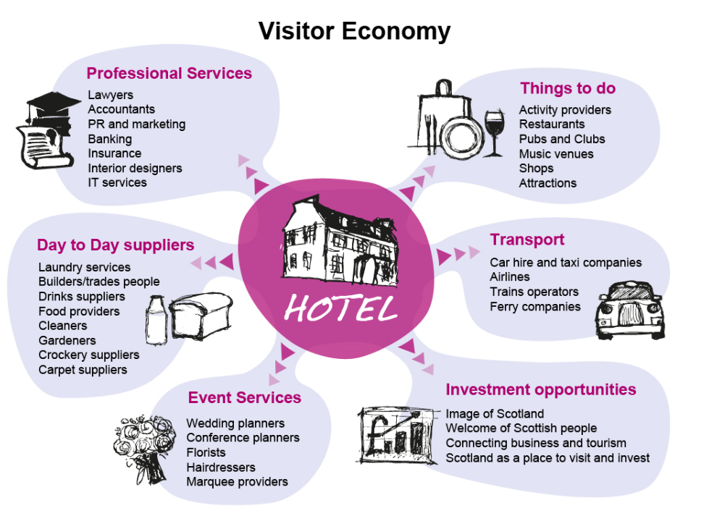
Tourism is Everyone’s Business

Slide 3
Key Sector GVA 2017 (£m)

Slide 4
Key sector total employment 2017 (Jobs 000’s)

Slide 5
Tourism Occupations 2017/2027

Slide 6
Expansion and replacement demand 2017 to 2027

Slide 7
Expansion and replacement comparison

Slide 8
Key sector productivity (2017), £ per job

Slide 9
Key Challenges and Priority Themes
Improving management, leadership and enterprise skills across the sector.
Supporting the development of professional and digital skills for all in the sector.
Ensuring staff at all levels understand and are able to respond to visitor needs and expectations
Raising the attractiveness of the sector.

Slide 10
Additional challenges
Brexit
Business Rates
National Living Wage
Low productivity

Slide 11
Activity
Apprenticeships
Springboard Activity
World Host, Glasgow Welcomes and its derivatives
HIT Scotland (214 Scholarships)
Hospitality Works
SE Programmes,(e.g. Destination Leaders Programme, Business Improvement Academy, Digital Tourism Scotland))
Tourism Sector Deal

Slide 12
Further Info
Our Skillsforce https://www.ourskillsforce.co.uk/
My World of Work https://www.myworldofwork.co.uk/
Apprenticeship. Scot https://www.apprenticeships.scot/
STA 5 Big Questions http://scottishtourismalliance.co.uk/page/people/
Lawrence.Durden@sds.co.uk

