Slide 1
Health Matters: Asbestos in the 2015 Waste Management Environment
Robert Southall / Graham Warren
TICA-ACAD

Slide 2
Who we are
Not for Profit Trade Association representing HSE, Licensed Asbestos Removal Contractors and others organisations involved with the sector.
Organisation is run and supported by people who are passionate about the sector and those working within it.
We share and promote aspirational standards as part of our central aim of raising standards.
Based in Darlington but with membership covering the UK and beyond.
Notes:
Build UK - 5 leadership committees, ACAD sit on the Health & Safety and Training & Skills committees– Graham attending H&S meeting today

Slide 3
Topics
Health Matters: Asbestos in the 2015 Waste Management Environment
The appropriate safe handling of asbestos waste to reduce, as far as reasonably practical, the dangers to health associated with exposure.
Review asbestos, not just as a waste product requiring treatment and disposal, but also the health and environmental issues associated with removal from the fabric of buildings.

Slide 4
Topics
Asbestos awareness
Health & Safety during removal work
Removal techniques
EA issues

Slide 5
Awareness
3 main asbestos types
Wonder material?
Microscopic airborne fibres can be inhaled
Increased likelihood of disease/death
Notes:
Chrysotile, Amosite & Crocidolite – these however do not determine if material is licensable or not

Slide 6
Problem of the past?
Asbestos still kills in excess of 5,000 workers each year
this is more than the number of people killed on the road
Question: Is this rate rising or falling?
Notes:
Very much a current problem with

Slide 7
Removal
Minimise fibre release at source
Wetting agents
Controlled removal
Shadow vacuuming/local LEV
Negative pressure/air movement

Slide 8
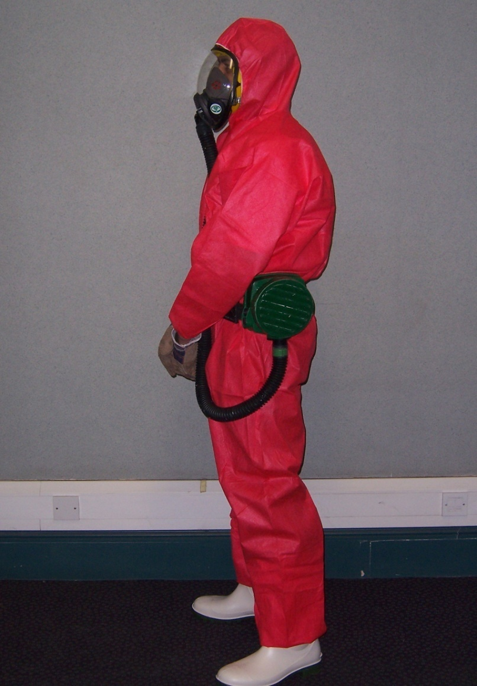
RPE
Coveralls
Gloves
Boots

Slide 10
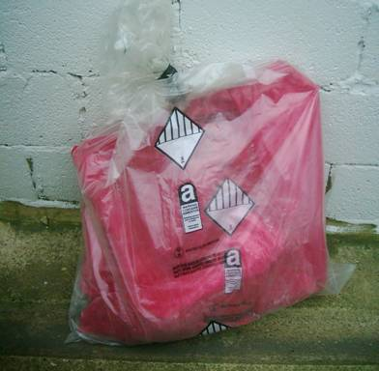
Baglock
3 stage baglock
Transit/waste routes
Emergency procedures
Large items
Careful handling

Slide 11
0.1%
Hazardous Waste threshold
Bonded and Fibrous waste
No safe minimum exposure level for Asbestos
Asbestos regulations still apply for removal of materials under this threshold although the material is not classified as hazardous waste for disposal

Slide 12
EA View
280,000 tonnes of asbestos waste removed in 2014
Site compliance issues
Unlocked skips
Top loading, emptying & compaction of skips
Asbestos debris outside skips

Slide 13
Questions?
www.tica-acad.co.uk
robertsouthall@tica-acad.co.uk
grahamwarren@tica-acad.co.uk

Slide 15
Sentencing Guidelines
Introduction
What are they?
How do they work?
Case Studies

Slide 16
Sentencing Guidelines - Introduction
Before 2014
Generic sentencing guidelines for regulatory offences
No clear guidance for judges imposing fines on companies convicted of EHS offences
Recent Court of Appeal judgment on how large companies should be sentenced for EHS offences
"Definitive Guideline for environmental offences" published by the Sentencing Council in July 2014

Slide 17
Court of Appeal judgment
R v Sellafield and R v Network Rail [2014] EWCA Crim 49
Important because of the significance the Court attributed to financial information
Significance of financial information during sentencing is much more than to check the defendant's ability to pay the fine, it is relevant to reflecting the statutory purposes of Criminal Justice Act
The fine must reflect seriousness of offence and financial circumstances of offender, however large the company's turnover
"A fine needs to be large enough to bring [the] message home where the defendant is a company, not only to those who manage it, but also to its shareholders"

Slide 18
Sentencing guidelines - what are they?
Applies to companies and individuals sentenced after 1 July 2014 for breaches of environmental offences
12 step approach to calculating a fine, broadly similar to existing established principles:
Harm (categories 1 to 4)
Culpability (low/no culpability; negligent; reckless; and deliberate)
Finances (company size determined by turnover)
Statutory objectives of punishment
Wide discretion reserved for sentencing judge to:
Impose a greater fine if the financial benefit of offending is not removed
Impose a lesser fine if a fine within stipulated range would make it impossible for a company to comply with environmental law

Slide 19
Large Company (Turnover or equivalent: £50 million+)

Slide 20
Sentencing guidelines
Where a company's turnover 'very greatly' exceeds £50 million, it may be necessary to move outside of the suggested range to achieve a proportionate sentence
Guidelines indicate fines in excess of £3 million are to be expected in serious cases involving very large companies, but no starting point or range is provided
Guidelines are likely to result in an increase in the overall size of fines, especially for larger companies
Looking to the future, enforcement undertakings (under the Regulatory Enforcement and Sanctions Act 2008) may become a good alternative to prosecution for companies to explore with regulators, but civil sanctions are only relevant before the decision is made to prosecute.

Slide 21
Culpability
Deliberate
Intentional breach of or flagrant disregard for the law by person(s) whose position of responsibility in the organisation is such that their acts/omissions can properly be attributed to the organisation;
OR
deliberate failure by organisation to put in place and enforce such systems as could reasonably be expected in all the circumstances to avoid commission of the offence
Reckless
Actual foresight of, or wilful blindness to, risk of offending but risk nevertheless taken by person(s) whose position of responsibility in the organisation is such that their acts/omissions can properly be attributed to the organisation
OR
reckless failure by organisation to put in place and enforce such systems as could reasonably be expected in all the circumstances to avoid commission of the offence

Slide 22
Culpability continued…
Negligent
Failure by the organisation as a whole to take reasonable care to put in place and enforce proper systems for avoiding commission of the offence
OR
Low or no culpability
Offence committed with little or no fault on the part of the organisation as a whole, for example by accident or act of a rogue employee and despite the presence and due enforcement of all reasonably required preventive measures, or where such proper preventive measures were unforeseeably overcome by exceptional events

Slide 23
Harm
Category 1
Polluting material of a dangerous nature, e.g. hazardous chemicals
Major adverse effect or damage to air or water quality, amenity value, or property
Polluting material noxious, widespread or pervasive with long-lasting effects on human health or quality of life, animal health or flora
Major costs incurred of clean-up, site restoration or animal rehabilitation
Major interference with or prevention of other lawful activities or regulatory regime
Category 2
Significant adverse effect or damage to air or water quality, amenity value, or property
Significant adverse effect on human health or quality of life, animal health or flora
Significant costs incurred of clean-up, site restoration or animal rehabilitation
Significant interference with or undermining of other lawful activities or regulatory regime due to offence
Risk of category 1 harm

Slide 24
Harm Continued….
Category 3
Minor, localised adverse effect or damage to air / water quality, amenity value or property
Minor adverse effect on human health or quality of life, animal health or flora
Low costs incurred for clean-up, site restoration or animal rehabilitation
Limited interference with other lawful activities or regulatory regime due to offence
Risk of category 2 harm
Category 4
Risk of category 3 harm

Slide 25
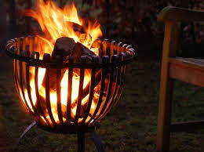
Environmental sentencing case study (1)
Magistrates' Court, August 2014
Client pleaded guilty to two offences of depositing waste without a permit (two employees burning off-cuts of wood in a brazier to keep warm in January)
Client has had Environmental Permit for site since 2008, clear CAR forms, environmental management systems in place, a TCM, and working towards ISO 14001
Site on an industrial estate
No previous convictions, environmental or otherwise

Slide 26
Medium Company (Turnover or equivalent: between £10 - 50 million)

Slide 27
Aggravating Features
Previous convictions, having regard to the nature of the offence to which the conviction relates and its relevance to the current offence; and time that has elapsed since the conviction
History of non-compliance with warnings by regulator
Location of the offence, e.g. near housing, schools, or environmentally sensitive sites
Repeated incidents of offending or over extended period of time
Deliberate concealment of illegal nature of activity
Offence committed for financial gain
Obstruction of justice

Slide 28
Mitigating Features
No previous convictions or no relevant convictions
Steps taken to remedy problem
Compensation paid voluntarily to remedy harm caused
One-off event not commercially motivated
Little or no financial gain
Effective compliance programme
Self-reporting, co-operation and acceptance of responsibility
Good character and/or exemplary conduct

Slide 29
Remaining steps for Court
Ensure that financial orders (compensation, confiscation if appropriate, and fine) removes any economic benefit derived from the offending
Is proposed fine based on turnover proportionate to means of the offender?
Any other factors that may warrant adjustment of the proposed fine?
Any other factors which indicate a reduction, e.g. assistance to the prosecution?
Reduction for guilty pleas in accordance with S144 of the Criminal Justice Act 2003 and the Guilty Plea guideline

Slide 30
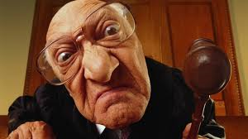
Environmental sentencing case study (2)
Client pleaded guilty at first opportunity
One count
Minor waste offence
No culpability
Category 4
Magistrates said……. too difficult, Crown Court for sentence!

Slide 31
Thank you
Any Questions?
WAMITAB
Peterbridge House
3 The Lakes
Northampton
NN4 7HE
Tel: 01604 231950
Email: info.admin@wamitab.org.uk
Web: www.wamitab.org.uk

