Slide 1
THE DTfA EXPERIENCE
… not suitable viewing for lecturers of a nervous disposition

Slide 2
LOs 1 and 2 …. not forgetting 3(a)
LO1
ICT Networks
Mobile Devices
Data Storage
Network Security
Benefits and Risks of ICT Innovations
LO2
Types of Social Software
Applications of Social Media in a Professional Context
Professional Communication and Etiquette
Legislation relating to social media communications
Web Analytics
LO3 (a)
Verification and validity of information

Slide 3
A WHOLE NEW WORLD ….
GOAL
FUNNELS
????
WEB ANALYTICS
????
CLICK THROUGH RATE
????

Slide 4
PREPARATION FOR ASSESSMENT
Find out who your Solar Administrator is in the Organisation.
Ask to be “registered”
Have your candidate list prepared – inc SQA numbers and
dates of birth.
Key in details – this may take a while …
Cohorts
Candidates
Assessment Schedules

Slide 5
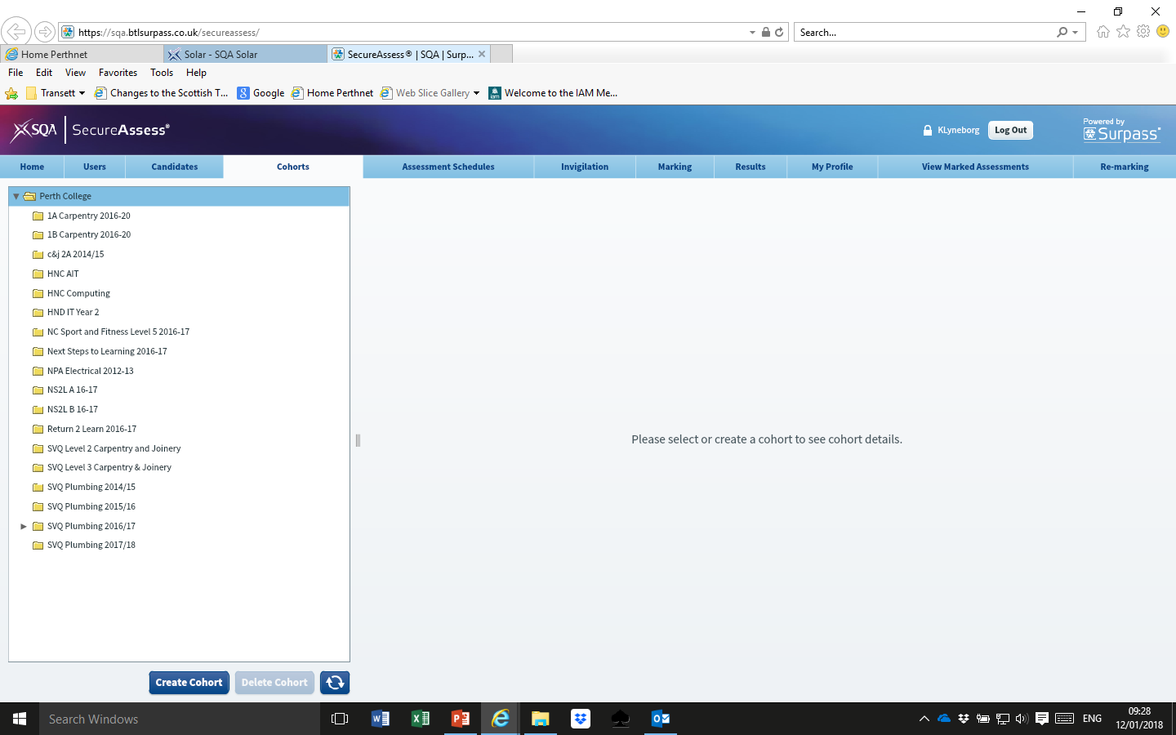
ASSESSMENT SCHEDULE:
Points to Note:
Not a bad idea to add yourself so that you can have a practice and be ready to answer any questions.
Date: Take into account that you may have candidates who need to resit or won’t appear first time around – so don’t just set it up for one day.

Slide 6
Multiple Choice/Multiple Response Assessment …
27/28 first attempt pass
Pass marks varied from 63.5% up to 91.2%
You have no marking!
Remember and take a print-out yourself … after a few weeks …
it disappears!
(IV/EV?)

Slide 7
The rest of LO3 …
Evidence requirements for this Outcome:
Explain and/or demonstrate the use of a web feed to source relevant information.
Create an e-checklist to identify and prioritise four or more tasks relating to work, identifying any dependencies.
Explain and/or demonstrate the use of a web service or software to organise a meeting or event involving 3 or more participants.
Use a web service or software to obtain relevant feedback relating to the work completed.
Evaluate and present findings and conclusions derived from the feedback using collaborative software.

Slide 8
Group Task 1
“Source a four or five star hotel in the Glasgow or Edinburgh area which has conference facilities. Upload information from each member of the group onto a discussion board or cloud service to enable all members to make an informed choice …”
Discussion Board

Slide 9
Contribute to the design and production of an agenda for the conference.
9.00 am to 9.30 am | Registration and Coffee
9.30 am to 11.00 am | Talk on BYOD Security for Your Business Guest Speaker: Lisa Phifer – Owner of Core Competence Inc Specializing in safe business use of emerging Internet Technologies
11.30 am to 12.30 pm | Presentation on the legislative requirements for businesses BYOD
12.30 pm to 2.00 pm | Lunch served in the BABA Restaurant
2.00pm to 3.00 pm | Talk on Cloud Computing Guest Speaker: David Linthicum – Founder of Blue Mountains labs A cloud computing consultancy & development company
3.00 pm to 4.00 pm | Presentation: Competition in the Industry
8.00 pm 11.00 pm | Evening Reception and Private Dinner with guest speaker: Geoff Burch
Students tended to use Google docs.

Slide 10
Contribute to the creating and production of an e-checklist to identify and prioritise 4 or more tasks relating to the work carried out in order to hold the Conference.

Slide 11
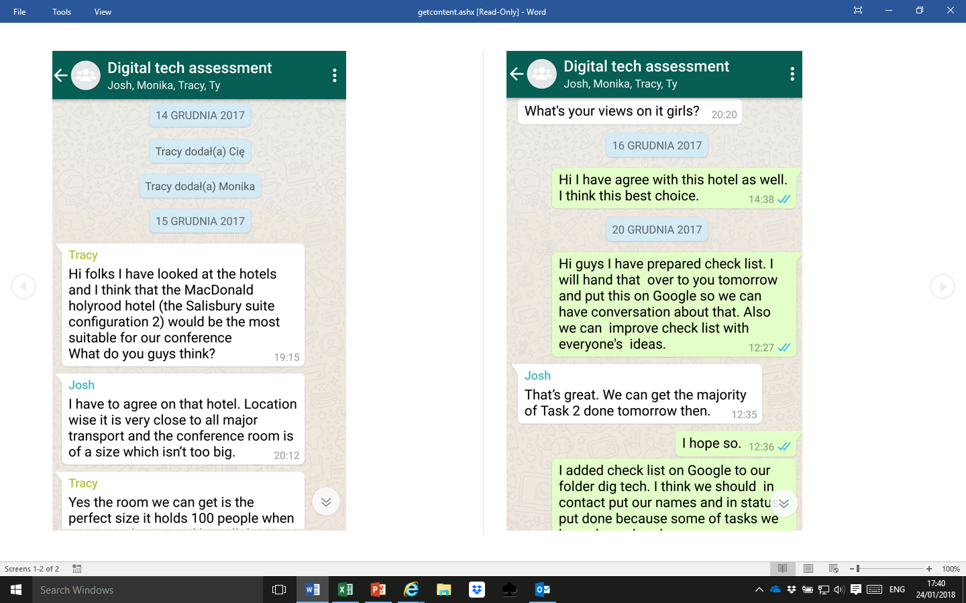

Slide 12
Contribute to the creating and production of a Facebook page with information on the hotel chosen to host the conference and include the following:
Conference Facilities
Contact details of 2 nearby hotels for those who may wish to stay overnight
A map showing location of the hotel the Conference will be held in

Slide 13
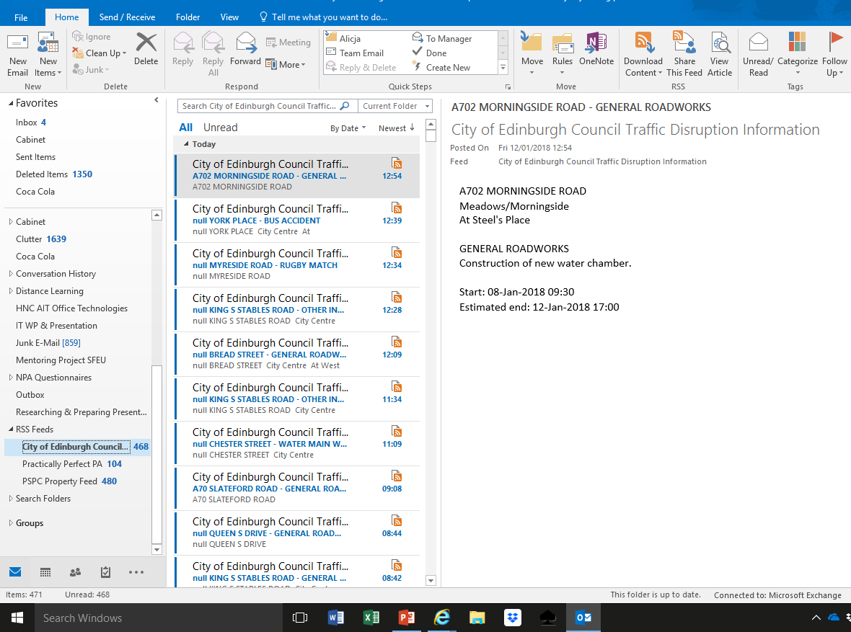
Contribute to the setting up of a web feed to source relevant traffic information:
Where?
Facebook or Outlook?

Slide 14
Group Task 3 and Ind Task 2 …
“Using a web service or software upload the questionnaire to gather feedback from the conference delegates relating to the networking event.”
Bristol On-line Survey
“Carry out an evaluation of feedback data received as a result of the questionnaire. Using collaborative software, interpret your findings and derive conclusions based on your interpretation of them. Your conclusions must be justified by evidence.”
….

Slide 15
Straightforward ….. Not!
Group Task 1 states that there will be around 100 delegates attending …
Where do we get around 100 responses from?
This prompted a long telephone conversation with my partners-in-crime – Gillian and Jacqui in Edinburgh … and this is what we came up with ..
Ask the students to collaborate and prepare a minimum of 5 questions for uploading.
When completed, ask their lecturer for the set “prepared earlier”
Students then upload this set of questions.
4. Lecturer then give students responses to evaluate.

Slide 16
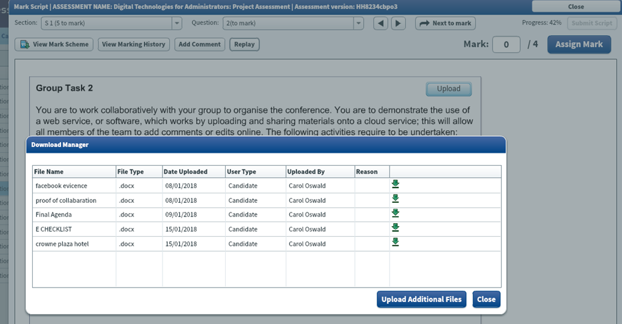
STUDENT UPLOAD TO SOLAR
Problems to look out for:
When uploading ensure they have “file type” set to docx
It will only accept Word Documents – or url of google docs - in a word doc
Students found it difficult to upload WhatsApp
Will only accept docs to a certain size.

Slide 17
The Marking …

Slide 18
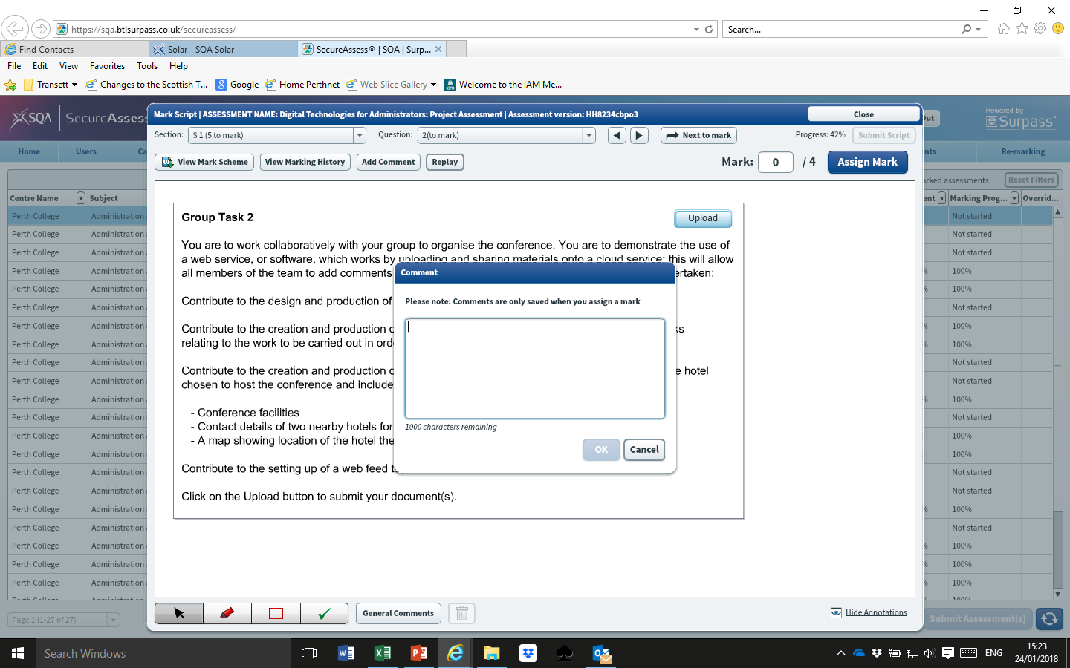

Slide 20
Marking …
Students are unable to go back in and make changes!

Slide 21
LO3 – WHAT TO LOOK OUT FOR!
Uploading of Google.docs
Web Feeds - settings
WhatsApp - uploading
Linked in - url
Evaluation – survey questions and results

Slide 23
Don’t worry – I have just the place for you to go to ….

Slide 24
KATHRYN’S HOME FOR THE BEWILDERED LECTURER …..

