Slide 1
SQA
HN Business Network Event 3rd April 2025

Slide 2
Introduction
SQA Qualifications Team
Tony Hamilton, Qualifications Manager
Louise Mycroft, Qualifications Officer
Amy Blain, Qualifications Officer (Maternity Leave)
Presenting today
Iain Walker, Senior External Verifier
Anca Marcantonio, External Verifier
Notes:
Many familiar to this Event – but for new delegates and reminder to others: this Event is really a conduit to support the ethos of continued partnership working. SQA hosts and facilitates these Events with a view to supporting practitioners with the delivery and assessment of HN Frameworks by: providing information/updates, facilitating workshops and providing a forum for both formal and informal networking.

Slide 3
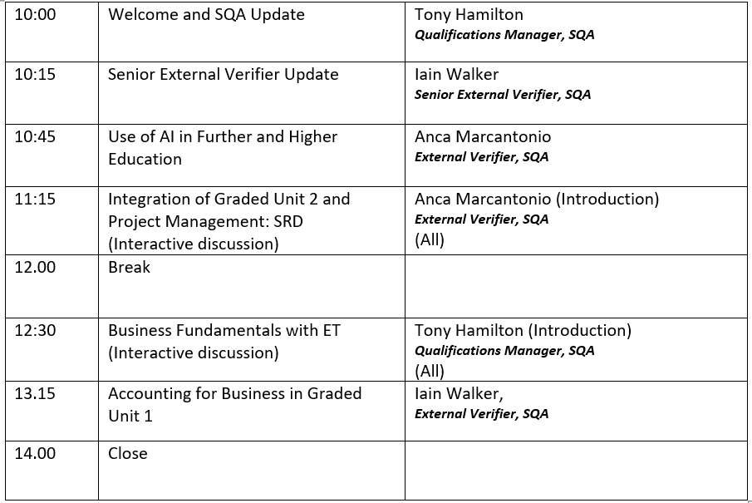
Agenda
Notes:
In our planning for today we have worked hard to ensure that this event is both interesting and relevant for delegates. We are dependent on colleagues from the Network and EVs being willing to support these Events by giving presentations, leading workshops - basically giving us the benefit of their knowledge and experiences. So, I would like to take this opportunity to thank all of today’s contributors.
Today’s programme includes:

Slide 4
Uptake
Entry numbers stabilising post-Covid
Post-Covid ~1200 (~700-800 HNC, ~400-500 HND)
Pre-Covid ~1700 (~1000 HNC, 700 HND)
2022/23 Awarding “Anomaly” due to timing of certification
SQA HN Marketing Campaign https://hn.sqa.org.uk/

Slide 5
Moving forward
Qualification Support Team
September/October meeting
NextGen
Transition from Pilot to Capacity Build Phase
Aug 25 Limited roll-out HNC/D Accounting
Aug 26 New HNC/D Admin & Digital Tech
No firm plans for new HNC/D Business, however….

Slide 6
New NextGen units (HNC Accounting options)
Business Structures an Organisational Culture
1 credit, open-book unsupervised, 70% threshold
Economics: An Introduction
1 credit, open-book unsupervised, 70% threshold
Law for Business: An Introduction
1 credit, open-book unsupervised, 70% threshold
Leadership and Management in Business
1 credit, open-book unsupervised, 70% threshold
Available @ https://www.sqa.org.uk/sqa/110487.html

Slide 7
Last slide

