Slide 1
Workshop A – HN Enhancement Project: A Practitioner’s Perspective
John Kelly and Iain Walker

Slide 2
HN Enhancement Project Background
Piloting ‘Enhancements’ to Higher National Qualifications to Achieve Articulation – September 2012
Collaboration between SQA, the Scottish Government, Scottish Funding Council (SFC) and the chair of SQA’s HN Key Partners Group
Restricted pilot activity would consider whether ‘enhancements’ were necessary to improve articulation between HN qualifications and degree programmes and what form these ‘enhancements’ might take.

Slide 3
HN Enhancement Project Background
The qualification areas to be included in the project were:
Business
Computing
Social Sciences
Engineering (Electrical)
One ‘enhancement’ within the project was assessment which would encompass
Alignment of HN and degree assessment
Development of Integrated Assessment Support Packs

Slide 4
HN Enhancement Project Background
Specific Units were identified within HN Business which were felt best suited to the project included:
Business Law: An Introduction
Business: Graded Unit 2 and Research Skills
Economic Issues: An Introduction
Business Culture and Strategy and Behavioural Skills for Business
The Units were to have either Combined assessments or examination based assessment

Slide 5
Economic Issues: Assessment
Structure

Slide 6
Economic Issues:
A practitioner’s perspective
A number of areas had to be considered prior to delivery:
Which courses to include in the pilot
HN Business, Accounting, Distance learning
Coordination of delivery across multiple sites
17 week semester, when to assess/reassess
Security and integrity
Scope for sharing materials
Blackboard
Exam preparation versus coaching

Slide 7
Economic Issues:
A practitioner’s perspective
Marking - How?
A balance between allocating marks and quality of the overall response
Allocating marks balanced between description and explanation/evaluation
Flexibility in marking to capture unconventional responses
Remarking all borderline results

Slide 8
Economic Issues:
A practitioner’s perspective
Marking - Paper 1
Q1 - 7 marks: 4 for explanation, 3 for link to article
Q2a/b - 2 marks, answers are right or wrong
Q3a/b - 5 marks: Deduct mark for each error and omission
Q3c/d - 8 marks: Difficult and dropped marks
Q4 - 6 marks: 4 for explanation, 2 for link to statement

Slide 9
Economic Issues:
A practitioner’s perspective
Marking - Paper 1
Q5a - 10 marks: 5 for description, 5 explanation
Q5b – 6 marks: 3marks per justified criticism
Q6 a or b - 4 marks: relatively easy marks
Q7 a or b – 12 marks: Based on Outcome 3 exercise
Marks ranged from 7 and upwards, quite a few on 30
Marks given back and detailed feedback to those not achieving

Slide 10
Economic Issues:
A practitioner’s perspective
Results

Slide 11
Economic Issues: A practitioner’s perspective
Results30

Slide 12
Economic Issues:
A practitioner’s perspective
Student perspective - 13 responses out of 63 (5 withdrawn) in an anonymous survey

Slide 13
Economic Issues:
A practitioner’s perspective

Slide 14
Economic Issues:
A practitioner’s perspective

Slide 15
Economic Issues:
A practitioner’s perspective
My perspective
More like a university assessment
Neat and tidy
No remediation
Preparation for Graded Unit 1
Limited number of papers
Bad weather

Slide 16
Economic Issues:
A practitioner’s perspective
It all starts again next year!

Slide 17
Business Graded Unit 2/Research Skills
Alternative Approach
Unit titles: Business Graded Unit 2 F8LE35
Research Skills F60A34
Type of Alternative
Assessment: Combined Assessment
Type of Assessment
Instrument: Investigation

Slide 18
Business Graded Unit 2/Research Skills
Alternative Approach - Rationale
Reduction in assessment
Integration of delivery of related content
Reduction in duplication
Contextualising of application of research skills
Better preparation for progression from FE to HE
Opportunities for application of independent learning skills
Development of critical thinking

Slide 19
Business Graded Unit 2/Research Skills
Alternative Approach
Research Skills Unit:
Each outcome has common requirements to Business GU2, however….

Slide 20
Business Graded Unit 2/Research Skills
Alternative Approach
The Research Skills Unit specifies that :

Slide 21
Business Graded Unit 2/Research Skills
Alternative Approach - Opportunities
The development and delivery of teaching of research skills early on in the HND Business course provides further opportunities for integration of these skills into other units such as:
Information and Communication Technology in Business
Economics 1 and Economics 2
Behavioural Skills for Business
Business Culture and Strategy

Slide 22
Business Graded Unit 2/Research Skills
Alternative Approach – How?
One class, 19 students.
My delivery has been over 3 x 12 week blocks.
I used extended Checklist as per exemplar to mark.
Stage 1 submitted and marked by early December.
Stage 2 submissions of Development Reports today!
Stage 3 submissions of Evaluation Reports 13th May.

Slide 23
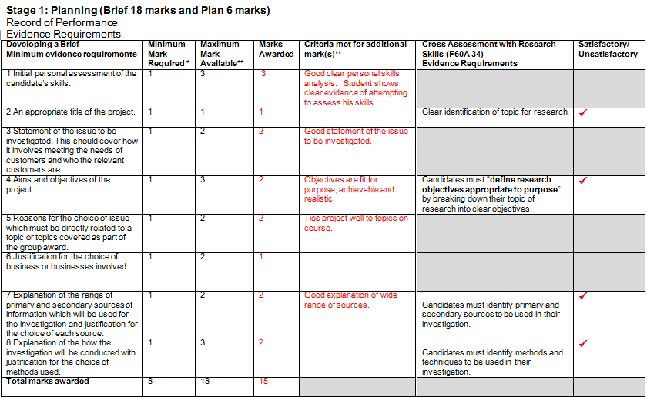
Business Graded Unit 2/Research Skills
Alternative Approach - Marking

Slide 24
Business Graded Unit 2/Research Skills
Alternative Approach - Marking

Slide 25
Business Graded Unit 2/Research Skills:
A practitioner’s perspective
My perspective
Stage 2 drawing to a close early March 2015
Stage 3 submissions due in on 13th May 2015
Improvements in timing of unit (s) – 3 credits/3 stages
Encourages holistic approach, helps to reduce “disintegration” of course
Preparation for university research and presentation
Provides clear evidence of “effective referencing”
Develops better projects with inclusion of surveys

Slide 26
Workshop A – HN Enhancement Project: A Practitioner’s Perspective
QUESTIONS
SUGGESTIONS

