Slide 1
Your Exams
What you need to know
about National 5, Higher
and Advanced Higher exams
School edition

Slide 2
Important things
you need to know
The exam timetable starts on 25 April and ends on Monday 2 June.
Your school will provide an estimated grade for each of your courses before the exams start.
You will receive your results by post on Tuesday 5 August. If you sign up to MySQA, you can get them by text, email or both.

Slide 3
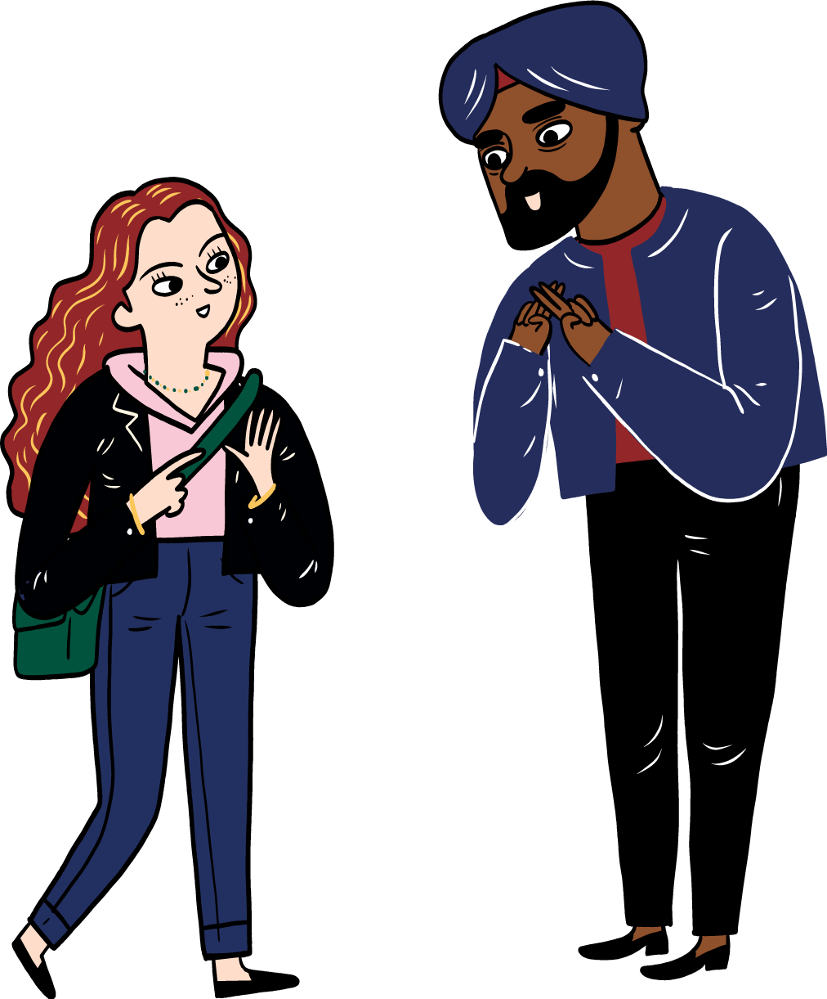
Assessment Arrangements
Allow learners who are disabled or need additional support to use different ways to complete an exam
May vary by subject, level and learner
Include adapted question papers, changes to exam timings and where the exam is taken
Speak to your teacher for more information about assessment arrangements

Slide 4
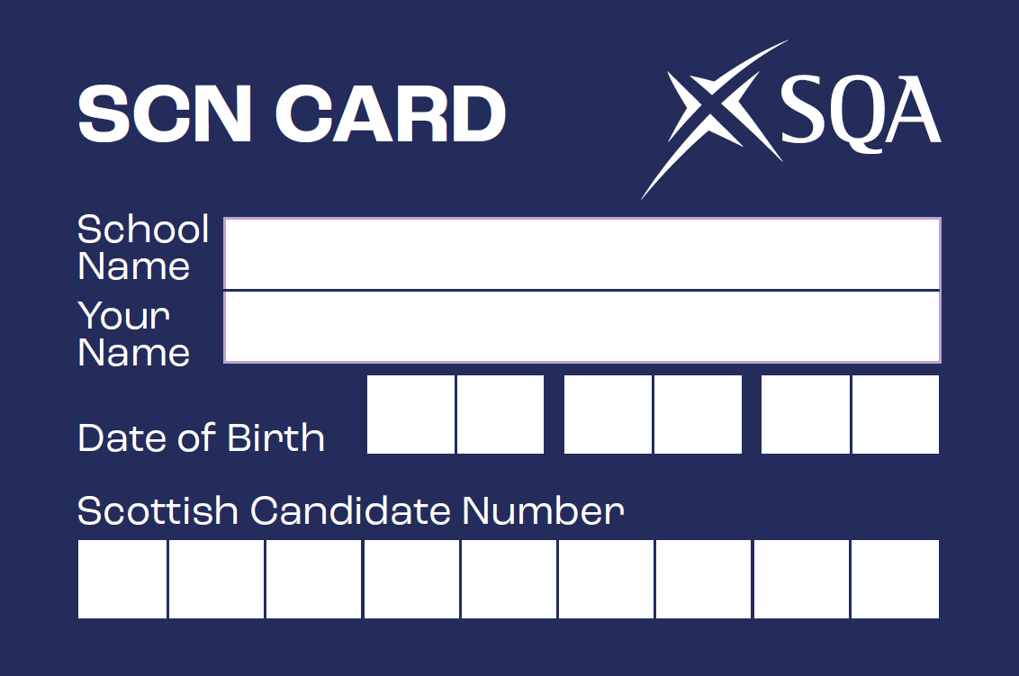
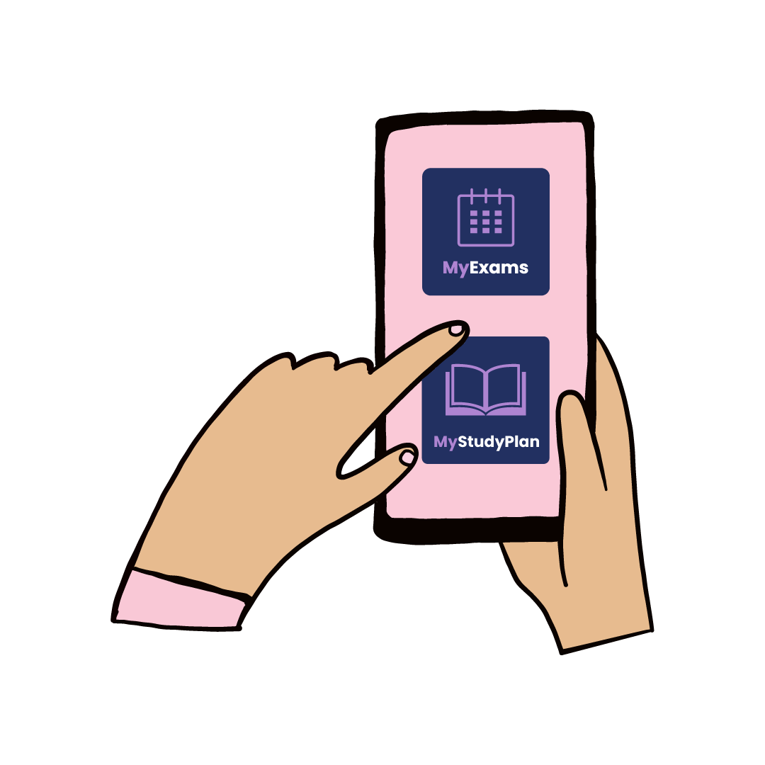
Preparing for your exams
Timetable
Make sure you have the latest version of the timetable – https://www.sqa.org.uk/timetable
Apps
Download the MyExams and MyStudyPlan apps to help you prepare
Scottish Candidate Number
Make sure you know your Scottish Candidate Number (SCN).
Your teacher will tell you it and give you an SCN card to
write you name, school name, date of birth and SCN.

Slide 5
On exam day
Make sure you arrive at least 10 minutes before your exam starts
You’ll be given a desk or seat number for each exam – please remember this!
Don’t take any prohibited items to your desk or seat – these include mobile phones, electronic devices, extra information, pencil cases and calculator cases
You can use a calculator or dictionary in some exams – please ask your teacher for more information.

Slide 6
You will be given either a combined question paper and answer booklet, or a separate question paper and answer booklet
If you need extra paper, ask the invigilator
You must use a pen with black or blue ink to write your answers
You may not get marks if your writing is difficult to read or has poor spelling or punctuation
Question papers and
answer booklets

Slide 7
Remember
Take your time
Read the questions carefully
Answer the exact questions being asked
Double check your answers if you finish early
Stay calm and do your best

Slide 8
Leaving the room
If you finish early or have done as much as you can, you can ask the invigilator for permission to leave.
You must give the invigilator all of your exam papers, including any answer booklets, extra sheets, question papers and data booklets.
If you think you need to leave the exam room for any other reason, speak to the invigilator

Slide 9
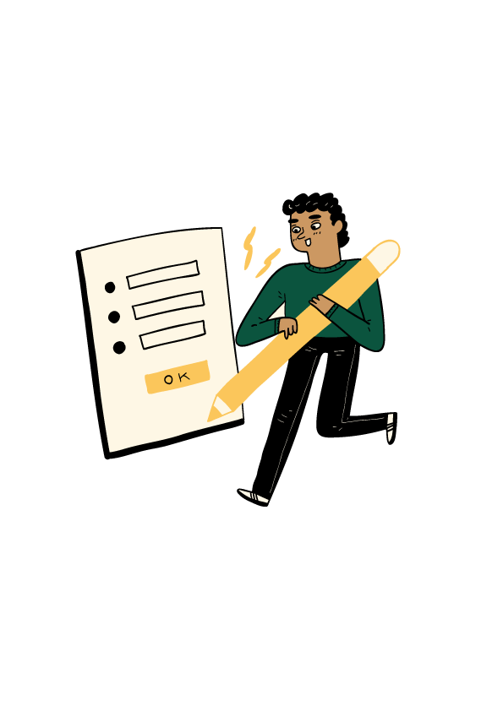
Fairness
Cheating or causing a disturbance during an exam are unfair to other candidates.
Any cheating or unfair behaviour can affect your results

Slide 10
Prohibited items
Electronic devices such as tablets, earbuds, smartwatches or any other device that stores information or can connect to the internet
Extra information — books, notes, sketches or paper, and anything written on your clothes or body
Mobile phones even if switched off
Calculators, except for exams where calculators are allowed
Dictionaries, except for exams where dictionaries are allowed
Extra information — unauthorised information written on your SCN card
Pencil cases or calculator cases

Slide 11
Do…
arrive in good time — at least 10 minutes before the exam starts.
bring the right equipment, including black or blue ink pens.
check that you don’t have any prohibited items with you at your seat.
check you have been given the correct exam paper.
put your name, SCN and the name of your school on every piece of work you hand in (including separate answer booklets and answer sheets).

Slide 12
Do…
write legibly so that the markers can read your answers.
read all instructions and listen carefully for any announcements from the invigilator.
cross out any rough work that is not part of your answer.
stay in the room until the exam is finished. You can only leave early with permission from the invigilator.
give the invigilator all your exam papers, including any answer booklets, extra sheets, question papers and data booklets, before you leave the exam room.

Slide 13
Don’t…
take any prohibited items to your seat.
use any rude, abusive, offensive or discriminatory language or images in your answers.
get someone else to sit your exam for you or pretend to be someone else.
behave in a disruptive way or cause a disturbance.

Slide 14
Don’t…
copy from anyone else.
share your work with anyone else.
share equipment with anyone else.
use correction pens, tape or fluid.

Slide 15
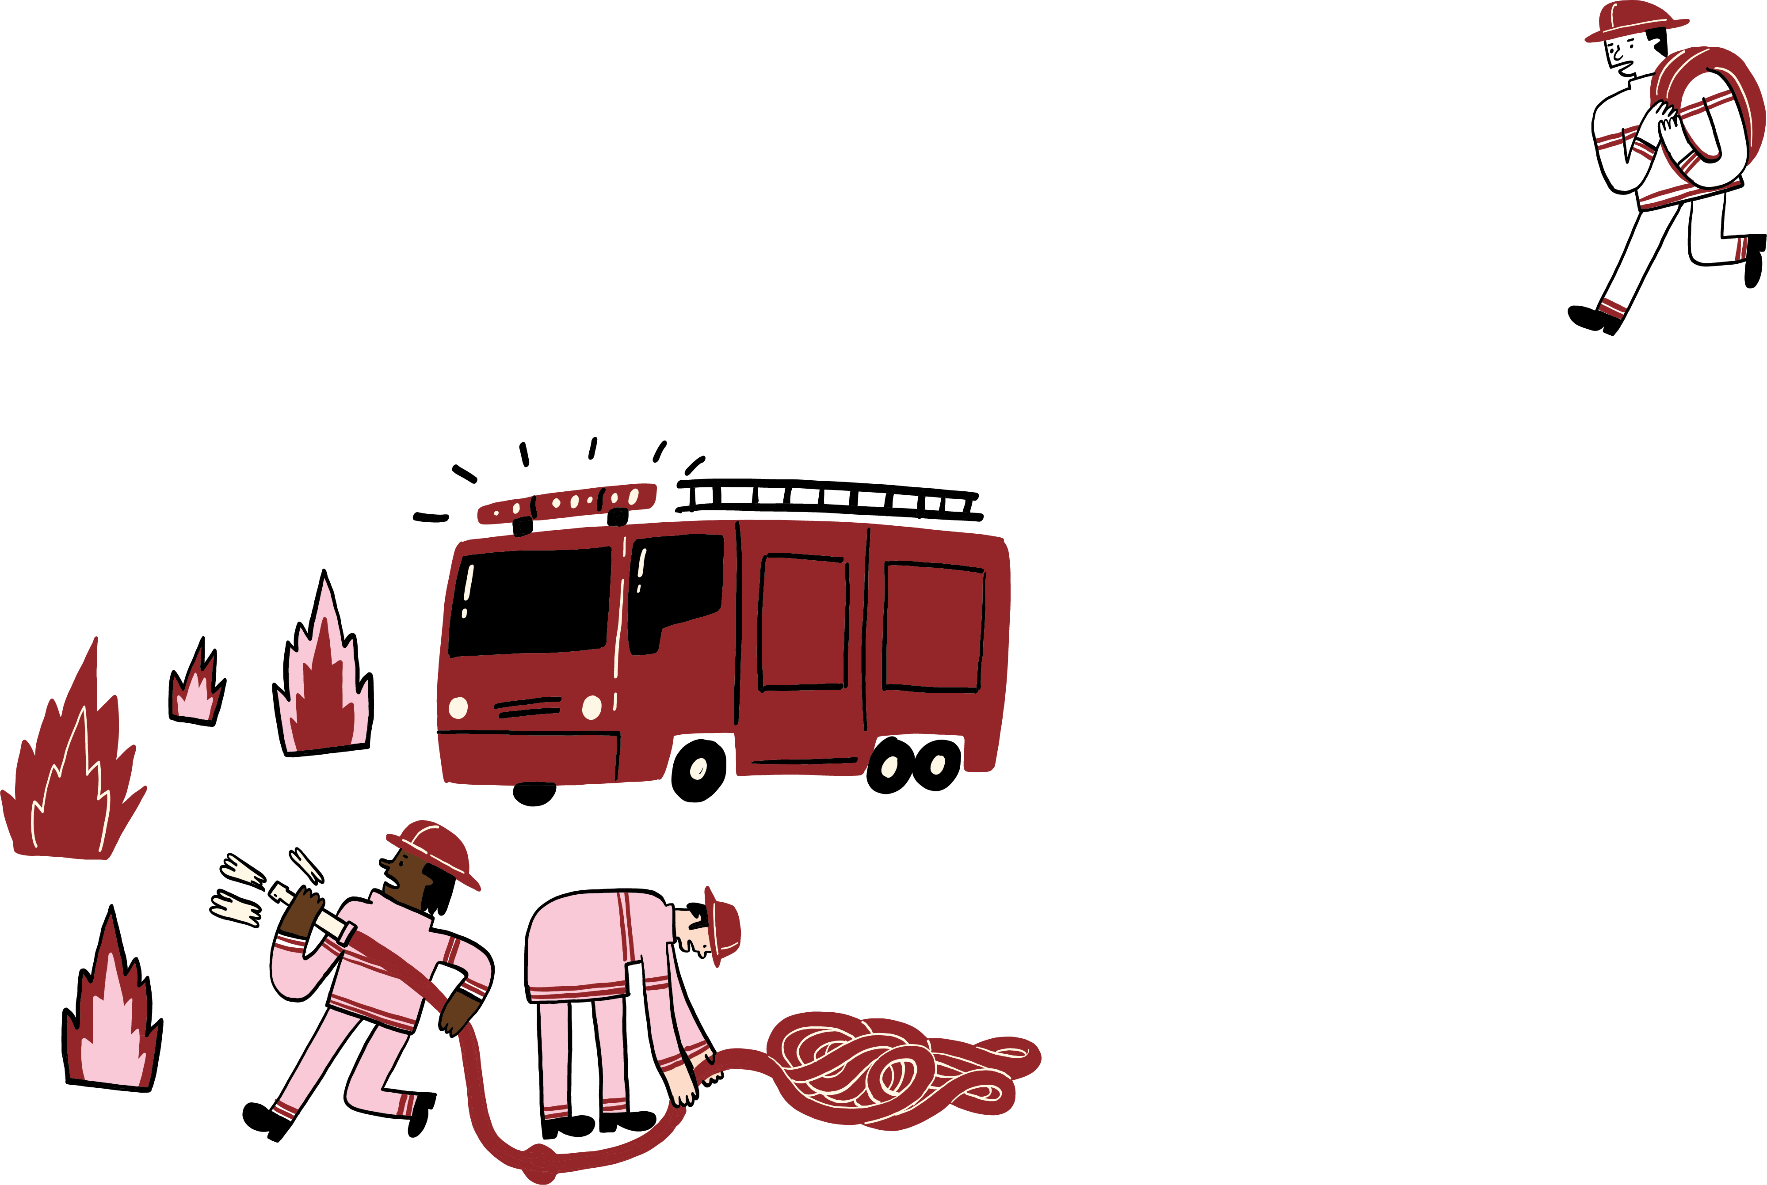
If something unexpected
happens on exam day
speak to your school as soon as possible
you may be able to use the Examination Exceptional Circumstances Consideration Service (EECCS)
More information on EECCS is available at wwqw.sqa.org.uk/exceptionalcircumstances

Slide 16
Appeals
There will be a free appeals service – you can appeal directly or ask your school or college to do it for you.
More information about your results and appeals will be available in June 2025.

Slide 17
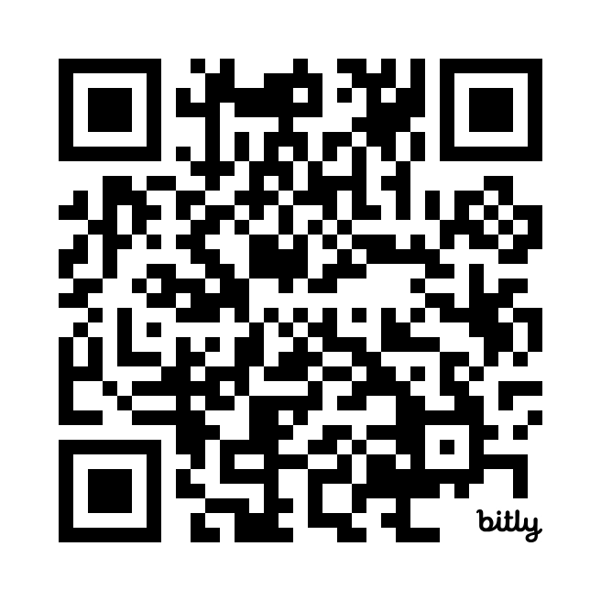
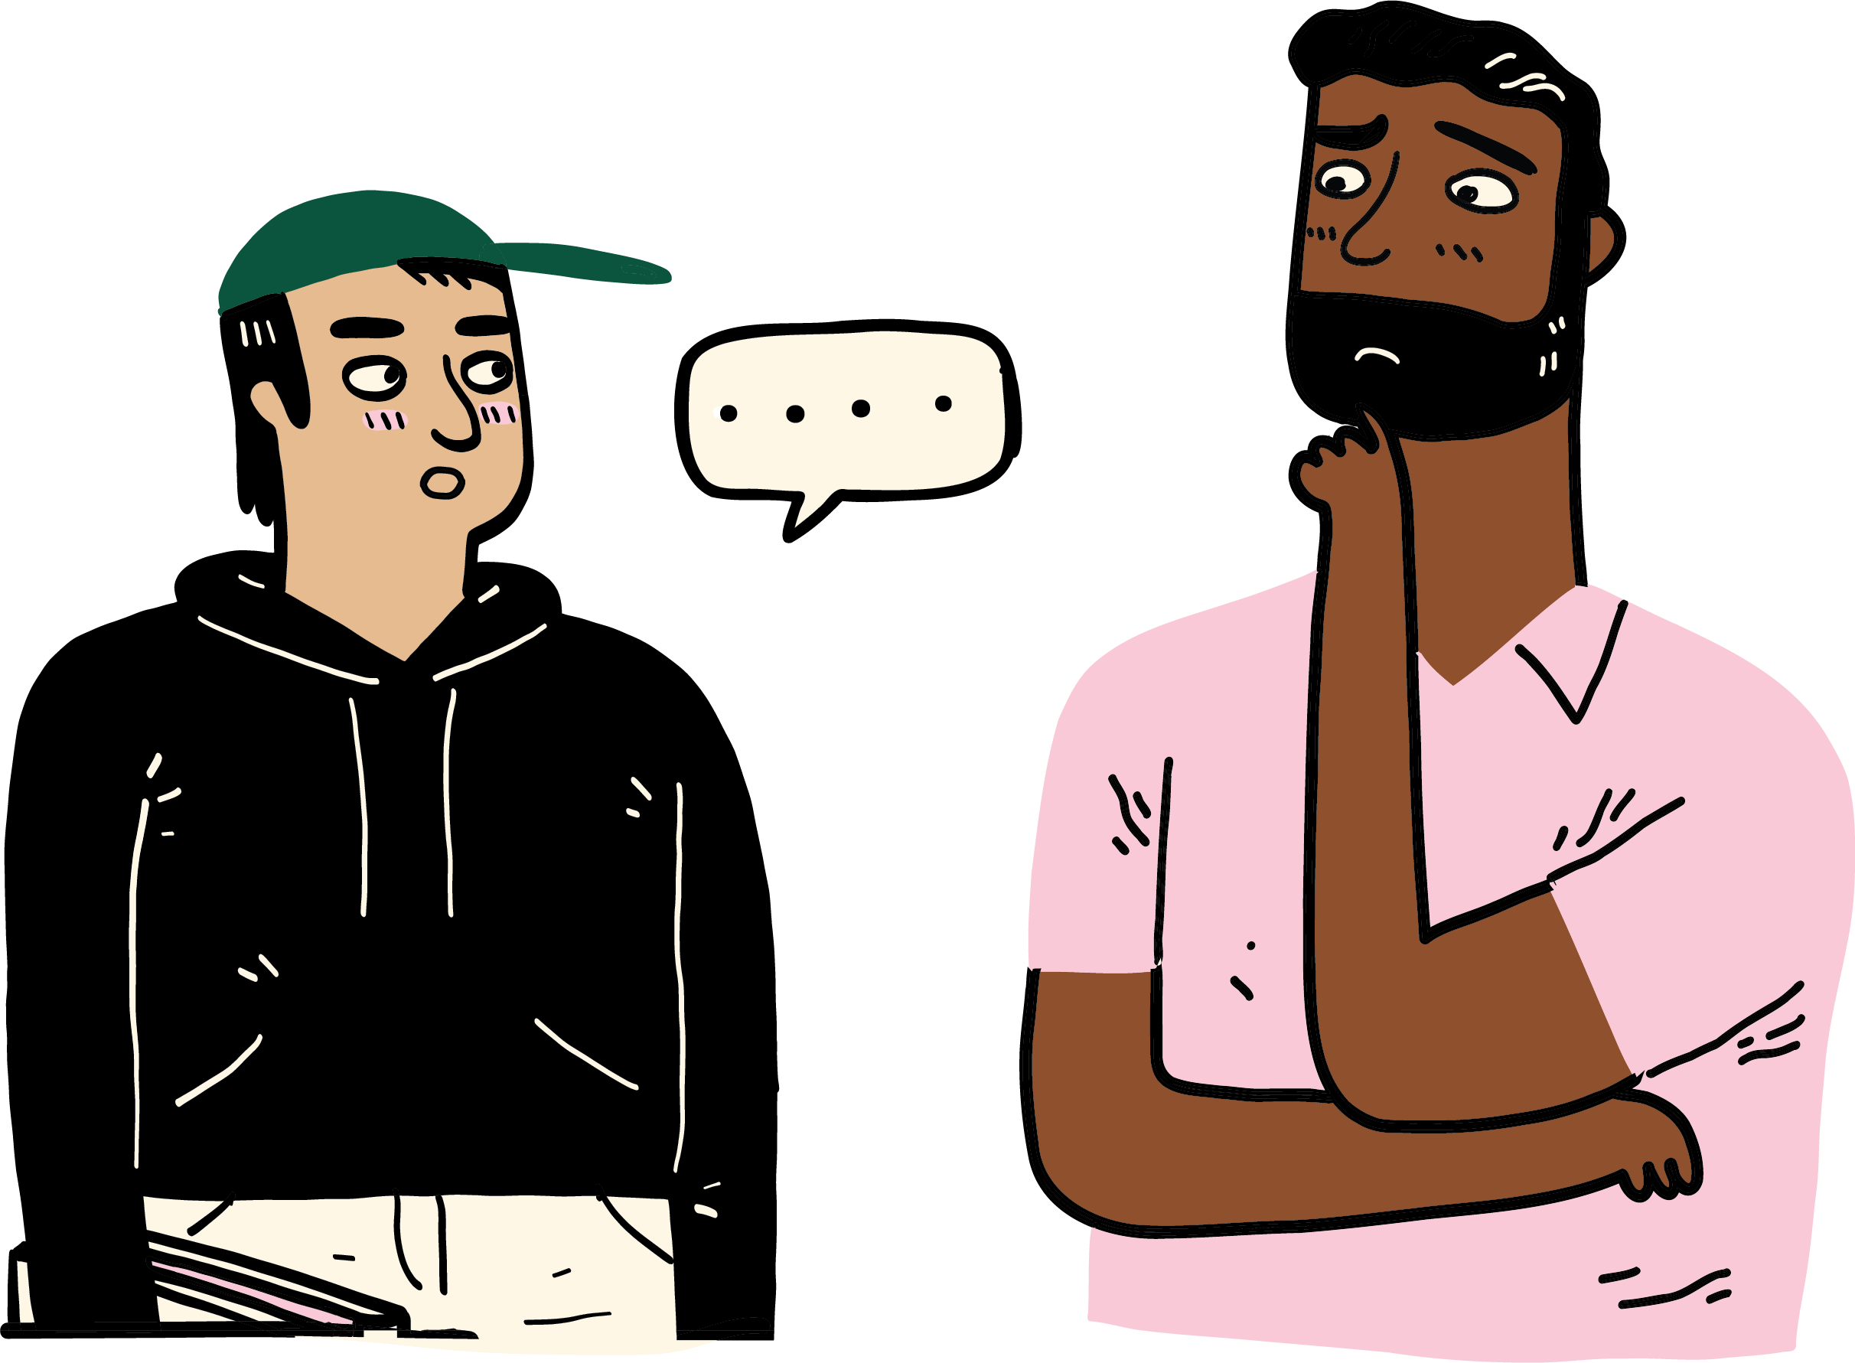
Help and support
Scan the QR code to download the full booklet
Stay up to date with information about your exams, the exam timetable and past papers at https://www.sqa.org.uk/learners
For more support, including who you can speak to if you’re feeling anxious, visit https://www.sqa.org.uk/learnersupport

